Slide 1

Emergency medical system
Team Members
Vishnu M 20AD039
Dhaanus K 20AD007
Farhan Ahmed khan A 20AD008
Naveen V 20AD020
Guided By
Lakshmi M
Assistant professor, CSE Dept

Slide 2
Outline
ABSTRACT
INTRODUCTION
PROBLEM STATEMENT
OBJECTIVE
FIELD MARKET ANALYSIS REPORT (EXISTING SCENARIO)
PROPOSED SOLUTION
BLOCK DIAGRAM
IMPLEMENTATION AND RESULTS
REFERENCES

Slide 3
ABSTRACT
THE PROBLEMS FACED BY PEOPLE WHO TRAVEL BY AUTONOMOUS CARS.
AND CHANCE OF HAVING SEVERE HEALTH CONDITIONS.

Slide 4
INTRODUCTION
We all know that automobile industries have achieved their success in creating autonomous driving systems and we can see them exist in our daily life.
Have you ever wondered how the safety features would be? So what will happen if your health goes down to critical condition while travelling in a autonomous vehicle? You’ll be moving to the fixed destination with the critical condition you are facing with.

Slide 5
OBJECTIVE OF THE SYSTEM
When the owner/client gets into some critical situations, the emergency mode will be turned on.
After this, the AI in the vehicle will search for the nearest hospital based on the clients medical records if any incidents happen
if the regular clinic is far away, the AI will search for the best hospitals near by and drive him to the hospital.
And side by side the AI will make a call or will send an information to the respective hospital.

Slide 6
EXISTING SCENARIO
There are more developed automobile industries which provide autonomous driving systems like Tesla , BMW , Benz.
But in these vehicles we don’t think this feature exists and these are just automatic self driving vehicles not an intelligent vehicle.
We thrive to make it intelligent using AI & ML skills.

Slide 7
PROPOSED SOLUTION
The vehicle will be provided with an application where the client saves his personal data in that given application.
When the owner/client gets into some critical situations, the emergency mode will be turned on.
After this, the AI in the vehicle will search for the nearest hospital based on the clients medical records
if the regular clinic is far away, the AI will search for the best hospitals near by and drive him to the hospital.
And side by side the AI will make a call or will send an information to the respective hospital.

Slide 8
BLOCK DIAGRAM
SENSING INCIDENT
SENSE
EMS
PLAN
FINDING PATH
ACT
SETTING THE ROUTE

Slide 9
STATUS OF THE WORK
Created a automation to for finding a nearby hospital changing the course of direction to there.
Introduced NLP[Natural language processing] for better interaction
Introduced a motion detection software for collecting info for worst case scenario
Created a drowsiness detection software.

Slide 10
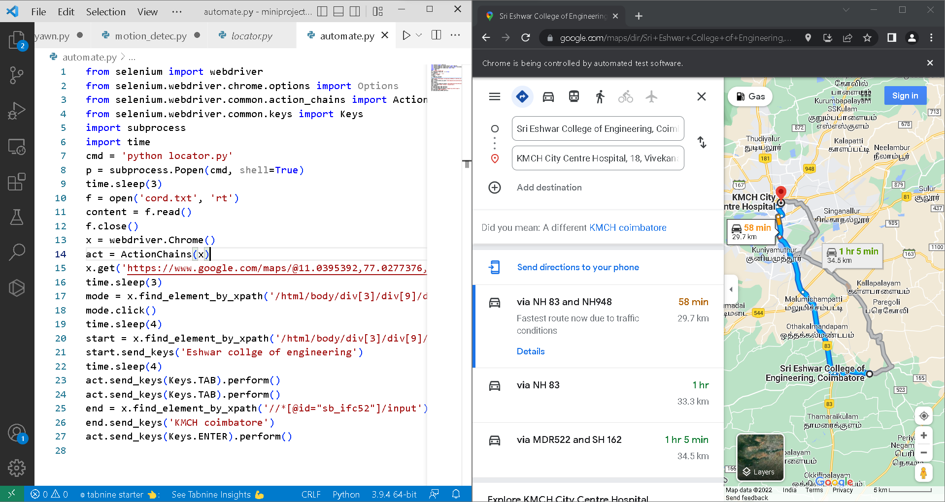

Slide 11
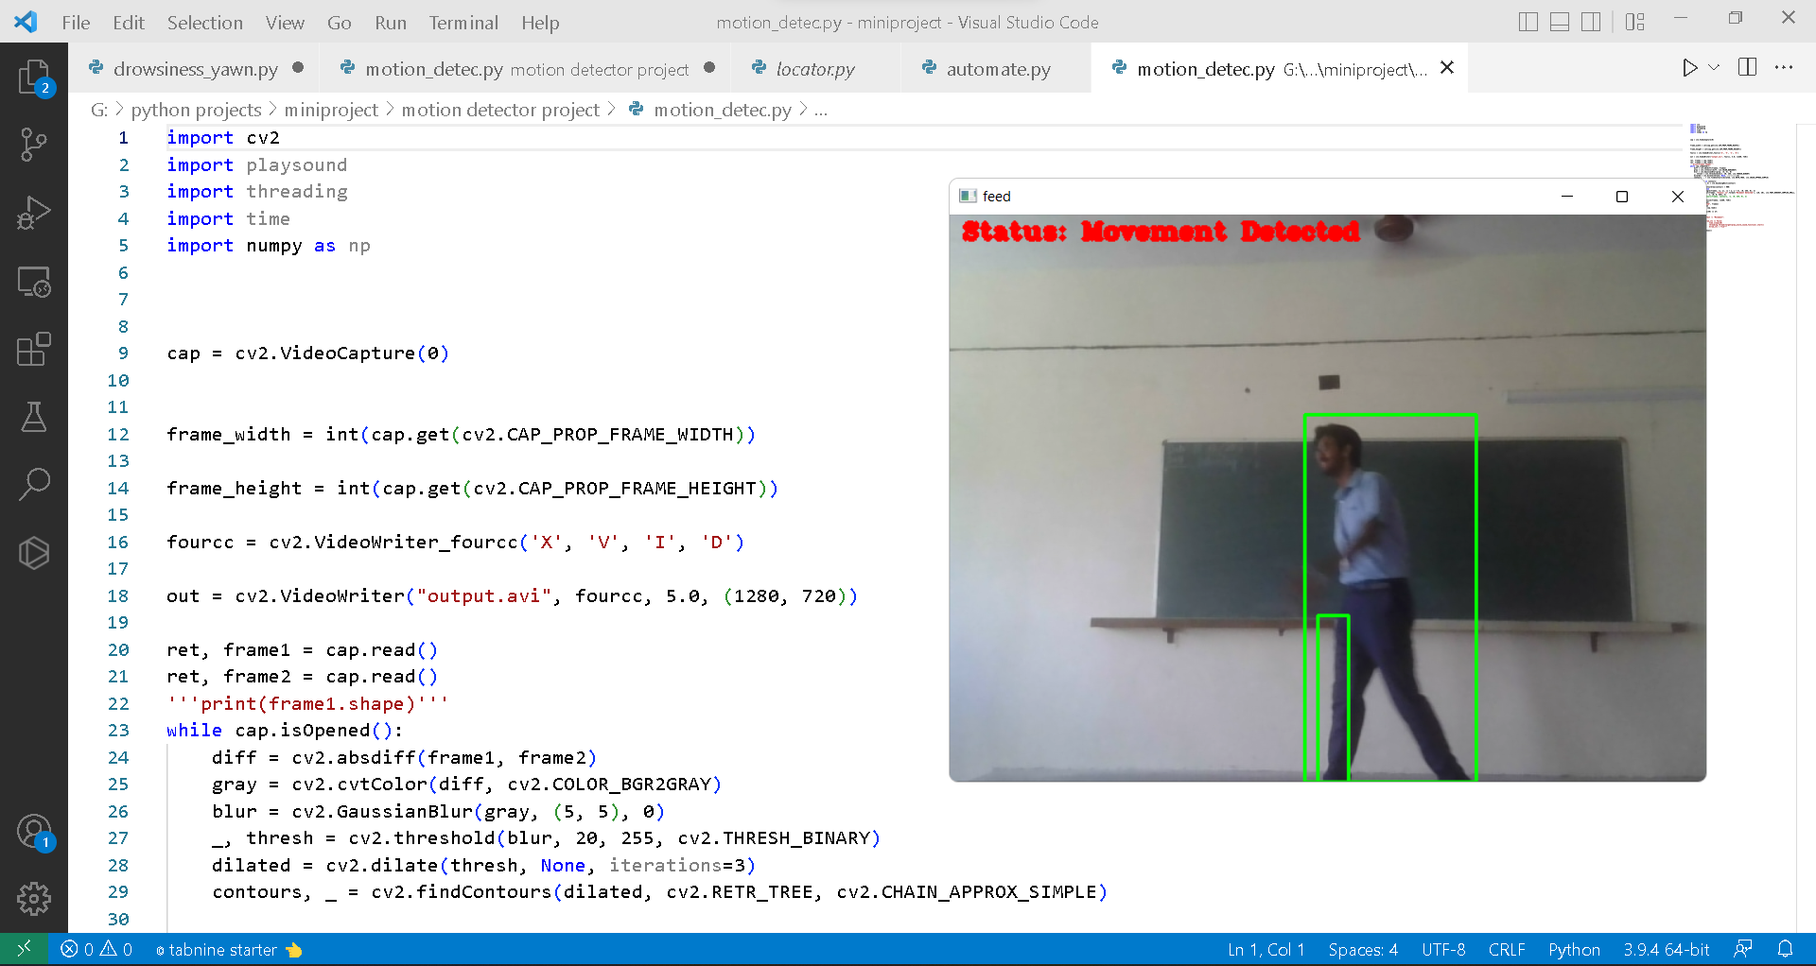

Slide 12
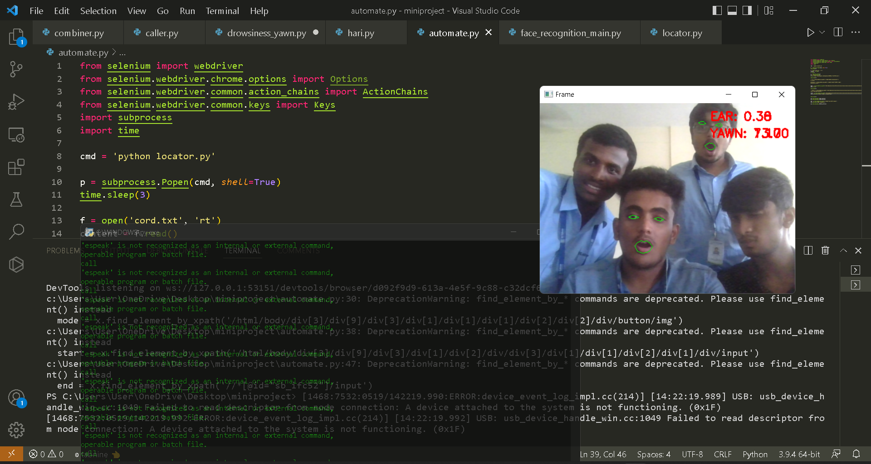

Slide 13
REFERENCES
Document for face detection
YouTube
Document for motion detection

Slide 14
THANK YOU

