Slide 1

CSE423 Virtualization and Cloud Computing
Faculty Name:
Dr. Madhavi Dhingra
Assistant Professor
Sitting Room-> 34-202

Slide 2
Course Credits and Weightage
Lecture | Tutorials | Practicals | Credits
3 | 0 | 0 | 3
Evaluation Criteria | Marks
Attendance | 5
Continuous Assessment | 25
Mid-Term Test(MTT) | 20
End-Term Test(ETT) | 50

Slide 3
Textbooks and References
Cloud Computing:Fundamentals,Industry Approach and Trends by Rishabh Sharma.Publisher Name-Wiley.
Mastering Cloud Computing by Rajkumar Buyya,Christian Vecchiola,S.Thamarai Selvi.Publisher Name- McGraw Hill Education
Cloud Computing: A Hands-on Approach by Arshdeep Bahga,Vijay Madisetti. Publisher Name-Universities Press Pvt. Ltd.

Slide 4
Continuous Assessment
Component | Weightage(%)
Term Paper | 50
Test 1 | 50
Test 2 | 50
No Copy + Paste.
No Delayed or Late Submissions Accepted.

Slide 5
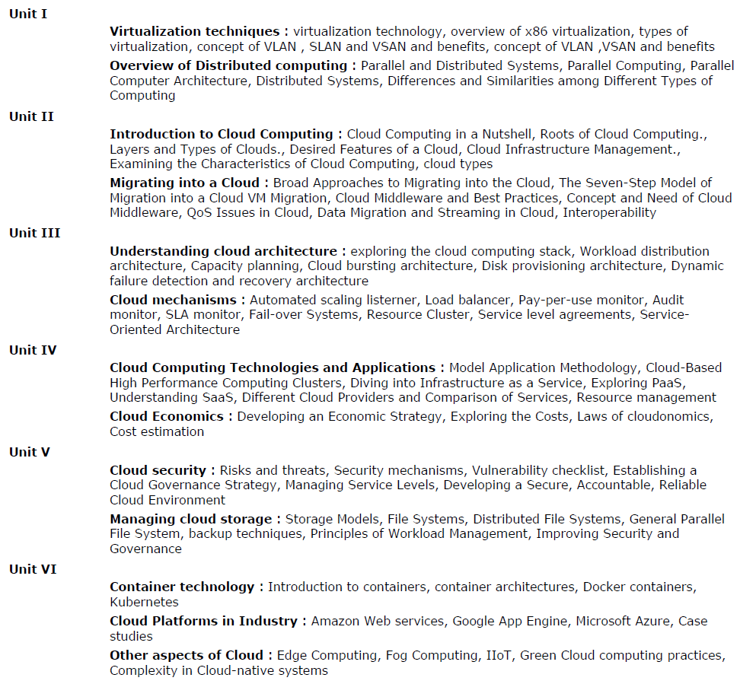
Course Syllabus

Slide 6
Let’s break down the Unit I
Virtualization Techniques | Overview of Distributed Computing
1. Virtualization Technology | 1. Parallel and Distributed Systems
2. Overview of x86 virtualization | 2.Parallel Computing
3.Types of Virtualization | 3.Parallel Computer Architecture
4.VLAN- Concept and Benefits | 4.Distributed Systems
5. SLAN-Concept and Benefits | 5. Different types of Computing
6. VSAN-Concept and Benefits | 6. Differences and Similarities among types of Computing
7. Revision | 7. Revision

Slide 7
Introduction to Terminologies
Real-ization(Real Environment) – OS with its own Capacities
Virtualization – Providing an virtual environment, to testify and execute the problems assuming the scenarios. Virtualization is technology that allows you to create multiple simulated environments or dedicated resources from a single, physical hardware system.
“Virtualization is base foundation towards Cloud Computing.”

Slide 8
Introduction to Terminologies
Cloud- The word itself provides the insights that it is a collective set of hardware, storage, services, networks and interfaces that enable the delivery of computing as a service.
Cloud Services-These are the certain services in form of software, Infrastructure and storage over the Internet.
Cloud Computing- The combined place of hardware and software clustered as on unit to provide the various services over the internet is referred to as Cloud Computing.
“Cloud computing is a model for enabling ubiquitous, convenient, on-demand network access to a shared pool of configurable computing resources (e.g., networks, servers, storage, applications, and services) that can be rapidly provisioned and released with minimal management effort or service provider interaction.”
- U.S. National Institute of Standards and Technology (NIST)

Slide 9
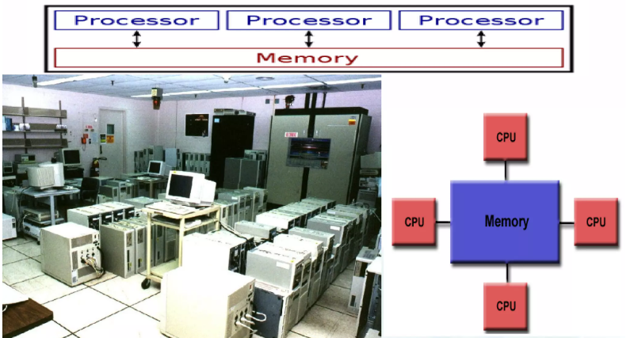
Overview of Distributed Systems
Parallel Systems
The system is referred to be parallel system when multiple processor have direct access to shared memory which forms a common address space.
These systems have, single system wide primary memory( address space) that is shared by all the processors.

Slide 10
Overview of Distributed Systems
Benefits of Parallel Systems
Provide Concurrency – multiple things can be done at same time.
Utilization of external resources
Cost-effective
Overcoming memory constraints
Save time and money
Global address space provides a user-friendly programming perspective to memory.

Slide 11
Overview of Distributed Systems
Distributed Systems
The distributed Systems are collection of independent computers, interconnected through a network which are capable of collaborating on a task.
A distributed System can be characterized as collection of multiple autonomous computers that communicate over a communication network and having following features:
No common physical clock
Enhanced reliability
Increased performance/cost ratio
Access to geographically remote data and resources
Scalability

Slide 12
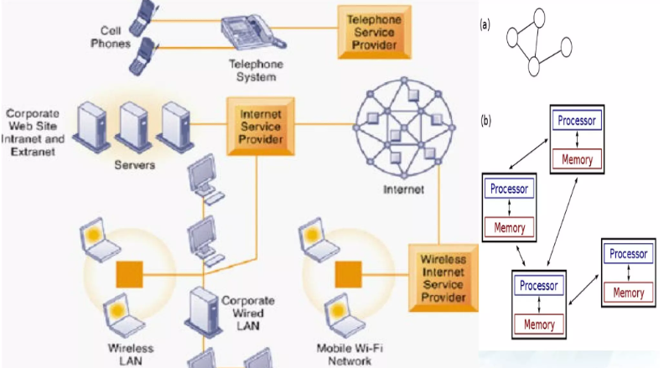
Overview of Distributed Systems
Distributed Systems

