Slide 1

CSE423 Virtualization and Cloud Computing
Faculty Name:
Dr. Madhavi Dhingra
Assistant Professor
Sitting Room-> 34-202

Slide 2
Why Distributed system ?
Distributed computing allows different users or computers to share information. Distributed computing can allow an application on one machine to leverage processing power, memory, or storage on another machine.
A distributed database is a specialization of distributed computing. A distributed database allows certain data specific operations to be distributed to one or more different machines. This means that the decision to perform an operation occurs on one machine and then one or more other machines end up performing the operation.
Distributing computing can help solve certain business problems.

Slide 3
What is a Distributed system ?
Distributed System is a collection of autonomous computer systems that are physically separated but are connected by a centralized computer network that is equipped with distributed system software. The autonomous computers will communicate among each system by sharing resources and files and performing the tasks assigned to them.
Example of Distributed System:
Any Social Media can have its Centralized Computer Network as its Headquarters and computer systems that can be accessed by any user and using their services will be the Autonomous Systems in the Distributed System Architecture.

Slide 4
Distributed System Software: This Software enables computers to coordinate their activities and to share the resources such as Hardware, Software, Data, etc.
Database: It is used to store the processed data that are processed by each Node/System of the Distributed systems that are connected to the Centralized network.

Slide 5
Characteristics
Resource Sharing: It is the ability to use any Hardware, Software, or Data anywhere in the System.
Openness: It is concerned with Extensions and improvements in the system (i.e., How openly the software is developed and shared with others)
Concurrency: It is naturally present in the Distributed Systems, that deal with the same activity or functionality that can be performed by separate users who are in remote locations. Every local system has its independent Operating Systems and Resources.
Scalability: It increases the scale of the system as a number of processors communicate with more users by accommodating to improve the responsiveness of the system.
Fault tolerance: It cares about the reliability of the system if there is a failure in Hardware or Software, the system continues to operate properly without degrading the performance the system.
Transparency: It hides the complexity of the Distributed Systems to the Users and Application programs as there should be privacy in every system.
Heterogeneity: Networks, computer hardware, operating systems, programming languages, and developer implementations can all vary and differ among dispersed system components.

Slide 6
Advantages
Applications in Distributed Systems are Inherently Distributed Applications.
Information in Distributed Systems is shared among geographically distributed users.
Resource Sharing (Autonomous systems can share resources from remote locations).
It has a better price performance ratio and flexibility.
It has shorter response time and higher throughput.
It has higher reliability and availability against component failure.
It has extensibility so that systems can be extended in more remote locations and also incremental growth.

Slide 7
Disadvantages
Relevant Software for Distributed systems does not exist currently.
Security possess a problem due to easy access to data as the resources are shared to multiple systems.
Networking Saturation may cause a hurdle in data transfer i.e., if there is a lag in the network then the user will face a problem accessing data.
In comparison to a single user system, the database associated with distributed systems is much more complex and challenging to manage.
If every node in a distributed system tries to send data at once, the network may become overloaded.

Slide 8
Application areas
Finance and Commerce: Amazon, eBay, Online Banking, E-Commerce websites.
Information Society: Search Engines, Wikipedia, Social Networking, Cloud Computing.
Cloud Technologies: AWS, Salesforce, Microsoft Azure, SAP.
Entertainment: Online Gaming, Music, youtube.
Healthcare: Online patient records, Health Informatics.
Education: E-learning.
Transport and logistics: GPS, Google Maps.
Environment Management: Sensor technologies.

Slide 9
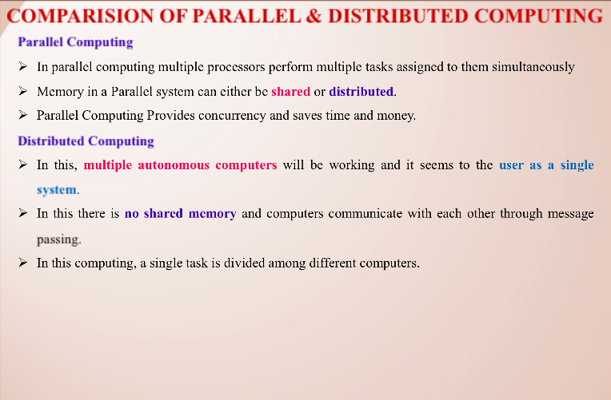

Slide 10
