Slide 1

CSE423 Virtualization and Cloud Computing
Faculty Name:
Dr. Madhavi Dhingra
Assistant Professor
Sitting Room-> 34-202

Slide 2
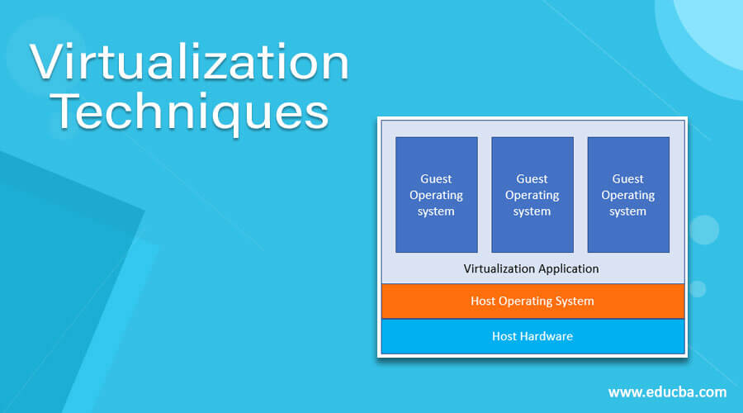
Virtualization Techniques
Implementing techniques depends on the use case or the problem statement the business wants to address. Here we will discuss how those techniques work and the level of abstraction achieved by implementing those techniques.

Slide 3
Guest Operating System Virtualization
This is the most simple and easiest way to do virtualization.
In this virtualization, one host operating system is present, and virtualization software is installed in that host operating system.
The host OS can be anything such as Windows, Mac, or Linux, and the virtualization software will run as just as any other application runs on the OS.
That virtualization software will take care of all the virtualization tasks, and it helps in running the guest operating system.
One can run multiple OS using that virtualization software; it will take care of all the things like memory management, resource management, hard disk partitioning, etc.,

Slide 4
Guest Operating System Virtualization

Slide 5
Shared Kernel Virtualization
In the technique, there is no extra configuration is required for the host OS and also the host hardware.
The virtualization application uses the same hardware as the host operating system and runs inside the host OS.
So, the advantage, in this case, is if there is no extra cost for the hardware configuration and software configuration is required.
But since it’s the cheapest way of virtualization, there will be performance issues due to high levels of abstraction.
VMware and VirtualBox are the software used for this virtualization.
The only drawback of this technique is the compatibility of the operating system; like one wants to run a Windows OS with this method, then it will not work, or if someone wants to run a Linux version 2.6 and the host OS is 2.4, then again it will not work.
These techniques include Linux Vserver, Solaris Zones, containers, etc.

Slide 6
Shared Kernel Virtualization

Slide 7
Kernel Level Virtualization
In this virtualization technique, the guest operating system runs its kernel, unlike the shared kernel virtualization.
There can be multiple guest operating systems, each with its kernel.
But the guest operating system kernel should have a similar configuration to the host kernel. Otherwise, there will be compatibility issues.
The kernel-level virtualization includes user-mode Linux and kernel-based virtual machines.
These techniques include Linux Vserver, Solaris Zones, containers, etc.

Slide 8
Kernel Level Virtualization

Slide 9
Hypervisor Virtualization
In this virtualization, a program called hypervisor runs directly in the hardware of the CPU, which is generally called the ring 0, which is the highest level of privileges provided by the CPU hardware to any software.
Generally, the Operating system only has the privileges to run in ring 0, so in this case, a hypervisor runs in ring 0, also called type 1 VMM (Virtual machine monitor). As the name suggests, it monitors all the guest operating systems installed in the virtual machine and provides interfaces for higher-level administration and monitoring.
So, suppose the hypervisor runs in ring 0. In that case, the kernel of the guest operating system will not get proper privileges to run, so to address this issue, hypervisor as several different solutions described here

Slide 10
Hypervisor Virtualization
A) Paravirtualization
In this technique, the system calls are made by the kernel of the guest operating system, and the hypervisor directly handles those calls, and the hypervisor, in turn, completes all the tasks.
The calls between the hypervisor and the guest operating system kernel are called the hypercalls.
B) Full virtualization
In this case, complete control of the guest operating system is given to the guest operating system.
The hypervisor generally controls and monitors the calls; it provides a CPU emulation to handle and modify the privileges.
But this scenario is never efficient and results in degrading the system performance compared to paravirtualization.
C) Hardware Virtualization
With the latest CPU coming into the market, INTEL and AMD have devised new CPUs that help provide an extra layer on top of ring 0, which allows the hypervisor to run and take control of the guest operating system.
This eliminates the overhead of the CPU emulation.

Slide 11
Hypervisor Virtualization

