Slide 1



smart emergency network prioritization system
Presented by :
A.Vishnu Vardhan:(1925260209)
P. Jaswanth:(1912260316)
Jovin Josh:(192511471)
Bhanu Prakash:(1925260217)
S.Sri raman:(192524264)
Subject : Computer Networks
Sub code : CSA0707
Guided by : Santhiya Lakshmi Kumaravel

Slide 2
Table of Content
Introduction
Problem statement
Objectives
Literature review
traditional network management
AI based traffic classification
Proposed model
Conclusion
References

Slide 3
Introduction
Emergency communication requires fast and reliable networks.
Heavy network traffic can delay important messages.
This system uses AI to identify emergency traffic.
It gives higher priority to urgent communication.
It helps emergency services respond quickly.

Slide 4
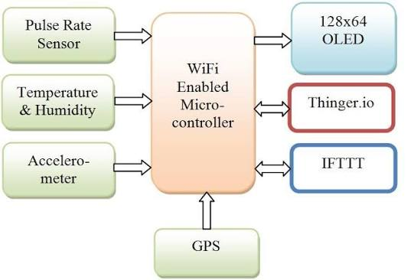
Problem statement
Heavy network traffic causes delays in emergency communication.
Emergency messages may not receive high priority.
Network congestion reduces communication speed.
Slow communication affects emergency response.
A smart system is needed to prioritize emergency traffic.

Slide 5
Objectives
To identify emergency network traffic using AI.
To give high priority to emergency messages.
To reduce network delays and congestion.
To improve communication speed and reliability.
To ensure faster emergency response.

Slide 6
Literature review
Author | Journal Name & Year | Methodology | Limitations
Moeyersons et al. | International Journal of Network Management, 2021 | SDN-based emergency traffic prioritization. | Requires SDN infrastructure.
Basu et al. | International Journal of Web and Grid Services, 2024 | Machine learning for network traffic classification. | Depends on training data quality.
Sanchez et al. | Journal of Parallel and Distributed Computing, 2024 | Deep reinforcement learning for traffic routing. | Requires complex model training.
Serag et al. | Journal of Network and Systems Management, 2025 | ML-based traffic classification using SDN. | Not specifically designed for emergencies.

Slide 7
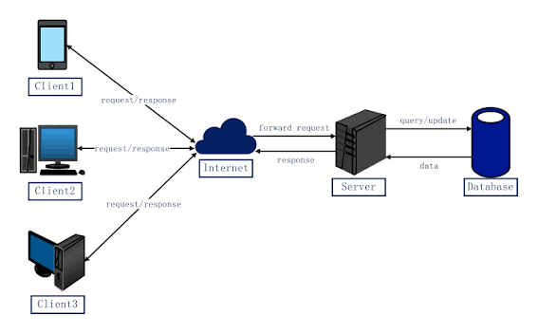
Traditional Network Management
Uses fixed rules to manage network traffic.
Emergency and normal traffic may receive similar priority.
Network congestion can cause communication delays.
Less efficient during emergency situations.

Slide 8
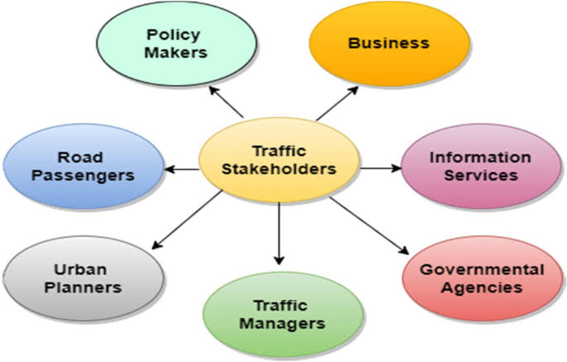
AI-Based Traffic Classification
Uses AI to identify emergency network traffic.
Classifies messages based on their importance.
Detects network congestion automatically.
Improves traffic management and communication speed.

Slide 9
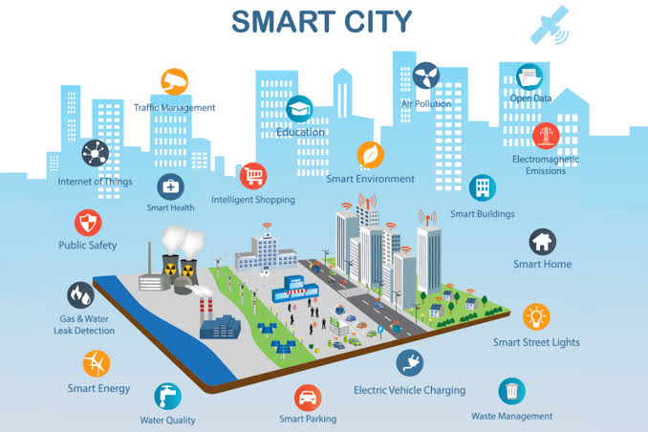
Smart Emergency Network Prioritization (Proposed Model)
Combines AI with real-time traffic monitoring.
Automatically gives high priority to emergency messages.
Allocates bandwidth based on urgency.
Reduces delays and improves emergency communication.

Slide 10
Conclusion
The system improves emergency network communication.
AI helps identify and prioritize emergency traffic.
It will reduces network delays and congestion.
It will provides faster and more reliable communication.
It will supports quick and efficient emergency response.

Slide 11
References
1. Kourtis et al., “Conceptual Evaluation of a 5G Network Slicing Technique for Emergency Communications,” Energies, 2021.
MDPI
2. Sheikh and Peng, “Procedures, Criteria, and Machine Learning Techniques for Network Traffic Classification,” IEEE Access, 2022.
DOAJ
3. Raussi et al., “Prioritizing Protection Communication in a 5G Slice,” The Journal of Engineering, 2023.
Wiley Online Library
4. Salau and Beyene, “Software Defined Networking Based Network Traffic Classification Using Machine Learning Techniques,” Scientific Reports, 2024.
5. Sharma and Lashkari, “A Survey on Encrypted Network Traffic,” Computer Networks, 2025.
ScienceDirect

Slide 12
Thank you !!!!

