Slide 1
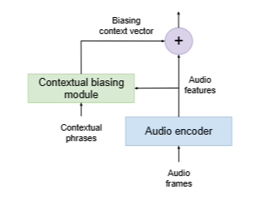
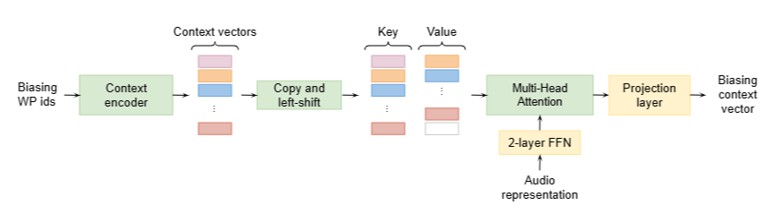
FAST CONTEXTUAL ADAPTATION WITH NEURAL ASSOCIATIVE MEMORY FORON-DEVICE PERSONALIZED SPEECH RECOGNITION
Two main approaches for contextual adaptation- re scoring approaches based on external language models(LMs) and end to end
Approaches with a jointly trained contextual module. . In this paper, they have introduced an end-to-end fast contextual biasing
Approach or personalized speech recognition. The technique consists of a novel Neural Associative Memory (NAM) and a
multi-head attention mechanism for efficient contextual adaptation.
NAM’s encoder architecture
The Context biasing module
This paper is concerned with contextual information in the form of text, though it says we can easily extend this to audio.
Only the encoder is changing, hence this process is decoder agnostic. One can incorporate this biasing module to any existing ASR
Model that is already trained and train them jointly, offering great flexibility.
Model:
ASR model used is an RNN-T model with Conformer encoder. The exact details can be found in the paper.

Slide 2
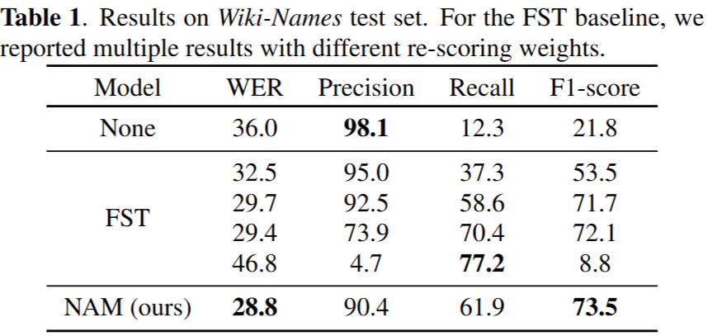
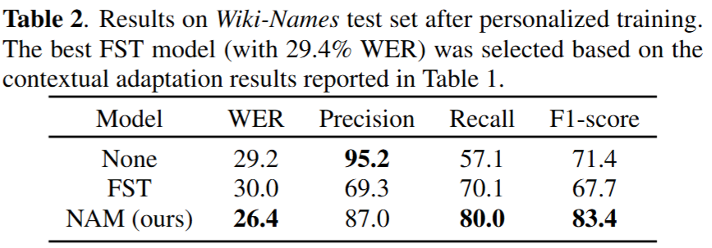
Dataset:
Training data consists of anonymized and transcribed English utterances from different domains including accented speech,
telephony speech, and YouTube . The total amount of training data is around 400k hours.
Tests were done on the wiki names corpus. The Wiki-Names corpus was designed for entity mention personalization.
this data set contains read speech collected from 100 speakers.
Results:
It has been shown in the paper that on continuous personalization, the NAM model outperformed the FST model. Attaching the
Results after 5 training rounds below-

Slide 3
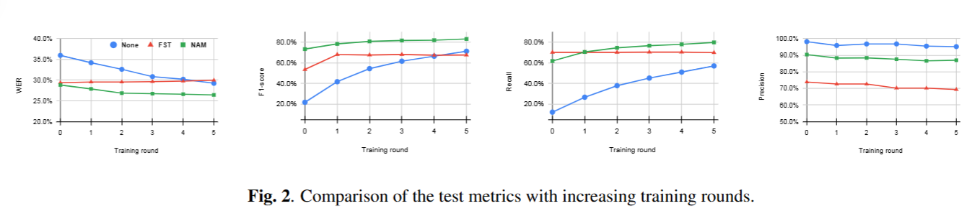
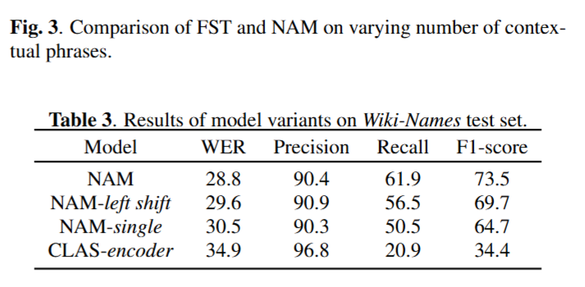
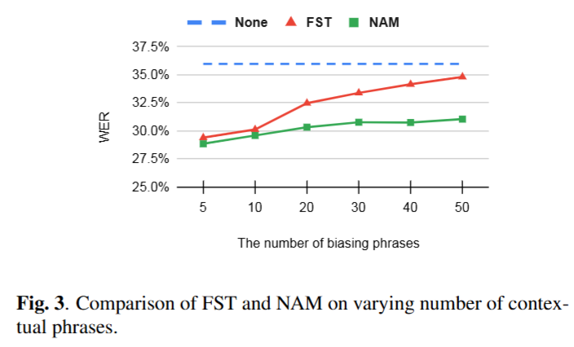
Model Ablation results:

Slide 4
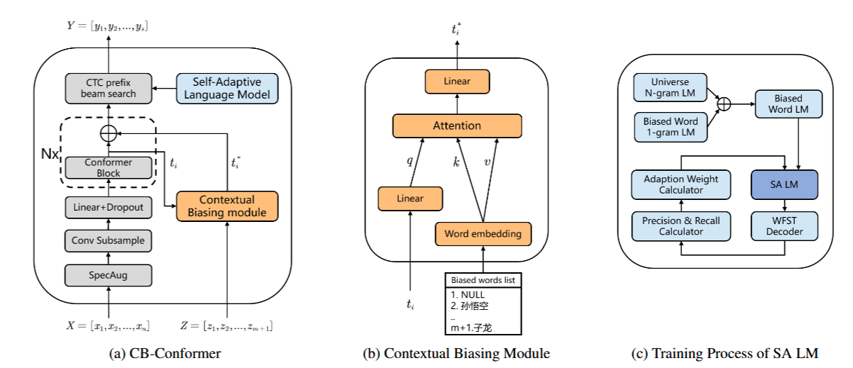
CB-CONFORMER: CONTEXTUAL BIASING CONFORMER FOR BIASED WORD RECOGNITION
The model architecture used in this paper
Datasets:
Mandarin biased words dataset based on the1000-hour WenetSpeech datasets. Details are provided below:

Slide 5
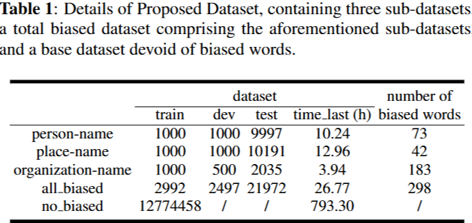
The named entities were divided into 3 categories- person
name, place-name and organization-name.
For each category, they:
Extracted a list of frequent entities.
Selected entities that appeared between 5 and 700 times in
the dataset (to ensure relevance but avoid overrepresentation.)
Retrieved all sentences containing those entities.
Created a subset for each category (person/place/
organization) and split it into train/dev/test.
Loss function- CTC loss
Evaluation metric- Character error rate (CER), biased word recall, biased word precision, and F1-score.

