Slide 1
Network Components
IP
An Internet Protocol address (IP address) is a numerical label assigned to each device connected to a computer network that uses the Internet Protocol for communication.^{[1][2]} An IP address serves two main functions: host or network interface identification and location addressing.
Subnet mask
A subnet mask is used to divide an IP address into two parts. One part identifies the host (computer), the other part identifies the network to which it belongs. To better understand how IP addresses and subnet masks work, look at an IP (Internet Protocol) address and see how it is organized

Slide 2
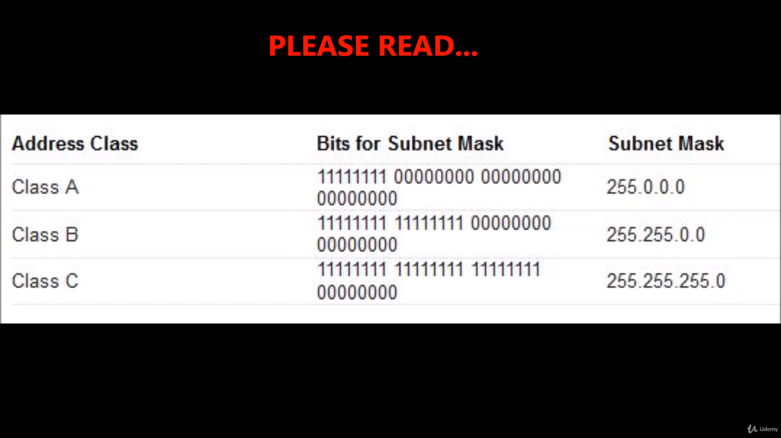
IP Class

Slide 3
Gatway
A gateway is a hardware device that acts as a "gate" between two networks. It may be a router, firewall, server, or other device that enables traffic to flow in and out of the network.

Slide 4
STATIC & DYNAMIC (DHCP)-----IP
Static:
A static IP address is simply an address that doesn't change. Once your device is assigned a static IP address, that number typically stays the same until the device is decommissioned or your network architecture changes. Static IP addresses generally are used by servers or other important equipment.
DHCP:
A dynamic IP address is an IP address that changes from time to time unlike a static IP address. Most home networks are likely to have a dynamic IP address and the reason for this is because it is cost effective for Internet Service Providers (ISP's) to allocate dynamic IP addresses to their customers.

Slide 5
Interface
.MAC add -Uniq and never changes

Slide 6
Network Files and Commands
Interface Detection
Assigning an IP Address
Interface configuration files
- /etc/nsswitch.conf
-/etc/hots
-/etc/sysconfig/network
-/etc/sysconfig/network-scripts
-/etc/resolv.conf

Slide 7
Network Commands
Ping
Ifconfig
Ifup & ifdown
Netstate
Tcpdump

