Slide 1
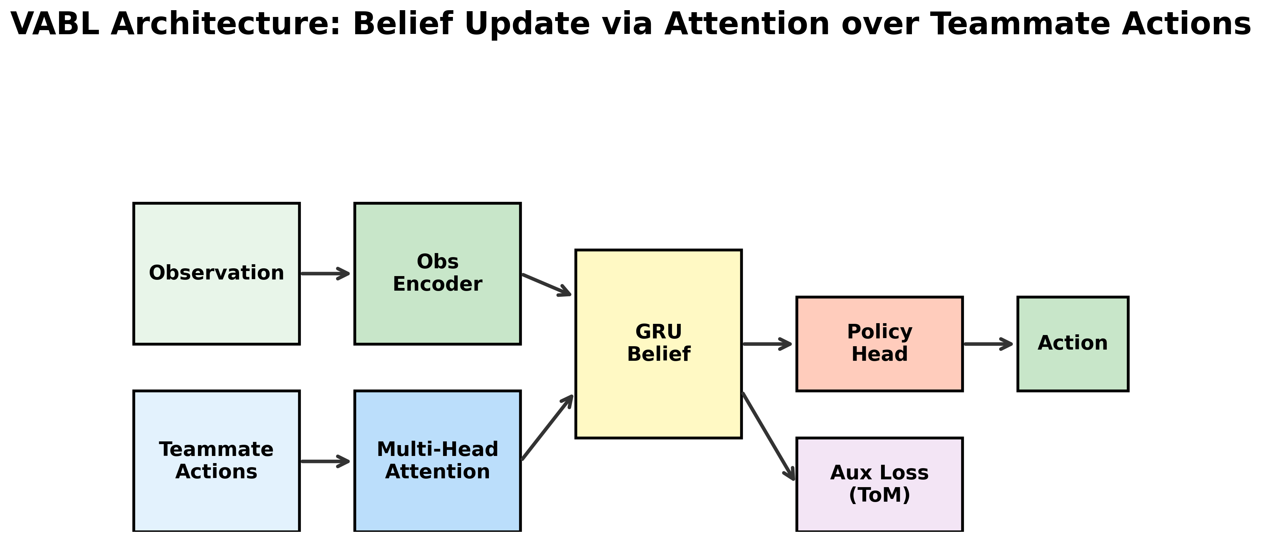
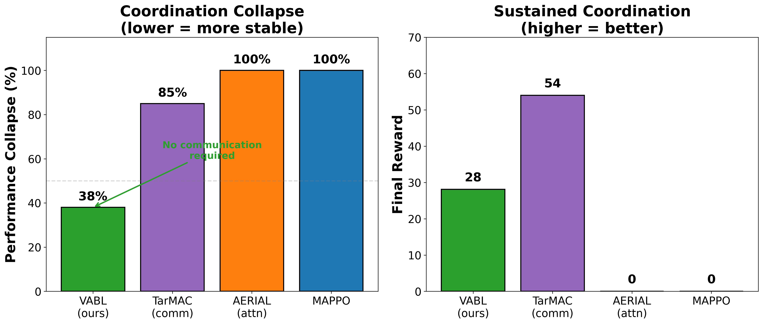
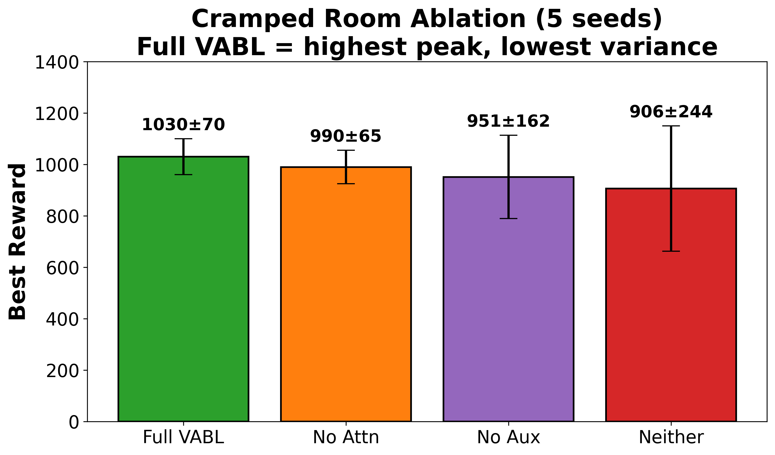
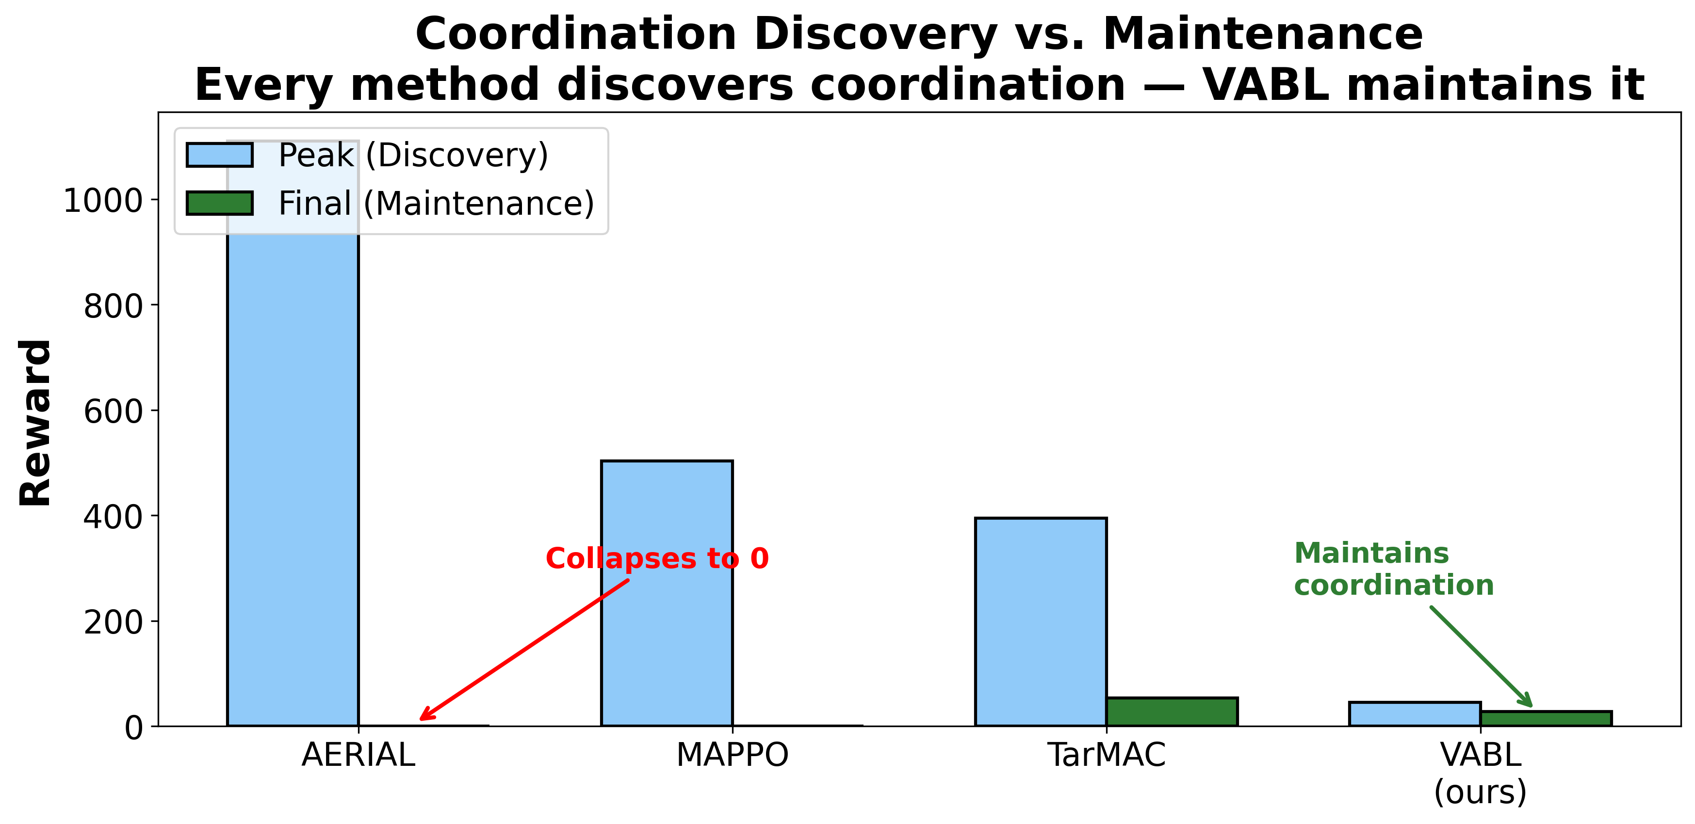
OU
Implicit Coordination via Attention-Driven Latent Belief Representations
Vishnu Kadiyala, Mohammed Atiquzzaman — School of Computer Science, University of Oklahoma
QR CODE
To Online submission
Poster ID: ###
SECTION NAME
SECTION NAME
The Problem: Coordination Collapse
Multi-agent coordination under partial observability
requires reasoning about teammate intent. Standard
methods use egocentric memory that fails to model
teammate behavior, leading to coordination collapse.
The collapse phenomenon:
• Agents discover coordination but cannot sustain it
• MAPPO: 100% collapse at 10M steps (peak 503, final 0)
• AERIAL (Phan et al., 2023): also 100% collapse
• TarMAC (communication): 85% collapse (final ~54)
Our answer: VABL
Attention over teammate actions + auxiliary
prediction loss = stable implicit coordination
without any communication channel.
Architecture & Main Results
3.3× higher reward than MAPPO on Overcooked │ 12× lower variance │ 38% collapse vs 100% (MAPPO/AERIAL)
VABL trades ~48% of TarMAC’s reward for eliminating communication — favorable when bandwidth is constrained.
SECTION NAME
SECTION NAME
SECTION NAME
How VABL Works
Each agent maintains a belief state updated by:
1. Attention over Teammate Actions
Multi-head attention aggregates visible teammate
actions. Query = belief, Keys/Values = actions.
2. GRU Belief Update
Observation encoding + attention context feed
into recurrent belief state.
3. Auxiliary Prediction (Theory of Mind)
Predicts teammates’ next actions from belief.
Regularizes beliefs, preventing collapse.
Accuracy: 17% (chance) → 86% during training.
No communication channel required.
< 10% overhead vs MAPPO (~1.3× parameters).
Component Ablation
Discovery vs. Maintenance
Key Insight
Every method can discover coordination.
The challenge is keeping it. VABL’s auxiliary
prediction loss prevents belief drift, sustaining
coordination without communication.
Future Work
• Hanabi evaluation (genuine partial observability)
• Scaling to N>10 agents (sparse attention)
• Hybrid implicit + explicit communication
Aux loss: consistent variance reduction (2.3×) across layouts.
Attention: helps at N>2, layout-dependent at N=2.
Contact: vishnupk@ou.edu | github.com/vishnukadiyala/vabl-multi-agent-coordination

