Slide 1

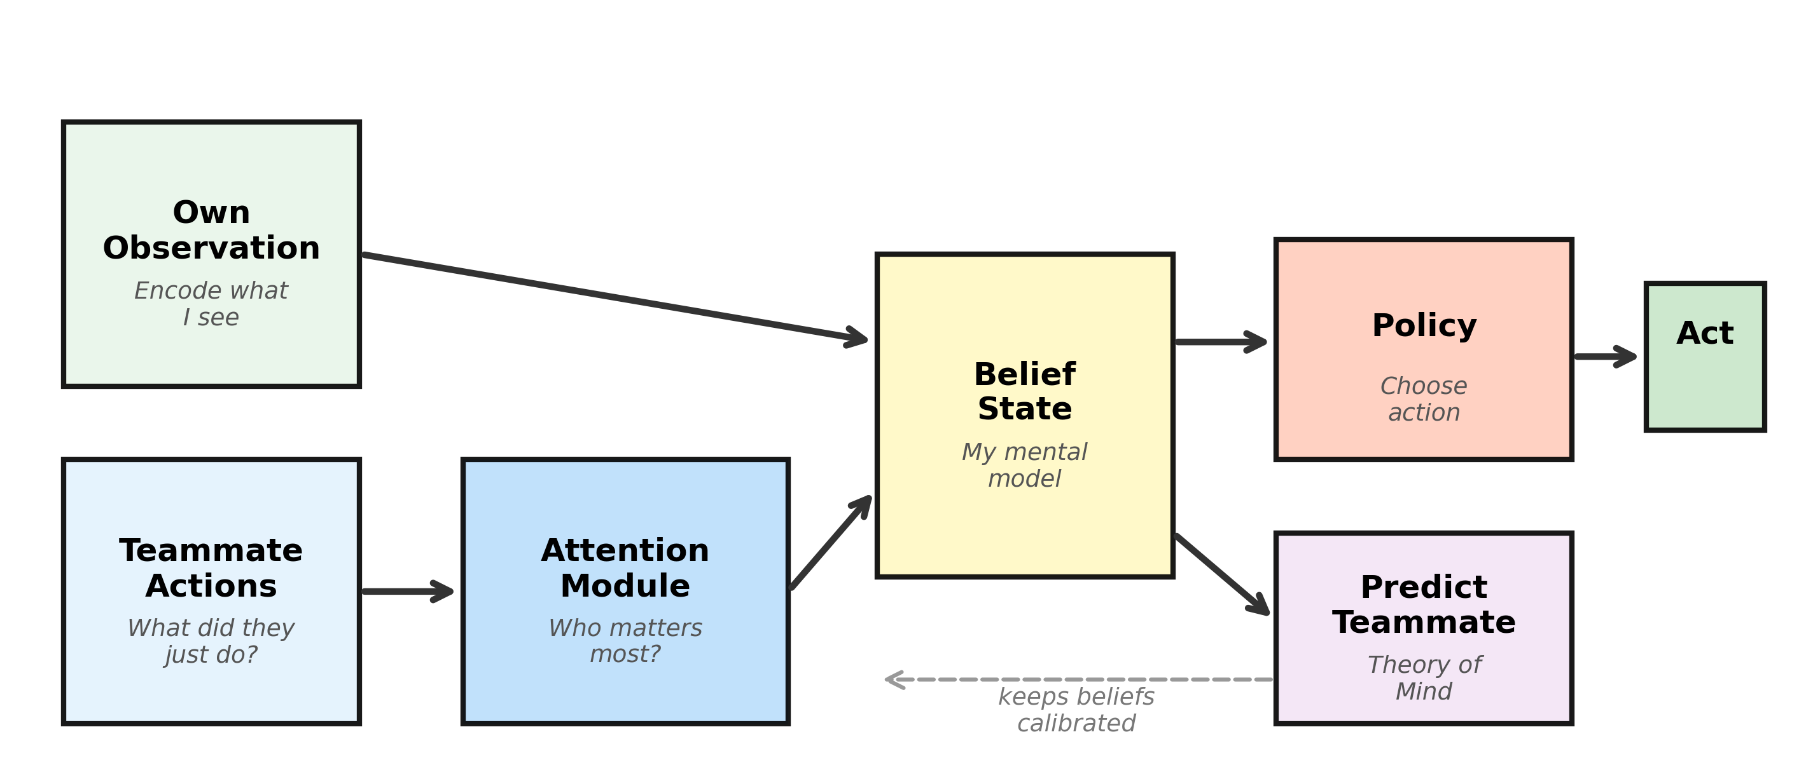
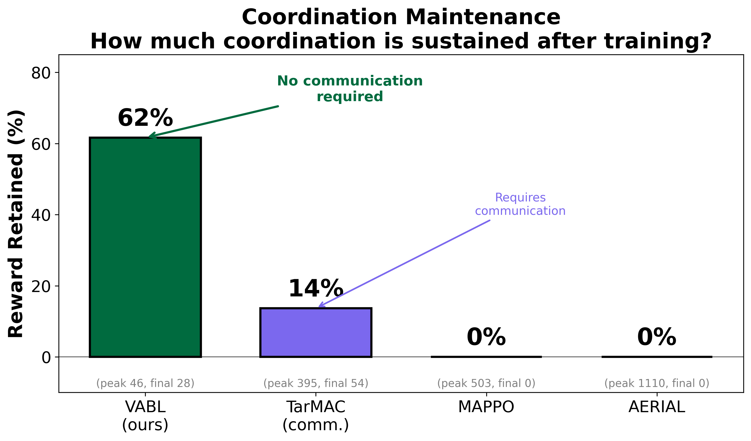
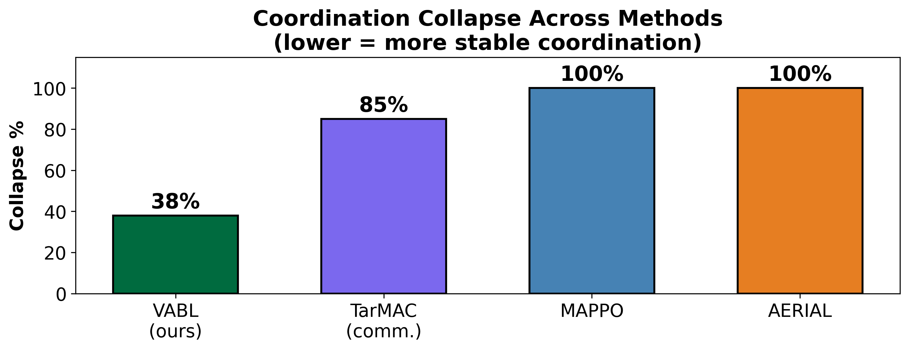
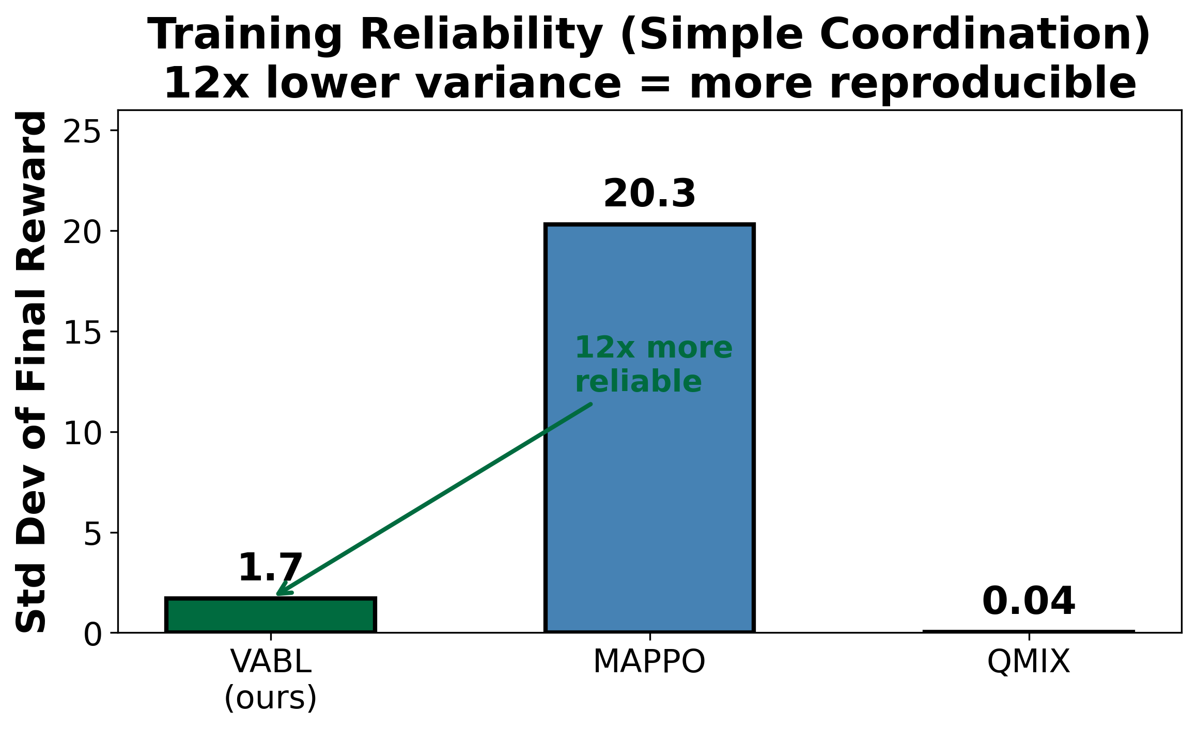
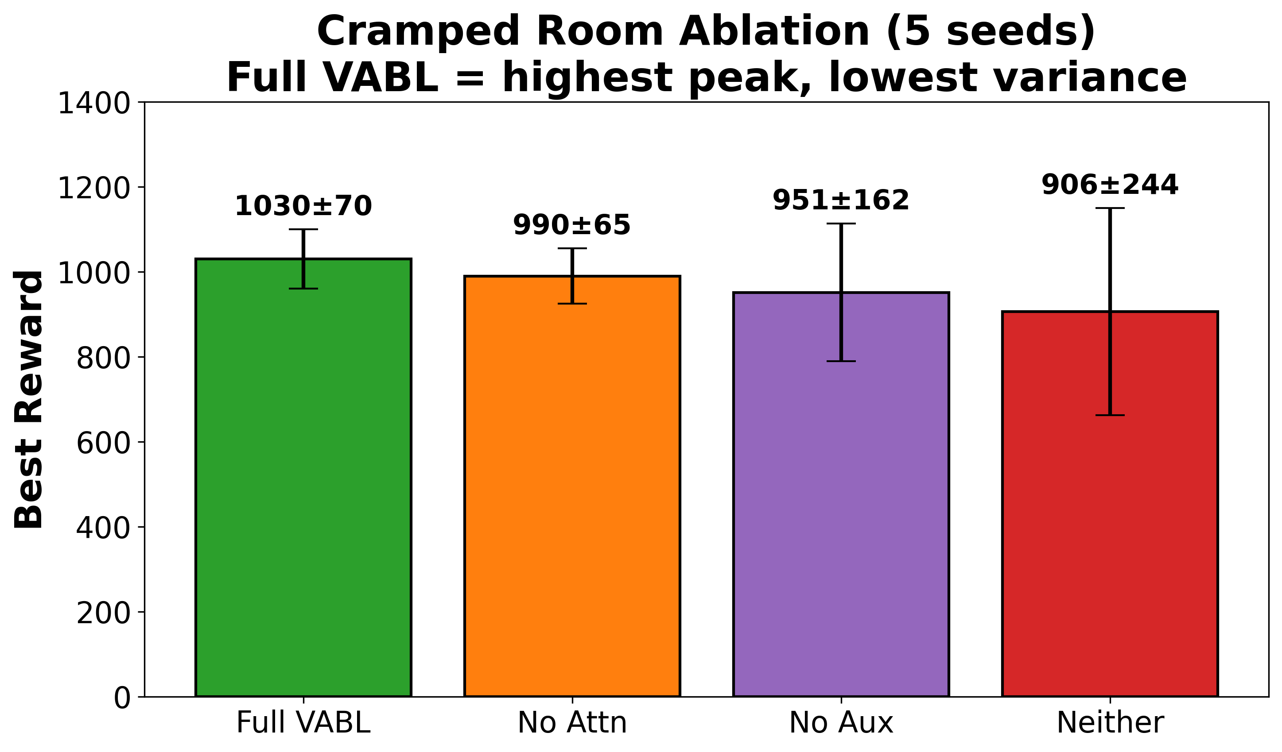
Learning to Coordinate Without Talking
Data-Driven Belief Models for Robust Multi-Agent Coordination
Vishnu Kadiyala, Mohammed Atiquzzaman — School of Computer Science, University of Oklahoma
QR CODE
To Online submission
Poster ID: ###
THE PROBLEM
VABL: HOW IT WORKS
Can AI agents coordinate
without communication?
A quarterback reads the safety, sees his receiver
break, and throws — no audible needed. He
coordinates by predicting, not communicating.
Setting: Decentralized POMDPs — agents act
on partial observations, no shared channel.
The Problem: Coordination Collapse
Agents learn teamwork then catastrophically
forget it — like a team that falls apart
in the 4th quarter of the big game.
Three steps, no communication needed:
❶ Observe teammate actions (behavioral data)
❷ Attend — Multi-head attention (h=4) weighs
which teammates matter. Query = belief state,
Keys/Values = encoded actions.
❸ Update belief via GRU recurrence
❹ Predict teammates’ next actions (Theory of
Mind) — keeps beliefs calibrated against drift.
L = L_PPO + 0.05 × L_prediction
Aux accuracy: 17% (chance) → 86%
VABL retains 62% of learned coordination vs 0% for MAPPO/AERIAL — no communication.
EVIDENCE
RESULTS
CONCLUSIONS & IMPACT
Key Insight
Every method discovers coordination.
The challenge is keeping it.
VABL’s auxiliary prediction loss prevents
belief drift, sustaining coordination
without any communication channel.
Data Science Contributions
• Behavioral prediction from sequential
observational data (86% accuracy)
• Self-supervised regularization prevents
catastrophic forgetting (2.3× variance ↓)
• Rigorous evaluation: 5 seeds, 4 baselines,
3 environments, 10M-step extended runs
Applications
• Warehouse robot fleets
• Autonomous vehicle coordination
• Disaster response drone swarms
Future Work
• Hanabi, scaling to N>10, hybrid communication
Key Results (5 seeds, 95% CIs)
• Overcooked: 3.3× higher reward than MAPPO
• 38% collapse vs 100% (MAPPO, AERIAL)
• TarMAC (comm.): Final 56.6 but 88% collapse
• 5-agent: VABL 95.7±3.3 vs MAPPO 84.0±10.4
• 10M steps: MAPPO collapses to zero reward
Cramped Room ablation confirms: Full VABL =
highest peak (1030±70), lowest variance.
12× more reliable training
VABL std dev 1.7 vs MAPPO 20.3 across
5 random seeds on Simple Coordination.
QMIX has low variance but fails to learn.
vishnupk@ou.edu │ github.com/vishnukadiyala/vabl-multi-agent-coordination

