Slide 1
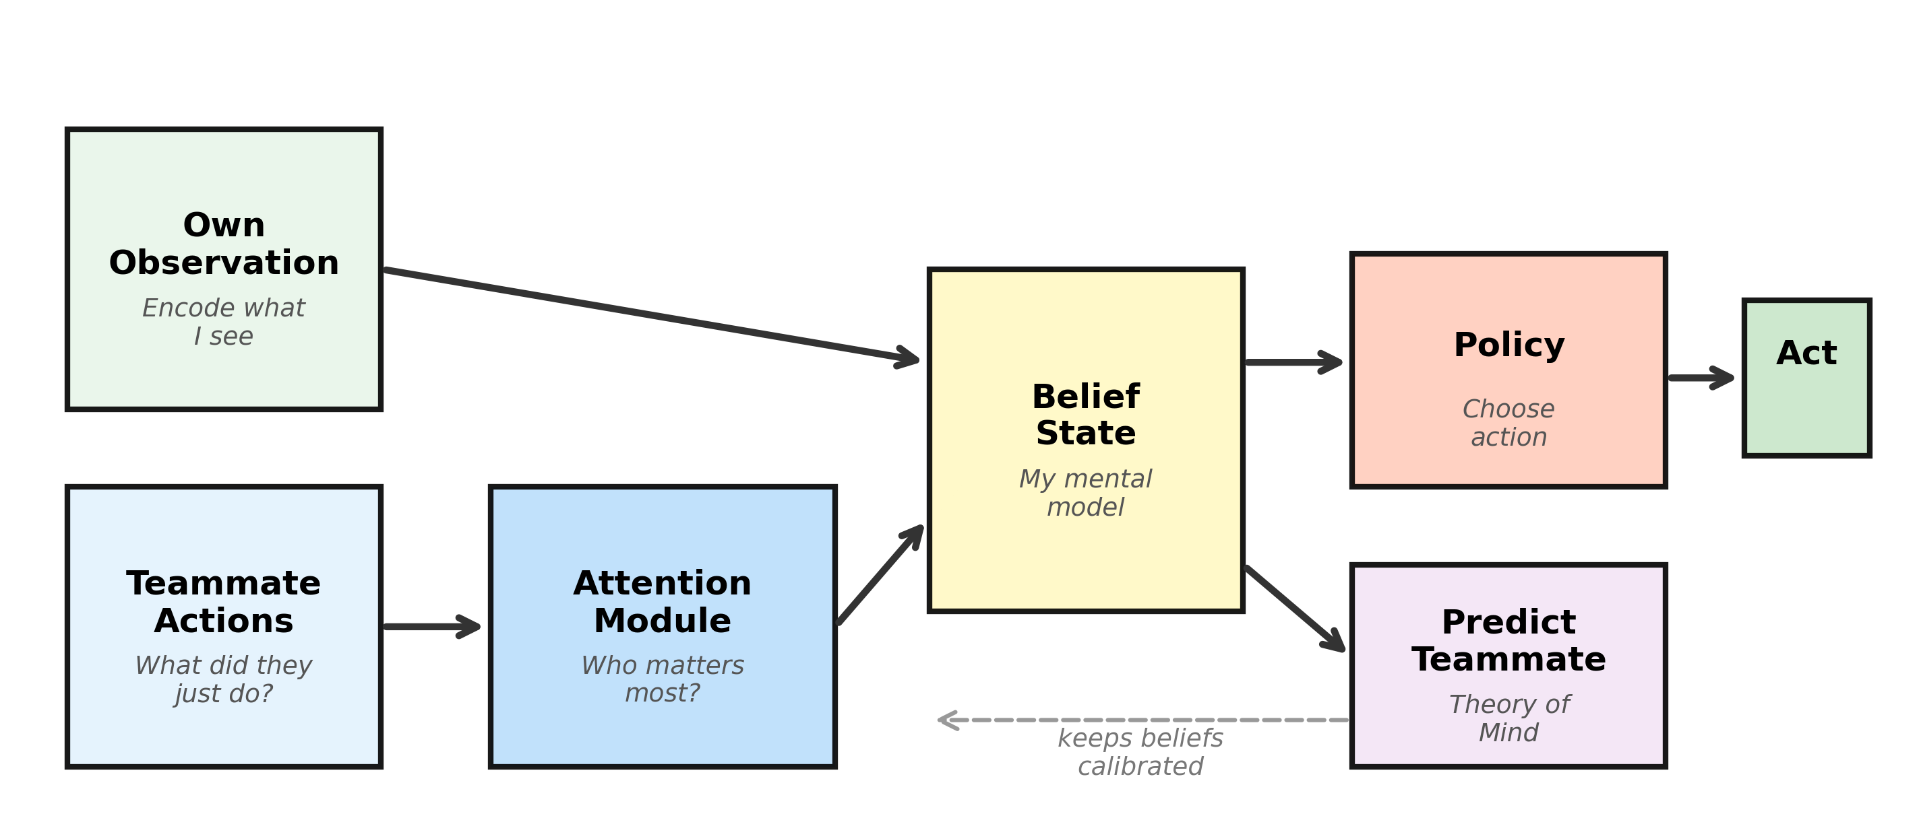
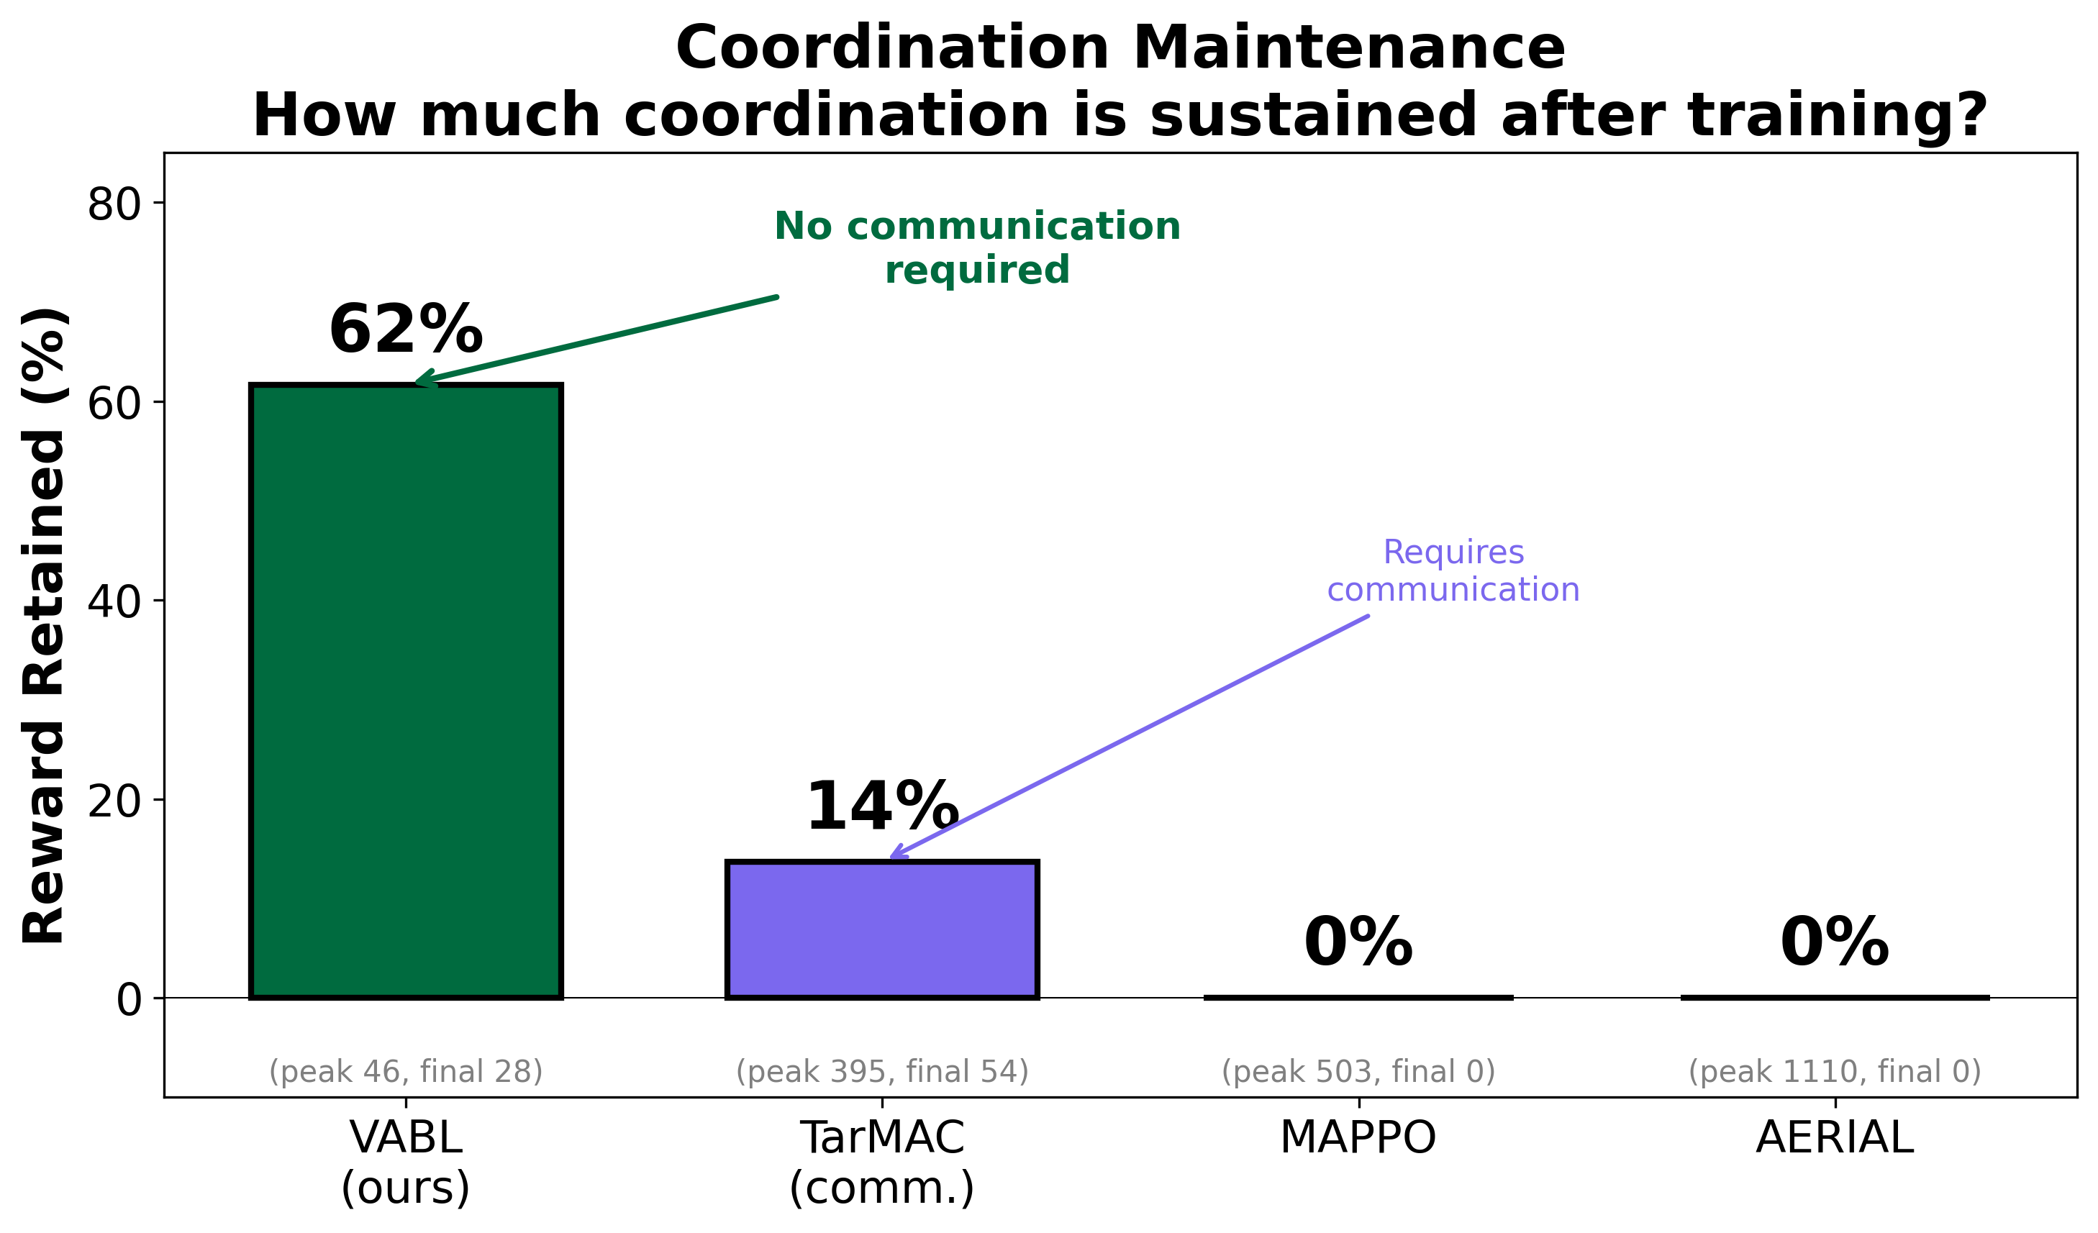
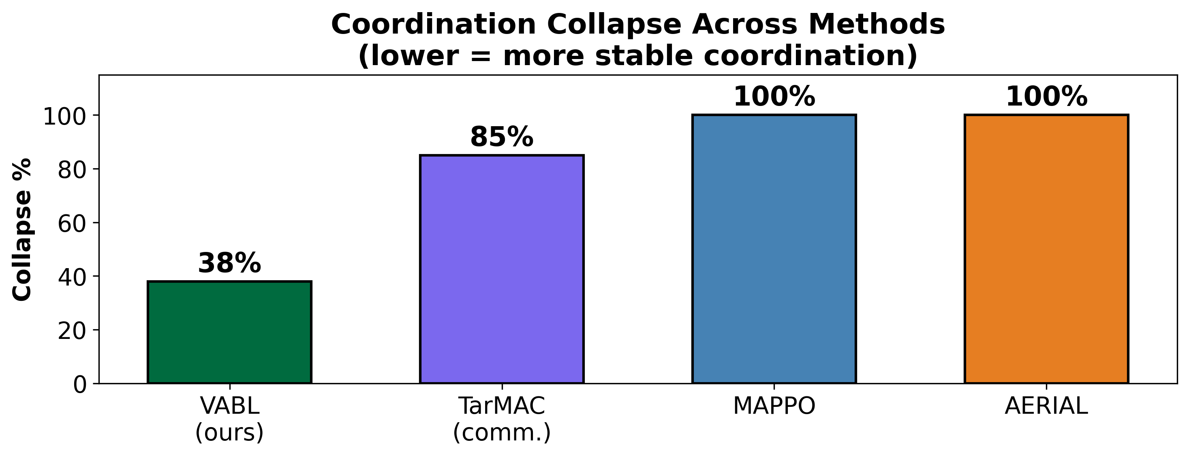
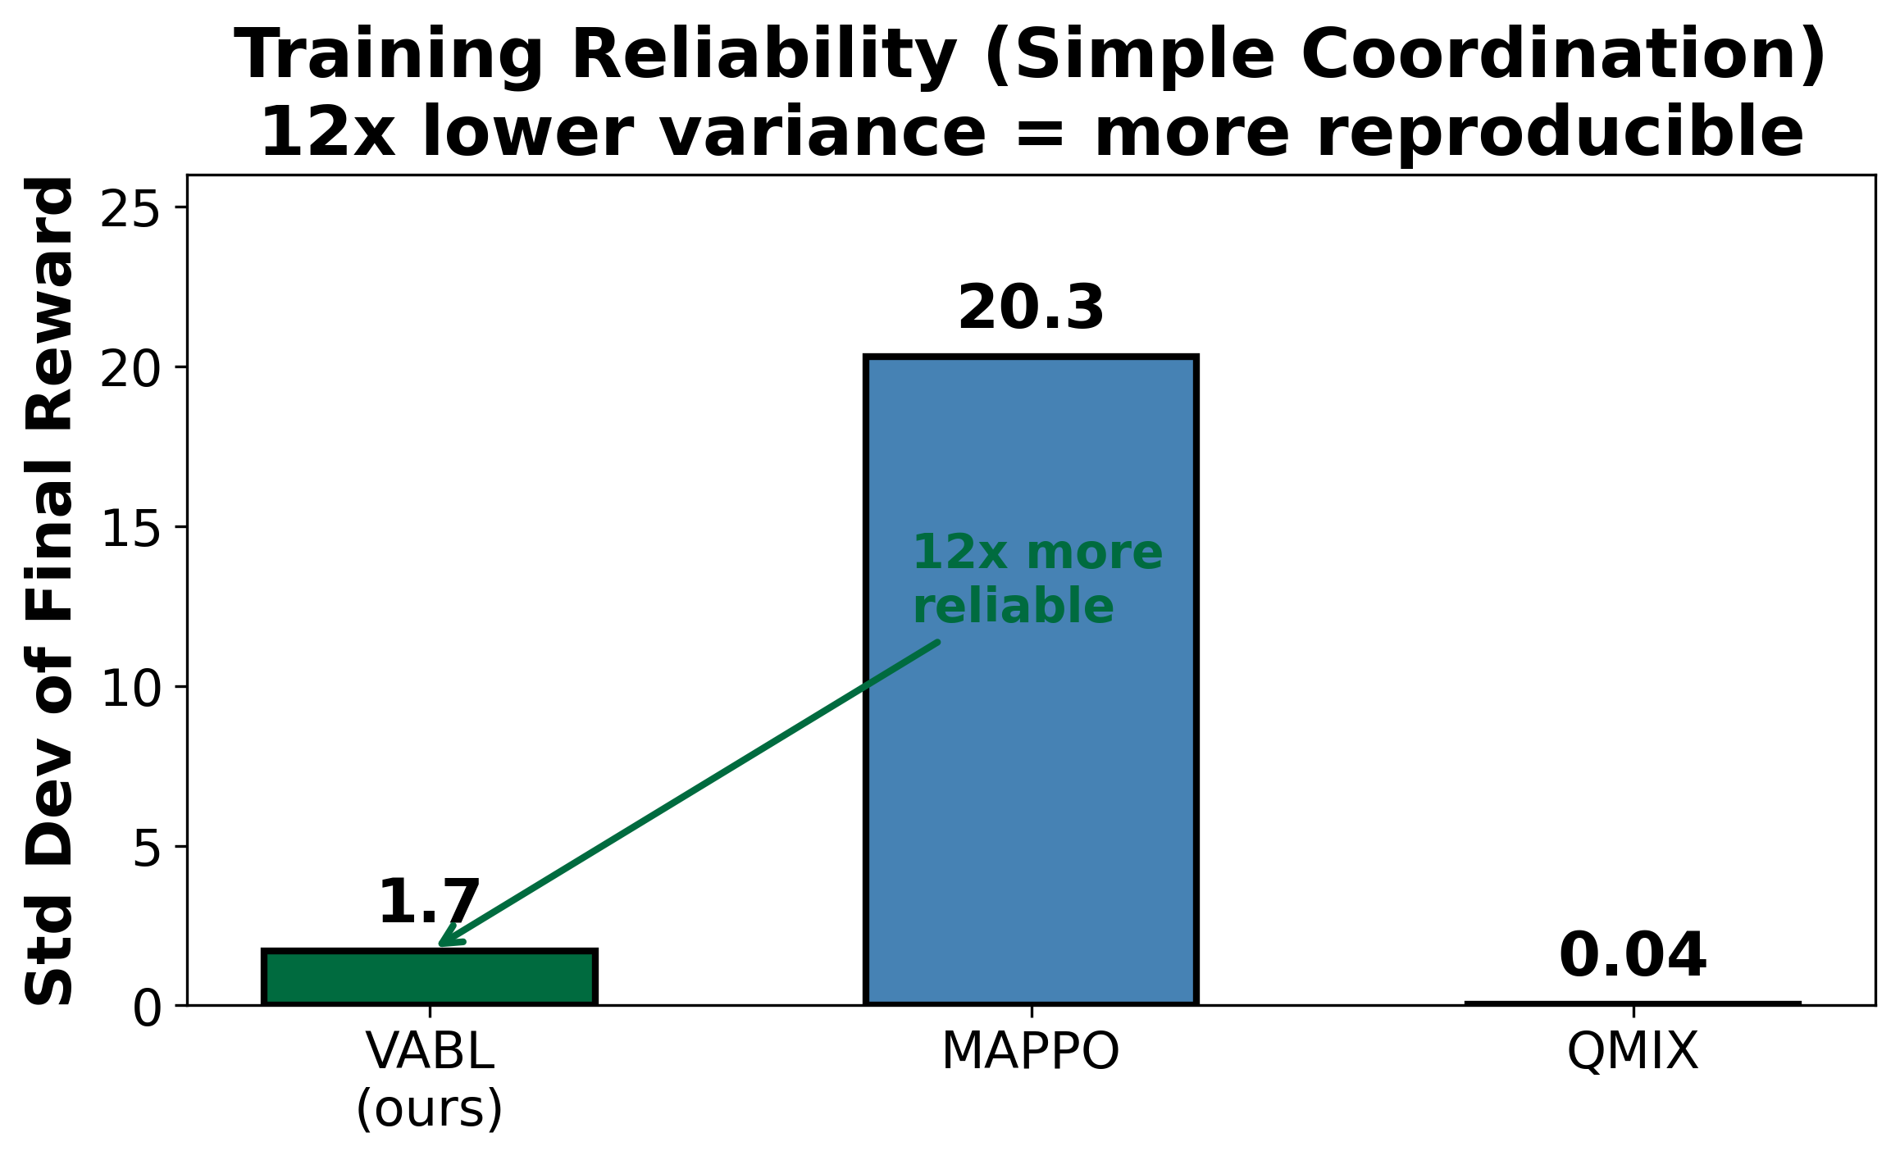
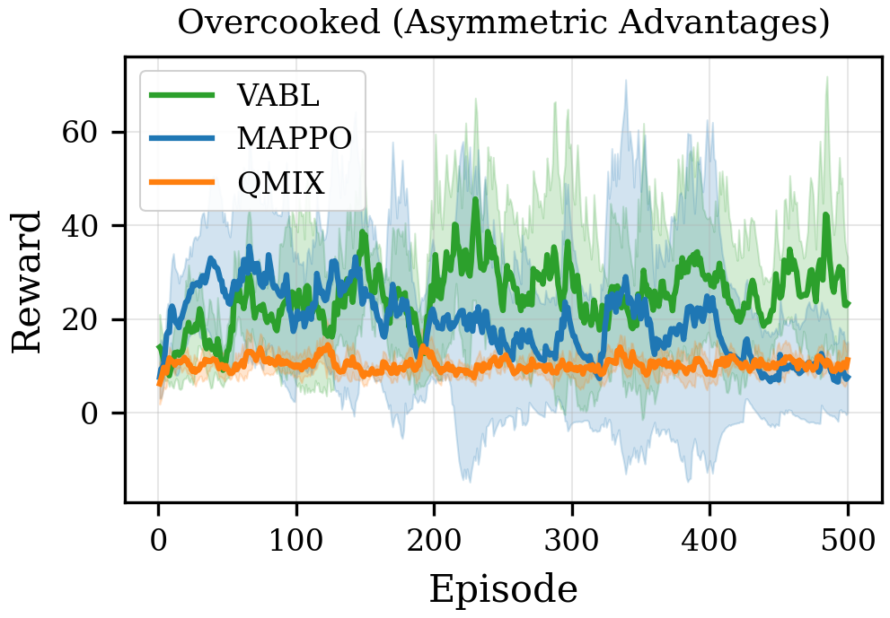
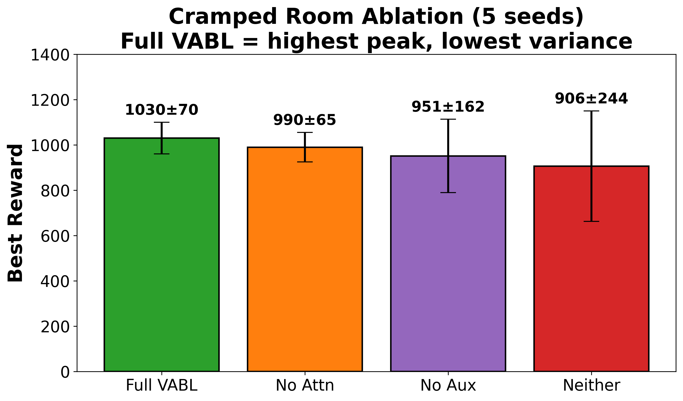
Learning to Coordinate Without Talking:
Data-Driven Belief Models for Robust Multi-Agent Coordination
Vishnu Kadiyala, Mohammed Atiquzzaman — School of Computer Science, University of Oklahoma
QR CODE
To Online submission
Poster ID: ###
① The Problem
② How VABL Works — Data-Driven Belief Learning
Can AI agents learn to work together
without talking to each other?
A QB reads the safety cheat left, sees his receiver
break right, and throws — no audible needed. He
coordinates by predicting, not communicating.
Setting: Decentralized POMDPs (Dec-POMDPs) —
multiple agents act on partial observations with
no shared communication channel.
The hidden problem: Coordination Collapse
Agents learn coordination, then catastrophically
forget it — like a team that falls apart in the 4th:
• MAPPO (PPO + centralized critic): 100% collapse
• AERIAL (attention, no aux loss): 100% collapse
• TarMAC (explicit communication): 85% collapse
Our solution: VABL — agents build predictive
belief models of teammates from observable
actions via attention + auxiliary prediction.
Only 38% collapse, no communication required.
CTDE paradigm: centralized critic (training), decentralized actors (execution)
❶ Observe — Encode teammate actions via MLP
(one-hot → d_e=64 embedding per teammate)
❷ Attend — Multi-head attention (h=4) over teammate
action embeddings. Query = belief state b_t,
Keys/Values = encoded actions. Produces social
context vector c_t (permutation-invariant).
❸ Update — GRU cell: b_t = GRU([obs_enc || c_t], b_{t-1})
❹ Predict — Auxiliary MLP predicts teammates' next
actions from b_t. Maximizes variational MI bound
I(b_t; a_{t+1}). Keeps beliefs calibrated.
L_total = L_PPO + 0.05 * L_aux_prediction
Aux accuracy: 17% (chance) → 86%. Overhead: <10%
VABL retains 62% of coordination vs 0% (MAPPO/AERIAL) — without any communication channel.
③ Evidence: Rigorous Evaluation Across Environments
④ Conclusions & Impact
Key Insight
Every method discovers coordination.
The challenge is keeping it.
VABL’s prediction loss prevents belief drift,
sustaining coordination without communication.
Data Science Contributions
• Prediction from behavioral time-series: each agent
processes sequential teammate action data to build
a real-time predictive model (86% accuracy)
• Self-supervised regularization: auxiliary prediction
task calibrates learned representations, preventing
catastrophic forgetting (2.3× variance reduction)
• Rigorous evaluation: 5 seeds, ablation studies,
4 baselines, 3 environments, 10M-step extended runs
Real-World Applications
• Warehouse robot fleets (comm. blackouts)
• Autonomous vehicle coordination
• Disaster response drone swarms
• Collaborative surgical robotics
Future Work
• Hanabi evaluation (card-game partial observability)
• Scaling to N>10 agents with sparse attention
• Hybrid implicit + explicit communication
Fig A: VABL 12× more reliable
across seeds (std 1.7 vs 20.3).
Fig B: VABL (green) sustains reward;
MAPPO (blue) collapses after ep 200.
Fig C: Removing components degrades
peak — full VABL is most reliable.
Summary (5 seeds, 95% CIs):
• Overcooked AA: VABL 3.3× MAPPO final reward, 38% vs 76% collapse
• 5-agent Simple Coord: Best 95.7±3.3 vs MAPPO 84.0±10.4
• Cramped Room: Full VABL Best 1030±70 (lowest variance)
• 10M steps: MAPPO & AERIAL collapse to 0; TarMAC to 54
Environments: Overcooked-AI (2 agents), Simple Coordination (3-5 agents, stochastic visibility)
Contact: vishnupk@ou.edu │ github.com/vishnukadiyala/vabl-multi-agent-coordination │ DISC 2026

