Slide 1
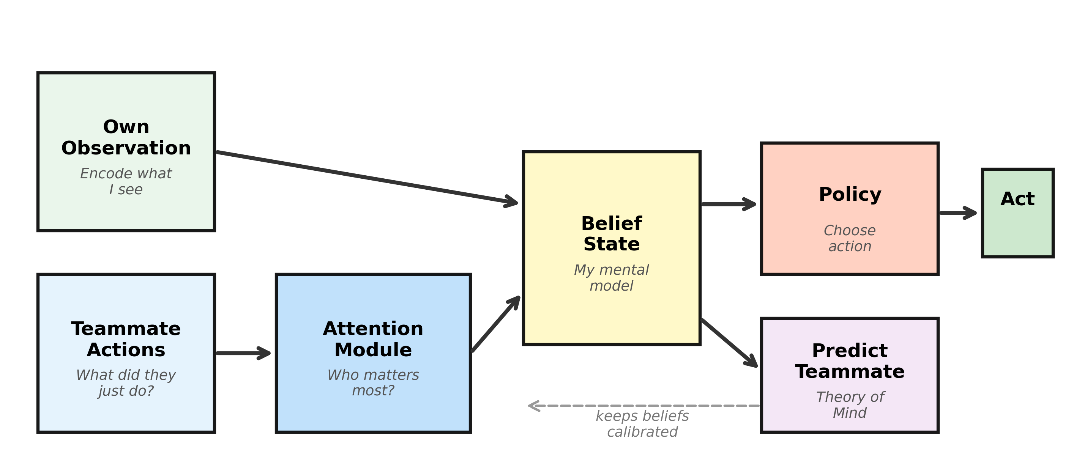
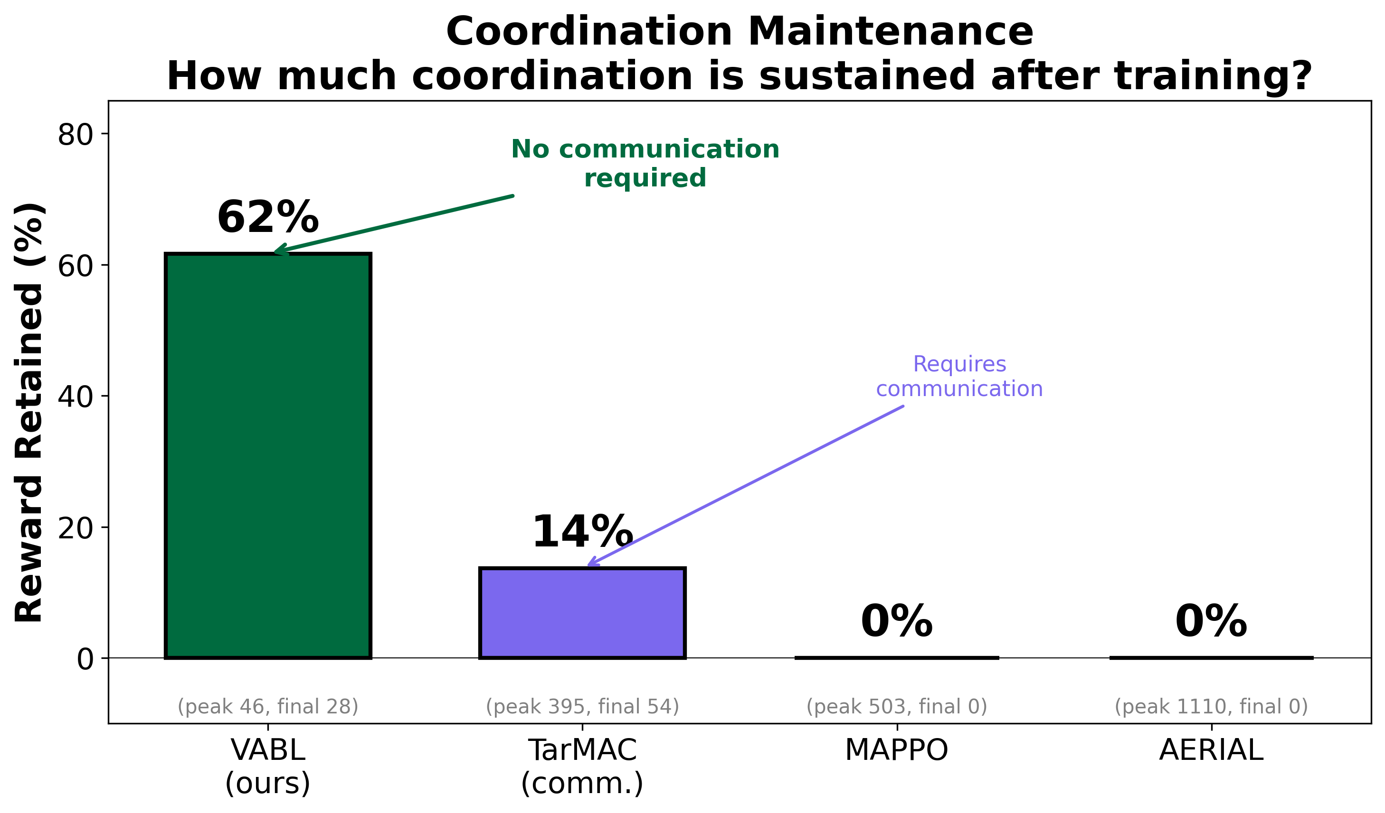
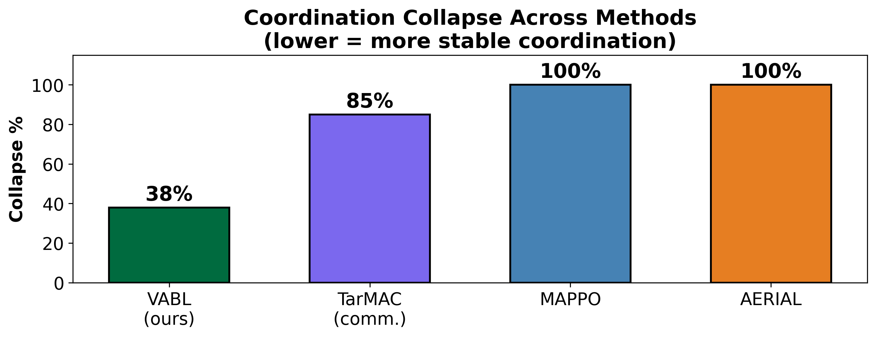
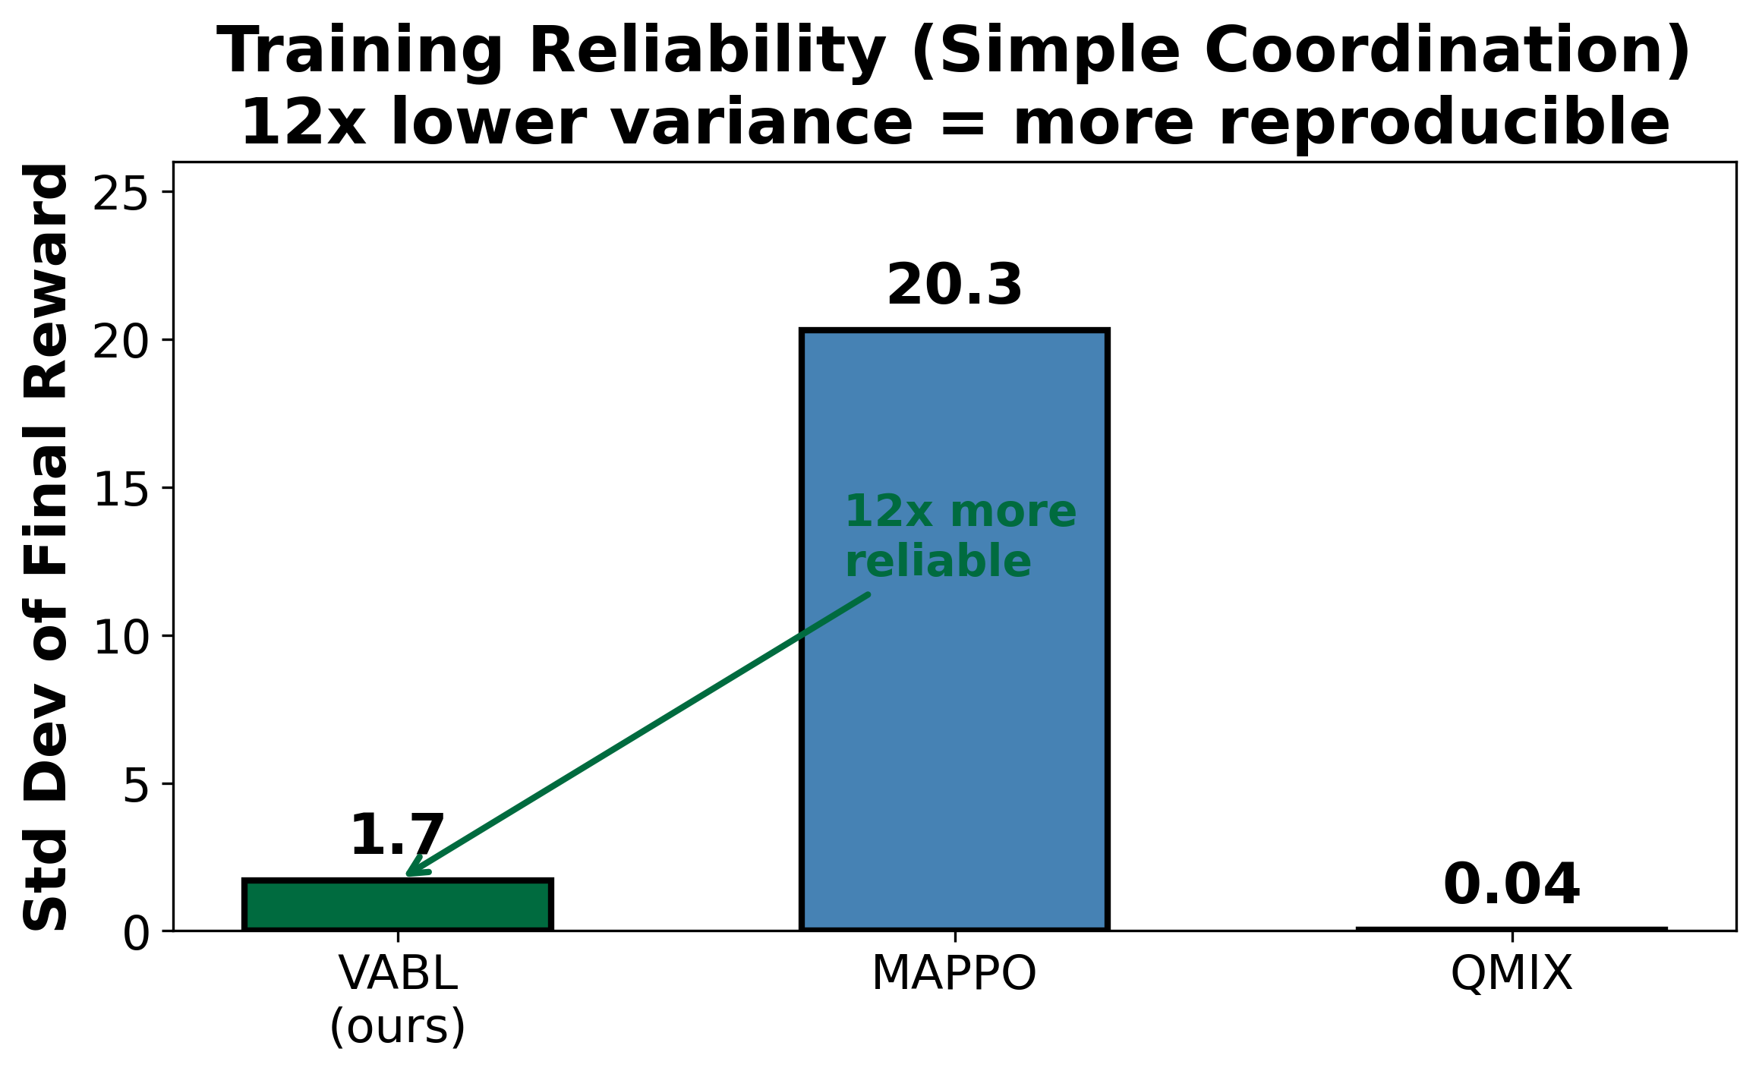
OU
Learning to Coordinate Without Talking
Data-Driven Belief Models for Robust Multi-Agent Coordination
Vishnu Kadiyala, Mohammed Atiquzzaman — School of Computer Science, University of Oklahoma
QR CODE
To Online submission
Poster ID: ###
SECTION NAME
SECTION NAME
Can AI agents learn to coordinate
without communicating?
A quarterback reads the safety, sees his receiver
break right, and throws — no audible needed.
He coordinates by predicting, not communicating.
VABL teaches AI agents the same skill.
The Hidden Problem: Coordination Collapse
❶ Observe — Encode teammate actions via MLP
One-hot action → 64-dim embedding per teammate
❷ Attend — Multi-head attention (h=4) over actions
Query = belief state, Keys/Values = action embeddings
❸ Update — GRU: b_t = GRU([obs || context], b_{t−1})
❹ Predict — Auxiliary MLP predicts next actions
Accuracy: 17% (chance) → 86%. Keeps beliefs calibrated.
L_total = L_PPO + 0.05 × L_aux | <10% overhead vs MAPPO
VABL retains 62% of coordination vs. 0% for MAPPO and AERIAL — without any communication channel.
SECTION NAME
SECTION NAME
SECTION NAME
Head-to-Head Comparison
VABL MAPPO TarMAC AERIAL
────────────────────────────────────────────────────────
Reward Retained 62% 0% 14% 0%
Collapse % 38% 100% 85% 100%
Reward Std Dev 1.7 20.3 -- --
Comm. Required? No No Yes No
────────────────────────────────────────────────────────
→ Replace this with a proper PowerPoint table
Key Insight
Every method discovers coordination.
The challenge is keeping it.
VABL's prediction loss prevents belief drift,
sustaining coordination without communication.
Data Science Contributions
• Prediction from behavioral time-series:
sequential teammate action data → real-time
predictive model (86% accuracy)
• Self-supervised regularization prevents
catastrophic forgetting (2.3× variance reduction)
• Rigorous evaluation: 5 seeds, 4 baselines,
3 environments, 10M-step extended runs
Component Ablation (Cramped Room, 5 seeds)
• Full VABL: 1030 ± 70 (best, lowest variance)
• No Attention: 990 ± 65
• No Aux Loss: 951 ± 162 (2.3× higher variance)
• Neither: 906 ± 244 (3.5× higher variance)
Auxiliary prediction is the critical stabilizer.
Real-World Applications
• Warehouse robot fleets (comm. blackouts)
• Autonomous vehicle coordination
• Disaster response drone swarms
• VABL std: 1.7 vs MAPPO: 20.3 (12× more reliable)
• Overcooked AA: VABL 3.3× MAPPO final reward
• 5 seeds, 95% CIs, extended 10M-step runs
Future Work
• Hanabi evaluation • Scale to N>10 agents • Hybrid communication
Contact: vishnupk@ou.edu │ github.com/vishnukadiyala/vabl-multi-agent-coordination │ DISC 2026

