Slide 1


PYTHON PROJECT PRESENTATION
Prepared & presented by K. Vishnu Vardhan Reddy
12311975

Slide 2
CONTENTS:
Introduction
Objective and scope of this project
Application Tools
Project Design
Flowchart
Testing and Validation
Data Flow Diagrams
Challenges Faced
Conclusion
Limitations
References

Slide 3


Introduction:
The Space Shooter game is an engaging arcade-style project developed using Python and Pygame. It allows players to control a spaceship, shoot bullets, and eliminate enemies while avoiding missed chances. The game features multiple levels with increasing difficulty, a scoring system, and interactive game states like Start, Pause, and End screens. This project demonstrates key concepts of game development, including collision detection, event handling, and multimedia integration, providing a strong foundation for building more advanced games.

Slide 4
Objective and scope of this project:
Objective: To design an engaging and interactive arcade-style game that includes features like increasing difficulty, scoring, and game states.
Scope: Enhances programming and game development skills.
Demonstrates implementation of game logic, event handling, and multimedia in Python.
Serves as a foundational framework for creating more complex games.

Slide 5

Application tools:
Programming Language: Python 3.10+
Libraries Used:
Pygame: For game development and multimedia handling.
Random: To spawn enemies at random positions.
Time: To track gameplay duration and manage timing.

Slide 6

Project Design
Player: Controlled by keyboard input, fires bullets to destroy enemies.
Enemies: Spawn randomly and move downward.
Bullets: Fired by the player to eliminate enemies.
Game States: Includes Start Screen, Pause Screen, Gameplay, and End Screen.

Slide 7
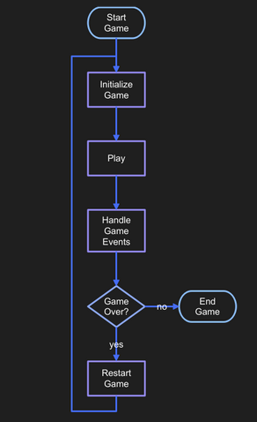
Flow Chart:

Slide 8
Testing and Validation:
Testing Scenarios:
Player can move left, right, and shoot bullets.
Bullets eliminate enemies correctly.
Enemies increase in speed with levels.
Game transitions between screens smoothly.
Validation:
Verified score and level progression.
Ensured missed chances counter increments when enemies pass.
Audio files load and play as expected.

Slide 9
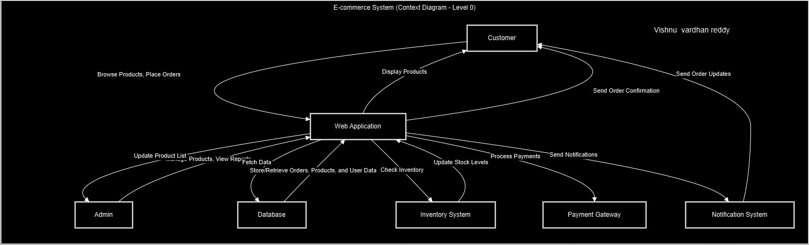
Data Flow Diagrams (DFD’s): Level 0
Vishnu vardhan reddy

Slide 10
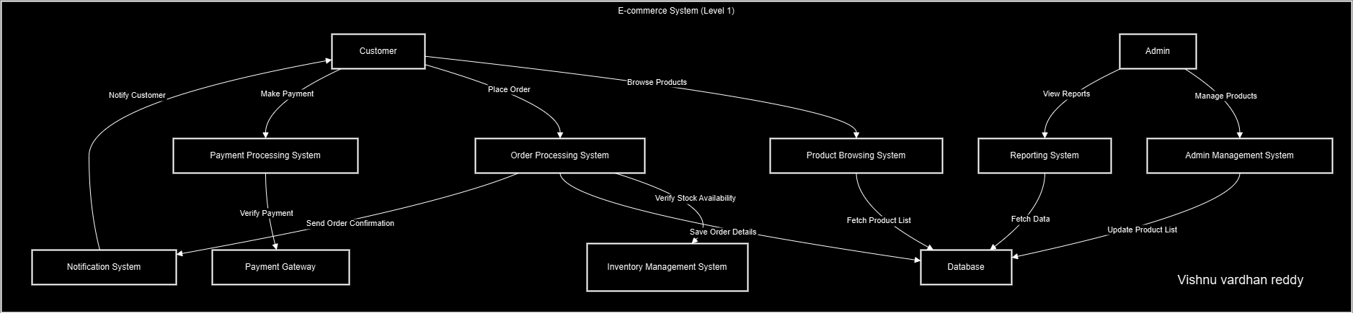
Level 1:
Vishnu vardhan reddy

Slide 11
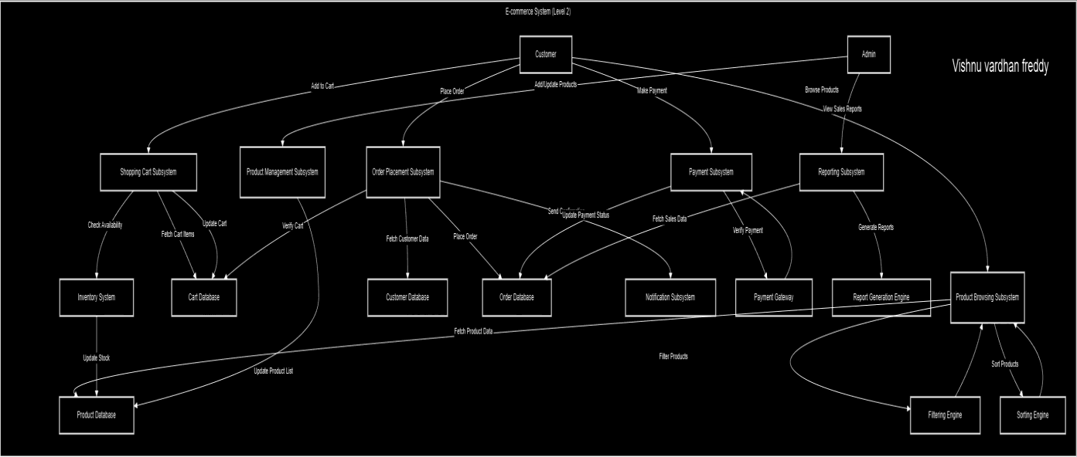

Level 2:
Vishnu vardhan reddy

Slide 12

Challenges Faced:
Collision Handling: Ensuring accurate detection between bullets and enemies.
Game Balance: Adjusting enemy speed and spawn rate to maintain difficulty.
Performance: Managing large numbers of bullets and enemies to avoid lag.

Slide 13
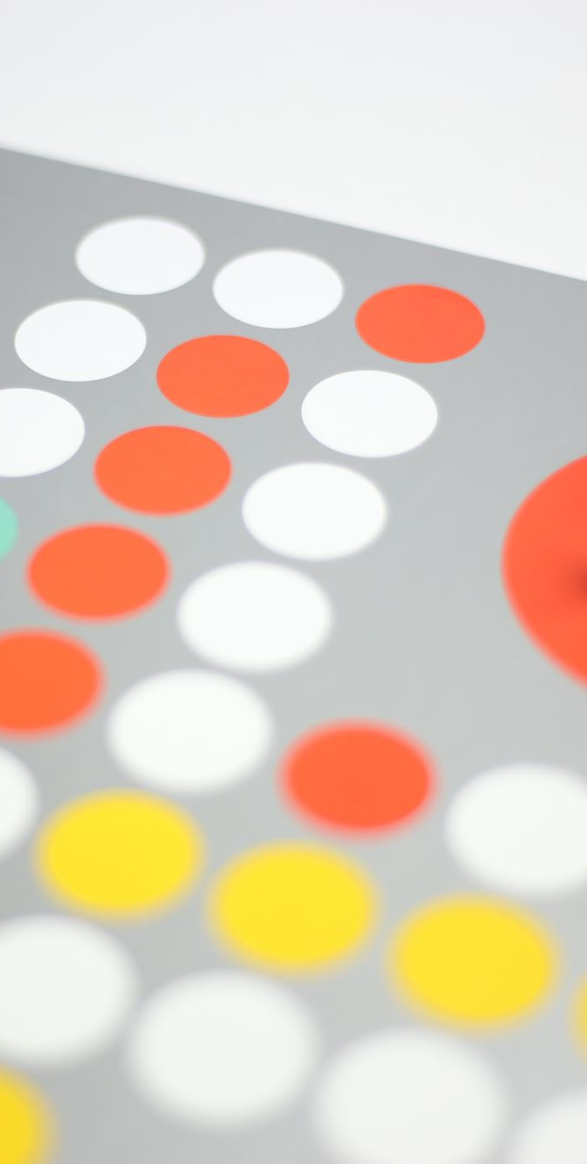
Conclusion
The game successfully implements core mechanics of an arcade-style shooter. It provides a scalable framework for additional features like power-ups or different enemy types.

Slide 14

References
Pygame Documentation: https://www.pygame.org/docs/
Python Official Documentation: https://docs.python.org/
Tutorials and Community Forums on game development.

Slide 15

This Photo by Unknown Author is licensed under CC BY-SA

