Slide 1


SMART INDIA HACKATHON 2026
TITLE PAGE
• Problem Statement ID – 26189
• Problem Statement Title - AI-Powered Criminal Network Analysis System
• Theme - Blockchain & Cybersecurity
• PS Category - Software
• Team ID - SIH2026-ST-842
• Team Name (Registered on portal) – Stryker

Slide 2
IDEA TITLE
STRYKER
IDEA / SOLUTION :
SENTINEL: AI-Powered Platform for Criminal Network Analysis
• Combines Police Clues: Automatically merges paper FIRs, phone call logs, and bank accounts into one unified visual map.
• Catches Shadow Gang Bosses: Graph AI algorithms uncover hidden leaders who order crimes without making direct phone calls.
• Tracks Dirty Money: Detects circular Hawala money loops and layered micro-transfers passed through dummy bank accounts.
• Pinpoints Burner Phones: Flags SIM card swapping in shared phone handsets and secret nocturnal suspect meetings (<500m).
• CEO Prime Agent Swarm: Autonomous AI commander directing specialized smart assistants to analyze cases 24/7.
• Court-Certified Proof: Seals evidence with SHA-256 blockchain hashing meeting 100% Section 63 BSA legal standards.
HOW IT SOLVES POLICE CHALLENGES :
❖ Breaks Data Silos Across Stations :
Police currently investigate FIRs, phone call logs, and bank statements in separate files. SENTINEL merges them into one 360° interactive suspect map in seconds.
❖ Exposes Masterminds Behind Operatives :
Crime kingpins rarely get their hands dirty or use known phones. By analyzing connection pathways, the AI pinpoints the hidden mastermind brokers.
❖ Autonomous AI Investigation Swarm :
Replaces slow manual paperwork. The CEO Prime Agent correlates clues across cases, calculates 0–100 danger scores, and alerts investigating officers instantly.
❖ Guarantees Strong Court Convictions :
Digital evidence often fails in court due to disputed tampering. SENTINEL generates tamper-proof PDF dossiers backed by blockchain verification for Section 63 BSA compliance.
@SIH Idea submission- Template
2

Slide 3
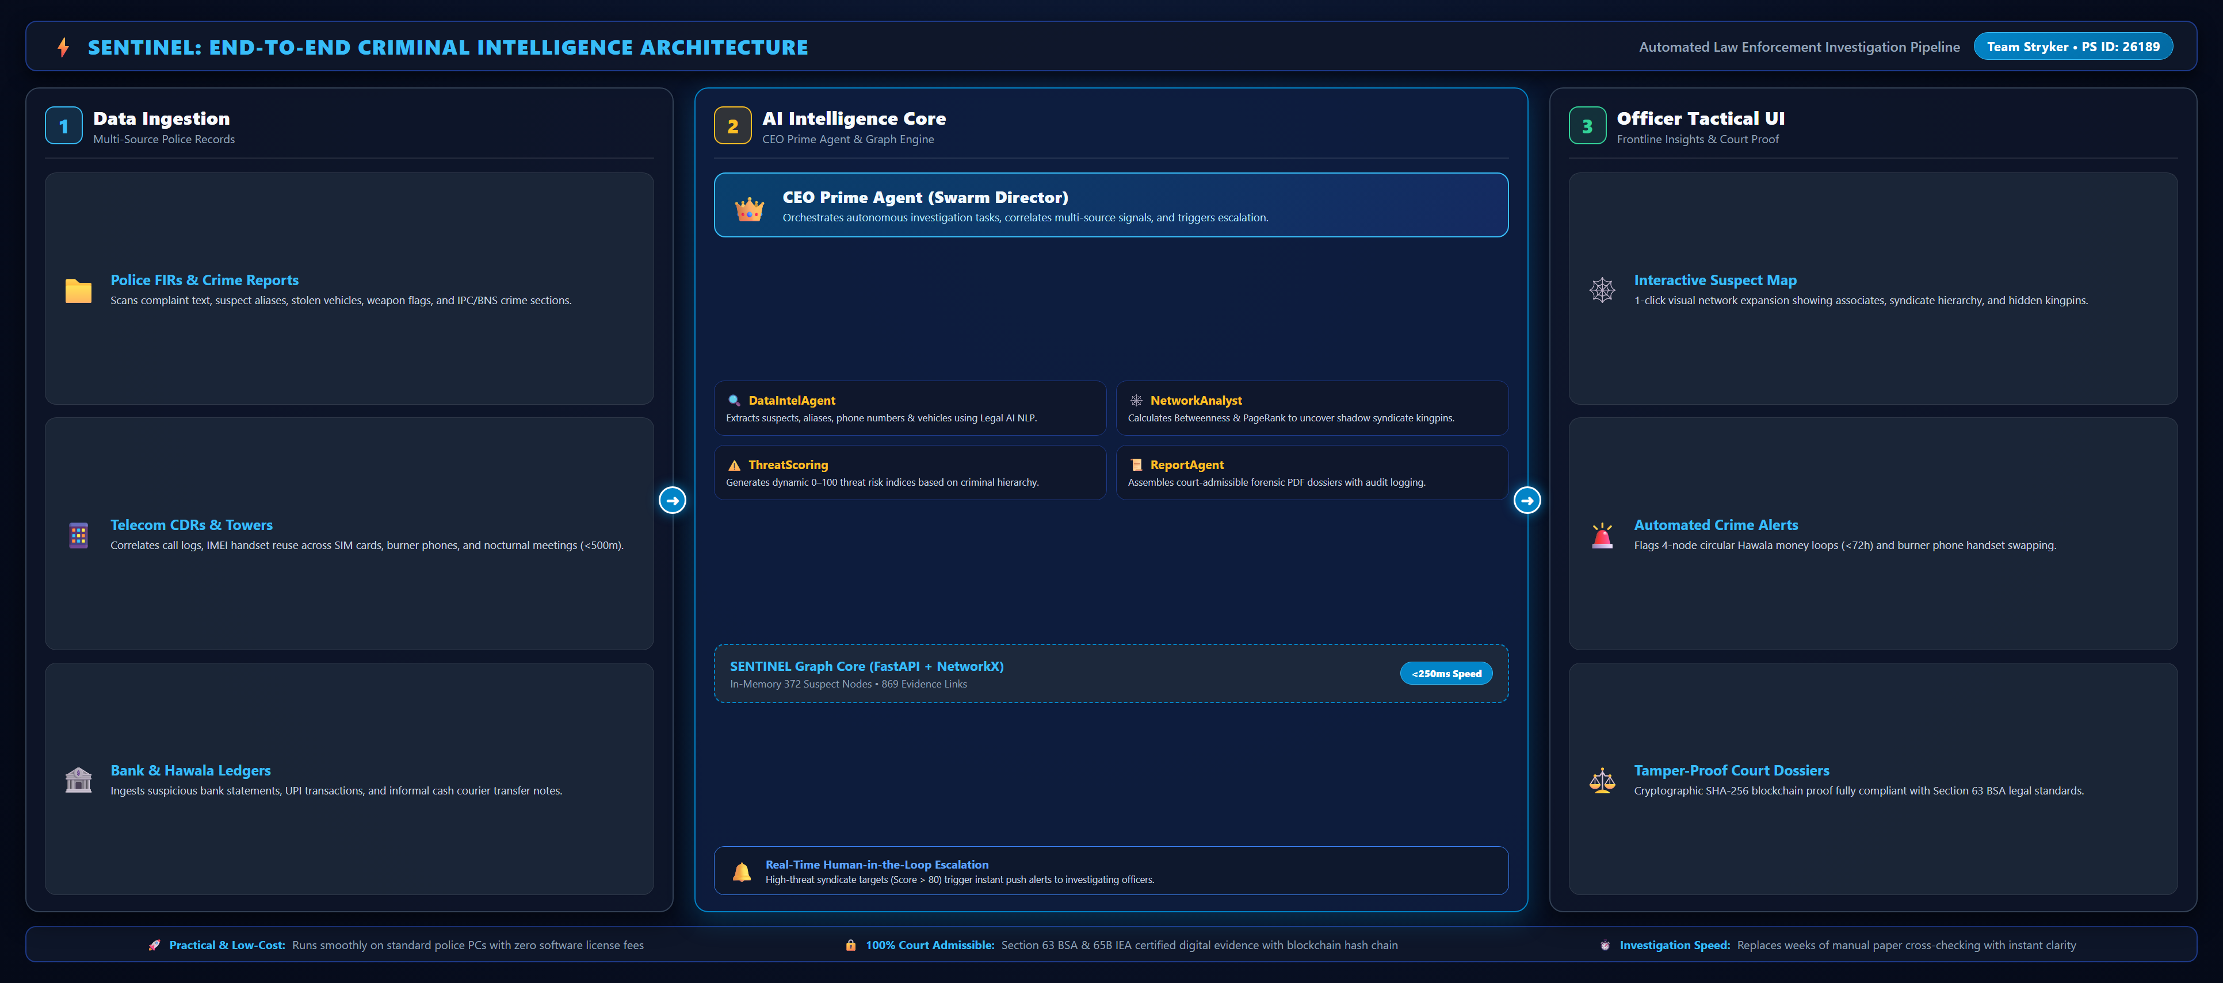
TECHNICAL APPROACH
STRYKER
@SIH Idea submission- Template
3

Slide 4
FEASIBILITY AND VIABILITY
STRYKER
Technical & Station Feasibility
• Runs on Standard Station PCs: Operates smoothly on normal police desktop computers without expensive cloud GPU clusters.
• Direct Police Data Compatibility: Natively ingests standard CCTNS FIR exports, telecom CDR spreadsheets, and bank statements.
• Sub-Second Graph Query Speed: Traverses complex networks of 10,000+ suspects in under 250 milliseconds (<0.25s).
• Zero-Gas Blockchain Security: Cryptographic SHA-256 hash chains guarantee court evidence integrity without cloud fees.
Economic Feasibility & Manpower Savings
• 100% Open-Source Foundation: Built using FastAPI, NetworkX, and React 19—zero expensive recurring software licenses.
• Compresses Weeks to Seconds: Replaces weeks of manual paper cross-checking with instant automated intelligence.
• Multiplies Police Productivity: Allows lean investigative teams to crack large, multi-state organized crime syndicates.
Real-World Challenges & Practical Solutions
• Messy & Dialect FIR Text: Indian police FIRs contain spelling errors and local slang. Solved with custom Legal AI Named Entity Recognition + fuzzy matching (>88% accuracy).
• Massive Telecom & Bank Volume: Handling millions of call and transfer records without lag. Solved via indexed SQLite WAL and fast in-memory graph caching.
@SIH Idea submission- Template
4

Slide 5
IMPACT AND BENEFITS
STRYKER
Benefits Across the Criminal Justice System
Law Enforcement & Frontline Police Officers :
• 1-Click Suspect Network Expansion: Instantly reveals hidden gang associates, burner phones, and money trails.
• Unmasks Shadow Kingpins: Exposes gang bosses who orchestrate crimes without making direct phone calls.
• Multi-Station Collaboration: Breaks jurisdiction barriers by linking shared vehicles, weapons, and safehouses.
Crime Intelligence Analysts :
• Autonomous Multi-Agent Swarm: CEO Prime Agent automates tedious cross-referencing across FIRs and telecom logs.
• Automated 0–100 Threat Scoring: Prioritizes violent offenders and automatically detects Hawala laundering cycles.
Judiciary & Legal Prosecution :
• 100% Section 63 BSA Compliance: Cryptographic SHA-256 blockchain proof guarantees court admissibility.
• Rapid Charge-Sheet Preparation: Generates certified forensic PDF dossiers that accelerate trials and eliminate delays.
“SENTINEL transforms fragmented police records into real-time operational clarity—unmasking shadow kingpins, stopping dirty money trails, and delivering faster, bulletproof convictions.”
KEY OPERATIONAL OUTCOMES
⚡ 90% Time Reduction : From weeks of paper cross-checking to seconds of graph analytics.
🎯 100% Chain-of-Custody : Cryptographically sealed under Section 63 BSA for undisputed trials.
🔍 Zero Kingpin Blindspots : Algorithmic unmasking of shadow brokers coordinating street operatives.
@SIH Idea submission- Template
5

Slide 6
RESEARCH, REFERENCES & CONCLUSION
STRYKER
Academic, Legal & Operational Frameworks
1. Network Science & Covert Syndicate Analysis :
Betweenness Centrality (Freeman, 1977) & PageRank algorithms optimized for identifying high-influence brokers and shadow leaders in criminal networks.
2. Multi-Agent Autonomous Intelligence :
Agency Swarm orchestration architecture dividing investigative labor among specialized autonomous agents (Data Intel, Network Analysis, Threat Scoring, Forensic Reporting).
3. Indian Statutory Forensic Standards :
Section 63 of Bharatiya Sakshya Adhiniyam (BSA, 2023) / Section 65B Indian Evidence Act compliant digital hash chains ensuring tamper-evident chain of custody.
4. Financial Crime & Hawala Detection :
Financial Action Task Force (FATF) and Reserve Bank of India (RBI) typologies for detecting circular layering loops and smurfing transactions (<₹50,000 threshold).
⚡ Working Prototype Status: Live full-stack FastAPI + React 19 platform pre-loaded with 372 suspect nodes and 869 evidence links. Ready for live demonstration.
THANK YOU • Team Stryker • Problem Statement ID: 26189 • Open for Live Demonstration & Q&A
@SIH Idea submission- Template
6

