Slide 1


SMART INDIA HACKATHON 2026
TITLE PAGE
• Problem Statement ID – 26189
• Problem Statement Title - AI-Powered Criminal Network Analysis System
• Theme - Blockchain & Cybersecurity
• PS Category - Software
• Team ID - SIH2026-ST-842
• Team Name (Registered on portal) – Stryker

Slide 2
IDEA TITLE
STRYKER
IDEA / SOLUTION :
SENTINEL: AI-Powered Intelligence Platform for Real-Time Criminal Network Analysis & Crime Deterrence
• Unified Knowledge Graph : Fuses police FIRs, phone call records (CDRs), bank accounts, and video feeds into one real-time network.
• Kingpin & Boss Discovery : Graph centrality algorithms automatically uncover covert syndicate leaders hiding behind operatives.
• Hawala & AML Detection : Detects 4-node circular money loops (<72h) and smurfing transfers below ₹50,000 threshold.
• Burner Phone Triangulation : Tracks shared mobile handsets (IMEI reuse) and co-located nocturnal meetings (<500m).
• CEO Prime Agent Swarm : Autonomous multi-agent coordination commanding DataIntel, NetworkAnalyst, ThreatScoring, and Report agents.
• Statutory Evidence Vault : Cryptographic SHA-256 blockchain ledger ensuring 100% Section 63 BSA / 65B IEA court admissibility.
PROBLEM RESOLUTION :
❖ Breaks Data Silos : Police usually examine FIRs, phone logs, and bank statements in isolation. SENTINEL automatically merges fragmented clues into an interactive 360° map in seconds.
❖ Exposes Hidden Syndicate Bosses : Crime kingpins rarely use their own phones. Advanced Betweenness Centrality and PageRank expose the mastermind brokers coordinating criminal activities.
❖ Autonomous Multi-Agent Investigation : Replaces manual investigative bottlenecks with autonomous AI agent coordination—CEO Prime Agent correlates multi-source signals, computes 0-100 threat scores, and flags high-priority syndicate targets.
❖ Guarantees Court Convictions : Digital evidence often fails in court due to broken chain of custody. SENTINEL creates Section 63 BSA certified PDF dossiers with SHA-256 blockchain verification.
@SIH Idea submission- Template
2

Slide 3
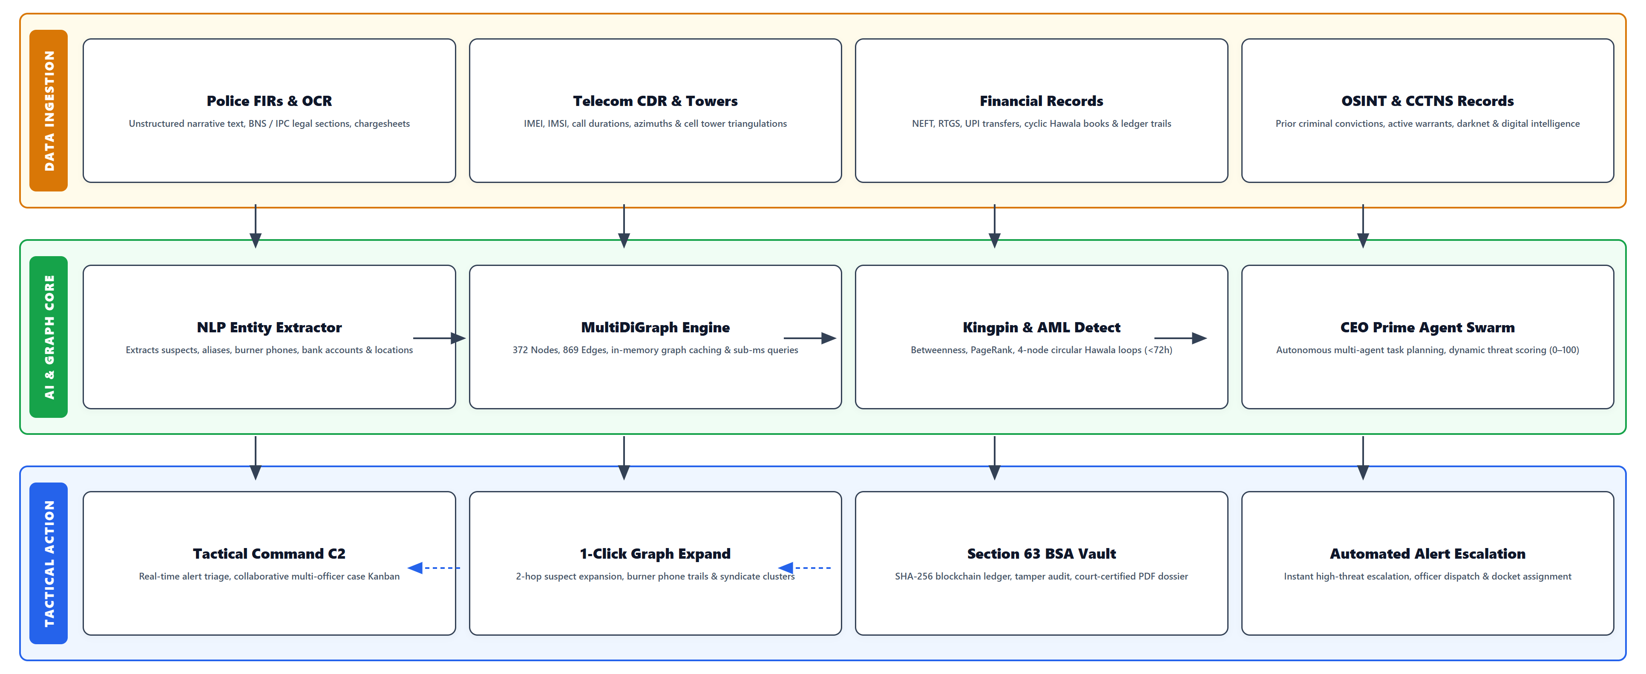
TECHNICAL APPROACH
STRYKER
@SIH Idea submission- Template
3

Slide 4
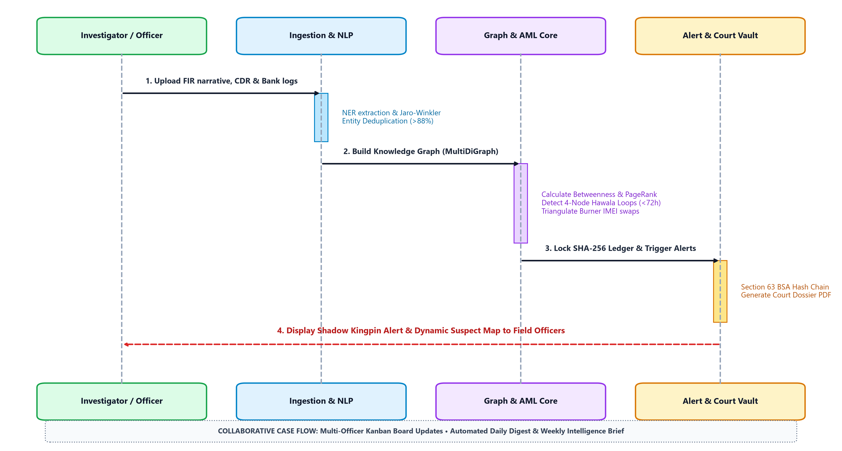
TECHNICAL APPROACH
STRYKER
@SIH Idea submission- Template
4

Slide 5
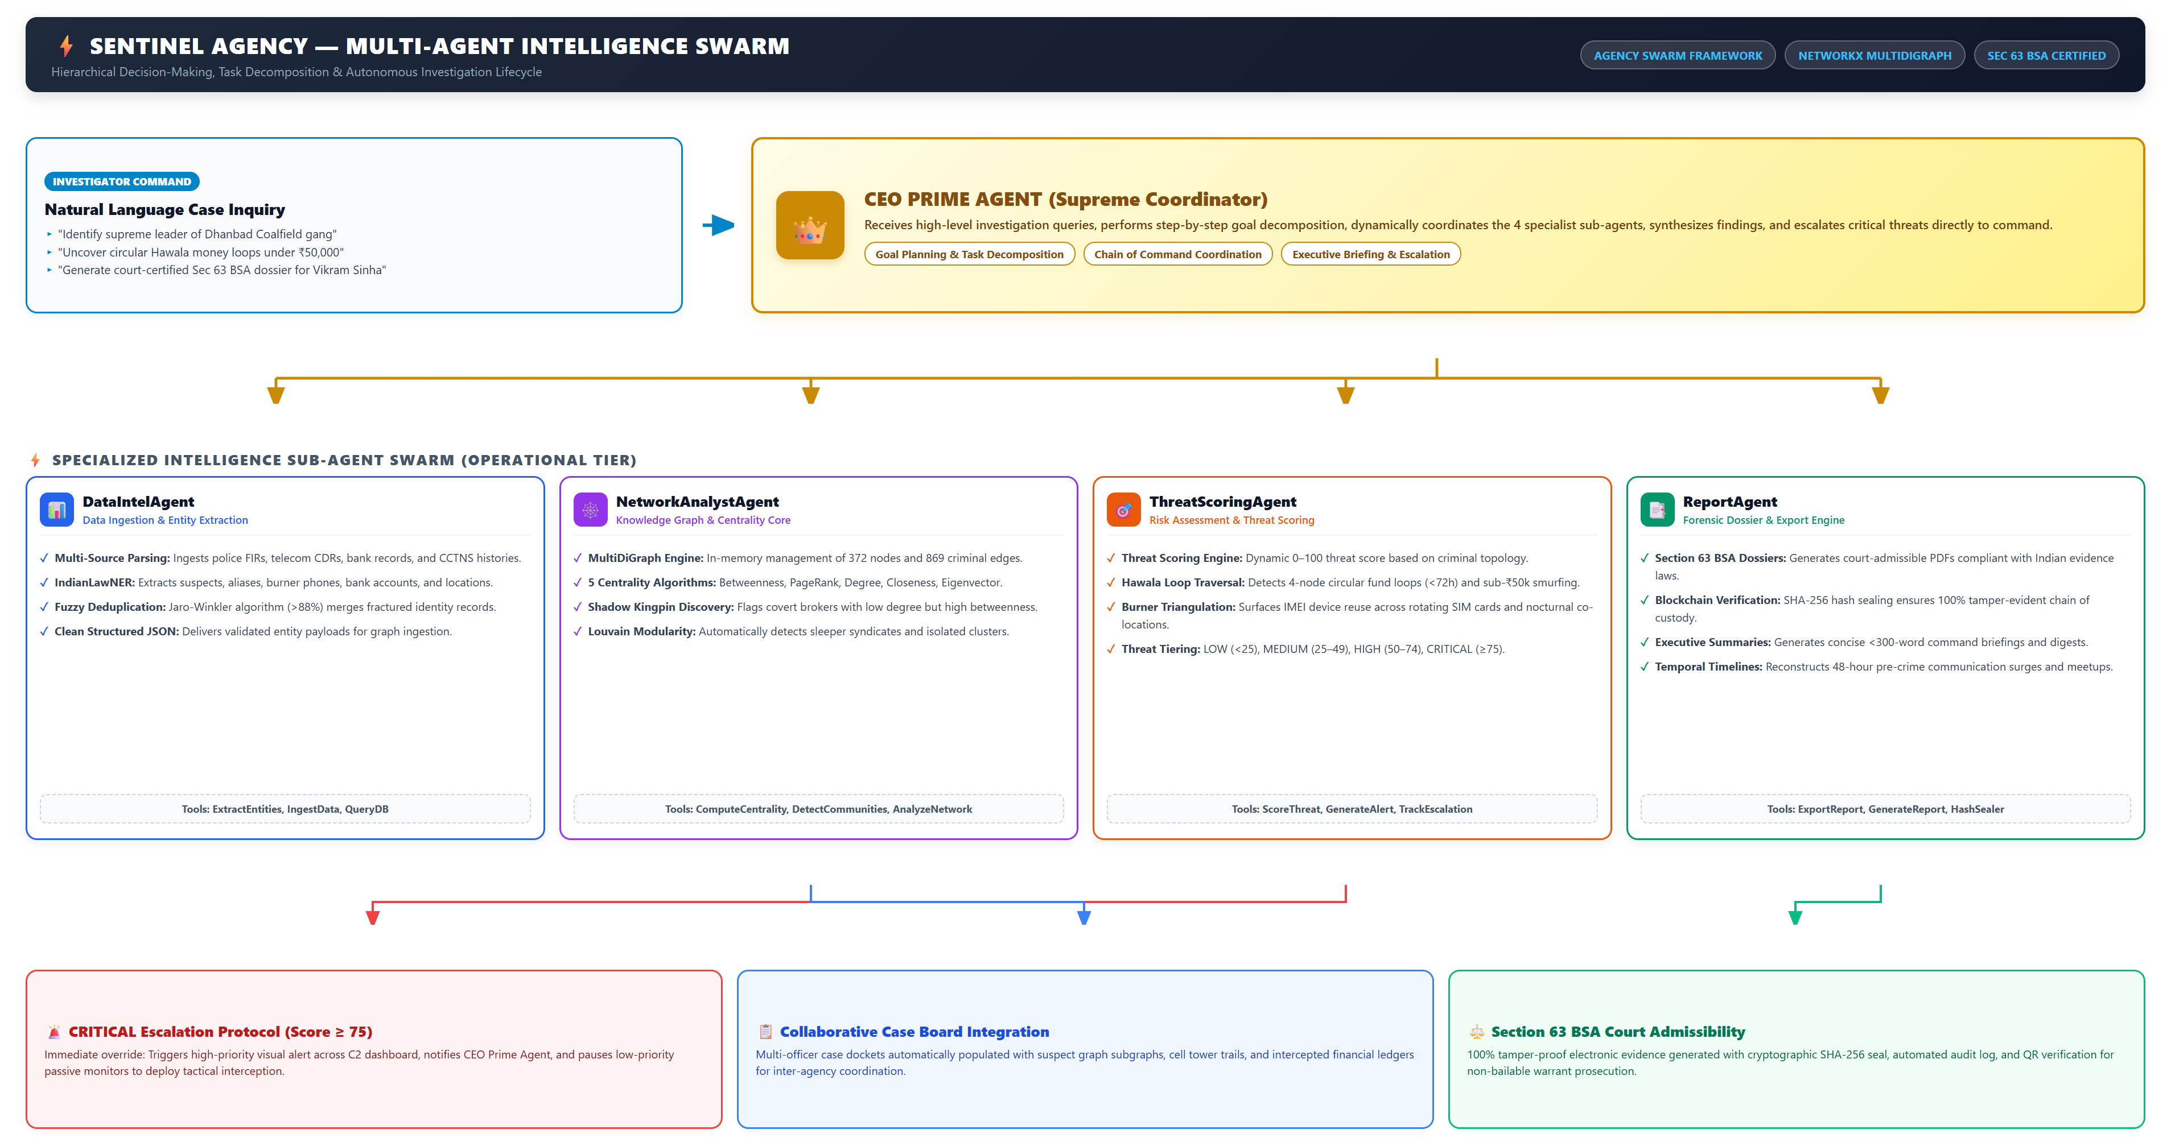
TECHNICAL APPROACH
STRYKER
@SIH Idea submission- Template
5

Slide 6
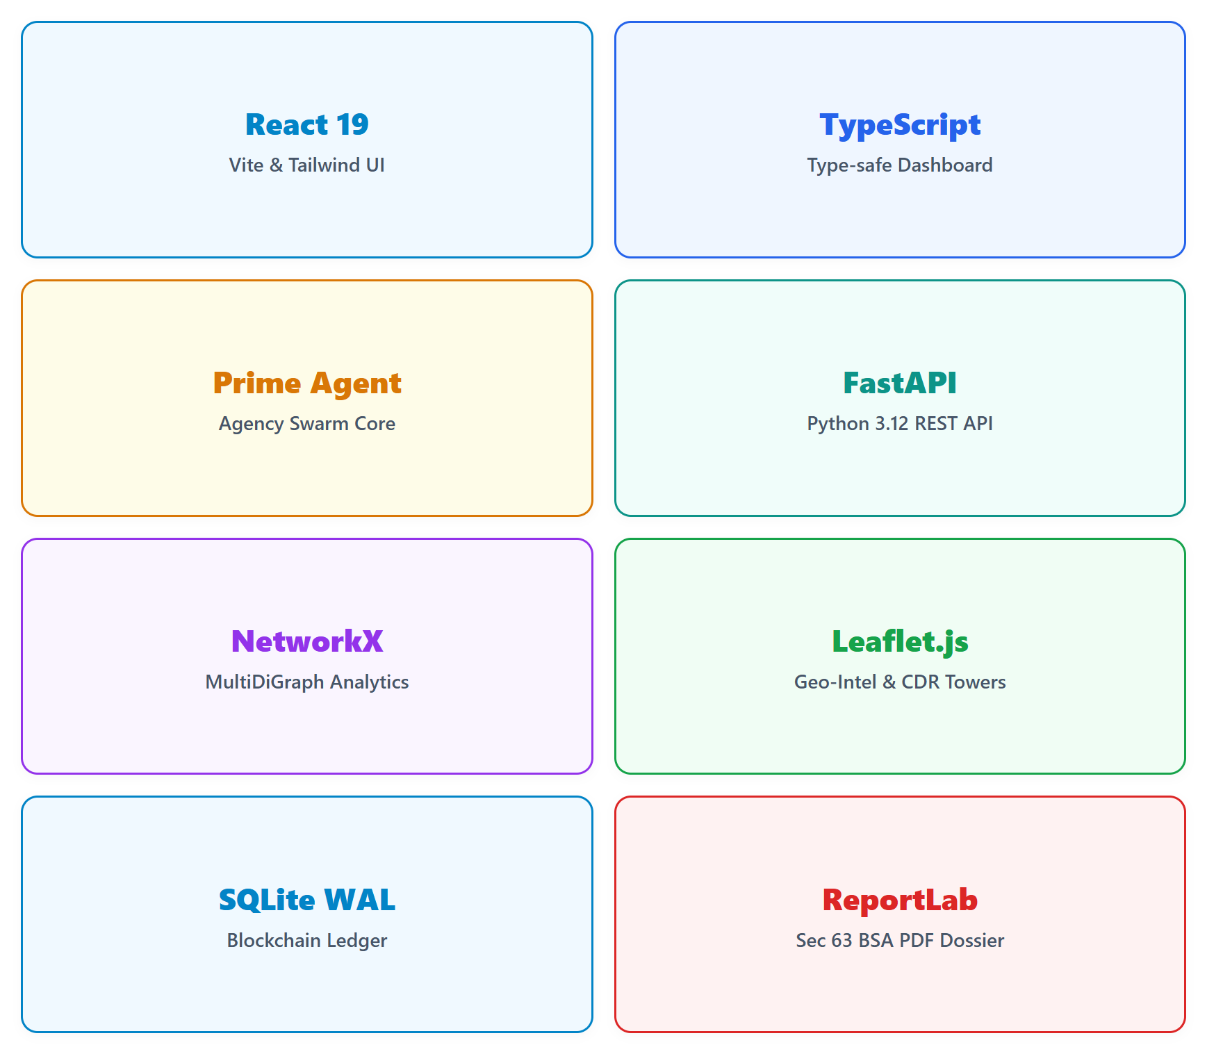
TECH STACK
STRYKER
Frontend Dashboard :
• React 19, TypeScript, Vite – High-performance responsive tactical UI built for police control room command.
• Tailwind CSS – Low-light dark tactical theme reducing officer eye fatigue.
• Cytoscape.js & Leaflet.js – Interactive 2D/3D suspect graph networks and geo-spatial cell tower tracking.
Backend + Intelligence Core :
• FastAPI (Python 3.12) – Ultra-fast asynchronous REST APIs with sub-millisecond query latency.
• NetworkX MultiDiGraph – In-memory graph engine managing 372 nodes, 869 edges and centrality metrics.
• SQLite WAL + Blockchain Hash Chain – Thread-safe data storage with SHA-256 evidence sealing.
• Agency Swarm & spaCy NLP – CEO Prime Agent multi-agent orchestration & automated IndianLawNER entity extraction.
Statutory Legal Vault :
• ReportLab Forensic Engine – Generates court-certified Section 63 BSA dossiers with QR code verification.
@SIH Idea submission- Template
6

Slide 7
FEASIBILITY AND VIABILITY
STRYKER
Technical Feasibility
• Uses proven open-source frameworks – FastAPI, React 19, NetworkX
• Direct compatibility with police CCTNS and telecom CDR exports
• Prime Agent multi-agent swarm runs efficiently on standard workstation CPUs / GPUs
• Cryptographic SHA-256 ledger ensures 100% zero-gas data integrity
Economic Feasibility
• Zero expensive software licenses or cloud vendor lock-in
• Directly leverages existing police CCTNS infrastructure, telecom CDR logs & standard department PCs
• Compresses weeks of manual investigative analysis into seconds
• Drastically reduces police manpower costs during major syndicate probes
“The solution is technically robust, low-cost, and operationally practical—enabling law enforcement to dismantle organized crime syndicates faster through autonomous multi-agent intelligence.”
Challenges & Strategies
• Unstructured Police Data – FIRs contain spelling mistakes, slang, and varied dialects. Solved via AI Named Entity Recognition + Jaro-Winkler fuzzy deduplication (>88%).
• Massive CDR & Financial Scale – Correlating millions of call records without lag. Solved via in-memory graph caching & SQLite WAL indexing for sub-millisecond lookups.
@SIH Idea submission- Template
7

Slide 8
IMPACT AND BENEFITS
STRYKER
Law Enforcement & Police Officers
• 1-click network expansion reveals 2-hop associates, burner phones, and money trails.
• Automatically identifies shadow kingpins who never make direct phone calls.
• Collaborative case board eliminates inter-departmental communication delays.
Intelligence Analysts & Investigators
• CEO Prime Agent automates tedious cross-referencing across FIRs, CDRs, and bank ledgers.
• Multi-agent swarm auto-calculates threat scores (0-100) and uncovers hidden Hawala laundering loops.
• Cross-case linking surfaces shared burner phones, vehicles, and safehouses across jurisdictions.
Judiciary & Legal Prosecution
• 100% tamper-evident digital evidence meeting Section 63 BSA / 65B IEA standards.
• Court-ready forensic PDF dossiers accelerate trials and eliminate chargesheet delays.
“SENTINEL transforms fragmented crime records into real-time operational clarity—unmasking shadow kingpins, disrupting criminal syndicates, and accelerating the delivery of justice.”
@SIH Idea submission- Template
8

Slide 9
STRYKER
THANK YOU
SENTINEL v2.0 – AI-Powered Criminal Network Analysis System
Team Stryker • Problem Statement ID: 26189
Open for Questions & Live System Demonstration
@SIH Idea submission- Template
9

