Slide 1
Data Exploration and Analysis
Vishnu Kolluri
Bellevue University
21302046
DSC530
Term Project Presentation

Slide 2
IBM HR Attrition Case Study
The IBM HR Attrition Case Study is a fictional dataset that aims to identify important factors that might be influential in determining which employee might leave the firm and who may not. This presentation provides an in-depth analysis of what factors affect employee attrition.
Variables in the dataset:1470 observations (rows), 35 features (variables)

Slide 3
IBM HR Attrition Case Study
Variables:
Age: Employee age numerical value
Monthly Income: Salary
Years at Company: Total years worked in the company
DISTANCE FROM HOME: Distance from work to home
Gender

Slide 4
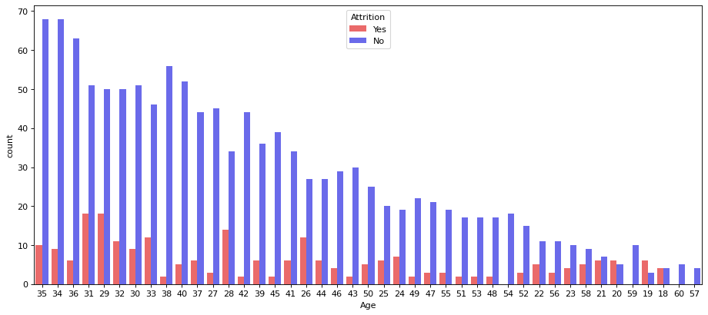
Histogram for age

Slide 5
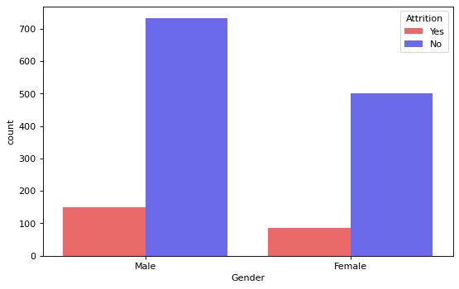
Histogram for Gender

Slide 6
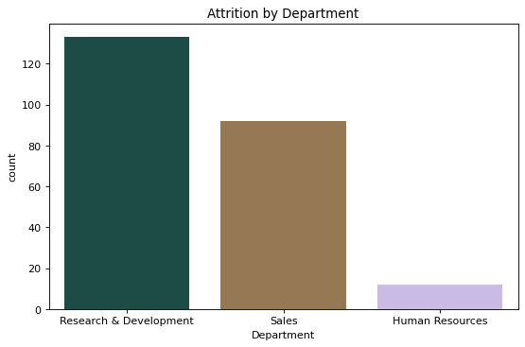
Histogram for Department

Slide 7
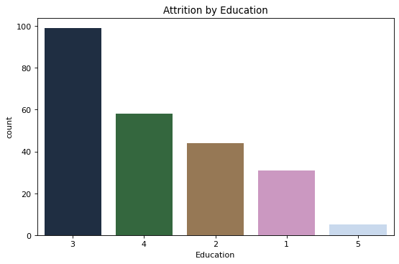
Histogram for Education

Slide 8
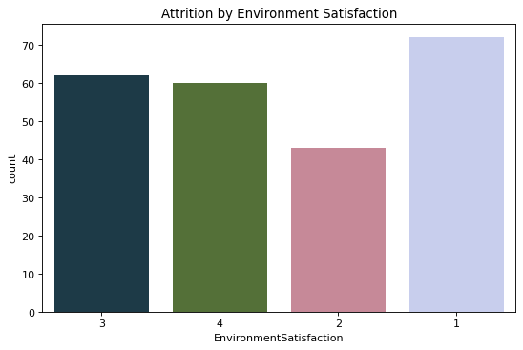
Histogram for Environmental satisfaction

Slide 9
Descriptive characteristics about the variables
count | mean | std | min | 25% | 50% | 75% | max
Age | 1470.0 | 36.923810 | 9.135373 | 18.0 | 30.00 | 36.0 | 43.00 | 60.0
DailyRate | 1470.0 | 802.485714 | 403.509100 | 102.0 | 465.00 | 802.0 | 1157.00 | 1499.0
DistanceFromHome | 1470.0 | 9.192517 | 8.106864 | 1.0 | 2.00 | 7.0 | 14.00 | 29.0
Education | 1470.0 | 2.912925 | 1.024165 | 1.0 | 2.00 | 3.0 | 4.00 | 5.0
EmployeeNumber | 1470.0 | 1024.865306 | 602.024335 | 1.0 | 491.25 | 1020.5 | 1555.75 | 2068.0

Slide 10
PMF on Gender

Slide 11
PMF on Age

Slide 12
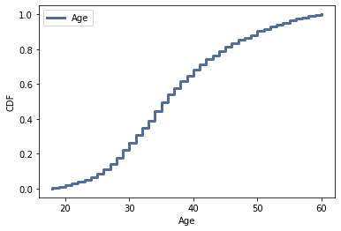
CDF on Age

Slide 13
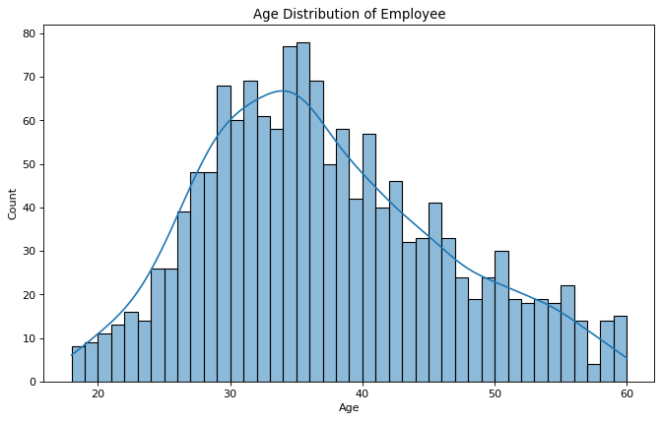
Age distribution of Employees

Slide 14
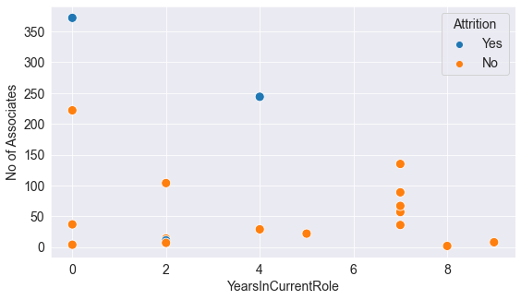
Scatter plot
Most of the employees with less than 2 years in current role, attrited
Also, there are a high number of employees with approx 4 years of working, attrited.
This may illustrate the pattern of the employees stay at the company and wait until their promotion while start looking for opportunities outside as mentioned above & the employees with approx 4 years of working tend to attrite based on the desire to change workplace, jobrole or occupancy

Slide 15
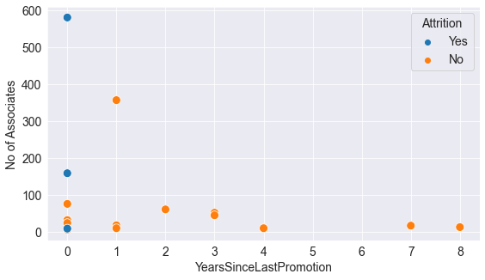
Scatter plot
All of the employees who got promoted within less than 1 year, attrited
This may illustrate the pattern of the employees staying at the company and waiting until their promotion while start looking for opportunities outside

Slide 16
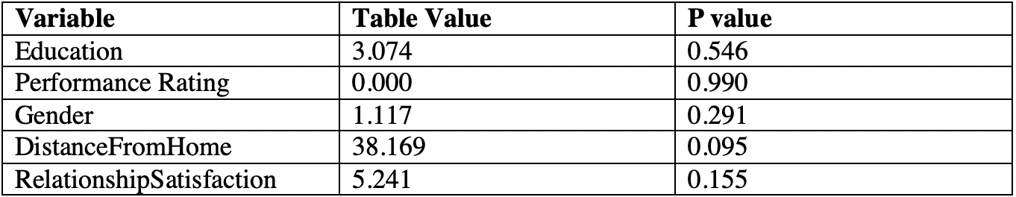
Chi-Square Test

Slide 17
Logistic Regression
accuracy= 82.6086956521739 %
precision recall f1-score support
Yes 0.83 1.00 0.90 302
No 1.00 0.03 0.06 66
accuracy 0.83 368
macro avg 0.91 0.52 0.48 368
weighted avg 0.86 0.83 0.75 368

