Slide 1
PROJECT TITLE & TEAM
Wildfire Alert System
Team Members:
1.Nagarjuna bonthu - EEE, 4th Year
2.Vishnu Kumar – CSE, 4th Year
3.Shameer – EEE, 4th Year
4.Babaiah – EEE, 4th Year

Slide 2
PROBLEM STATEMENT
Wild fires cause great lose to both vegetation and wildlife leaving mankind in grief over the inability to face them. As the causes behind these fires are mixed and complex we cannot completely curb them. Forests are not completely inhabited and it is not possible to sense any fire in the deep forests until it devastate millions of hectares.
Even when we try to equip surveillance like systems , we end up with the network availability limitations in the deep forests so that our sight of preparedness reaches only to the edges of the forests.
Due to these limitations we are unable to respond to these wildfires quickly unless the destruction takes its worst shape.

Slide 3
SOLUTION
This is a sensing and reporting system which consists of individually operating nodes placed in a matrix mdel across the forest. Each node stores its own address and can only communicate with its adjacent nodes only via short range radio channel which operates on requirement only.
Every node is embedded with sensing devices,microcontroller and radio network adapters and EMP transmitter and detector.
On detection of any fire , the respective node immediately activates the adjacent nodes using EMP transmitter and transmits its own address to all its adjacent nodes. The adjacent nodes in-turn transmit the same address to their adjacent nodes. This process repeats till the address of fire incident reaches central cloud system.
This process doesn't need any dedicated network system as each node communicates with its adjacent ones only.

Slide 4
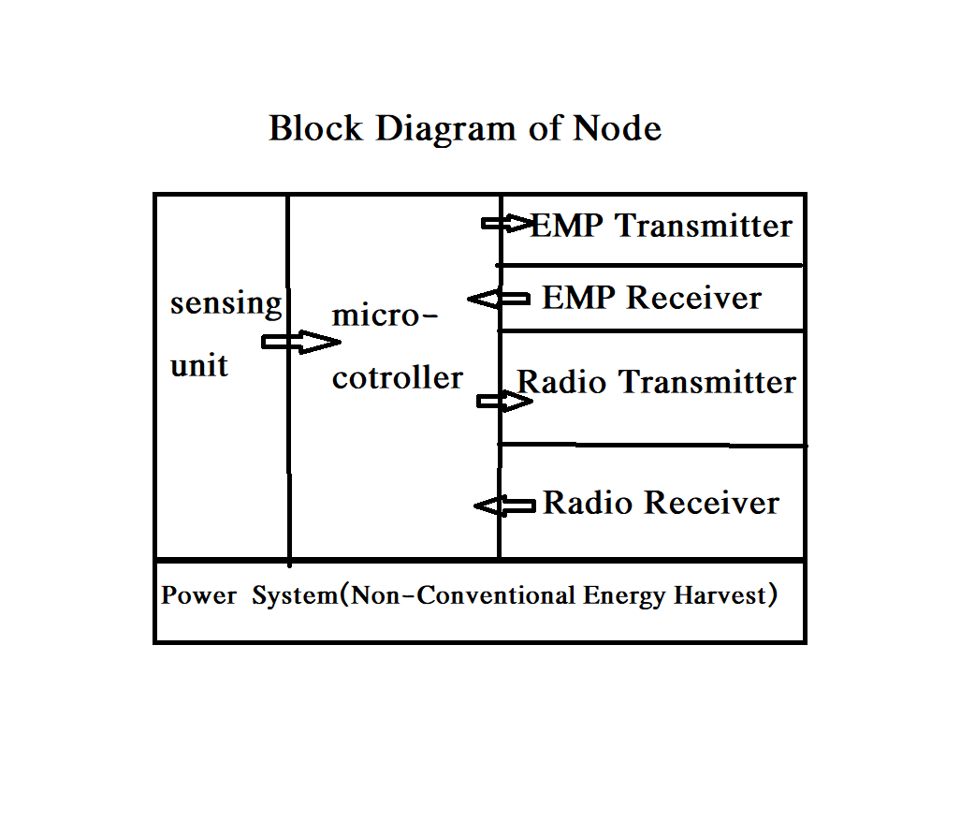
PROTOTYPE BLOCK DIAGRAM

Slide 5
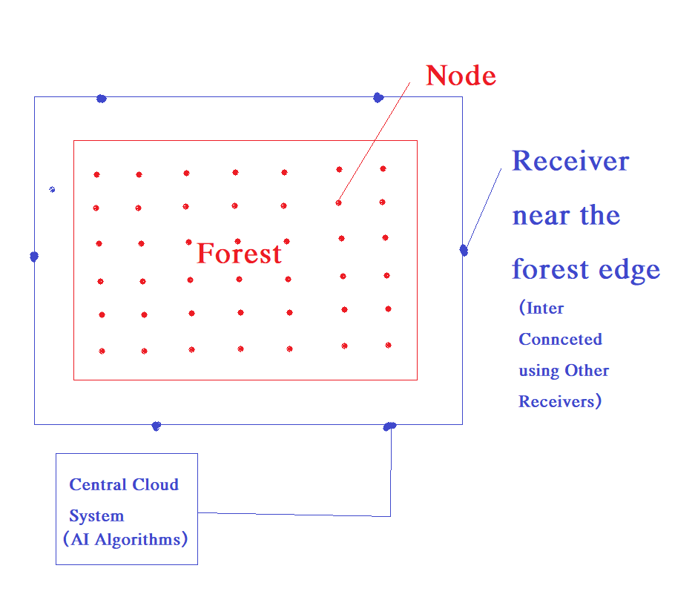
PROTOTYPE BLOCK DIAGRAM

Slide 6
TECHNOLOGY STACK
1. Micro-Controller
2.EMP Generator
3.EMP Receiver
4.Radio Transmitter and Receiver Unit
5.Power Source
6.Flame Sensors

Slide 7
CHALLENGES
POWER –A Challenge
Like any other method this system also has challenges. One of such challenge is that the Power supply for the Nodes in the forest. As there is no practical way to supply power for each node they should be equipped with suitable batteries chargeable with non-conventional methods like wind , Piezoelectric feeders , Solar etc..
The Radio transmission units of each module will be in off mode to save the power and gets activated once any EMP pulse hits the detector. This minimises the power requirement to great extent and overall power demand falls below 15ma at 12V.

Slide 8
CONTACT US
Name: Nagarjuna Bonthu
Mobile No:9849084596
Email ID: nsnagarjuna8@gmail.com
Name: Puttaparthi Vishnu Kumar Reddy
Mobile No: 9908971155
Email ID: vishnukumar650@gmail.com
Name: Shaik Shameer
Mobile No:9642760298
Email ID: shaikshameer1997@gmail.com
Name: Nagaruru Babaiah
Mobile No:8639507473
Email ID:babanagaruru@gmail.com

