Slide 1
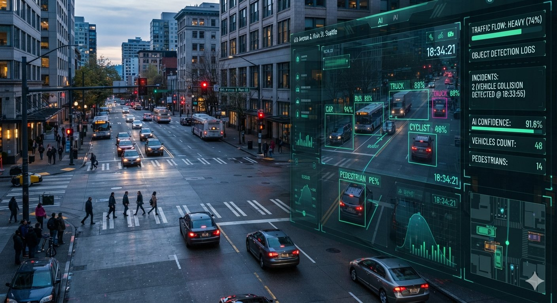
AI-POWERED TRAFFIC FLOW OPTIMIZATION SYSTEM
Congestion Reduction and Adaptive Traffic Signal Timing Using YOLO and SUMO Simulation
Submitted by:
V. Vishnu Lavanya Supraja
Roll No.: 24F01A4264
Department of CSE-AIML
St. Ann's College of Engineering and Technology, Autonomous
Academic Year: 2026–2027

Slide 2
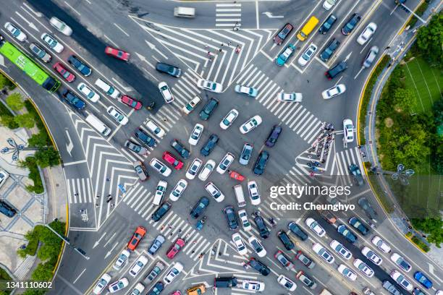
Introduction
Traffic congestion is a major problem in urban areas.
Increasing vehicle numbers lead to delays, fuel consumption and vehicle waiting time.
Traditional traffic signals generally use fixed timing plans.
Fixed timings may not respond effectively to changing traffic conditions.
AI and computer vision can help analyze traffic conditions and support adaptive signal control.
This project combines YOLO11n, vehicle counting, congestion classification, adaptive signal timing and SUMO simulation.

Slide 3
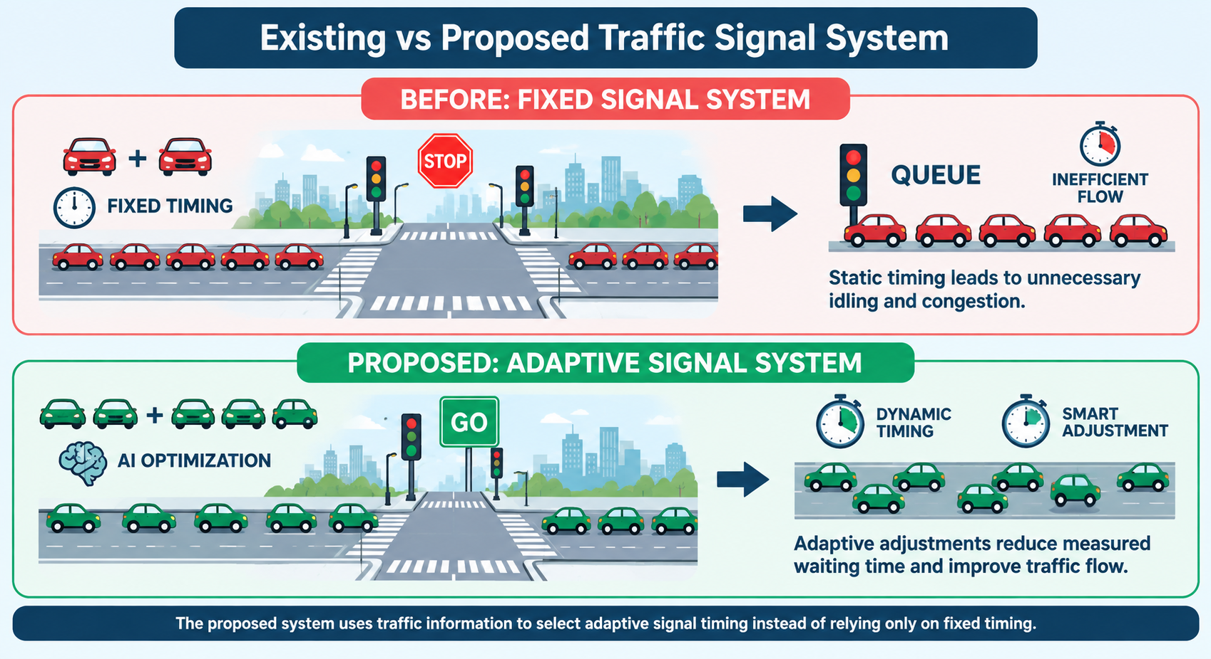
Problem Statement
Existing fixed-time traffic signals have a major limitation:They cannot dynamically respond to changing traffic demand.
Problems:
Same or similar green time may be given to different traffic directions.
Lightly loaded roads may receive unnecessary green time.
Congested roads may continue to experience long queues.
Vehicle waiting time can increase.
Real-time traffic information is not effectively utilized.
Our Approach:
Detect → Count → Analyse → Adapt Signal Timing

Slide 4
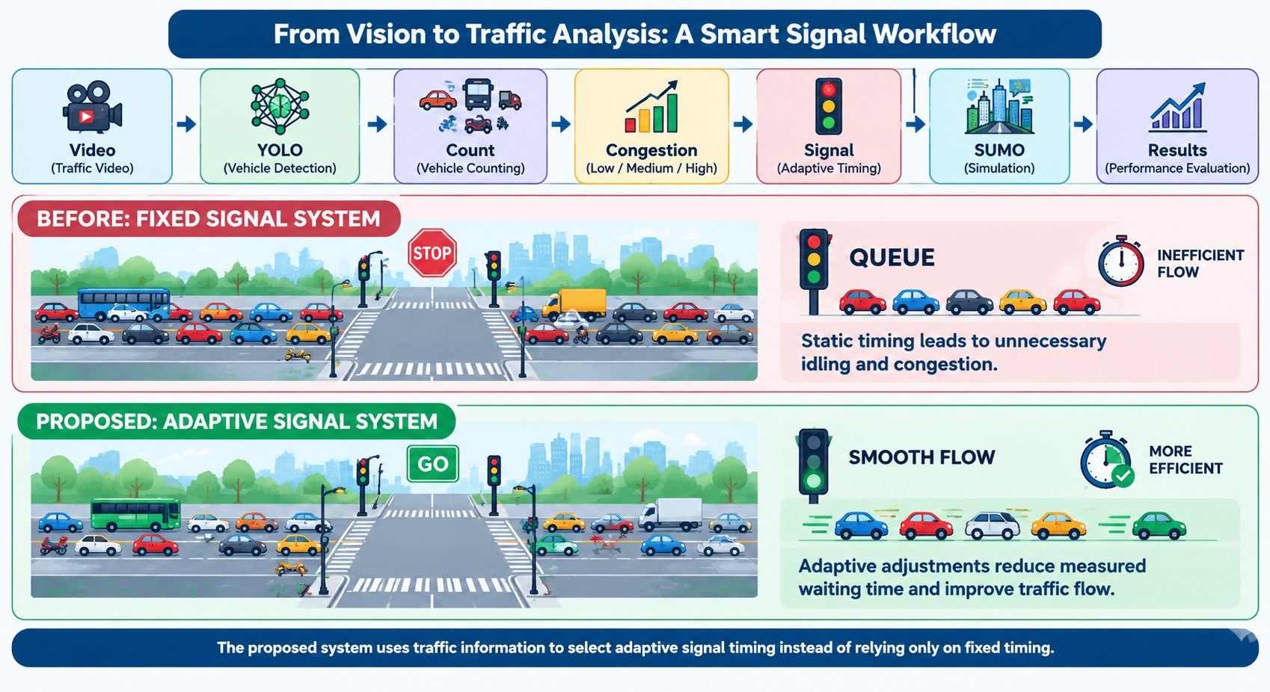
Project Objectives:
Detect vehicles from traffic video using a pretrained YOLO model.
Count cars, motorcycles, buses and trucks.
Classify traffic into LOW, MEDIUM and HIGH congestion.
Select suitable green-light duration.
Connect Python traffic logic with SUMO using TraCI.
Compare fixed and adaptive signal behaviour.
Measure waiting-time results from the simulation.
🎥 Video → 🤖 YOLO → 🚗 Count → 📊 Congestion → 🚦 Signal → 🖥️ SUMO → 📈 Results

Slide 5
Proposed AI-Based System:
The proposed system uses AI and computer vision to make traffic signal control more adaptive.
Main Process:
Traffic Video
↓
YOLO11n Vehicle Detection
↓
Vehicle Counting
↓
Congestion Classification
↓
Adaptive Green-Time Selection
↓
SUMO Simulation
↓
Performance Evaluation

Slide 6
Technologies & Tools
Technology | Purpose
Python | Processing and control logic
YOLO11n | Vehicle detection
OpenCV | Video/computer vision processing
PyTorch | Deep-learning framework
SUMO | Traffic simulation
TraCI | Python–SUMO communication
Visual Studio Code | Development

Slide 7
YOLO VEHICLE DETECTION:
Vehicle Detection Using YOLO11n:
The project uses the pretrained YOLO11n model.
YOLO detects objects in individual traffic-video frames.
Bounding boxes and class information are generated.
Relevant vehicle classes are counted.
Traffic lights and other non-vehicle objects are excluded from the vehicle count.
Vehicle Classes:
🚗 Car
🏍️ Motorcycle
🚌 Bus
🚚 Truck

Slide 8
CONGESTION CLASSIFICATION:
Traffic Congestion Classification:
The detected vehicle count is converted into a traffic-congestion level.
Vehicle Count | Congestion | Green Time
0–5 | LOW | 20 sec
6–10 | MEDIUM | 40 sec
11+ | HIGH | 60 sec

Slide 9
SUMO SIMULATION:
Traffic Simulation Using SUMO:
SUMO — Simulation of Urban Mobility:
A four-way intersection was created.
A traffic signal was placed at the center.
Four main traffic directions were simulated.
Vehicle flows were generated for 300 seconds.
Python communicates with SUMO using TraCI.
Signal timing can be modified during the simulation.
ADAPTIVE SIGNAL CONTROL:
Adaptive Traffic Signal Logic: The system changes the green-light duration according to traffic conditions.
Logic:
Vehicle Count
⬇
Congestion Level
⬇
Green-Light Duration
Example:
LOW → 20 sec
MEDIUM → 40 sec
HIGH → 60 sec

Slide 10
Advantages
AI-based vehicle detection
Adaptive response to simulated traffic demand
Combines computer vision and traffic simulation
Modular Python implementation
Provides measurable simulation results
Can be extended to real-time camera feeds
Conclusion
The project demonstrates a practical prototype for adaptive traffic signal control.
YOLO11n is used for vehicle detection and vehicle counting.
Traffic conditions are classified into LOW, MEDIUM and HIGH.
Green-light duration is selected according to the detected traffic condition.
SUMO and TraCI are used to simulate and evaluate traffic-control behaviour.
In the implemented scenario, adaptive control reduced measured waiting time from 2600 seconds to 2376 seconds.
This represents a 224-second / 8.62% reduction for the selected simulation scenario.

Slide 11
THANK YOU

