Slide 1
Brain Tumor Classification Using Machine Learning
Akshay Anthony, Vishnu, Mathew Rohit Thomson, Shreyas Misra
Notes:
Main title: 40 pt. Arial
Presenter Name: 16 pt. Arial
Presenters Title: 16 pt. Arial Italic

Slide 2
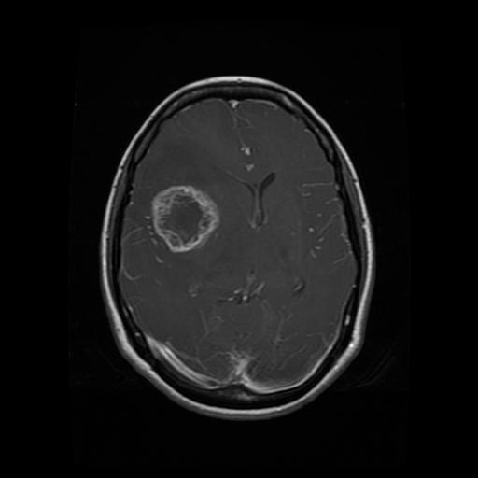
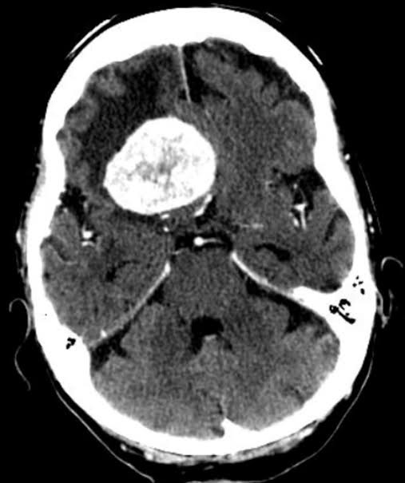
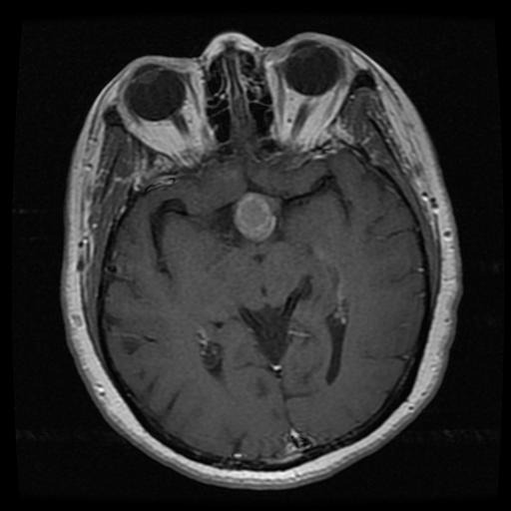
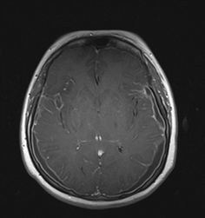
Problem Statement & Dataset
Motivation: Detecting and classifying brain tumors at an early stage is an important and accordingly helps in selecting the most convenient treatment method to save patients' lives. Machine Learning provides a fast and accurate solution for this problem.
Goal: To classify around 7000 brain MRI images into 4 different classes. Compare 3 different ML models and feature extraction methods, and benchmark the results with proven CNN architectures.
Dataset: Obtained from Kaggle.
Glioma
Meningioma
Pituitary
No tumor

Slide 3
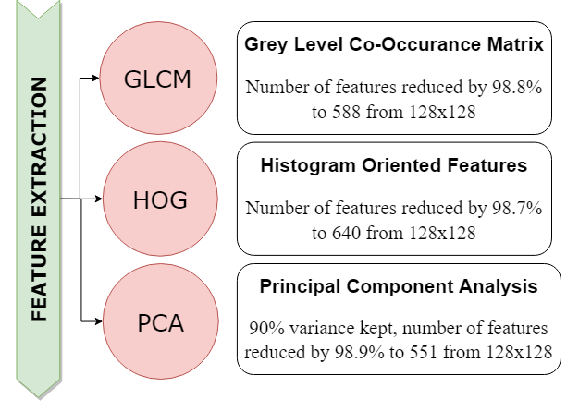

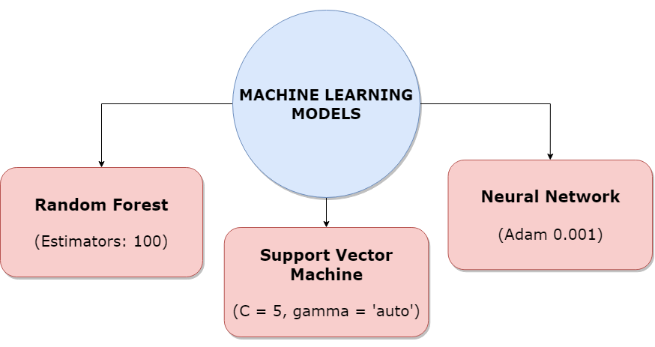
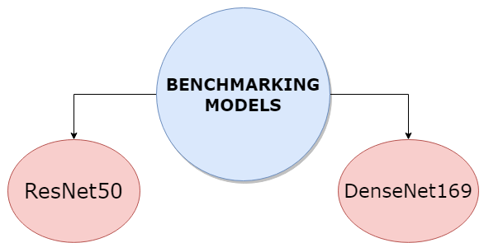
x3
x3
EigenBrains: 10 principal components.
Example of a HOG Image.

Slide 4
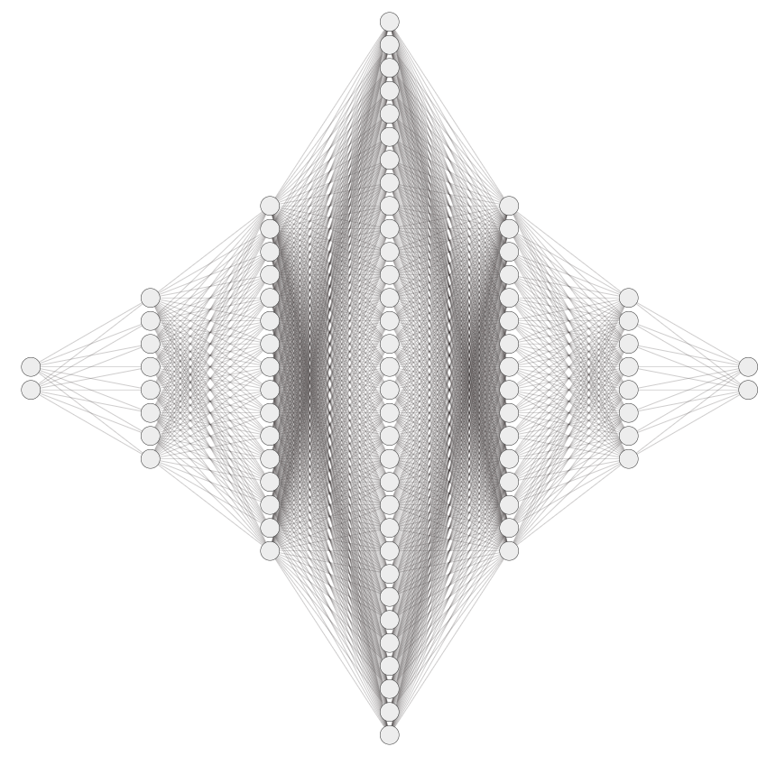
Neural Network Architecture
inputs
Outputs (SoftMax)
*Note: Each layer is scaled down by 16. The actual network contains 16 times the # neurons in each hidden layer shown in the diagram.

Slide 5
Results: Accuracy
 | Random Forest |  | SVM |  | Neural Net
 | Train acc | Test acc | Train acc | Test acc | Train acc | Test acc
GLCM | 100 | 84.1 | 99.78 | 84.51 | 98.6 | 91.7
HOG | 100 | 92.88 | 99.81 | 95.08 | 95.66 | 90.68
PCA | 100 | 89.98 | 99.92 | 94.6 | 98.77 | 92.88
HOG + PCA | 100 | 92.4 | 100 | 96.1 | 99.16 | 91.95
 | ResNet50 | DenseNet169
Train acc (%) | 99.33 | 99.9
Test acc (%) | 93.02 | 99.214

Slide 6
Results: False Positives and Negatives
Conclusion –
Features are orientation invariant, thus, producing high accuracy.
HOG+PCA combination can be trained on SVM to get maximum test accuracy (96%) and Recall score (0.96).
Extracted features produce results close to CNNs with low computational cost and hence, are a better option for clinics and hospitals that don’t have access to high computational resources.

Slide 7
Results & Conclusion
 | Random Forest |  | SVM |  | Neural Net
 | Train acc | Test acc | Train acc | Test acc | Train acc | Test acc
GLCM | 100 | 84.1 | 99.78 | 84.51 | 98.6 | 91.7
HOG | 100 | 92.88 | 99.81 | 95.08 | 95.66 | 90.68
PCA | 100 | 89.98 | 99.92 | 94.6 | 98.77 | 92.88
HOG + PCA | 100 | 92.4 | 100 | 96.1 | 99.16 | 91.95
 | ResNet50 | DenseNet169
Train acc (%) | 99.33 | 99.9
Test acc (%) | 93.02 | 99.214
Conclusion –
Features are orientation invariant, thus, producing high accuracy.
HOG+PCA combination can be trained on SVM to get maximum test accuracy (96%) and Recall score (0.96).
Extracted features produce results close to CNNs with low computational cost and hence, are a better option for clinics and hospitals that don’t have access to high computational resources.

Slide 8
Extras

