Slide 1
PROJECT OVERVIEW
Efficient Text Recognition
Reading printed and handwritten text from images with one CNN and three interchangeable “readers”: BiLSTM, Transformer and Mamba. All three are trained from scratch on the same data and compared on the same test lines.
CNN + BiLSTM
CNN + Transformer
CNN + Mamba
Best result: CNN + Mamba, 7.4% wrong characters on handwriting, 1.6% on print
Notes:
This deck explains what the project does, how each step works, and how the three model designs the client asked about compare. Everything shown comes from the real code and the real trained models; the pictures are produced by tools/make_figures.py from the project itself.

Slide 2
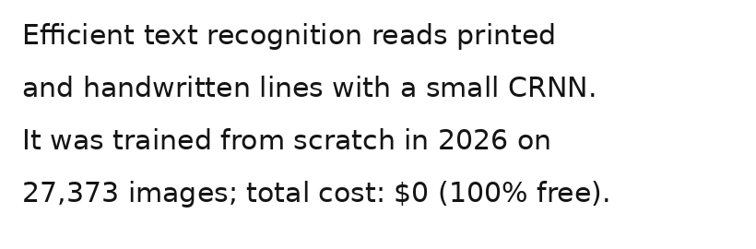
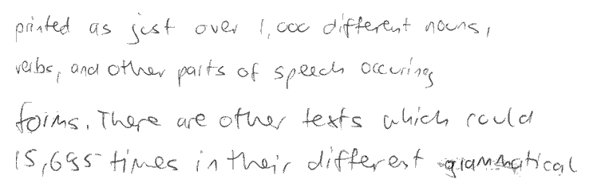
Turn a picture of text into text you can edit
THE PROBLEM
PRINTED · IN
HANDWRITTEN · IN
TEXT · OUT
TEXT · OUT
Efficient text recognition reads printed
and handwritten lines with a small CRNN.
It was trained from scratch in 2026 on
27.373 images; total cost: $0 (100% free) .
pinted as just over l ,oo diftereut nous ,
veibs , and other parts of speech occuring
foims , There are other texts which rould
(S,66s-timec in their different ygramsatical
Real output of the original model (CNN + BiLSTM). Printed text is nearly perfect; handwriting is readable but has about one wrong character in eleven.
Notes:
Two kinds of input. Printed text in any font, and real handwriting from about 650 different writers (the IAM database). On the left, the model gets almost everything right; the only mistakes are a comma read as a full stop and a stray space. On the right, handwriting is much harder: “printed” became “pinted”, “1,000” became “l ,oo”. That gap between printed and handwritten accuracy is what the rest of the project tries to close.

Slide 3
The CNN stays. Only the reader after it changes.
THE CLIENT BRIEF
HOW THE BRIEF READS
HOW OCR ACTUALLY WORKS
Try one method, switch if it fails
Same eyes, three different readers
Start with a CNN. If it does not work well enough, use a Transformer instead. Then try Mamba or diffusion.
This suggests each method replaces the one before.
Every modern OCR model starts with a CNN that looks at the pixels. A sequence model then reads its output left to right: a BiLSTM, a Transformer or Mamba.
We build all three on one shared CNN and measure them on the same test lines. Diffusion creates images and does not read them, so it fits at the data step (slide 14).
Notes:
This is the most important slide for the client conversation. The brief describes a chain: CNN, then if that fails a Transformer, then Mamba or diffusion. In practice the CNN is the feature extractor in every one of these designs, including Transformer and Mamba OCR models. What differs is the sequence model on top of it. So the honest version of the requirement is a fair three-way comparison: same CNN, same data, same training budget, same test lines, and only the reader changes. Diffusion is a different kind of model: it generates images. It can help OCR by making extra training handwriting or by restoring bad scans, but it is not the part that reads the text.

Slide 4
Six steps from picture to text
HOW IT WORKS
1
2
3
4
5
6
Clean
Find lines
Resize
CNN
Reader
CTC
Even out the paper, make text dark
Cut the page into text lines
Every line becomes 40 px tall
Pixels into one feature vector per column
BiLSTM, Transformer or Mamba reads in order
Column guesses into the final text
Steps 1–3: fixed image processing, no learning
Steps 4–6: the neural network, learned from data
Only step 5 differs between the three models. Everything else is shared, so the comparison is fair.
Notes:
The whole system in one picture. Steps 1 to 3 are ordinary image processing written by hand: they make every input look like the training data. Steps 4 to 6 are one neural network trained end to end with the CTC loss. The CNN (step 4) and CTC (step 6) are identical in all three variants; only the reader in step 5 changes. The next slides walk through each step with real pictures from the project.

Slide 5
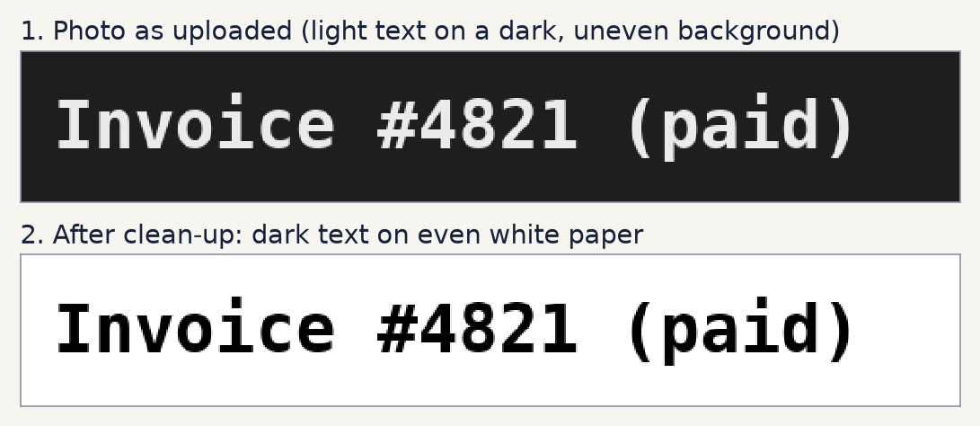
Make every photo look like dark ink on white paper
STEP 1 · CLEAN
1
Flip dark themes
If most of the image is dark, the colours are inverted so the text becomes the dark part.
2
Remove shadows
A blurred maximum filter estimates the paper brightness around every pixel; dividing by it evens out shadows.
3
Stretch the contrast
The darkest ink is pushed to black, so faint pencil and dark marker look alike.
Notes:
The network was trained on dark text on light paper, so every input is converted to look like that first. The code is in ocr/predict.py, function clean(). It checks the median brightness to decide whether to invert, estimates the paper colour with a shrink, max-filter and blur, divides the image by that estimate, then stretches the result so the darkest one percent of pixels becomes black. No learning is involved; it is plain image arithmetic with NumPy and Pillow.

Slide 6
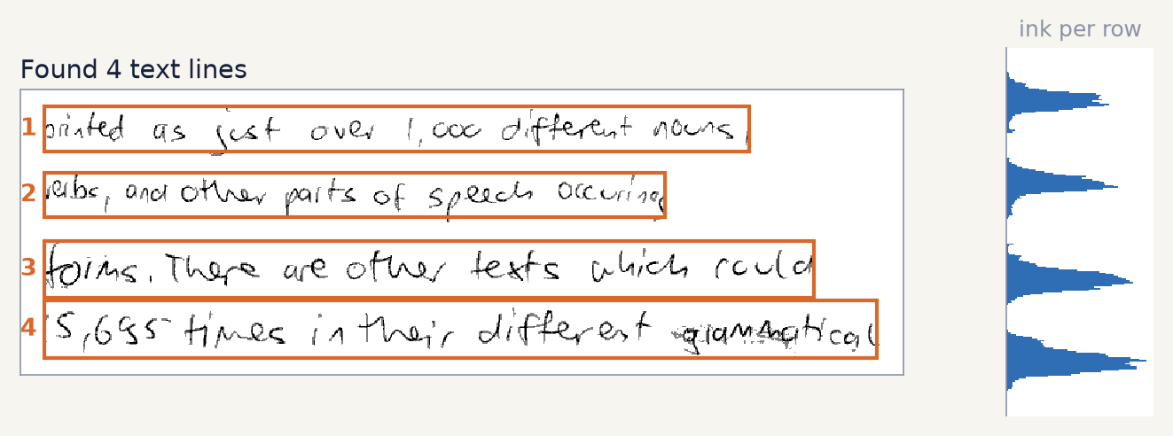
Cut the page into lines by counting ink per row
STEP 2 · FIND LINES
1
Ink profile
Otsu’s method picks a threshold between ink and paper; then the ink pixels in each row are counted (the blue chart).
2
Peaks are lines
Runs of busy rows become lines. Thin runs such as dots and accents are merged into the line next to them.
3
Room for tails
Each box grows a little so g, y and p keep their tails, then it is trimmed left and right to the ink.
Notes:
The recogniser reads one line at a time, so a page must be split first. ocr/predict.py, find_lines(), thresholds the cleaned page with Otsu’s method, counts ink pixels per row, and treats runs of rows above a small fraction of the typical peak as lines. Very short runs, such as the dots of i and j, are merged into the neighbouring line. This is simple and fast, and it is also the main limit of the project: it expects straight lines in a single column.

Slide 7
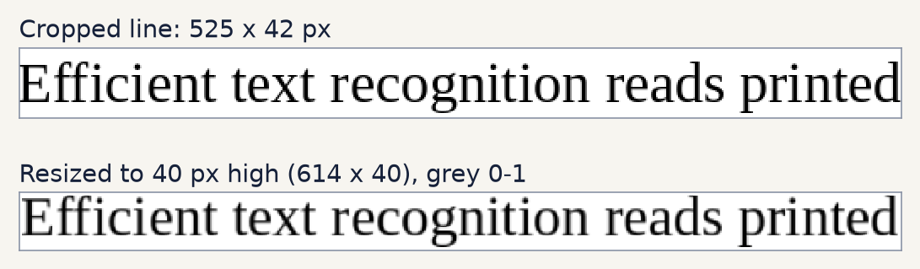
Every line becomes 40 pixels tall, whatever its width
STEP 3 · RESIZE
1
Fixed height
The network expects 40-pixel lines, so each line is scaled to 36 px plus a 2 px white border.
2
Any width
The aspect ratio is kept, so a long line simply gives the model more columns to read.
3
Numbers, not pixels
Grey levels become values between 0 and 1, with ink as the high value.
Notes:
Neural networks need a fixed input shape in at least one direction. Here the height is fixed at 40 pixels and the width is free, because text lines vary in length. normalize_line() in ocr/dataset.py does this for both training and prediction, so the model always sees inputs prepared the same way.

Slide 8
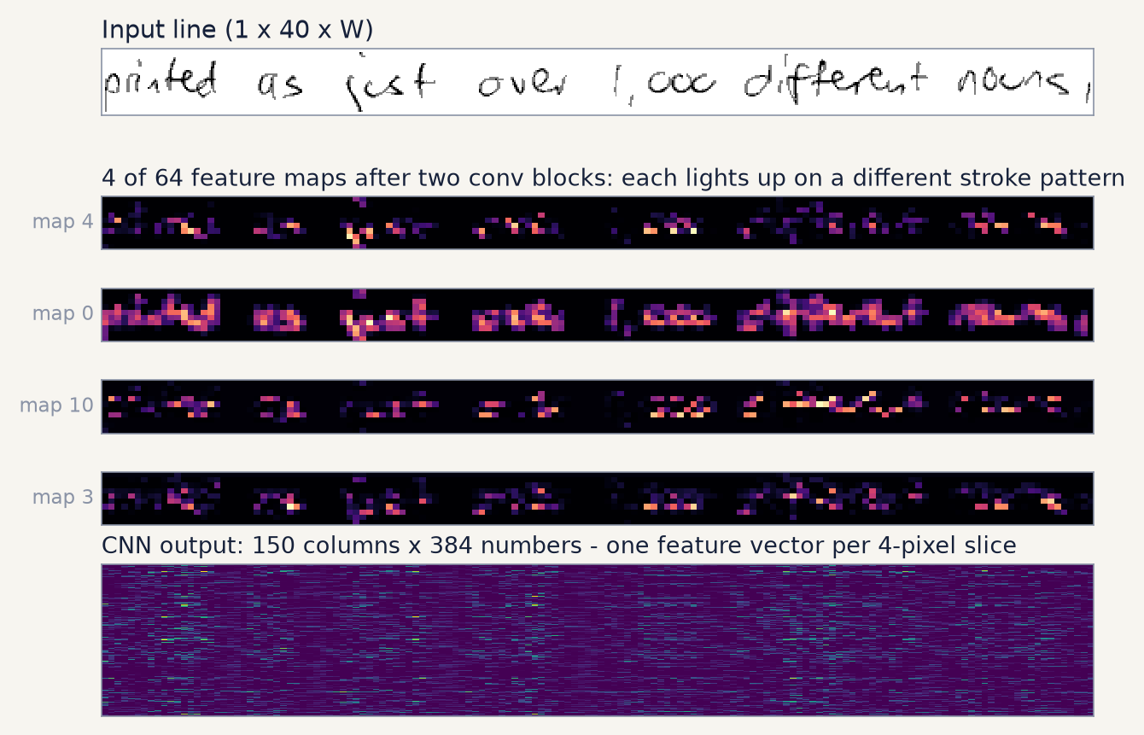
The CNN turns pixels into one feature vector per column
STEP 4 · CNN, THE EYES
1
5 convolution layers
Small 3×3 filters (32 up to 192 of them) learn to respond to edges, curves, loops and stroke ends.
2
Pooling shrinks it
Height goes 40 → 2 and width shrinks by 4. Each 4-pixel slice of the line becomes one column.
3
384 numbers per column
192 filters × 2 rows describe what is drawn in that slice. This sequence goes to the reader.
Notes:
These are real activations from the trained model, not an illustration. The four magenta strips are feature maps after the second convolution block: each one has learned to fire on a different kind of stroke. The bottom image is the CNN’s final output for the whole line: 150 columns, each a vector of 384 numbers. The CNN only sees a small neighbourhood, so it recognises stroke shapes but not whole words. Putting letters in order is the job of the reader in step 5. This CNN is the same in all three model variants.

Slide 9
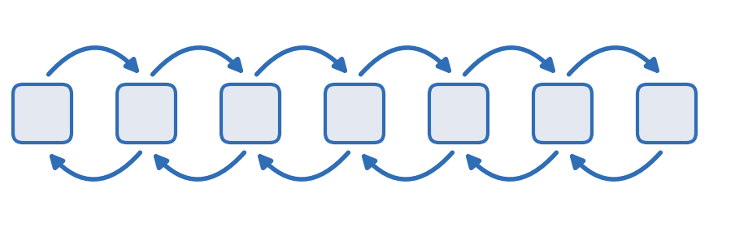
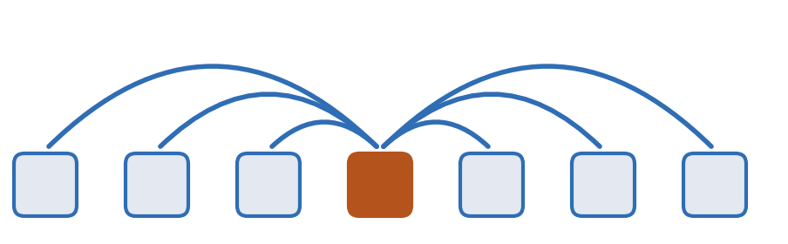
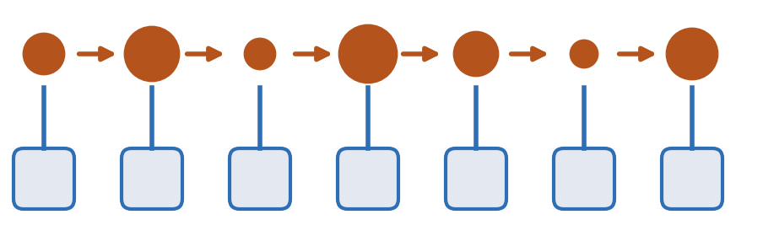
Three ways to read the columns in order
STEP 5 · THE READER: THE ONLY PART THAT CHANGES
BiLSTM
Transformer
Mamba
How: reads one column at a time, left to right and right to left, carrying a memory.
Good: small, learns well from little data; the classic OCR design since 2015.
Weak: steps run one after another, so it trains less in parallel.
How: every column looks at every other column at once (self-attention).
Good: fully parallel; the strongest design when pre-trained on huge data.
Weak: needs a lot of data, and its cost grows with length squared.
How: reads in order with a memory that chooses, per column, what to keep or forget.
Good: cost grows only linearly with length; trains in parallel.
Weak: new (2023–24) and less proven for OCR than the other two.
Notes:
All three take the same input, the CNN’s sequence of column vectors, and produce one output vector per column. The BiLSTM is the reader of the classic CRNN (2015) and is what the project originally shipped. The Transformer encoder (4 layers, 4 attention heads) lets every column attend to every other; it is what large OCR systems such as TrOCR use, but those are pre-trained on hundreds of millions of images. Mamba (6 layers) is a selective state-space model: like an LSTM it carries a memory along the line, but the update can be computed in parallel. The circle sizes show the memory keeping more or less at each step. Mamba reads one way, so every other layer reads backwards so each column sees both sides. All three are about 2 million parameters, so the comparison is fair.

Slide 10
A memory that decides what to keep, column by column
INSIDE MAMBA
h[t] = a[t]·h[t-1] + b[t]·x[t]
y[t] = c[t]·h[t]
57 s → 0.18 s
per training step. The first version stepped through the columns in a Python loop; the final one computes the same recurrence as one matrix product (Mamba-2’s “SSD” form).
h is the memory, x is the column from the CNN and y is what goes on to CTC.
Selective: a, b and c are computed from x itself. A space or a clear letter can wipe or keep the memory as needed. This is what Mamba adds to older state-space models.
4.5 → 1.3 GB
GPU memory, so it fits a 4 GB laptop GPU. A unit test proves both versions give the same output.
Notes:
The recurrence on the left is the whole idea. Like an LSTM, Mamba carries a hidden state along the line. The difference from older state-space models is that the decay Ā and the maps B̄ and C depend on the current input, so the model can choose to remember or forget. The official mamba-ssm package uses CUDA kernels that do not install on Windows, so the project has its own plain-PyTorch version. The first attempt looped over columns in Python: 57 seconds per training step and 4.5 GB of memory, more than the laptop GPU has. Rewriting the recurrence in its exact matrix form made it about 300 times faster. tests/test_model.py checks that the matrix form and the step-by-step loop give the same numbers.

Slide 11
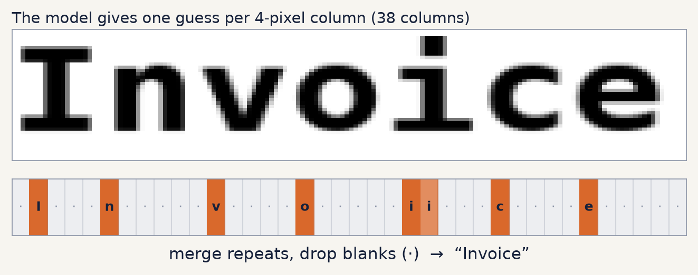
One guess per column, then merge and drop blanks
STEP 6 · CTC
1
84 choices per column
83 characters plus a special “blank” meaning “no new letter here”. Most columns are blank.
2
Decode
Merge repeated guesses (“i i” → “i”), then remove blanks. A blank between two l’s keeps the double l in “hello”.
3
Train without positions
The CTC loss adds up every alignment that spells the right text, so nobody marks where each letter is.
Notes:
This is the real output of the trained model on the word “Invoice”. The line is 38 columns wide, so the model makes 38 guesses. Most are blank (the grey dots). The two orange i’s next to each other merge into one i. Removing the blanks leaves “Invoice”. CTC (Connectionist Temporal Classification, Graves 2006) is what lets us train on images labelled only with their text. It is the same in all three model variants.

Slide 12
Same data, same recipe, same test lines for all three
TRAINING
10,373
17,000
240,000
~20 min
real handwritten lines by about 650 writers (IAM)
printed words in 170 fonts, joined into random lines
lines seen per model: 30 epochs × 250 batches × 32
per model on a laptop RTX 3050 GPU (hours on a CPU)
Augmentation
Optimiser
Fair test
Every line is randomly slanted, stretched, blurred, thickened or thinned, faded and given noise, so the model never sees the same image twice.
AdamW with a one-cycle learning rate (peak 0.001), gradient clipping and mixed precision on the GPU.
After every epoch: 960 held-out IAM lines and 1,920 printed lines. The best epoch is kept. Test lines are never trained on.
Notes:
The comparison is only meaningful if everything except the reader is identical, so all three use the same code path: ocr/train.py with the same data, augmentation, optimiser and schedule, the same number of steps and the same validation lines. Only the --arch setting differs. On the laptop GPU the Transformer took 21 minutes and Mamba 18 minutes; the original BiLSTM was trained earlier on a CPU with the same recipe (about 3 hours). Progress is saved after every epoch, so an interrupted run can be resumed.

Slide 13
Mamba reads best, on handwriting and on print
RESULTS
Model | Size | Handwriting wrong | Handwritten lines perfect | Printed lines perfect | Speed, ms per line
CNN + BiLSTM | 2.21 M | 8.9% | 15.9% | 80.1% | 3.1
CNN + Transformer | 2.28 M | 12.0% | 6.4% | 83.1% | 0.9 (fastest)
CNN + Mamba (best) | 1.89 M | 7.4% | 20.1% | 88.1% | 1.6
Notes:
Measured with python run.py --compare on the held-out lines: 960 handwritten IAM validation lines and 1,920 printed lines. Mamba is the most accurate and also the smallest model: about 17 percent fewer handwriting mistakes than the BiLSTM, one in five handwritten lines completely right, and almost nine in ten printed lines completely right. Its best epoch was the last one, so it was still improving. The Transformer is the fastest at prediction time but clearly the weakest on handwriting, which is expected for a Transformer trained from scratch on only about ten thousand handwritten lines. On printed text the three are close, and differences of a few tenths of a percent could change with another training run; the handwriting gaps are large enough to trust. Example on the same handwritten paragraph: the BiLSTM read “foims”, Mamba read “forms”. Speed is per line for a batch of 32 long printed lines on the laptop GPU.

Slide 14
Diffusion models draw images. They do not read them.
WHERE DIFFUSION FITS
USE 1 · MORE TRAINING DATA
USE 2 · BETTER INPUT
Generate new handwriting
Restore bad scans
A diffusion model trained on IAM can write any sentence in many styles. That gives the reader thousands of extra labelled lines, the main fix for weak handwriting accuracy.
Before step 1, a diffusion model can sharpen blurry photos or remove stains and fold marks, so the reader gets cleaner lines.
Recommendation: keep diffusion as a phase 2 data and restoration step. It is slow (dozens of network passes per image) and would not replace the reader.
Notes:
The brief lists diffusion next to Mamba as if it were another recogniser. It is a different kind of model: it learns to turn noise into realistic images step by step. Where it clearly helps OCR is around the reader: generating synthetic handwriting to enlarge the training set, which is the main thing holding handwriting accuracy back, or cleaning damaged scans before recognition. Both would be a separate phase with its own training run and a GPU budget.

Slide 15
One command: pick a model, train it, compare, read
USING IT
1
First run sets itself up
> python run.py
1 CNN + BiLSTM handwriting 8.9%, printed 2.1%
2 CNN + Transformer handwriting 12.0%, printed 1.9%
3 CNN + Mamba handwriting 7.4%, printed 1.6%
1-3 open the web app with that model
t train a model from scratch
c compare all trained models
q quit
Your choice [3]:
Installs PyTorch, NumPy and Pillow if missing and unpacks the 28 MB dataset.
2
Web app
Upload, paste or drop an image, or write on the drawing pad. Each line is shown with its confidence.
3
Scripted use
--arch, --train, --compare and --image do the same without the menu.
Notes:
Everything goes through run.py. Started with no options it shows the start screen: each model with its measured error rates, or “not trained yet”. Pressing Enter picks the most accurate model, now Mamba. A number opens the local web app with that model; t trains one from scratch; c prints the comparison table. If a training run is interrupted, the menu says so and --resume continues it. The same actions exist as command-line flags for scripts.

Slide 16
Use CNN + Mamba, then spend effort on handwriting data
RECOMMENDATION
NOW
NEXT
PHASE 2
Ship Mamba as default
Train longer, add a word model
More handwriting
Most accurate on both kinds of text and the smallest model. It is already the default choice in run.py.
Mamba was still improving at epoch 30. A small language model over the CTC output would fix near-misses like “pinted”.
Handwriting is the weak spot for every reader. More real lines, or diffusion-generated ones, help more than another architecture.
Open questions for the client: target error rate, handwriting or print priority, and GPU or CPU deployment.
Notes:
The measured answer to the brief: of the three readers, Mamba wins on accuracy and size, the Transformer wins on raw speed but loses clearly on handwriting without pre-training, and the BiLSTM is a good baseline. The biggest remaining gain is not another architecture but more handwriting data; that is where diffusion can contribute, as a data generator. Three questions decide the next phase: what error rate the client needs, whether handwriting or print matters more, and whether it must run on a CPU.

