Slide 1
EVENT HANDLING-2
https://tinyurl.com/hbond6p

Slide 2
Event Bubbling
Event bubbling and capturing are two ways of propagating events
Event bubbling occurs by default;
Occur in an element that is nested within another element
  when both elements have registered a handle for that event.
When an event is triggered on the deepest element, it then triggers on parents in nesting order.
event.stopPropagation()
  A handler may decide that event is fully processed and stop the bubbling.
  By invoking this method

Slide 3
Capturing
The event first goes down and then bubbles up
In capturing the outer most element's event is handled first and then the inner:
All methods of event handling ignore the capturing phase.
Using addEventListener with last argument true can be used to catch the event at capturing.
elem.addEventListener( type, handler, phase )
phase = true
  The handler is set on the capturing phase, default is false.
  Captures down - 1 -> 2 -> 3.
  Bubbles up - 3 -> 2 -> 1.

Slide 4
Load and beforeunload
onload
  used to call the execution of script after a page or image has completely loaded.
Beforeunload
  event is fired when the window, the document and its resources are about to be unloaded.
  A string is assigned to the returnValue Event property, a dialog box appears, asking the users for confirmation to leave the page
  In many browsers the returned string is not displayed to the user.

Slide 5
Load and beforeunload
  window.onload =function(){
  alert("Welcome to My Page");
  }
  window.addEventListener('beforeunload',function(){
  window.event.returnValue=“ “;
  });

Slide 6
Referencing a Form Element
  The elements within a form are organized into an elements collection
  Can reference a form element either by its position in the collection or by its name or id attributes
  Can set the value contained in a field such as an input box,
    formObject.element.value = fieldvalue;
    element.options[idref]

Slide 7
Interacting With Text Boxes
When the text box is brought into focus or by using the tab key and when something else takes away that focus:
focus – when the cursor is active inside the text box
blur – when the cursor no longer is active.
Copy
  Occurs when the user copies the content of an element.
Paste
  occurs when the user pastes some content in an element.

Slide 8
Context Menu
contextmenu
  By default, the browser shows it’s own context menu on right mouse click.
  But if a JavaScript handler returns false it can suppress the native menu.

Slide 9
Detecting When a Form Field Has Changed
Various form elements don’t have text inputs:
  Drop-down select boxes
  Radio and Checkbox Inputs
  Multi-select options
onchange
  Is triggered when a field has changed.
  useful for dropdown lists.
  As soon as a new selection is made, the event is triggered
If used in a text field, the event will not be triggered until the mouse is clicked somewhere outside the field.
  JavaScript doesn't know whether or not you are done typing.

Slide 10
Change Event
  (function(){
  var elem=document.querySelector("select");
  elem.onchange=function(event){
  selectElement=event.target;
  selectedIndex=selectElement.selectedIndex;
  console.log(selectElement.options[selectedIndex].value);
  console.log(selectElement.options[selectedIndex].text);
  }
  })();

Slide 11
Handle Radio Box
  var subOptions = document.forms[0].elements['subscribe'];
  for(var i =0;i<subOptions.length;i++)
  {
  subOptions[i].addEventListener('click',function(){
  if(this.checked)
  {
  console.log(this.value);
  }
  });

Slide 12
Handle Check Box
  var skillElements = document.forms[0].elements['skill'];
  for(var i =0;i<skillElements.length;i++)
  {
  skillElements[i].addEventListener('change',function(){
  if(this.checked)
  {
  console.log(this.value)
  }
  });
  }

Slide 13
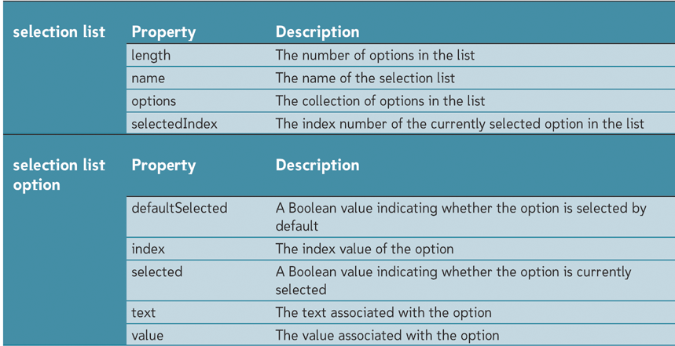
Working with Selection Lists

Slide 14
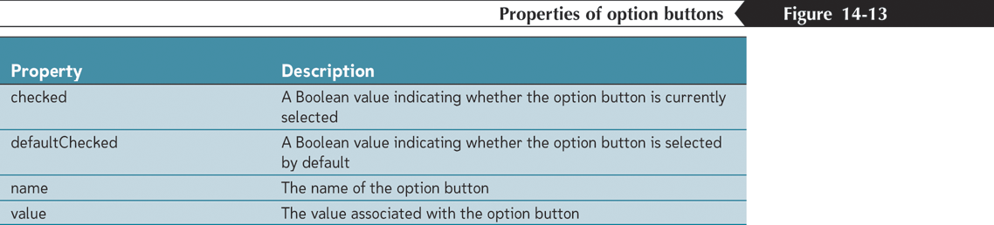
Working with Option Buttons and Checkboxes
Using option buttons
  Have the reference
  Element[idref]
  Where element is the reference to the group of option buttons and idref is either the index number or id of the individual option button

Slide 15
Custom Submit Button
  <html>
  <head>
  <title>Submit Example</title>
  </head>
  <body>
  <form id="form1" method="post" action="javascript:alert('Submitted')">
  <input type="text" id="txtName" name="txtName" /><br />
  <!-- custom submit button -->
  <input type="button" value="Submit Form" onclick="document.forms[0].submit()" />
  </form>
  </body>
  </html>

Slide 16
onError Event Handler
The onerror event handler provides three pieces of information to identify the exact nature of the error:
Error message . The same message that the browser would display for the given error
URL . The file in which the error occurred
Line number . The line number in the given URL that caused the error

Slide 17
On Error Handler
  <script type="text/javascript">
  window.onerror = function (msg, url, line,colno) {
  var errorMSG = 'Exception in line := '+ line +":" +"column:= "+colno + msg;
  alert(errorMSG);
  }
  show();
  </script>

Slide 18
Resize
Resize:
  applies to the body or a window.
  This is used to determine if the size of the viewable area or the window has changed.
innerWidth :returns the inner width of a window's content area.
innerHeight : returns the inner height of a window's content area.
window.addEventListener('resize',function(){
console.log("Resize");
console.log(window.innerWidth);
console.log(window.innerHeight);
})

Slide 19
resize
  var random = function(min, max){
  var rand = min + Math.random()*(max+1-min);
  rand = rand^0;
  console.log(rand);
  return rand;
  }
  window.addEventListener('resize',function(){
  var divElement = document.getElementsByTagName('div')[0];
  divElement.style.background = 'rgb('+random(0,255)+','+random(0,255)+','+random(0,255)+')';
  });

Slide 20
Mouse Events
onMouseOver:
  the same as CSS’s :hover this triggers code when the cursor is over an element.
onMouseOut:
  this triggers when a cursor is no longer over an element.
onMouseDown, onMouseUp:
  detects whether a mouse button is in the down position (onMouseDown)
  has moved to the up position (onMouseUp).

Slide 21
Mouse Coordinates
Cross-browser property pair clientX/clientY
  Contain coordinates relative to window.
On scroll down, left or up without moving the mouse
  The values of clientX/clientY don’t change,
  They are relative to the window, not the document.

Slide 22
Mouse Events
<img name="pict" src="../images/Indian.png" alt="Indian Flag">
  (function(){
  var element = document.pict;
  var currentImage= document.pict.src;
  function hoverImage(){
  element.addEventListener("mouseover",function(){
  element.src="../images/AirForce.jpg"
  });
  element.addEventListener("mouseout",function(){
  element.src=currentImage;
  });
  }
  hoverImage();
  })();

Slide 23
OnMouseDown
  function showingPositions(){
  element.addEventListener(“mousedown",show_coords);
  }
  function show_coords(event) {
  x=event.clientX
  y=event.clientY
  console.log("X coords: " + x + ", Y coords: " + y)
  }
  The Event Object can be Passed to a Regular Java Function while Using it as a Call Back Method

Slide 24
Key Press Event
The order of events When a Key is Pressed :
  onkeydown
  onkeypress
  Onkeyup
Key Down
  As soon as the keyboard key is pressed
  Works for all keys.
  Triggered before the character is typed into the form field.
  Represent keys being pressed or released
Key Press
  Represents a character being typed.
  It is guaranteed for character keys only.
  May not work for ALT, CTRL, SHIFT, ESC in all browsers

Slide 25
Key Up
To identify the key that the user just released
The event is triggered after the character is typed
  event.keyCode :(the key code of the key just pressed)
  event.shiftKey (true if the event occured while Shift was pressed)
  event.ctrlKey (true if the event occured while Ctrl was pressed)
  event.altKey (true if the event occured while Alt was pressed)

Slide 26
This in “Form”
The “this” refers to form Object
  var frm = document.forms[0];
  frm.addEventListener("submit", function(event){
  console.log(this.elements.length);
  console.log(this.elements[0].value);
  event.preventDefault();
  });

Slide 27
Accessing URL
JavaScript can access the current URL in parts
window.location.assign:
  window.location.assign("https://www.google.com")
window.location.protocol
window.location.pathname
window.location.hostname

Slide 28
Internet Explorer
IE provides a global object window.event
  It references the last event.
  Before IE9 there are no arguments in the handler.
  element.onclick = function(event) {
  event = event || window.event
  }

Slide 29
Internet Explorer
  function reportMyBrowser() {
  var eventObject;
  var eventTarget;
  if (window.event) {
  eventObject = window.event;
  eventTarget = window.event.srcElement;
  }
  else {
  eventObject = event;
  eventTarget = event.target;
  }
  }

