Slide 1


Slide 2

K.Srivatsan - vatsan@gmail.com
IT Trainer Since 1991
Conducting Java Training Since 2004
About 40+ Corporate Clients

Slide 3
Topics
Angular 2 & 4 Introduction
Angular Branding
Single Page and Multi Page Application
MVC Pattern

Slide 4
Angular
A platform that makes it easy to build applications with the web.
It combines declarative templates, dependency injection, end to end tooling
Integrated best practices to solve development challenges.
Empowers developers to build applications that live on the web, mobile, or the desktop
_x000b_

Slide 5
AngularJs -1.x
A JavaScript-based front-end web application framework
  maintained by Google
Helps developing single-page applications.
Simplifies both the development and the testing of applications
  by providing a framework for client-side
  model–view–controller (MVC)
  model–view–viewmodel (MVVM) architectures
  Also components commonly used in rich Internet applications.

Slide 6
AngularJS 1.x
Works by first reading the HTML page, which has embedded into it additional custom tag attributes.
Interprets those attributes as directives to bind input or output parts of the page to a model that is represented by standard JavaScript variables.
The values of those JavaScript variables can be manually set within the code, or retrieved from static or dynamic JSON resources.
Its is the frontend part of the MEAN stack
  MongoDB database,
  Express.js web application server framework,
  Angular.js itself,
  Node.js server runtime environment.

Slide 7
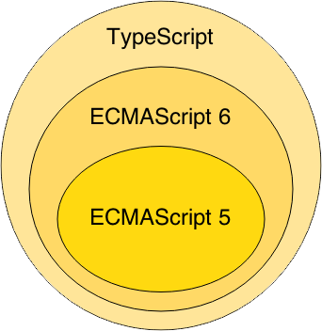
Angular 2
Angular 2 successor to Angular 1 than a “update.”
  The final version was released on September 14, 2016
Component based without any controllers or scopes.
  Much Cleaner and has removed most of the directives found in Angular1
Uses strongly typed language
  Extended version of TypeScript annotations decorators

Slide 8
Angular1.X vs Angular 2
Angular 2 shares some concepts with its predecessor
  the special HTML templating syntax,
  directives/components to modify the DOM
Has Introduced better strategies and concepts to improve the performance
  By updating data binding concept.
Angular 1 may not be deprecated or will not lack support
  It will be there to stay
Angular 2 is Well designed and its is mobile oriented.
  Need for Iconic framework is minimized

Slide 9
Angular 2
Dropped controllers - uses component-based UI
  Instead of binding to properties in the scope they are directly bound to the components
  Uses the ES6 modules.
  Similar to ReactJS.
Routers
  Enhanced Routing
  Feature rich than the old ngRoute

Slide 10
Angular 4
Released on March 23, 2017.
  Skipping 3 to avoid a confusion due to the misalignment of the router package's version which was already distributed as v3.3.0
  Angular 4 is backward compatible with Angular 2.
Smaller & Faster
  Angular applications becomes smaller and faster.
View Engine
  AOT generated code reduce the size of the generated code by around 60%
  More complex the templates the higher the savings.
  Migrating to 4 reduced production bundles by hundreds of kilobytes.

Slide 11
What is New angular 4
Animation Package
  Animations is removed from @angular/core and into their own package.
  Added by importing @angular/platform-browser/animations.
Improved *ngIf
  Can now use an if/else style syntax
TypeScript 2.1 and 2.2 compatibility
  Updated to a more recent version of TypeScript.
  Improve the speed of ngc
  Better type checking in application.
Source Maps for Templates
  When there is an error caused by something in templates
  A Source Map is generated that give a meaningful context in terms of the original template.

Slide 12
Angular 5
Angular 5 was released on November 1, 2017.
Key improvements in Angular 5
  Support for progressive Web apps,
  A build optimizer that makes the application smaller by eliminating unnecessary code.
  Pipes for internationalized number, date, and currency.
  Run validation and value updates on blur and submit rather than on every input event.

Slide 13
Angular 4 - Architecture
The architecture of Angular 2 contains following modules:
  Module
  Component
  Template
  Metadata
  Data Binding
  Service
  Directive
  Dependency Injection

Slide 14
Single Page Applications
Writing large-scale, maintainable single-page-applications are big challenge.
  fixing bugs, writing unit tests and creating reusable chunks of code…
Single-page-applications with older frameworks gies different ways to design an application.
  There wasn’t any structure, encapsulation and everything was tightly coupled to each other.
SPA-technologies like Angular make use components.
  With a predefined structure and encapsulation

Slide 15
Single Page Application
HTML is a great declarative language for static documents.
  It does not contain much in the way of creating applications,
One "real" HTML page whose content can be changed in Javascript without having to download a new page.
  The new content is created programmatically using templates.
  Server sends an application engine along with the HTML page
The engine controls the entire application including processing, input, output, painting, and loading of the HTML pages.
Server is used when there is a need for new data or must perform secured operations such as authentication.

Slide 16
Characteristics Single Page Application:
Chunking
  Pages are constructed by loading chunks of HTML fragments and JSON data instead of receiving full HTML from server on every request.
Controllers
  JavaScript code that handles complex DOM and data manipulations, application logic and AJAX calls is replaced by controllers that separate views and models using MVC or MVVM patterns.
Templating
  coding of UI and DOM manipulations are replaced by declarative binding of data to HTML templates.
Routing
  selection of views and navigation (without page reloads) that preserves page state, elements and data

Slide 17
MVC on Client Side
Client side MVC
  MVC framework is built entirely on the client side.
  Server only delivers data to the application.
  The binding of the data to the models happens client side.
Need for client-side MVC
  operations are not only with HTML but with data on the page.
  when data is collection of JSON
  Process data, perform all required calculations, render HTML and put that into page.
  CRUD actions , over REST API.
  adding or deleting should not make page to reload
  can update page according to current data state.

Slide 18
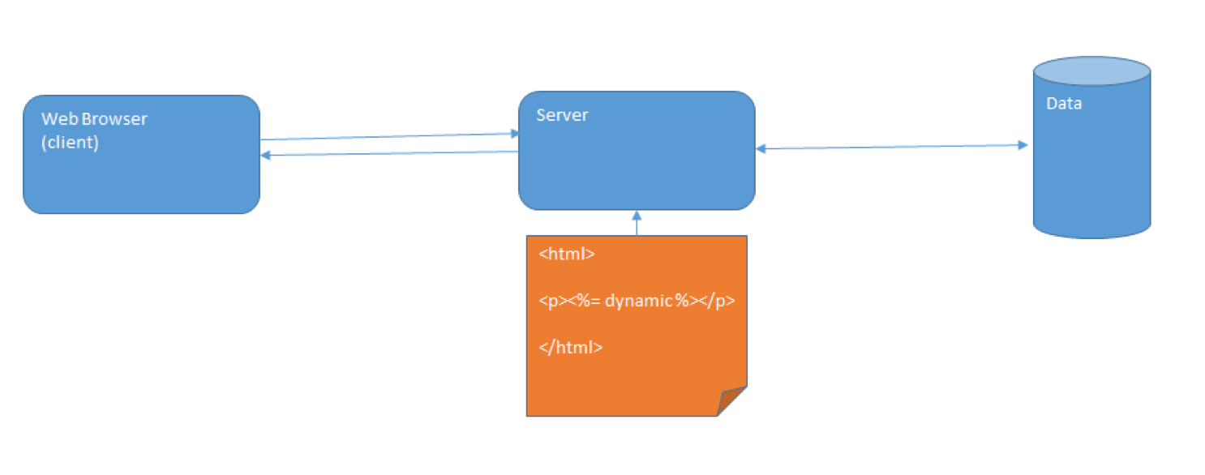
MVC on Server Side

Slide 19
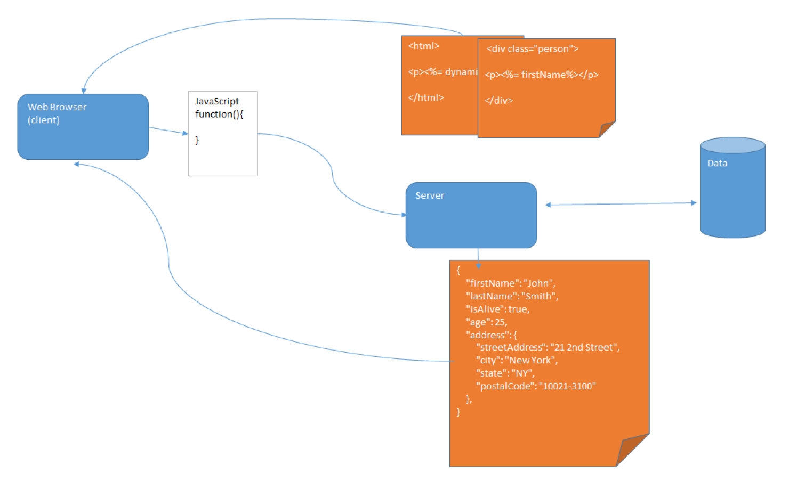
MVC on Client Side

Slide 20
MVC in Angular
Angular is more of component based architecture.
  A well defined component consist of individual set of MVC architecture.
Model will mostly uses services, which is accessed through Components
  A Simple class file can also be called Model.
component.html
  These are the view
  The HTML, is what is presented to the user (along with some CSS for layout). It is easy to see how this represents the view.
component.ts
  Is the controller .
  It can choose which data to push to view
  Has difference forms of binding

Slide 21
Single Page Application in Angular
Single Page application have many MVC relationships
MVC’S be side by side
A user can navigate from one page to another
MVC can be nested
Example : In a Hotel Application
  We can components for
  Reservation
  front desk
  room service
  catering
Each one of them MVC on its own

Slide 22
NODE JS

Slide 23
Introduction
Developed by Ryan Dahl in 2009
Writing JavaScript applications outside web browsers.
It is Open source, cross-platform runtime environment
Built on Google Chrome's JavaScript Engine (V8 Engine).
An event driven, non-blocking (asynchronous) I/O
  Cross-platform runtime environment for building highly scalable server-side applications

Slide 24
Introduction
Client-side JS makes heavy use of the DOM,with no access to files/databases
Server-side JS deals mostly in files/databases,
Provides a rich library of various JavaScript modules which simplifies the development of web applications
Node.js = Runtime Environment + JavaScript Library

Slide 25
NodeJs
Uses JavaScript to build entire server side application.
Can be used to build different types of applications
  command line application,
  web application,
  real-time chat application,
  REST API server etc.

Slide 26
Use Case for Node.js
Create an HTTP server
Create a TCP server similar to HTTP server
Creating online games, collaboration tools
MVC Applications

Slide 27
Parts of Node Js
Modules
  Import Module by using require directive
Servers
  A server which will listen to client's request similar to Apache HTTP Server.
Read request and return response
  Server will read HTTP request made by client
  Client can be a browser or console and return the response.

Slide 28
Installation
Download From : http://nodejs.org/#download
Check the Application Running
  Type “node” and enter
  Type ‘Hello From Node JS’
  The text gets printed shows node is installed correctly
Create a JS File
From the Command Prompt node xxx.js

Slide 29
Development Environment
Can be setup in Windows, Mac, Linux and Solaris.
The following tools/SDK help developing a Node.js application
  Node.js
  Node Package Manager (NPM)
  IDE (Integrated Development Environment) or TextEditor
  NPM (Node Package Manager)

Slide 30
NodeJS Console
Has virtual environment called REPL
  Read-Evaluate-Print-Loop.
started by invoking node on console
> "10 + 20"
> "Hello" + "World"
> var x = 10, y = 20;
> x + y
>function add(a, b){ return a+b; }
>add(4,5)
>console.log(‘\033c’);

Slide 31
Node.js Module:
Module are organized with single or multiple JavaScript files
  Reused throughout the Node.js application.
Node.js includes three types of modules:
  Core Modules
  Local Modules
  Third Party Modules

Slide 32
Modules
Many programming Languages use the import function to load other libraries
Node can also load other dependencies using the require keyword.
Modules created locally in Node.js application.
  They are placed in a separate JavaScript file.
var http = require('http');
var dns = require('dns');
We can also require relative files:
var myFile = require('./myFile');

Slide 33
Creating Modules
Modules are loaded once, and after that they are cached by Node.
Unlike the browser, Node does not have a window global object, but instead has two others: globals and process.
  Should avoid adding properties on the two.
module.exports or exports to expose a function, object or variable as a module in Node.js.

Slide 34
Module
  var bankModule ={};
  bankModule.simpleInterest=function(){
  return "SimpleInterest Calculation Invoked";
  }
  bankModule.compoundInterest=function(){
  return "Compound Intrest calculation Invoked";
  }
  module.exports = bankModule;

Slide 35
Application
  Loading the Local Module
  var module = require("./PaymentModule.js");
  console.log(module.simpleInterest());
  console.log(module.compoundInterest());

Slide 36
Modules
  exports.calculate=function(){
  var amt = (5000 * 2 * 3)/100;
  return amt;
  }
  var obj = require("./CalculateModule.js").calculate;
  console.log(obj);

Slide 37
Core Module
Include bare minimum functionalities of Node.js.
Compiled into its binary distribution and load automatically when Node.js process starts.
  Need to import the core module to use it in application.
http :
  http module includes classes, methods and events to create Node.js http server.
Path
  path module includes methods to deal with file paths.
fs
  fs module includes classes, methods, and events to work with file I/O.
Util
  util module includes utility functions useful for programmers.

Slide 38
Loading Core Modules
Core module are imported require() function
  var module = require('module_name');
  var util =require("util");
  console.log("Hello");
  setTimeout(function () {
  console.log("World!");
  }, 3000);
    //it prints ‘hello’ first and waits for 3 seconds and then prints ‘world’

Slide 39
Node.js Ecosystem
Node.js heavily relies on modules,
  require keyword loaded the local modules.
Libraries in Node.js are called packages and they can be installed by typing
  npm install “package_name”;
NPM (Node Package Manager) comes bundled with Node.js installation.
Modules can be installed globally or locally to a directory of Node application

Slide 40
Node Package Manager
NPM command line tool installs, updates or uninstalls packages
An online repository for open-source Node.js packages.
It has useful modules and many deveopers publishes to it
Popular package
  AngularJS, jQuery, Gulp, Bower etc.
Official website: https://www.npmjs.com

Slide 41
Npm install
Npm always installs the latest version
Can install specific version by defining it in package.json file in the local directory
-g or --global
  to install the package globally rather than locally.
-f or --
  force npm to fetch remote resources even if a local copy exists on disk.

Slide 42
Npm Install
Install takes optional flags which save or update the package version in your main package.json:
-S, --save:
  Package will appear dependencies.
-D, --save-dev:
  Package will appear development Dependencies.
-O, --save-optional:
  Package will appear in optional Dependencies.

Slide 43
NPM Operations
Two Modes :
  global and local.
  Global mode : Performs operations which affect all the Node.js applications on the computer
  Local mode : Performs operations for the particular local directory which affects an application in that directory only.
C:\>npm install <package name>
npm install -g latest
Global packages into <User>/local/lib/node_modulesfolder.
C:\MyNodeProj> npm install -g expressUpdate

Slide 44
Package.json
A JSON File and not a Object Literal
  Has a name and version fields. Required entries,
  package.json
  {
  "name": "file_upload", "version": "0.0.1", "dependencies": {
  "express": "^4.8.6",
  "ejs": "^1.0.0",“
  mysql": "^2.4.3"
  }}

Slide 45
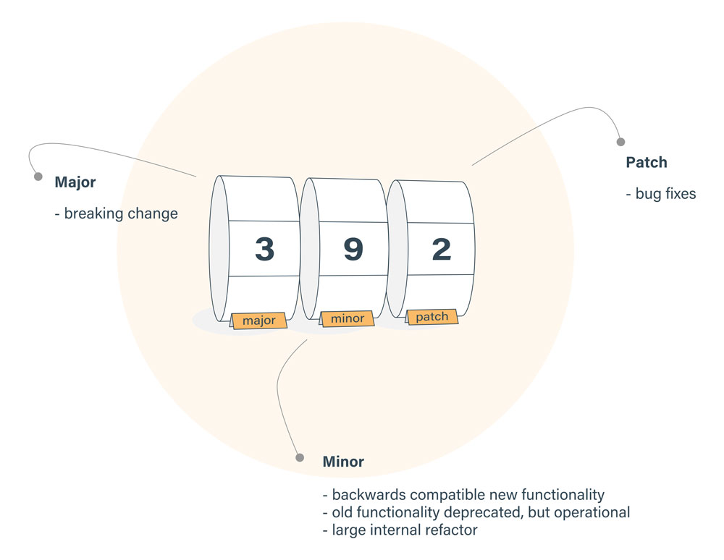
(^) Packages.json
Locks down the major version number, but leaves the minor and patch versions to be more flexible.
Version of ^2.2.3, will match any version that is greater than or equal to 2.2.3 and also less than 3.0.0.

Slide 46
(~) Packages.json
Fixes both the major and minor version numbers, while matching any patch number
~2.3.1,
  Would match all versions greater than or equal to 2.3.1 and less than 2.4.0 for that dependency.
Dependency with a version of '*' would equate to any version that was greater than or equal to 0.0.0,
while 1.* would allow versions greater than or equal to 1.0.0 and less than 2.0.0.

Slide 47
Package.json
name - name of the package
version - version of the package
description - description of the package
homepage - homepage of the package
author - author of the package
contributors - name of the contributors to the package
dependencies - list of dependencies. npm automatically installs all the dependencies mentioned here in the node_module folder of the package.
repository - repository type and url of the package
main - entry point of the package
keywords - keywords

Slide 48
REST CALLS WITH NODEJS

Slide 49
REST Overview
Resource Oriented Architecture
  Data and functionality are considered resources
  Accessed using Uniform Resource Identifiers (URIs), typically links on the Web.
A resource is accessed via a common interface based on the HTTP standard methods.
A REST server provides access to the resources and a REST client which accesses and modify the REST resources.
Resources are identified by global ID's (which are typically URIs).

Slide 50
Choosing – Resource Oriented Architectures
Involve loose-coupling between client and server, due to:
  Late binding to resource data
Successful use revolves around the cache-ability of resource data
  HTTP cache-control headers are used to specify resource to be cached.
Best for “linking and referring” across organization boundaries
Interaction are Stateless , new request should carry all the information required to complete
Must not rely on previous interactions with the same client.

Slide 51
REST Request Methods
GET - Requests a specific representation of a resource
PUT - Creates or updates a resource with the supplied representation
DELETE - Deletes the specified resource
POST - Submits data to be processed by the identified resource

Slide 52
Post Method
Utilized to **create** new resources.
Used to create subordinate resources.
Subordinate to some other (e.g. parent) resource.
POST to the parent and the service takes care of associating the new resource with the parent, assigning an ID
On successful creation, return HTTP status 201, returning a Location header with a link to the newly-created resource with the 201 HTTP status.

Slide 53
REST with JSON Server
Can call a third party rest web service that will returns JSON data
Instead of usign a Real Web Service , could also use a mockup Rest Webservice
JSON Server
  A Node Module that can be used to create demo rest json webservice
  Done with a simple JSON file with sample data.
Installing JSON Server
    $ npm install -g json-server
  Starting JSON Server
    json-server --watch db.json

Slide 54
Creating a Mock DB
  Create a File : db.json
  {
    "invoices": [
      {
      "id": 1,
      "name": "Ramesh",
      "amount": "10000"
      },
      {
      "id":2,
      "name": "Suresh",
      "amount": "5000"
      }
    ]
    }

Slide 55
REST Client
  REST Client for Node.js
  $ npm install node-rest-client
  var Client=require('node-rest-client').Client;
  var client = new Client();
  client.get("http://localhost:3000/invoices",function (data, response) {
  console.log(JSON.stringify(data));
  });

Slide 56
Post Request
  var Client=require('node-rest-client').Client;
  var invoice={
  "id": 6,
  "name": "Murugan",
  "amount": "20000"
  };
  var args = {
  data: invoice,
  headers: { "Content-Type": "application/json" }
  };
  var client = new Client();
  client.post("http://localhost:3000/invoices", args, function (data, response) {
  console.log(data.toString());
  });

Slide 57
ES6 FEATURES

Slide 58
Topics
ES6 features, arrow functions
Template Literals
Block Scope, Constant, Variables
ES6 Classes, Inheritance, Interfaces
ES6 modules, export, import

Slide 59
Need For ES6
JavaScript is everywhere!
Used as the development language everywhere
  IoT devices
  mobile apps
  databases
  front-end and backend web technologies.
JavaScript has profound effects on multiple different technologies.
JavaScript need to meet the expectations of modern web Application Development !

Slide 60
Java Script
JavaScript has many pitfalls…
  Prototype inheritance (No class)
  new, this
  Function scope (No block scope)
  Global variables (No module system)
  Hoisting
  NaN, undefined
  typeof null
  with, eval
ES6 has Modern syntax fixing pitfalls

Slide 61
ECMA Script 6
Published on June 17, 2015
Many nicknames to refer Es6
  ES6, ECMAScript 2015, Harmony JavaScript 2015.
A significant update to the language and includes numerous new language features.
Many Browsers are Yet to support the new Features
ES6 Transpiler:
  source code converter from ES6 to ES5/ES3
ES6 Polyfill:
  library to provide ES6 built-in classes,
  functions and objects for ES5/ES

Slide 62
Backward Compatability
Many of the Newly Introduced features are syntactic sugar over existing JavaScript..
Still Javascript classes don’t really exist other than for cosmetic reasons.
The reason for this was to ensure backwards compatibility, new features gives a cleaner and better way to organize your code.
Case Use Tools like Babel to work Till All the Browsers adapt the new features of JavaScript
  https://babeljs.io/rep

Slide 63
CLASSES

Slide 64
CLASSES
JavaScript classes provide a much simpler and clearer syntax to create objects and deal with inheritance.
Declared with class keyword and the name of the class
Introduces class, constructor, static, extends, and super.
  Extends is used to tell an object to inherit from another object, forming a parent-child relationship.
  Super is used to call a function in the parent object from the child object

Slide 65
Defining Classes
The class syntax has two components: class expressions and class declarations.
class declaration.:
  Declared using the class Keyword followed by className
  Class Book{}
Class Expression
  Declared Using Expression Syntax
  Can be re-declared
  Constructor property is optional
  var Foo = class {};
Function declarations and class declarations is that function declarations are hoisted and class declarations are not.

Slide 66
Constructor
Constructor:
  This is a special function used to initialize an object created with a class.
  Default constructors that do nothing or pass arguments to the parent constructor
  There can only be one special method with the name "constructor" in a class.
  A Syntax Error will be thrown if the class contains more than one occurrence of a constructor method.
  A constructor can use the super keyword to call the constructor of a parent class.

Slide 67
Public , private , protected
Public by default
  In Type Script, each member is public by default.
  Can mark member public explicitly.
Private
  It cannot be accessed from outside of its containing class.
Protected
  Similar to private modifier
  Members declared protected can also be accessed by instances of deriving classes.

Slide 68
Simple Class Definiion
  class WelcomePage {
  heading :string;
  constructor(heading) {
  this.heading=heading;
  }
  getHeading() {
  return this.heading.toUpperCase();
  }
  }
  var data = new WelcomePage("ES6 –Programming”);
  var element = document.querySelector('#h1');
  element.innerHTML = data.getHeading();

Slide 69
Transpilers
Traceur
<script src="https://google.github.io/traceur-compiler/bin/traceur.js"></script>
  A tool for compiling ES6 code into ES5 code
  It compiles and use the result in environments where ES6 features are not implemented.
<script src="https://google.github.io/traceur-compiler/bin/BrowserSystem.js"></script>
  Apply the compiler to the web page
  script tag is using "module" as its type instead of the usual "text/javascript":
<script src="https://google.github.io/traceur-compiler/src/bootstrap.js"></script>
  Bootstrap.js finds all of the <script type="module">tags

Slide 70
Html Page
  <script src="https://google.github.io/traceur-compiler/bin/traceur.js"></script>
  <script src="https://google.github.io/traceur-compiler/bin/BrowserSystem.js"></script>
  <script src="https://google.github.io/traceur-compiler/src/bootstrap.js"></script>
  <body>
  <h1 id="h1"></h1>
  <script type="module">
  </script>
  // Script is Added
  // Script can also be Loaded
  </body>

Slide 71
Get & Set
ES6 classes brings a new syntax for getters and setters on object properties.
Get and set allows to run code on the reading or writing of a property.
‘_’ convention is used to create a backing field to store property.
Not Following the convention may cause stack overflow.
  The get would be called resulting into an infinite loop.
  May result in Duplicate Identifier Error also.

Slide 72
Get/Set (…Contd)
  class Catalog{
  private _category:string;
  private _numberOfItems:number;
  constructor(category:string,numberOfItems:number)
  {
  this.category = category;
  this.numberOfItems = numberOfItems;
  }
  set category(category:string){
  this.category = category;
  }
  get category(){
  console.log('hi');
  return this.category;
  }

Slide 73
Get/Set
  set numberOfItems(numberOfItems:number){
  this.numberOfItems = numberOfItems;
  }
  get numberOfItems(){
  return this.numberOfItems;
  }
  }
  let tvCatalog = new Catalog("Television",45);
  console.log(tvCatalog.category);
    tsc --target es5 .\Catalog.ts

Slide 74
Static
  Static
  To Define static function that can be called without creating a new instance of the object.
  Called without instantiating their class and are also not callable when the class is instantiated.
  Used create utility functions for an application.

Slide 75
Class Definition
  class Book {
  constructor(bookNumber, bookName) {
  this.bookNumber = bookNumber;
  this.bookName = bookName;
  }
  static triple(n) {
  n = n || 1;
  return n * 3;
  }
  toString() {
  return this.bookNumber + this.bookName;
  }
  }

Slide 76
BLOCK SCOPING

Slide 77
Scoping
var declarations in JS
  Difficult to immediately discern which are scoped locally vs. globally.
  Confusion with the working of Hoisting
May end up creating variables on the global Object
Can cause problems for enterprise level applications
Confusing workaround patterns
  IIFE.-workaround to the lack of block scope.

Slide 78
Using let
Allows to scope variables at the block level (the nearest curly brackets).
  (function(){
  "use strict"
  var foo = 1;
  function bar() {
  {
  let foo = 10;
  console.log("Inside If Block"+foo);
  }
  console.log("Outside the block"+foo);
  }
  bar();
  console.log(foo);
  })();

Slide 79
Example
One caveat with let is that it doesn’t hoist in the same way var does.
Using it before it’s been declared will get a reference error.
This has been termed the Temporal Dead Zone
Each iteration creates its own block scope
  for( let i=0;i<=10;i++) {
  console.log(i);
  }
  console.log('Out Side for loop'+i);
  for(var i=0;i<=10;i++) {
  console.log(i);
  }
  console.log('Out Side for loop'+i);

Slide 80
Constant
Constant in programming Languages are used for values that won’t need to be reassigned in a program’s execution.
Const is the new ES6 keyword
  like Java's final
The const declaration creates a read-only reference to a value
  It does not mean the value it holds is immutable,
  Means variable identifier cannot be reassigned.
Can mutate the properties of an object being referenced by the variable.
const PI = 3.141593 PI > 3.0

Slide 81
Example
  const PI_VALUE = 3.141592
  const APIKEY = 'aekljefj3442313kalnawef';3.
  const NAMES = [];
  NAMES.push(“Jagan");
  console.log(NAMES.length === 1); // true
  NAMES = [“Ramesh", “Kumar"]; // error
  const AGE = 13;
  AGE = 20; // Error!

Slide 82
Arrow Functions
Arrow functions are, as the name suggests, functions defined with a new syntax that uses an “arrow” (=>).
  They doesn’t require function keyword, return keyword and curly brackets.
More expressive closure syntax.
No this, super, arguments
Cannot be called with new ,throws an an error
No prototype
No duplicate named parameters

Slide 83
Arrow Functions
There are a variety of syntaxes available in arrow functions.
var sum = function(num1, num2) {
return num1 + num2;
};
var sum = (num1, num2) => num1 + num2;
var sum= (num1, num2) => { return num1 + num2; };
var square = n => n * n;
[1, 2, 3, 4].filter(n => n % 2 === 0).map(n => n * n);

Slide 84
Arrow Functions
  var names = [
  "Ram",
  "Shyam",
  "Magesh",
  "Rajesh Khanna"
  ];
var count = names.map( s => s.length );
console.log(count);
Output : [ 3, 5, 6, 12 ]

Slide 85
Arrow Functions
Arrow functions can return an object literal expression.
The body needs to be wrapped in parentheses, in order to distinguish between a block and an object
  var setNameIds=(id,name)=>({id:id,name:name});
  var student =(setNameIds(12,"Ramesh"));
  console.log(student);
  var array=[1,2,3,4,5,6,7,8,9,10,11,12,13,14,15];
  var divisibleByThree=array.filter(v=> v%3 ==0);
  console.log(divisibleByThree);

Slide 86
Template Literals
These are enclosed by the back-tick (` `) character
  instead of double or single quotes.
They can contain place holders indicated by the Dollar sign and curly braces (${expression}).
The expressions in the place holders and the text between them get passed to a function.
  Can be used to create multi-line strings and for String interpolation

Slide 87
Template Literals
Multi-line strings
  console.log("hello World\n"+ "How are You");
  console.log(`hello World\nHow are You`);
Expression interpolation
  var qty = 5;
  var rate = 10;
  console.log(`Quantity= ${qty} Rate= ${rate} and the Total= ${qty * rate} `);

Slide 88
Functions
Java Script Functions Parameter passing is special
Functions can handle different numbers of parameters
Values are often by filled with default values when parameters aren’t provided.
Es6 makes it easier to provide default values for parameters
  by providing initializations that are used when the parameter isn’t formally passed.

Slide 89
Default function parameters
In JavaScript, parameters of functions default to undefined.
Instead of that default value can be set for the parameter
Defaults was set by testing parameter values in the body of the function and assign a value if they are undefined.
With default parameters in ES6, the check in the function body is not necessary.
The default argument gets evaluated at call time
  a new object is created each time the function is called.

Slide 90
Default Parameters
  function multiply(a, b = 2) {
  return a*b;
  }
  multiply(5); :output : 10
  function add(a = 1, b = 2) {
  return a + b;
  }
  add(); // 1 + 2 = 3
  add(0); // 0 + 2 = 2
  add(undefined, 0); // 1 + 0 = 1
  add(0, 0); // 0 + 0 = 0

Slide 91
Default Parameters
  function setBackgroundColor(element, color =“red') {
  element.style.backgroundColor = color;
  }
  setBackgroundColor(someDiv);
  setBackgroundColor(someDiv, undefined);
  function append(value, array = []) {
  array.push(value);
  return array;
  }
  append(1); //[1]
  append(2); //[2], not [1, 2]

Slide 92
Rest Parameters
A rest parameter is indicated by three dots (...) preceding a named parameter.
  Aggregation of remaining arguments into single parameter of the functions.
  Parameters becomes an Array containing the rest of the parameters passed to the function
  function fun1(...theArgs) {
  console.log(theArgs.length);
  }
  fun1(); // 0
  fun1(5); // 1
  fun1(5, 6, 7); // 3

Slide 93
Rest Parameter
  function sum(…numbers) {
  var result = 0;
  numbers.forEach(function (number) {
  result += number;
  });
  return result;
  }
  console.log(sum(1)); // 1
  console.log(sum(1, 2, 3, 4, 5)); // 15

Slide 94
Rest Parameter Restrictions
Restrictions on rest parameters.
There can be only one rest parameter, and the rest parameter must be last.
Rest parameters cannot be used in an object literal setter.
let object = { setname(...value) { // do something } };
Object literal setters are restricted to a single argument.
Rest parameters are, by definition, an infinite number of arguments,

Slide 95
Module basics
Module definition and consumption is now part of the language
Its a file containing JS code and read reads like a script.
Differences.
  can use import and export in modules.
Everything declared inside a module is local to the module, by default.
Features of the module can be made public by export
The simplest way is to add the export keyword.

Slide 96
Module Basics
Can export any top-level function, class, var, let, or const.
No need to put everything in an IIFE or a callback.
All the declarations will be scoped to that module, not globally visible across all scripts and modules.
Export the declarations that make up the module’s public API
Apart from exports, the code in a module is pretty much just normal code.
It can use globals like Object and Array.
It can use document and XMLHttpRequest.

Slide 97
ES6 Modules
Module.js
  class Greeting{
  showMessage() {
  return 'good morning';
  }
  }
module.exports =Greeting

Slide 98
Module basics
<script src="https://google.github.io/traceur-compiler/bin/traceur.js"></script>
<script src="https://google.github.io/traceur-compiler/bin/BrowserSystem.js"></script>
<script src="https://google.github.io/traceur-compiler/src/bootstrap.js"></script>
  <body>
  <script type="module">
  import {Greeting} from 'ModuleExample1.js';
  var msg1 = showMessage();
  var element = document.querySelector('#h1');
  element.innerHTML = msg1;
  </script>
  </body>

Slide 99
Module basics
In another format for using named exports, can also export objects/function as and when its created
export function foo() { return 'foo'; }
export function bar() { return 'bar'; }

Slide 100


Slide 101
Type Script
A New scripting language designed to make enterprise javascript development more scalable
Starts from the same syntax and semantics of JavaScript developers know today.
Compiles to clean, simple JavaScript code which runs on any browser and Node.js,
Types enable to use highly-productive development tools and practices like static checking and code refactoring
Can define interfaces between software components and gain insights into the behavior of existing JavaScript libraries.

Slide 102
TypeScript
Developers face Challenges with writing JavaScript:
  Difficulty in identifying mistakes at development time.
  Scoping issues
  Mismatched parameters
  Editors and IDEs that could Highlight a mistakes
Its is a typed superset of JavaScript that compiles to plain JavaScript.
  Not a shortcut language.
  It doesn’t deviate from JavaScript.

Slide 103
Type Script and ES6
TypeScript offering over ES2015?
  Types
  Interfaces
Types and interfaces help identify problems early as we type .
Editors don’t have to guess
Brings the agreed upon features in the future ECMAScript spec to us today.
  Decorators,asyc/await

Slide 104
Basic Types
Supports much the same types in JavaScript
  A convenient enumeration type is added
Boolean
  let isDone: boolean = false;
Number
  Numbers in TypeScript are floating point values.
  Supports decimal,hexadecimal binary and octal
  let decimal: number = 6;
  let hex: number = 0xf00d;
  let binary: number = 0b1010;
  let octal: number = 0o744;

Slide 105
String
Uses double quotes (") or single quotes (') to surround string data.
let color: string = "blue"; color = 'red';
Can also use template strings
  span multiple lines and have embedded expressions.
  Surrounded by the backtick/backquote (`) character,
  Embedded expressions of the form ${ expr }.
let fullName: string = `Ramesh Kumar`;
let age: number = 37;
let sentence: string = `Hello, my name is ${ fullName }.I'll be ${ age + 1 } years old next month.`

Slide 106
Array
Array types can be written in one of two ways.
Used with type of the elements followed by [] to denote an array of that element type:
let list: number[] = [1, 2, 3];
The second way uses a generic array type, Array<elemType>:
let list: Array<number> = [1, 2, 3];

Slide 107
Enum
Giving more friendly names to sets of numeric values.
enum Color {Red, Green, Blue};
  let c: Color = Color.Green;
By default, enums begin numbering their members starting at 0.
  can change manually by setting the value of one of its members.
  For unsure values , can lookup with number
enum Color {Red = 1, Green, Blue};
  let c: Color = Color.Green;
enum Color {Red = 1, Green = 2, Blue = 4};
  let colorName: string = Color[2];

Slide 108
Variable Declarations
let and const
  new types of variable declarations in JavaScript.
var declarations are accessible anywhere within their containing function, module, namespace, or global scope
let Allows to scope variables at the block level (the nearest curly brackets).
const is an augmentation of let
  prevents re-assignment to a variable.

Slide 109
Type Script Hello World
Install TypeScript
  $ npm install -g typescript
Any JavaScript program is already a TypeScript program.
The TypeScript compiler performs local file transformations on TypeScript programs.
Hence, the final JavaScript output closely matches the TypeScript input.

Slide 110
Example
var message:string = "Hello World"
console.log(message)

Slide 111
Type Annotation -Example
  function greeter(person :string) {
  return "Hello, " + person;
  }
  var user = "Ramesh";
  console.log(greeter(user));
Allows us to check and express our intent in the programs
TypeScript features, are enforced at compile-time.

Slide 112
Transpiling
The Typescript transpiler is invoked to obtain javascript code.
$ tsc person.ts
The *.ts extension designates a TypeScript file.
  The transpiler creates a new file called “person.js” with the javascript code.
$ tsc person.ts --target ES5
$ tsc person.ts --target ES6

Slide 113
Transpiling
  class Person {
  public firstName: string;
  public lastName: string;
  private _fullName: string;
  constructor (firstName: string, lastName: string) {
  this.firstName = firstName;
  this.lastName = lastName;
  }
  get fullName(): string {
  return this.firstName +”:”+this.lastName;
  }
  }

Slide 114
Typing Functions
Can types to each of the parameters and then to the function itself to add a return type.
TypeScript can figure the return type out by looking at the return statements,
  Can leave it optionally l

Slide 115
Classes
JavaScript can be used for object-oriented class-based approach.
  class Greeter {
  greeting: string;
  constructor(message: string) {
  this.greeting = message; }
  greet() {
  return "Hello, " + this.greeting;
  } }
  let greeter = new Greeter("world");

Slide 116
Classes
Classes has three members:
  a property
  a constructor,
  and a method
this.
  This denotes that it’s a member access.
construct an instance class using new.
This calls into the constructor, creating a new object with running the constructor to initialize it.

Slide 117
Typing the function
function add(x: number, y: number): number {
return x + y; }
let myAdd = function(x: number, y: number): number {
return x+y; };
Can add types to each of the parameters and then to the function itself to add a return type.
TypeScript can figure the return type out by looking at the return statements
  can also optionally leave in many cases.

Slide 118
Optional and Default Parameters
In TypeScript, every parameter is assumed to be required by the function.
This doesn’t mean that it can’t be given null or undefined, but rather, when the function is called the compiler will check that the user has provided a value for each parameter.
The compiler also assumes that these parameters are the only parameters that will be passed to the function.
The number of arguments given to a function has to match the number of parameters the function expects.

Slide 119
Optional Parameters
function buildName(firstName: string, lastName: string) {
return firstName + " " + lastName;
}
let result1 = buildName("Babu"); // error, too few parameters
let result2 = buildName("Babu", “Reddy", "Sr.");
// error, too many parameters
let result3 = buildName("Babu", “Reddy"); // ah, just right

Slide 120
Interfaces
Type-checking focuses on the shape that values has
This is sometimes called “duck typing” or “structural subtyping”.
Interfaces fill the role of naming these types,
A powerful way of defining contracts within code as well as contracts with code outside of the project.
Don’t have to explicitly implements interface
  It’s only the shape that matters.
  type-checker does not require that these properties come in any sort of order, only that the properties the interface requires are present and have the required type.

Slide 121
Interface-example
  interface Person {
  firstName: string;
  lastName: string;
  }
  function greeter(person: Person) {
  return "Hello, " + person.firstName + " " + person.lastName;
  }
  var user = { firstName: "Magesh", lastName: "Kumar" };
  console.log(greeter(user));

Slide 122
Optional Properties
Not all properties of an interface may be required.
Interfaces with optional properties are denoted by a ? at the end of the property name in the declaration.
Can describe these possibly available properties
  still also preventing use of properties that are not part of the interface.

Slide 123
Optional Properties
  interface Passenger{passName:string,src:string,dest?:string,age
  :number,mode?:string};
  function BookBusTicket(client:Passenger):string{
  let status='Available';
  return status;
  }
  let busStatus = BookBusTicket({'passName':"ramesh",'age':45,"src":'chennai',"mode":'ac'});

Slide 124
Interface Function Types
Interfaces are also capable of describing function types.
To describe a function type with an interface, we give the interface a call signature.
This is like a function declaration with only the parameter list and return type given.
Each parameter in the parameter list requires both name and type.

Slide 125
Example
  class Startup {
  public static main(): number {
  console.log('Hello World');
  return 0;
  }
  }
  Startup.main();

Slide 126
Interfaces Function Types
Once defined, can use this function type interface like we would other interfaces.
create a variable of a function type and assign it a function value of the same type.
interface SearchFunc { (source: string, subString: string): boolean; }
let mySearch: SearchFunc;
mySearch = function(source: string, subString: string) {
  let result = source.search(subString);
  if (result == -1) {
  return false; }
  else { return true;
  } }

Slide 127
Class Types
Implementing an interface
Explicitly enforcing that a class meets a particular contract, is also possible in TypeScript.
interface ClockInterface { currentTime: Date; }
  class Clock implements ClockInterface {
  currentTime: Date;
  constructor(h: number, m: number) { }
  }

Slide 128
Interfaces with Methods
Can describe methods in an interface that are implemented in the class
Interfaces can extend each other.
Can extend multiple interfaces, creating a combination of all of the interfaces.
interface ClockInterface { currentTime: Date; setTime(d: Date); }
  class Clock implements ClockInterface {
  currentTime: Date;
  setTime(d: Date) {
  this.currentTime = d; }
  constructor(h: number, m: number) { }
  }

Slide 129
Type Script Visual Studio Code
Ctrl+Shift+B.
Click the Configure Task Runner option to set up a config file.
The Task Runner uses the config file, which instructs VS Code to use a specific executable with certain parameters

Slide 130
Tasks.json
Used to Create a task configuration to instruct VS Code to execute tsc.exe
  {
  "version": "0.1.0",
  "command": "tsc",
  "showOutput": "silent",
  "args": ["hello-world.ts"],
  "problemMatcher": "$tsc“
  }
"args": ["-p", "."],
  This will find all *.ts files in the project and transpile them to *.js.

Slide 131
Tasks.json
command: which executable to call
showOutput: [silent, always, never]
silent:
  The output window is brought to front only if no problem matchers fire for the task.
  This is the default
always:
  The output window is always brought to front
never:
  The user must explicitly bring the output window to the using the View menu or the short cut Ctrl+Shift+U
isShellCommand:
  When set to true runs the tsc command in a shell
  Must be executed in a shell interpreter (e.g. cmd.exe, bash)

Slide 132
Tasks.json
args :
  explicitly call tsc -p to compile all *.ts files using the tsconfig.json settings
problemMatcher:
  A string or array of strings based on the pre-defined problem matchers.
  The problem matcher to be used if a global command is executed (e.g. no tasks are defined).
  A tasks.json file can either contain a global problemMatcher property or a tasks property but not both.

Slide 133
Problem Matcher
  "problemMatcher": {
  "owner": "typescript",
  "fileLocation": ["relative", "${workspaceRoot}"],
  "pattern": {
  "regexp": "^TypeScript (warning|error): (.*)\\((\\d+),(\\d+)\\): (.*)$", "severity": 1,
  "file": 2,
  "line": 3,
  "column": 4,
  "message": 5 }
  }

Slide 134
Tasks.json
{
"version": "0.1.0",
"command": "tsc",
"isShellCommand": true,
"args": ["-p", ".\\scripts"],
"showOutput": "silent",
"problemMatcher": "$tsc"
}

Slide 135
Tsconfig.json
tsc --init
{
"compilerOptions": {
"target": "es5",
"module": "commonjs",
"sourceMap": true
}
}

Slide 136
Decorators
A Decorator is a special kind of declaration that can be attached to a class declaration, method, accessor, property, or parameter.
Decorators use the form @expression, where expression must evaluate to a function that will be called at runtime with information about the decorated declaration.
Decorators are an experimental feature that may change in future releases.
To enable experimental support for decorators, must enable the experimentalDecorators compiler option either on the command line or in your tsconfig.json:

Slide 137
Class Decorator
  @log
  class Employee {
  constructor(name: string, age: number) {}
  }
  new Employee("Ramesh", 12);

Slide 138
Class Decorator
The class decorator is applied to the constructor of the class and can be used to observe, modify, or replace a class definition.
A class decorator cannot be used in a declaration file, or in any other ambient context (such as on a declareclass).
The expression for the class decorator will be called as a function at runtime, with the constructor of the decorated class as its only argument.
If the class decorator returns a value, it will replace the class declaration with the provided constructor function.

Slide 139
Class Decorator
  const log = <T>(originalConstructor: new(...args: any[]) => T) => {
  function newConstructor(... args) {
  console.log("Arguments: ", args.join(", "));
  new originalConstructor(args);
  }
  newConstructor.prototype = originalConstructor.prototype;
  return newConstructor;
  }

Slide 140
CommonJs
Enterprise Application Development with JavaScript Need the following
  Hiding implementation details behind interfaces
  Splitting large projects into multiple files
  Reusing functionality from libraries and other code bases
CommonJS modules
  enables to include javascript modules within the current scope and effectively keeps the global scope from being polluted.
Instead of running JavaScript code from a global scope
CommonJS starts out JavaScript files in their own unique module context (just like wrapping it in a closure).

Slide 141
CommonJS
In the CommonJS adds two new variables e to import and export other modules:
  module.exports and require.
exports.foo = function() { //... do stuff }
var lib = require("./library.js");
lib.foo();

Slide 142
Choosing a Module Loader
Module bundling.
  Module loader takes a group of modules with their dependencies and merges them into a single file in the correct order.
Having <script> tag loads files is inefficient as it reduces the page speed as the browser requests each file separately.
Can bundle several files together into one big file.
The entire file can be downloaded in one single request reducing the number of requests.
Can also minify the file (remove the extra spaces,comments, unnecessary characters etc) and make files smaller

Slide 143
Choosing a Module Loader
The two popular Module loaders are Webpack and SystemJS
Webpack is a more flexible module bundler than SystemJS.
It can not only bundle modules but also minifies our modules.
It also comes with a development server with hot module replacement option.
The Angular CLI project has moved to Webpack from the SystemJS.

Slide 144
Webpack
Webpack is a powerful module loader.
It takes modules with dependencies and generates static assets representing those modules.
Webpack has the ability to bundles any kind of file: JavaScript, TypeScript, CSS, SASS, LESS, images, HTML, fonts etc.
The clever parser that can process nearly every 3rd party library.

Slide 145
Webpack Dev Server
The Webpack also comes with a development server.
Can be used run application as we are developing the application.
The Development server uses the Webpack’s watch mode.
Any changes made to our application are instantly updated.
Configured by using the webpack.config.js. Configuration file

Slide 146
Installing Webpack
The best way to install Webpack is to add it your project.json file as Dev dependency as shown below
"devDependencies": {
"webpack": "^1.13.2",
"webpack-dev-server": "^1.16.2"
}
And run npm install to install Webpack & dev server

Slide 147
System.Js
System.JS is a module loader that can import modules at run-time
It keeps track of all loaded modules in a module registry.
System.Js is built on top of the ES6 module loader polyfill.
It is smart enough to detect the format of the module being used and handle it appropriately.
SystemJS can also transpile ES6 code (with Babel or Traceur) or other languages such as TypeScript and CoffeeScript using plugins.

Slide 148
System.Js Configuration
The system.Js uses the Systemjs.Config.Js to locate and load the modules.
This config file tells SystemJs how to find certain modules.
Can also map the module names ‘angular’ and ‘angular-route’ to their long paths:
can be installed via NPM Package Manager.

Slide 149
Angular Development Environment
Installing Angular CLI
Done by using the following command.
    npm install -g @angular/cli
Creating the Project
  Created by executing the following command from the Prompt
  ng new “gettingstarted”
  Creates a folder gettingstarted and copies all the required files and configuration settings.
  npm install
  To install the required libraries and dependencies from Package.Json file

Slide 150
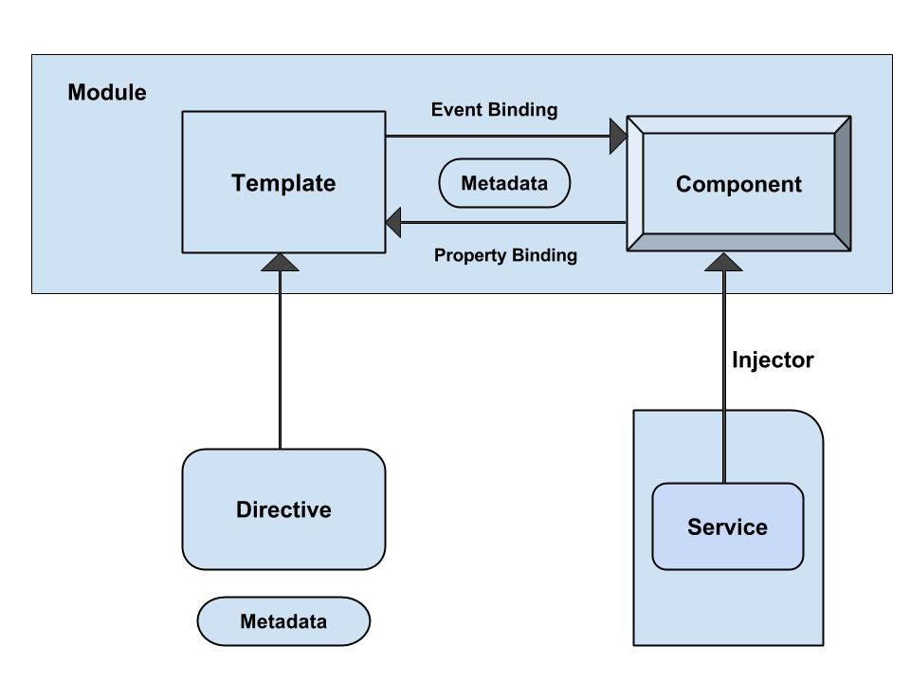
Angular - Architecture

Slide 151
Angular CLI commands
Component
  ng g component my-new-component
Directive
  ng g directive my-new-directive
Pipe
  ng g pipe my-new-pipe
Service
  ng g service my-new-service
Class
  ng g class my-new-class
Interface
  ng g interface my-new-interface
Module
  ng g module my-module

Slide 152
Angular Application Folder structure
Creates a Sample Angular Application
It contains the subfolders e2e, node_modules and src.
It also contains the few configuration files
Angular-cli.json
  This is the configuration file for Angular CLI
karma.json
  The Configuration file karma test runner. Angular uses the Jasmine as the testing framework
protractor.conf.js
  The Configuration file for protractor end to end test runner.
tslint.json
  tslint is a static code analysis tool used in software development for checking Typescript code quality.

Slide 153
Packages.json
It also creates a packages.json which contains dependencies
  {
  "name": "quickstart",
  "version": "0.0.0",
  "scripts": {
  },
  "dependencies": {
  },
  "devDependencies": {
  }
  }

Slide 154
Packages.json
Script Section
  This Script section contains many of the most useful commands
  Ng,start,test etc
devDependencies Section
  This section contains the entries required for application development
  Typescript,karma,jasmine,protractor etc.,

Slide 155
dependencies section
  This section contains the framework and utility capabilities
@angular/core
  Critical runtime parts for every application.
  metadata decorators, Component, Directive, dependency injection, and the component lifecycle hooks.
@angular/common
  The commonly needed services, pipes, and directives provided by the Angular team.
@angular/compiler
  Template Compiler
  Can convert to code
  Used indirectly via platform-browser-dynamic or the offline template compiler.
@angular/platform-browser
  For bootstrapping applications for production

Slide 156
Updating Package.json
Can also add in Project’s package.json and run update
  "dependencies": {
  "bootstrap": "^3.3.7”
  },
Import the Bootstrap.min.css to style.css
  @import "../node_modules/bootstrap/dist/css/bootstrap.min.css";

Slide 157
Sample Application
app/app.component.ts
  where root component is defined
app/app.component.css
  where Css Styles are defined
app/app.component.html
  where HTML templates are defined
app/app.component.spec.ts
  where Test Specification are defined
app/app.module.ts
  - the entry Angular Module to be bootstrapped
index.html
  this is the page the component will be rendered in
app/main.ts
  - is the glue that combines the component and page together

Slide 158
@Component decorator
Components are decorated with @Component decorator.
Provides Metadata about component
It consists of three main parts
  @Component({
  selector: 'app-root',
  templateUrl: './app.component.html',
  styleUrls: ['./app.component.css']
  })

Slide 159
@Component
Selector
  Denotes the location to display the template.
  The tag in the HTML file is replaced with the the template
templateUrl
  Contains the path to the HTML template file.
  This HTML file is used to render the view.
  The file is in the same folder as the AppComponent.
styleUrls
  An array of Style Sheets that uses to style our HTML file.
  It points towards to app.component.css style sheet.

Slide 160
Export and Import Component
  import { Component } from '@angular/core';
  @Component({
  selector: 'app-root',
  templateUrl: './app.component.html',
  styleUrls: ['./app.component.css']
  })
  export class AppComponent {
  title = 'app';
  }

Slide 161
app/app.component.html
  <div style="text-align:center">
  <h1>
  Welcome to {{title}}!!
  </h1>
  </div>

Slide 162
NgModule
Modules are class decorated with the @NgModule
Decorator function which has one argument
  A metadata object with properties describing the module.
Some of its important properties are:
Bootstrap Array
Export Array
Import Array
Provider Array.

Slide 163
Modules
  import { NgModule } from '@angular/core';
  import { BrowserModule } from '@angular/platform-browser';
  import { CreditCardModule } from '../credit-card/credit-card.module';
  import { AppComponent } from './app.component';
  @NgModule({
  imports: [ BrowserModule, CreditCardModule ],
  declarations: [AppComponent],
  bootstrap: [AppComponent] })
  export class AppModule { }

Slide 164
Modules
Bootstrap array
  Used to inform which components need to be loaded, so that its functionality can be accessed in the application.
Export array
  Used to export components, directives, and pipes which can then be used in other modules.
Import array
  Used to import the functionality from other modules.
Providers array
  Used to provide the services by the module

Slide 165
app/app.module.ts
The Angular applications are organized as modules.
  application must have at least one module.
  root Module is loaded first
  Reference of root component type is passed as argument
  Its called as root module
Application routes declarations should be done here

Slide 166
app/app.module.ts
  import { BrowserModule } from '@angular/platform-browser';
  import { NgModule } from '@angular/core';
  import { AppComponent } from './app.component';
  @NgModule({
  declarations: [
  AppComponent
  ],
  imports: [
  BrowserModule
  ],
  providers: [],
  bootstrap: [AppComponent]
  })
  export class AppModule { }

Slide 167
environments.ts
  The list of env maps are found in angular-cli.json
  The file is Present in the folder src/environments.
  contains the contents for the current environment.
  In the production environment, environment.prod.ts will be used.

Slide 168
Modules
Modules help organize an application into cohesive blocks of functionality.
Every Angular app has a root module class.
By convention, the root module class is called AppModule and it exists in a file named app.module.ts.
imports
  -Import the modules that you need in your App.
  Example: BrowserModule
declarations
  Declare the components and directives that belong to your angular App.
bootstrap
  Declare the bootstrap component that your application.

Slide 169
app/main.ts
Makes angular to load the AppModule and controls the start up of the application
bootstrapModule method of platformBrowserDynamic library
  to bootstrap AppModule
  import { enableProdMode } from '@angular/core';
  import { platformBrowserDynamic } from '@angular/platform-browser-dynamic';
  import { environment } from './environments/environment';
  import { AppModule } from './app/app.module';
  if (environment.production) {
  enableProdMode();
  }
  platformBrowserDynamic().bootstrapModule(AppModule);

Slide 170
app.main.ts
platformBrowserDynamic library.
  Contains the functions required to bootstrap the angular application.
enableProdMode from @angular/core library.
  The Angular’s code by default runs in development mode.
  The development mode runs few assertions and checks
  helps in debugging the application.

Slide 171
index.html
  <html>
  <head>
  <link rel="icon" type="image/x-icon" href="favicon.ico">
  </head>
  <body>
  <app-root></app-root>
  </body>
  </html>
The selector “app-root”, defined in component metadata is used as HTML tag.
Angular scans the HTML page for <app-root>
  replaces the entire content with content of app.component.html

Slide 172
Running Angular Application
  npm start
  will run definitions of the start command of the scripts object in package.json file.
  Compiles the Angular application and invokes the Webpack development server.
  Watches project folder and if any changes are made it compiles the project again.
  Server listens on HTTP Port 4200.
  http://localhost:4200/
Can Change the Default Port using angular-cli.json
  "defaults": {
  "styleExt": "css",
  "component": {},
  "serve": {
  "port": 5200
  }
  }

Slide 173
Ng-serve
ng serve
  command launches the server,
  Watches files, and rebuilds the app
  serves an Angular project via a development server
Using the --open or -o option
  will automatically open browser on http://localhost:4200/.

Slide 174
COMPONENTS-IN DEPTH

Slide 175
The Component
Angular migrated from directives to components
  Directives that are always associated with a direct template.
They represent the view of the application.
Can have methods and properties, which supply logic to view.
Smart / Container components
  application-specific, higher-level, container components, with access to the application's domain model.
Dumb / Presentational components
  components responsible for UI rendering and/or behavior of specific entities passed in via component properties and events
_x000b_

Slide 176
Generating Components
ng generate or ng g
Ng generate component footer
ng generate component my-new-component
ng g component my-new-component
ng g component feature/new-cmp
Creating a new component, generates the following files
  component.html (View)
  component.ts (Controller)

Slide 177
Assets
Static Files like images and styles are served from assets folder
src/assets/css and copy the styles.css to it.
src/assets/images and copy the images to it

Slide 178
Component Class
The basic building block of an UI
  An application is a tree of components.
Component decorator marks a class as an Angular component
A component must belong to an NgModule in order for it to be usable by another component or application.
Component Class has a constructor() to setup Dependency Injection
Components can control their runtime behavior by implementing various Life-Cycle hooks.

Slide 179
Constructors
The default method that runs when component is being constructed.
Its a typescript feature and it is used only for a class instantiations
  Has nothing to do with Angular
  JavaScript engine calls the constructor, and not by Angular directly.
Its called first time before the ngOnInit().

Slide 180
Lifecycle Hooks
A component has a lifecycle managed by Angular.
Provide visibility into life moments and the ability to act when they occur.
  Creates ,renders its children,
  checks it when its data-bound properties change,
  destroys it before removing it from the DOM.

Slide 181
Life Cycle Hook Interfaces
The interfaces are optional for JavaScript and Typescript
  from a purely technical perspective.
No need to add the lifecycle hook interfaces to directives and components
Angular inspects component classes and calls the hook methods if they are defined.
However It's good practice to add interfaces
  To benefit from strong typing and editor tooling.

Slide 182
Component lifecycle hooks overview
Two interface each with a single hook method
  OnInit interface method named ngOnInit()
  called shortly after creating the component:
ngOnInit()
  Initialize the directive/component after Angular first displays the data-bound properties
  Used as a signal that Angular has finished initializing the component.
  Called once, after the first ngOnChanges().
Change Detection happens against the properties that are bound to the component itself - such as using an @Input() decorator.
@Input() properties are available inside ngOnInit
  They are undefined inside the constructor, by design.

Slide 183
Constructor and ngInit
  export class Users implements OnInit {
  user_list: Array<any>;
  constructor(private _userService: UserService){
  };
  ngOnInit(){
  this.getUsers();
  };
  getUsers(){
  this._userService.getUsersFromService().subscribe(users => this.user_list = users);
  this.user_list.toUpperCase();
  }; }

Slide 184
Header Component
  import { Component, OnInit } from '@angular/core';
  @Component({
  selector: 'app-header',
  templateUrl: './header.component.html',
  styleUrls: ['./header.component.css']
  })
  export class HeaderComponent implements OnInit {
  banner: string;
  constructor() {
  this.banner = 'assets/images/Banner.jpg';
  }
  ngOnInit() { }
  }

Slide 185
Data Binding - Interpolation
communication between a component and it’s Template
  {{ expression }} to render the bound value to the component’s template.
  To weave calculated strings into the text between
    HTML element tags and within attribute assignments.
  Replaces the name with the string value of the corresponding component property
  <img src={{banner}} class='banner' />

Slide 186
Configuring More than One Component
  Done in the app.module.ts
  import { AppComponent } from './app.component';
  import { HeaderComponent } from './app.headercomponent';
  @NgModule({
  declarations: [
  AppComponent,
  HeaderComponent,
  ],
  imports: [
  BrowserModule
  ],
  providers: [],
  bootstrap: [AppComponent,HeaderComponent]
  })
  export class AppModule { }

Slide 187
Index.html
  <!doctype html>
  <html lang="en">
  <head>
    <base href="/">
    <meta name="viewport" content="width=device-width, initial-scale=1">
    <link rel="icon" type="image/x-icon" href="favicon.ico">
  </head>
  <body>
      <app-header> </app-header>
      <app-root> </app-root>
  </body>
  </html>

Slide 188
TEMPLATES

Slide 189
Angular Templates
Templates mix native HTML with custom elements.
Inline Templates
  Specified directly in the component decorator
  Template literals with back-ticks allow multi-line strings.
  @Component({
  selector: 'inline-template',
  template: ` <h2>Inline Template</h2>
  <p> Multi-line inline template using back-ticks </p>`
  })
  export class InlineComponent {}

Slide 190
Angular Templates
External Templates
  Defined in a separate HTML file
  Referenced with templateUrl.
  Recommended to use if the template contains more than 3 lines.
  @Component({
  selector: 'external-template',
  templateUrl: 'app/templates/external-template.html'
  })
  export class ExternalComponent {}

Slide 191
PROPERTY BINDING

Slide 192
Types of Property Binding
Element property binding
  works within HTML element
  binds a component property to a DOM property.
Component property binding
  works within component element to bind parent component property into child component property.
Directive property binding
  works within HTML element with angular directives such as NgClass and NgStyle.
  In directive property binding a component property or any angular expression is bound to angular directive.

Slide 193
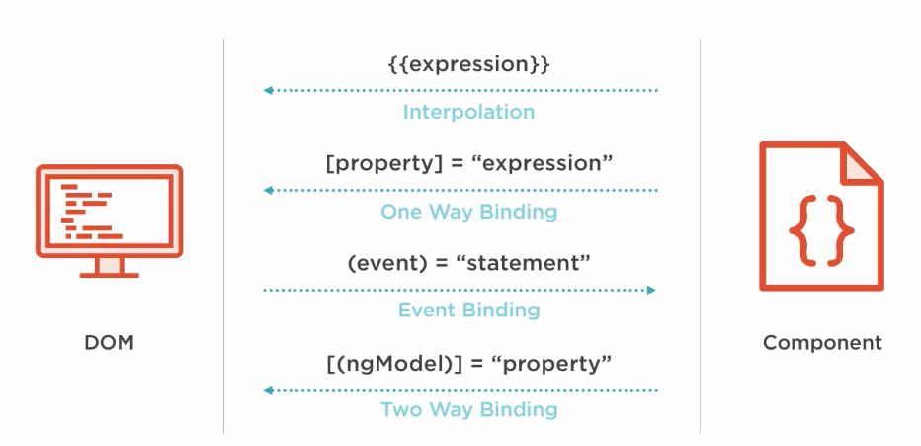
Element Property Binding

Slide 194
Property Binding
  Property binding A One way Binding that allows to send
    from the component class, to the component’s template.
Sets an element property to a component property value.
Can be Used for non-string data value.
Done by wrapping brackets around an element
  Done to a component property.
  <img [src]=" imageUrl ">

Slide 195
Property Binding – Element Property
  export class FoodComponent {
  idly :Food={
  favTime:’Any time”,
  name:'idly',
  imageUrl:'assets/images/idly.jpg'
  }
  }
  export class Food{
  favTime:string;
  name:string;
  imageUrl:string
  }
  <img [src]="idly.imageUrl">
  <h1 [innerHTML]=“idly.name"></h1>

Slide 196
Event Binding
Event handler is specified inside the template using () to denote event binding.
Can take the same property that is on the HTML element wrap it in parenthesis. Use input to trigger the template statement.
This event handler is then coded in the class to process the event.
  template: `
  <h1>My First Angular App</h1>
  <img [src]="imageUrl" (click)='myMethod()'> `
      imageUrl =‘’assets/images/idly.jpg'
  myMethod() {
  console.log('Hello);
  }

Slide 197
Event Binding
Can also pass information about the event to the component class:
  ` <img src=“{{imageUrl}}" (click)='myMethod($event)'> `
  myMethod(event:any) {
  console.log(event);
  }

Slide 198
Two Way Binding
Combines the input and output binding into a single notation
Done by using a special directive called ngModel.
<input [(ngModel)]="name" >
  <input [ngModel]="name" (ngModelChange)="name=$event">
square braces [..] refers property binding.
circle braces (..) refers to the event binding.
  Together as [(..)] refers two way binding
This syntax is called Banana in a Box ([()]).

Slide 199
Two Way Binding- App Module
  import { FormsModule } from '@angular/forms';
  @NgModule({
  declarations: [
  AppComponent,
  ],
  imports: [
  BrowserModule,FormsModule
  ],
  providers: [],
  bootstrap: [AppComponent,ShowplacesComponent]
  })

Slide 200
Two Way Binding
  <div> <label>Name:</label>
  <input type="text" [(ngModel)]="name">
  <h1>Hello {{name}}!</h1> </div>
  export class AppModule {
  private name:string='World';
  }

Slide 201
Two way Binding
  <div> {{student.studentNumber}}</div>
  <div> {{student.studentName}} </div>
  <div>{{student.mark}}</div>
  <input [value]="student.studentNumber“ [(ngModel)]="student.studentNumber">
  <input [value]="student.studentName" [(ngModel)]="student.studentName">
  <input [(ngModel)]="student.mark">
  <p> <button (click)="reset()">Reset</button> </p>

Slide 202
Two Way Binding
  export class AppComponent {
  private name:string='World';
  private student:Student={
  studentNumber :101,
  studentName :'Ramesh',
  mark :78
  }
  reset(){
  this.student.studentNumber=0;
  this.student.studentName='';
  this.student.mark=0;
  }
  }

Slide 203
DIRECTIVES

Slide 204
Directives
Used to attach behavior to DOM elements.
There are built-in directives to the framework
  NgFor, NgIf, NgModel, NgClass
There are three kinds of directives:
Components
  @Component(): Is also a directive with a template.
Structural Directives
  Can change the DOM layout by adding and removing DOM elements
Attribute Directives
  doesn’t change the DOM but can change the appearance or behavior of an element such as NgStyle.

Slide 205
Attribute Directives
These directives change the appearance or behavior of a component.
They work in a way that is component agnostic and not bound to implementation details.
Example:
  ngClass and ngStyle work on any component or element.

Slide 206
NgStyle Directive
To modify a component or element's style attribute.
  @Component({
  selector: 'style-example',
  template: `
  <p [ngStyle]="{'background-color':messageStyle}">
  `
  })
  export class StyleExampleComponent {
  messageStyle:string='yellow';
  }

Slide 207
NgClass Directive
Directive changes the class attribute that is bound to the component or element it's attached
Binding a string
  Can bind a string directly to the attribute.
  @Component({
  selector: 'class-as-string',
  template: `
  <p ngClass='centerText'>Page Designed by Ramesh</p>
  `,
  Binding an Array : A list of applicable class names defined in css
  <p [ngClass]="['centerText','highLight']">Page Designed by Ramesh</p>

Slide 208
Binding an object
Object can be bound to the directive.
Each property name of that object to the component if that property is true.
  @Component({
  selector: 'class-as-object',
  template: `
  <p [ngClass]="{ card: true, dark: false, flat: flat }">
  <button type="button" (click)="flat=!flat">Toggle Flat</button>
  </p>
  `,
  export class ClassAsObjectComponent {
  flat: boolean = true;
Object's card and flat properties are true
  those classes are applied
  Since dark is false, it's not applied.

Slide 209
Structural Directives
Handling how a component or element renders through the use of the template tag.
Prefixed with an asterisk.
Expression binding without square brackets.
  syntactic sugar that allows using the directive in a more intuitive way
ngIf , ngFor , and ngSwitch .
  @Component({
  selector: 'directive-example',
  template: `
  <p *structuralDirective="expression">
  Under a structural directive.
  </p>
  `})

Slide 210
Built-in Directives -ngFor
Part of core directive to build data presentation lists and tables
Takes an iteration expression
A loop variable defined using the keyword let
  <tr *ngFor="let medicine of medicineList">
    <td>{{medicine.medicineName}}</td>
    <td>{{medicine.price}}</td>
    <td>{{medicine.unit}}</td>
  </tr>
  <tr *ngFor="let medicine of medicineList let i=index">
  <td>{{i+1}}</td>
  </tr>

Slide 211
Ng-For
NgFor directive is use for iterate items in a templates.
NgFor run as a loop in the collection and bind data into html template.
  Its work similar to ng-repeat work on Angular 1.x.
Changes in collection , templates recreate and load into DOM.
Basic syntax of ng-for is -
ng-for #item [ng-for-of]="items" #i="index"
Short hand syntax of ng-for is
*ng-for="#item of items"

Slide 212
Ng-For
  <ul>
  <li *ng-for="#items of collections; #i = index">
  {{items }}
  </li>
  </ul>
  <ul type="none">
  <li *ng-for="#emp of employees; #i = index">
  <p> <b>Index - {{i}}</b>
  <br> <b> Name</b> - {{emp.name}} </p>
  </li>
  </ul>

Slide 213
ngFor
ngFor also provides some other values that can be bound to:
index - position of the current item in the iterable starting at 0
first - true if the current item is the first item in the iterable
last - true if the current item is the last item in the iterable
even - true if the current index is an even number
odd - true if the current index is an odd number

Slide 214
Built-in Directives –ngIf
*ngif="condition“
  Removes element from DOM if condition is not “truthy”
  <div>
  <button (click) =“clicked()”>Toggle</button>
  <div *ngIf=“show”>
  <p> see Image</p>
  </div>
  </div>
  export class AppComponent{
  show:boolean =true;
  Clicked (){
  this.show=!this.show;
  }
  }

Slide 215
*ngIf and Else
Components has a defined template in the component class.
  Can display a template if an expression matches some condition.
  <li *ngIf="myArr">Yeah, I exist.</li>
If object myArr is defined, it evaluates to true and displays the HTML element
<li *ngIf="myArr == 'something'">Yeah, I exist.</li>
Can also specify the ! not operator and it won't display the given HTML element

Slide 216
*ngIf and Else
Can also declare else as conditions:
  template: `
  <h1>Hey guys!</h1>
  <ul> <li *ngIf="myArr; else otherTmpl">Yeah, I exist.</li> </ul>
  <ng-template #otherTmpl>No, I do.</ng-template> `
Can also use then inside of expression
  template: `
  <h1>Hey guys!</h1>
  <div *ngIf="myArr; then tmpl1 else tmpl2"></div>
  <ng-template #tmpl1>I'm here</ng-template>
  <ng-template #tmpl2>I'm not here</ng-template> `,

Slide 217
NESTING COMPONENTS

Slide 218
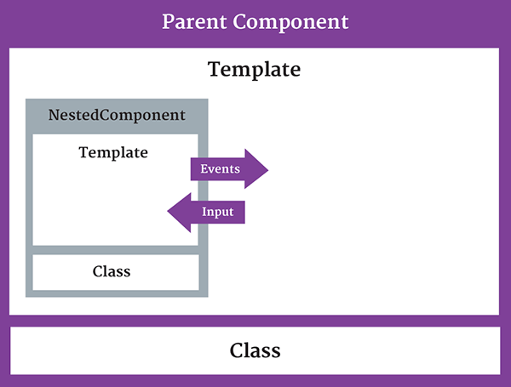
Nested Component
The component being used inside another component is known as the child component
  and the enclosing component is known as the parent component.

Slide 219
Nested Component -Child
  import { Component } from '@angular/core';
  @Component({
  selector: 'appchild',
  template: `<h2>Hi {{greetMessage}}</h2>` })
  export class AppChildComponent {
  greetMessage: string = "I am Child";
  }

Slide 220
Nested Component- Parent
  import {Component } from '@angular/core';
  import {AppChildComponent} from './appchild.component';
  @Component({
  selector: 'my-app',
  template: `<h1>Hello {{message}}</h1>
  <appchild></appchild> `,
  })
  export class AppComponent {
  message : string = "I am Parent";
  }

Slide 221
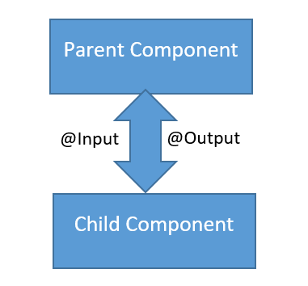
Communication Between Components
Can share data and information with another component by passing data or events.
Components can communicate to each other in different ways:
  Using @Input()
  Using @Output()
  Using Services
  Parent component calling ViewChild

Slide 222
PASSING DATA USING @INPUT
  This decorator is used to pass data into components from template and to dynamically configure them.
  Can NOT pass @Input() to a bootstraped component.
  Can also pass the value as an attribute.
Binds a property within one component (child component) to receive a value from another component (parent component).
  One way communication from parent to child.
Component property should be annotated to act as input property.

Slide 223
Child Component
  import { Component,Input,Output,EventEmitter, OnInit } from '@angular/core';
  @Component({
  selector: 'review-food',
  templateUrl:'reviews.component.html',
  styleUrls: ['../food-items/food/food.component.css']
  })
  export class ReviewsComponent {
  @Input() reviewedby:string;
  details='Reviewed by 200 peoples';
  }

Slide 224
Parent Component-One Way Component Property Binding
  import { ReviewsComponent } from '../../reviews/reviews.component';
  @Component({
  selector: 'app-food',
  templateUrl: './food.component.html',
  styleUrls: ['./food.component.css'],
  })
  export class FoodComponent {
  reviewer:string = 'Zomoto';
  }
Reviwed by <review-food [reviewedby]='reviewer'></review-food>
Parent component sets the value of the child component’s property
Input Property as defined in Child
Bound property in Parent

Slide 225
@output
One way communication from child to parent component
Uses events
  binds a property of a component to send data from one component (child component) to calling component (parent component).
The child component exposes an EventEmitter property
  It emits events when something happens.
  The parent binds to that event property and reacts to those events.
The child's EventEmitter property is an output property,
  Its adorned with an @Output decoration

Slide 226
OutPut
Can also alias the property name as @Output(alias)
  alias name will be used in custom event binding in calling component.
  @Output('addStudentEvent')
  addStdEvent = new EventEmitter<Student>();
  addStudentEvent will become custom event name.
  @Output()
  sendMsgEvent = new EventEmitter<string>();
  sendMsgEvent will be custom event name.

Slide 227
Child Component
  import { Component,Input, Output,EventEmitter,OnInit } from '@angular/core';
  export class ChildComponent implements OnInit {
  @Input() childName: string;
  @Output() result: EventEmitter<String> = new EventEmitter<string>();
  constructor() { }
  ngOnInit() { }
  addData(){
  this.result.emit(this.childName + 'Added');
  }
  }

Slide 228
Emit
emit()
  emit a change to (change) listener in the parent
  Which will invoke the onchange($event) callback
  The data associated with the event will be given via the $event property.
Child-Component.html
  <p>
  <button (click)="addData()">Add Medicine</button>
  </p>

Slide 229
Parent-component.html
  <p>
  <input type='text' [(ngModel)]='nameFromParent'>
  </p>
  <app-child childName={{nameFromParent}} (result)="onchange($event)"></app-child>
  <p>{{msgRecvdFromChild}}</p>

Slide 230
Parent Compnent
  export class ParentComponent implements OnInit {
  constructor() { }
  msgRecvdFromChild: string;
  nameFromParent: string;
  ngOnInit() {
  }
  onchange(val) {
  this.msgRecvdFromChild = val;
  }
  }

Slide 231
OnChange
In parent-child component
  Child component declares @Input() property to get values from parent component.
OnChange()
  Whenever parent changes the value used in child Input Property
    This method In child component runs automatically.

Slide 232
Parent Component
  export class OutputComponent {
  msg:string;
  constructor() { }
  onChange(val)
  {
  this.msg=val;
  }
  }

Slide 233
CUSTOM DIRECTIVES

Slide 234
Custom Directives
Custom Attributes Directive are created as a class.
The class is decorated with the Directive decorator
  specifies a selector which will be looked up in views.
ng generate directive [name]
<p> <span myUnderline>Hover to underline</span> </p>

Slide 235
Directive
ElementRef
  Injected into the directive’s constructor to access the DOM element
  Can access the DOM Element through nativeElement property
  @Directive({
  selector: '[red]'
  })
  A CSS selector to identify the HTML in the template
  The CSS selector for an attribute is the attribute name in square brackets.
Used in the HTML code
<h1 red> Let's 'RED' me!</h1>

Slide 236
Simple Directive
  import { Directive, ElementRef } from '@angular/core';
  @Directive({
  selector: '[red]'
  })
  export class RedDirective {
  constructor(el: ElementRef) {
  el.nativeElement.style.color = 'red';
  }
  }

Slide 237
Directive With Input Properties
The inputs property defines
  directiveProperty to bindingProperty configuration:
directiveProperty
  specifies the component property where the value is written.
bindingProperty
  specifies the DOM property where the value is read from.
By default bindingProperty is equal to directiveProperty.

Slide 238
Directive
  @Directive({
  selector: '[appColorText]'
  })
  export class ColorTextDirective {
  constructor(private el: ElementRef) {
  this.el = el;
  }
  @Input() set favColor(color: string){
  this.el.nativeElement.style.color = color;
  }
  @Input()set bgColor(color: string){
  this.el.nativeElement.style.backgroundColor = color;
  }
  }

Slide 239
Using the Directive
  <h1 appColorText favColor="blue" bgColor="red">
  Custom Directive
  </h1>

Slide 240
Directives with Host Listeners
Specifies which DOM events a directive listens to via a set of (event) to method key-value pairs:
event:
  the DOM event that the directive listens to.
statement:
  the statement to execute when the event occurs.
  If the evaluation of the statement returns false, then preventDefault is applied on the DOM event.
To listen to global events, a target must be added to the event name.
  The target can be window, document or body.

Slide 241
Host Listener Directive
  export class UnderlineDirective {
  constructor(
  private renderer: Renderer,
  private el: ElementRef
  ){}
  @HostListener('mouseenter') onMouseEnter() {
  this.hover(true);
  }
  @HostListener('mouseleave') onMouseLeave() {
  this.hover(false);
  }
  <h1 appUnderLine>Movie List</h1>

Slide 242
Host Listener Directive
  hover(shouldUnderline: boolean){
  if(shouldUnderline){
  this.renderer.setElementStyle(this.el.nativeElement,
  'text-decoration', 'underline');
  } else {
  this.renderer.setElementStyle(this.el.nativeElement,
  'text-decoration', 'none');
  }
  }

Slide 243
Directive and Components
@Components
@Directive
To register the components.
To create UI widgets.
To split to application into smaller parts.
Only one component is used per DOM element.
template and templateUrl are mandatory in the components.
To register the directives.
To Change or add existing DOM elements.
To design a reusable components.
More than one directive are used per DOM element.

Slide 244
DEPENDENCY INJECTION

Slide 245
Dependency Injection
The ability to add functionality to components at runtime.
  Simplify dependency management in software components.
Done by reducing the amount of information a component needs to know about its dependencies,
  unit testing can be made easier and code is more likely to be flexible.

Slide 246
Without DI
  class Travel{
    private localTransport: Car;
    private hotel: Hotel;
  constructor() {
    this.localTransport = new Car(‘BMW');
    this.hotel = new Hotel(‘ThreeStar');
  }

Slide 247
Passing Dependencies
  class Travel{
    private localTransport: Car;
    private hotel: Hotel;
  constructor(vechType:string,hotelCategory:string) {
    this.localTransport = new Car(vechType);
    this.hotel = new Patty(hotelCategory);
  }
travelPlan = new Travel(new Car(), new Hotel(‘Three Star‘));

Slide 248
DI – Next Step
  class Travel{
    private localTransport: Car;
    private hotel: Hotel;
  constructor(localTransport:Car,hotel:Hotel) {
    this.localTransport =localTransport;
    this.hotel =hotel;
  }
  When Travel is instantiated it does not need to know anything about its Hotel or Local Transport
  The construction of these elements has been moved out of the class
  Angular provides a dependency injection system.

Slide 249
DI Framework
DI Frameworks have the concept of an Injector object.
An Injector is a like the factory function for a collection of objects.
Injectors return singletons.
  There is not just one injector per application, there is at least one injector per application.
Injectors are organized in a tree that parallels Angular 2's component tree.

Slide 250
DI with Angular
A separate class with injectable decorator.
  Allows the functionality of the class to be injected
The Component in which it has to be used ,
  Defined as a provider in the @Component decorator.
A provider is a resource that Angular uses to provide
A class provider generates/provides an instance of the class.
  @Component ( {
  providers : [classname]
  })

Slide 251
SERVICES

Slide 252
Services
A service is used when a common functionality needs to be provided to various modules.
  Eg: A database functionality that could be reused among various modules.
A separate class which has the injectable decorator
  ng g service my-new-service
Added to the module to use the service as a provider in the @Component decorator.
Services are singleton objects.
Services are capable of returning the data in the form promises or observables.

Slide 253
@Injectable
@Injectable()
  Let know a class can be used with the dependency injector.
  Not strictly required if the class has other Angular decorators on it.
However best practice is to decorate injectables with @Injectable(), as it is makes more sense to the reader.

Slide 254
Model Class
  import { Injectable } from '@angular/core';
  @Injectable()
  export class WeatherData {
  minTemp:number;
  maxTemp:number;
  forecast:string;
  constructor(){
  this.minTemp=29;
  this.maxTemp=30;
  this.forecast='thundstrom and rains';
  }
  getWeatherData(){
  return this;
  }
  }

Slide 255
Service
  import { Injectable } from '@angular/core';
  import {WeatherData} from "./weather-data";
  @Injectable()
  export class WeatherService {
  data:WeatherData;
  constructor(data:WeatherData) {
  this.data=data;
  }
  getWeather(): any {
  return this.data.getWeatherData();
  }
  }

Slide 256
Component
    import { Component } from '@angular/core';
    import {WeatherService} from "./weather.service";
    import {WeatherData} from "./weather-data";
    @Component({
    providers:[WeatherService,WeatherData]
    })
    export class AppComponent {
    weatherReport:WeatherData;
    constructor(private ws :WeatherService){
    this.weatherReport=ws.getWeather();
    }

Slide 257
*R*eactive E*x*tensions for *J*ava*S*cript
A library for composing asynchronous and event-based programs by using observable sequences.
Observable:
  Invokable collection of future values or events.
Observer:
  Callbacks to listen to values delivered by the Observable.
Subscription:
  Execution of an Observable
  Used for cancelling the execution by unsubscribing.
Operators:
  Functions dealing with collections
  map, filter, concat ,etc.

Slide 258
RxJS
  var button = document.querySelector('button');
  button.addEventListener('click', () => console.log('Clicked!'));
Using RxJS
var button = document.querySelector('button');
  Rx.Observable.fromEvent(button, 'click') .
  subscribe(
  () => console.log('Clicked!')
  );

Slide 259
Http Service
Import the map from rxjs
The major difference between Promises and Observables
  Observables may emit data more than once
  They can be subscribed to and unsubscribed from.
The difference between $http and Http
  Http doesn't actually make the request to the server until there is a subscription to the observable.
Map operator takes the response data, converts it to JSON
  Return it to any subscribers that are waiting for the data to resolve.

Slide 260
Http Service
Performs http requests using XMLHttpRequest as the default backend.
Http is an injectable class, with methods to perform http requests.
  Calling request returns an Observable
  which will emit a single Response when a response is received.
Invokes a map on the response observable to get the parsed object
  .map(res => res.json())
Subscribe to the observable to get the parsed object and attach it to the component
  .subscribe(people => this.people = people);

Slide 261
Service
  import { Injectable } from '@angular/core';
  import { Observable } from 'rxjs/Observable';
  import 'rxjs/add/operator/map';
  import { Http } from '@angular/http';
  @Injectable()
  export class MovieServiceService {
  movieList: string[];
  constructor(private http: Http) { }
  getMovieList(): Observable<string[]> {
  return this.http.get('http://localhost:3000/movies')
  .map(res => res.json()); }
  }

Slide 262
Component Injected With Service
  export class ShowmoviesComponent implements OnInit {
  movieList: string[];
  constructor(private service: MovieServiceService) {
  }
  ngOnInit() {
  this.service.getMovieList().subscribe(list => { this.movieList = list});
  }
  }

Slide 263
Template
  <ul *ngFor='let movie of movieList'>
  <li>{{movie.movieId}} {{movie.movieName}}</li>
  </ul>

Slide 264
Module
  @NgModule({
  declarations: [
  AppComponent,
  ShowmoviesComponent
  ],
  imports: [
  BrowserModule,HttpModule
  ],
  providers: [MovieServiceService],
  bootstrap: [AppComponent,ShowmoviesComponent]
  })

Slide 265
PIPES

Slide 266
Pipes
“Pipes transform displayed values within a template.”
  A pipe takes in data as input and transforms it to a desired output.
Used in any template.
Inside the interpolation expression, pipe operator ( | ) is used
<p>The Joining Date is {{ joinDate | date }}</p>
  export class Employee {
  joinDate = new Date(2016, 3, 15);
  }

Slide 267
Built In Pipes
  DatePipe,
  UpperCasePipe, LowerCasePipe,
  CurrencyPipe,
  PercentPipe,
  JsonPipe,
Pipes can accept any number of optional parameters to fine-tune its output.
Pipe name is followed a colon ( : ) and then the parameter value
  currency:'EUR‘
Some of pipes not supported in New versions of angular
  orderBy and filter
Can by achieved by using “custom pipes”.

Slide 268
Date Pipe
date_expression | date[:format]
format indicates which date/time components to include.
  'medium': equivalent to 'yMMMdjms' (e.g. Sep 3, 2010, 12:05:08 PM for en-US)
  'fullDate': equivalent to 'yMMMMEEEEd' (e.g. Friday, September 3, 2010 for en-US)
  'mediumDate': equivalent to 'yMMMd' (e.g. Sep 3, 2010 for en-US)
  'mediumTime': equivalent to 'jms' (e.g. 12:05:08 PM for en-US)
  'shortTime': equivalent to 'jm' (e.g. 12:05 PM for en-US)

Slide 269
Currency Pipe
number_expression | currency[:currencyCode[:symbolDisplay[:digitInfo]]]
currencyCode is the ISO 4217 currency code,
  USD for the US dollar and EUR for the euro.
symbolDisplay
  is a boolean indicating whether to use the currency symbol or code.
  true: use symbol (e.g. $).
  false(default): use code (e.g. USD).
digitInfo
  minIntegerDigits = 2
  minFractionDigits = 2
  maxFractionDigits = 4
  {minIntegerDigits}.{minFractionDigits}-{maxFractionDigits}

Slide 270
Percentage Pipe
Formats a number as a percentage according to locale rules.
number_expression | percent[:digitInfo]
number_expression:
  An angular expression that will give output a number.
percent :
  A pipe keyword that is used with pipe operator and it converts number into percent
digitInfo:
  defines a percentage format.
  {minIntegerDigits}.{minFractionDigits}-{maxFractionDigits}

Slide 271
Decimal Pipe
To format a number as decimal number according to locale rules.
It uses number keyword with pipe operator.
number_expression | number[:digitInfo]
number_expression:
  An angular expression that will give output a number.
number :
  A pipe keyword that is used with pipe operator.
digitInfo :
  Defines number format.
  {minIntegerDigits}.{minFractionDigits}-{maxFractionDigits}

Slide 272
Chaining pipes
Can chain pipes together in potentially useful combinations.
To display the birthday in uppercase, the birthday is chained to the DatePipe and on to the UpperCasePipe.
birthday is {{ birthday | date:'fullDate' | uppercase}}

Slide 273
Pipes Example
<p>The Joining Date is {{ joinDate | date }}</p>
<p>Employee Name is {{name | uppercase}}</p>
<p>Employee Salary is {{salary | currency :'INR':true: '2.2-3'}}</p>

Slide 274
Two Types Pipes
  Pure by Default
  Impure
Pure Pipes:-
  Gets executed only when it detects a pure change to the input value.
  A pure change can be primitive or non-primitive.
  Primitive data are only single values, they have not special capabilities
  Non-primitive data types are used to store the group of values.
Impure Pipes:-
  Get executed during every component change detection cycle.
  Its is called as often as every keystroke or mouse-move.
  Done by setting pure flag to false.
  @Pipe({ name: ‘ImpurePipe', pure: false })

Slide 275
Creating a Custom Pipe
“@Pipe” decorator
  To define the pipe name that is globally available for use in any template
Steps for Creating a Custom Pipe:-
  Create a typescript class.
  Decorate the class using @Pipe.
  Implement PipeTransform interface.
  Override transform() method.
  Configure the class in application module with @NgModule.
  Use custom pipe anywhere in application.

Slide 276
Pipe Transform
Pipes Implement the PipeTransform interface's
  transform method accepts an input value followed by optional parameters and returns the transformed value.
  Can have one additional argument to the transform method for each parameter passed to the pipe.

Slide 277
Custom Pipe
  @Pipe({ name: 'filter‘ })
  @Injectable()
  export class CoursePipe implements PipeTransform {
  transform(mycourses: any[], field: string, value: string): any[] {
    if (!mycourses) {
    return [];
    }
    if (!field || !value) {
    return mycourses;
    }
    return mycourses.filter(courses =>
  Courses[field].toLowerCase().includes(value.toLowerCase()));
  }
  }

Slide 278
Sample Data
  courseList=[
    {"courseName":"java","fees":20000},
    {"courseName":"jee","fees":12000},
    {"courseName":"python","fees":3000},
    {"courseName":"spring","fees":6000},
    {"courseName":"hibernate","fees":40000},
    {"courseName":"RestWebservice","fees":10000},
  ]

Slide 279
Template
  <input [(ngModel)]="srchCriteria">
  <table>
  <tr *ngFor="let course of courseList | filter: 'fees' : srchCriteria">
  <td>{{course.courseName}} </td>
  <td> {{course.fees}} </td>
  </tr>
  </table>

Slide 280
Resources
Type Script Codes
  https://tinyurl.com/yb73kyqr
Angular Hands-On – Module -1
  https://tinyurl.com/y7xuzdn4

