Slide 1

CAR RENTAL MANAGEMENET SYSTEM
Project by:(Group 12)
Karthik Reddy Suram(78)
Vishnu Vardhan Nagunnuri(53)

Slide 2

Introduction
In today's fast-paced world, the demand for transportation services is ever-growing. Car rental businesses play a crucial role in providing convenient and flexible transportation solutions to individuals and organizations alike. However, managing a fleet of vehicles efficiently while ensuring excellent customer service can be a daunting task.
The Car Rental Management System (CRMS) is a comprehensive software solution designed to streamline and automate various aspects of the car rental process. By leveraging the power of technology, CRMS aims to enhance operational efficiency, improve customer experience, and drive business growth for car rental companies

Slide 3

Objective:
The Car Rental Management System is a comprehensive solution tailored to customers seeking car rentals based on specific make and model preferences. Our system provides flexibility for customers to select different locations, catering to their diverse needs and travel plans. In cases where a rental car is returned beyond the scheduled return date and time, our system automatically imposes a late fee to ensure fair usage of the rental service. Our system also provides flexibility to manage billing by adding discount ,late fee and calculate tax.

Slide 4
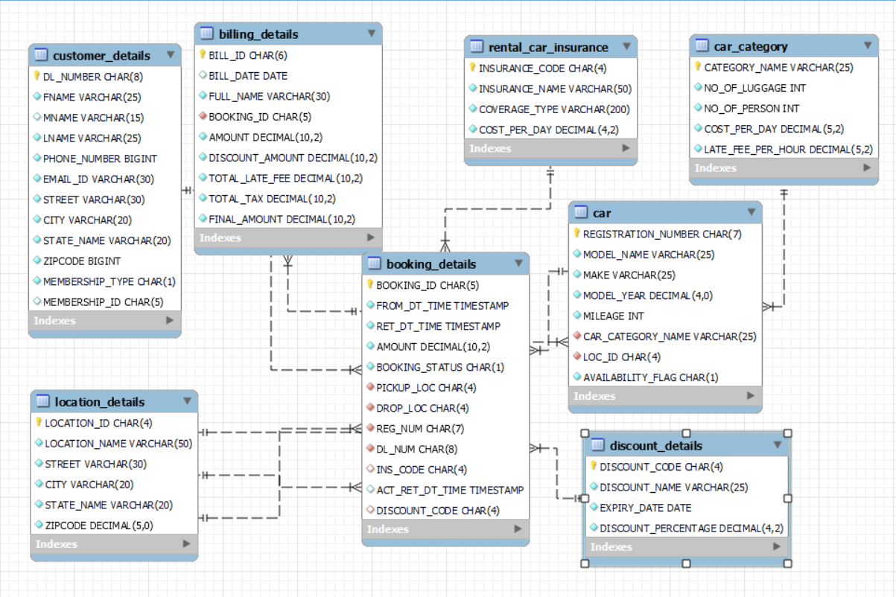
ER Relationship Schema:

Slide 5

Key Features:
Manage Cars
Add a new Car
Display Available Cars
Update Car Details
Delete a Car
Manage Billing
Generate New Bills

Slide 6



Tools Used

Slide 7

THANK YOU

