Slide 1

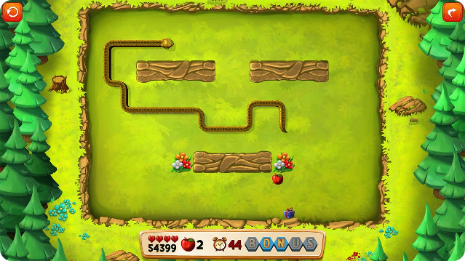
Introduction to the Snake Game
The snake game is a timeless arcade classic that has captivated players for decades. This simple yet addictive game challenges players to navigate a growing snake through a grid, collecting food while avoiding obstacles and the snake's own body.

Slide 2

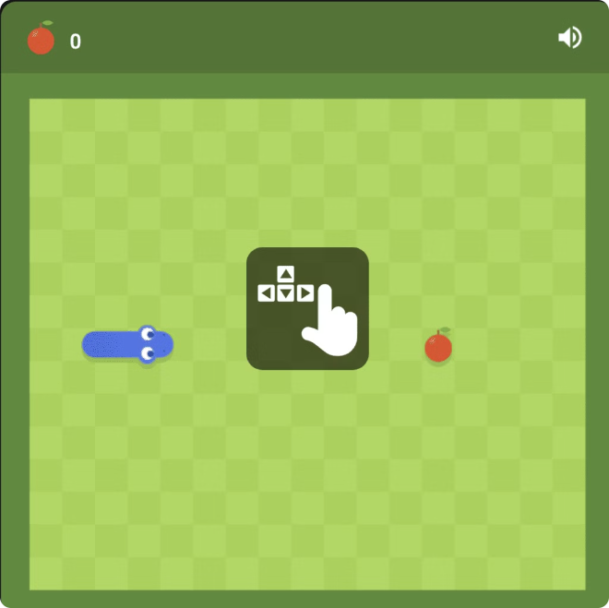
History and Origins of the Snake Game
1
1970s
The earliest versions of the snake game were developed in the 1970s on mainframe computers, with the first commercially released version appearing in 1976.
2
1990s
The snake game gained widespread popularity in the 1990s as mobile phones became ubiquitous, with Nokia including it as a pre-loaded game on their devices.
3
Today
The snake game continues to be a beloved classic, with modern versions and adaptations available on a variety of platforms and devices.

Slide 3
Fundamentals of the Snake Game
Objective
Movement
Scoring
The objective is to guide the snake around the game grid, collecting food items to grow the snake's length while avoiding obstacles and the snake's own body.
Players control the snake's movement using the arrow keys or WASD keys, directing it to turn and navigate the grid.
Players earn points by collecting food items, with the score increasing as the snake grows longer.

Slide 4

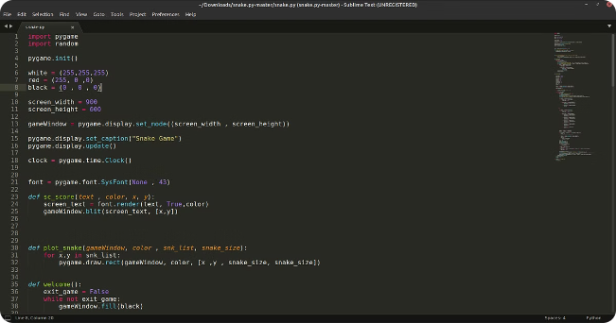
Coding the Snake Game
1
Game Loop
Implement a game loop that continuously updates the snake's position and checks for collisions.
2
Snake Representation
Use a data structure, such as a linked list or array, to represent the snake's body and track its growth.
3
Collision Detection
Develop a collision detection system to handle the snake colliding with walls, obstacles, and its own body.
4
Food Spawning
Randomly spawn food items on the game grid, which the snake must consume to grow longer.

Slide 5


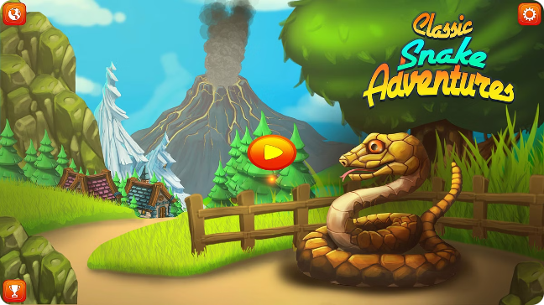


Game Mechanics and Gameplay
Movement
The snake can move in four directions: up, down, left, and right, turning in response to player input.
Growth
When the snake consumes a food item, its length increases, and the player's score is incremented.
Collision
If the snake collides with a wall or its own body, the game ends, and the player's score is displayed.

Slide 6


Challenges and Obstacles in Snake Game Development
Smooth Movement
Ensuring the snake's movement is fluid and responsive, especially as the snake grows longer.
Collision Detection
Accurately detecting and handling collisions between the snake and obstacles, walls, and the snake's own body.
Game Pacing
Balancing the game's difficulty and speed as the player's score increases.
Visual Design
Creating an engaging and visually appealing game environment that enhances the player's experience.

Slide 7


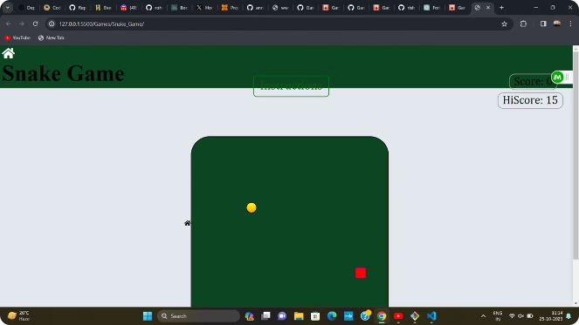



Enhancing the Snake Game Experience
Power-ups
Introduce special power-ups that grant temporary abilities or bonuses to the player.
Leaderboards
Integrate online leaderboards to allow players to compete for the highest scores.
Customization
Allow players to customize the appearance of the snake or the game environment.
Levels
Introduce progressively challenging levels with unique obstacles and layouts.

Slide 8

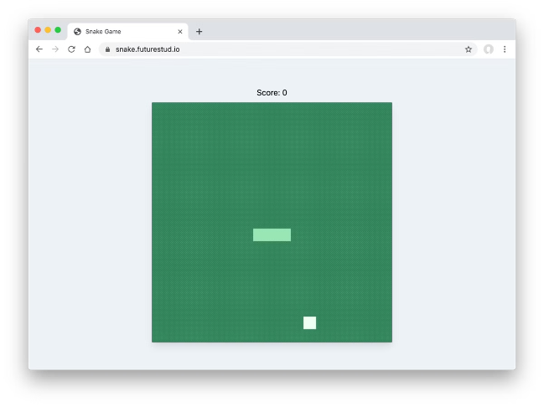
Conclusion and Future Directions
1
Enduring Popularity
The snake game has stood the test of time, remaining a beloved classic in the gaming world.
2
Technical Advancements
As technology advances, the snake game can be further enhanced with features like VR support or AI-driven gameplay.
3
Endless Possibilities
The simplicity and versatility of the snake game concept allow for endless variations and adaptations to captivate new generations of players.

