Slide 1
FITNEST HEALTH CARE WEBSITE
Submitted By:
Vemula Vishnuvardhan(111915136)
Thottempudi Akash Babu(111915134)
Maddu Raviteja(111916026)
Manideep Kaushal Karna(111916023)
Guided By:
Dr. Anagha Khiste

Slide 2
OUTLINE
INTRODUCTION
AIM AND MOTIVATION
STATISTICS OF GRADUATES ON THEIR ABILITY TO WRITE CODE
SOFTWARE REQUIREMENTS
METHODOLOGY
DESIGN ANALYSIS (USER END/FRONT END)
DESIGN ANALYSIS (DEVELOPER END/BACK END)
Chat Box (Back End Purpose)
VIEW OF WEBSITE AND RESULTS
WHAT WE HAD LEARNED
CONCLUSION
REFERENCES
THANK YOU

Slide 3
INTRODUCTION
This project is aimed in developing “FITNEST WELLNESS WEBSITE”.
The project titled “FITNEST WELLNESS WEBSITE” is a responsive website designed/developed using HTML, CSS, JAVASCRIPT and BOOTSTRAP.
FITNEST WELLNESS is a website that looks around the nutrition and wellness of the users.
Users can visit the website and check for the calorific science and much more nutritional information.

Slide 4
AIM AND MOTIVATION
Fitness is the emerging trend throughout the world.
Getting into a good physique has become a motive for most of the youth and also different age groups.
Because of the increased stress and indulging into unhealthy food habits, people are suffering from obesity and various diseases at very younger ages.
People are unaware of the calorific and nutritional sciences.
People now-a-days are very much interested in getting into a good physique as it makes the person look good as well as makes him confident as per some studies .
So, Our Main Aim is to help out everyone reaching out to our website for any possible information regarding to wellness .

Slide 5
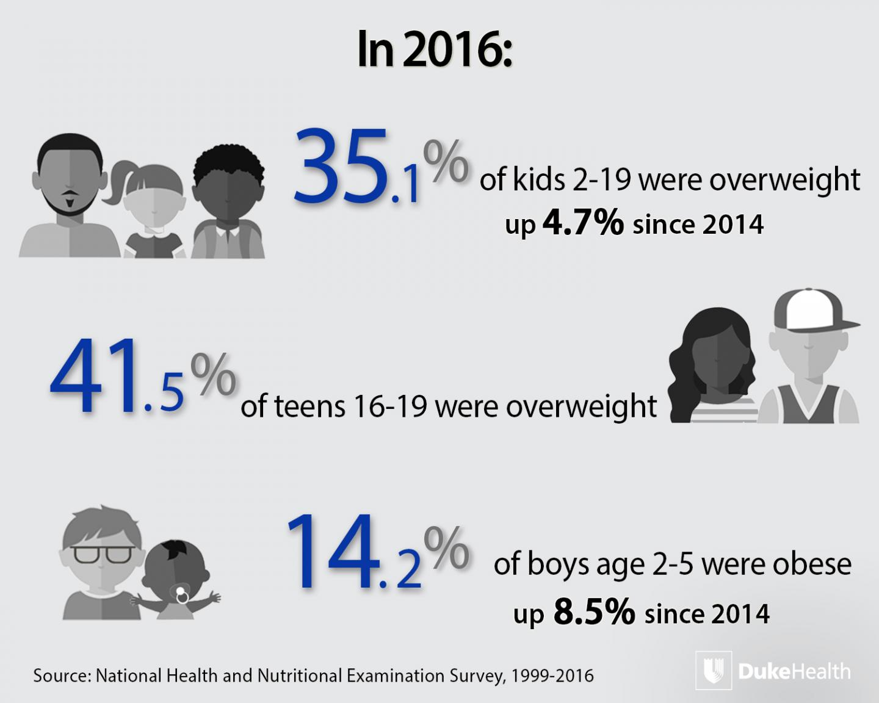
STATISTICS OF OBESITY INCREASING GRADUALLY THROUGHOUT THE WORLD

Slide 6
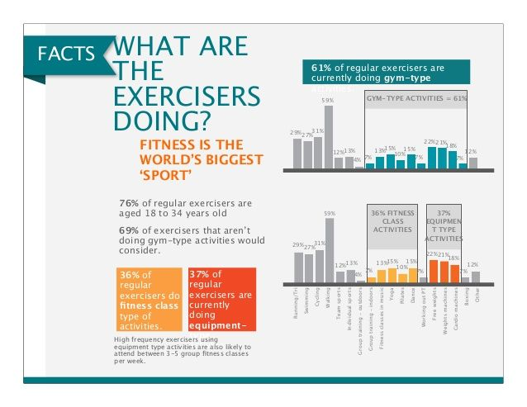
INCREASING TREND OF FITNESS IN THE WORLD

Slide 7
SOFTWARE REQUIREMENTS
Platform : WINDOWS 10 or any
Front End: HTML, CSS, JAVASCRIPT, BOOTSTRAP(we may use REACTJS in future)
Back End: NODEJS
Hosting Service: Github
Browser: Google Chrome, Internet Explorer 8.0 and above, Mozilla Firefox etc (any of these)

Slide 8
METHODOLOGY
Website is the most powerful weapon for communication.
The main reason we created this website is for communication.
For the first time we decided to build/design a website we started making it from scratch using HTML, CSS and a bit of JavaScript.
We will try to host our website using GitHub.
Our website has a calorie counter and daily calorie profile .
We will also add recipes and macro , micro nutrient profile .

Slide 9
CHAT BOX
For the interaction of user and developer we will include a Chat Box which is added to the screen.
Chat box will be able to answer FAQs and basic information .
Using this Chat Box we can interact with the users live.

Slide 10
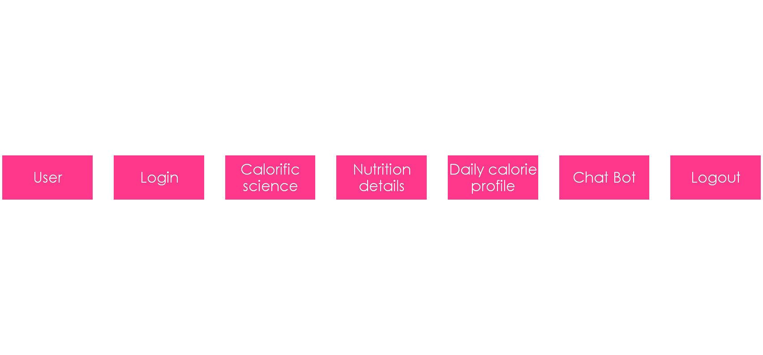
DESIGN ANALYSIS (USER END/FRONT END)

Slide 11
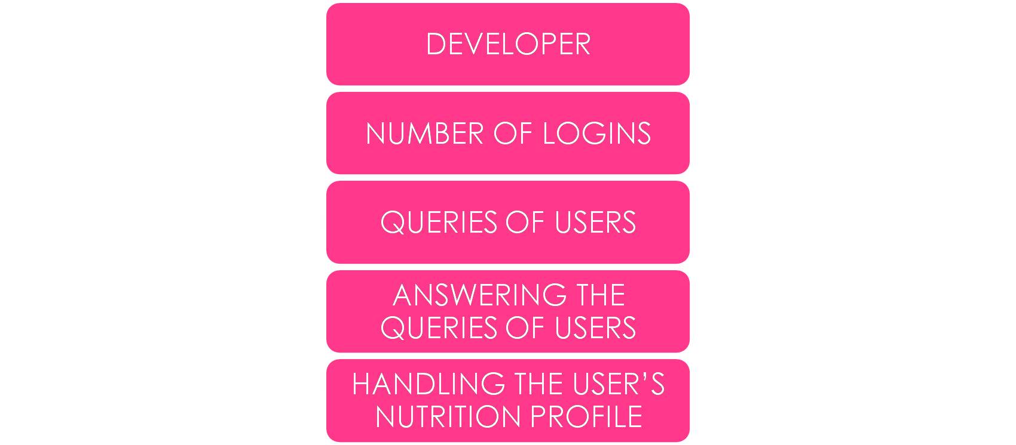
DESIGN ANALYSIS(DEVELOPER END/BACK END)

Slide 12
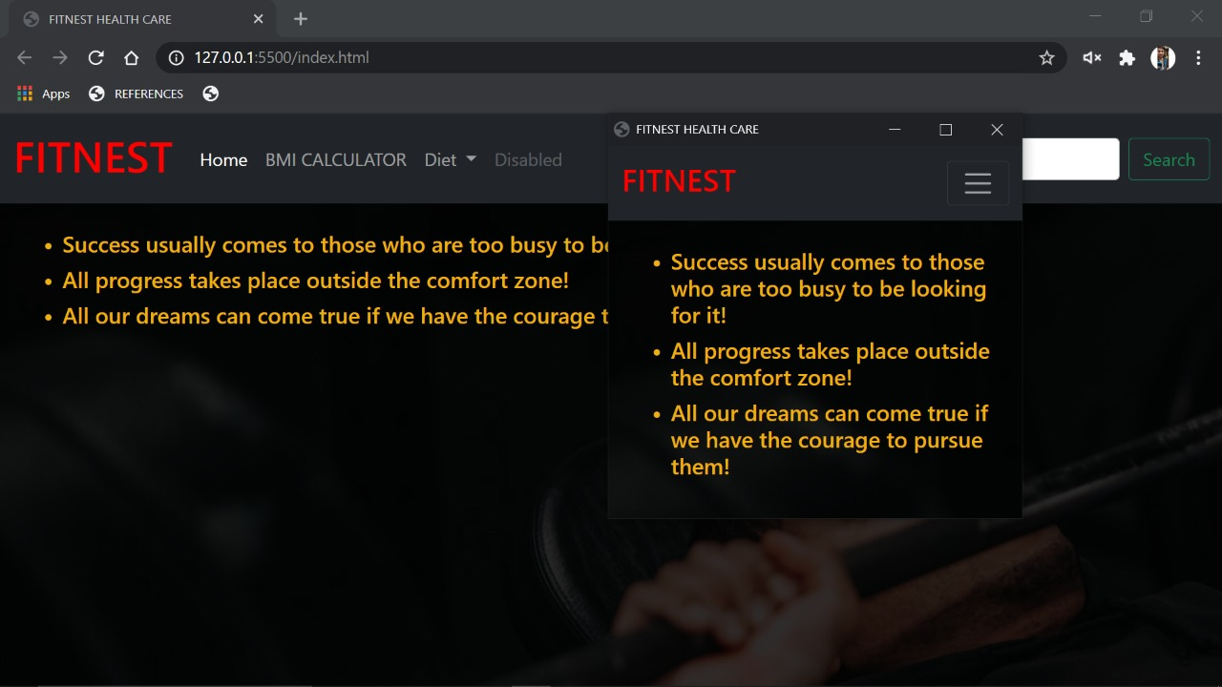
View of website and results

Slide 13
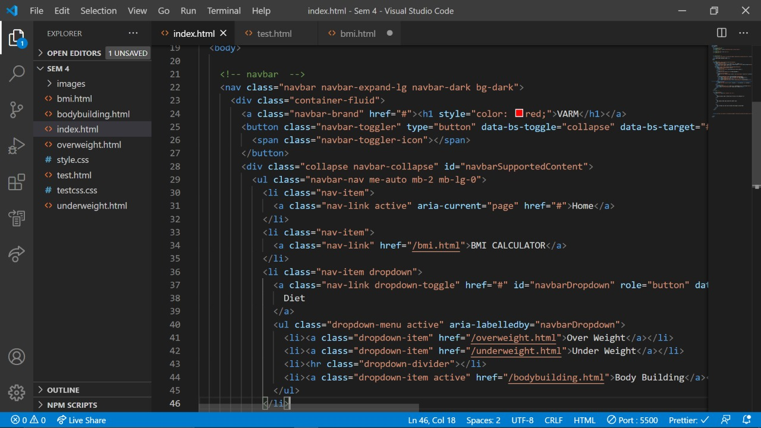
Code outlook

Slide 14
WHAT WE HAD LEARNED
At the start we had zero knowledge on Web Development. We slowly started to know roadmap to design websites.
In the way we started learning HTML, CSS, JS, Bootstrap through some Online Tutorials and Documentations.
And now we are confident enough to design a front end website.
We started learning NodeJS to add backend to the website.
We also improved our skills to work with a group.

Slide 15
CONCLUSION
We finally conclude that our project “FITNEST ELLNESS WEBSITE” is on its way to the completion and hosting. Most of our ideas are finalised and code is yet to be modified.
We are thinking to build this website using for react js for front end and nodejs back end if possible.
We would also like to thank all the faculty members in the Dept. of CSE, ECE and my classmates for their steadfast and strong support and engagement with this project.

Slide 16
REFERENCES
Refsnes Data, W3schools (HTML, CSS, JAVASCRIPT)
Mark Otto and Jacob Thornton, Aug 2017, Bootstrap 4 Documentation (Bootstrap)
Mosh Hamedani,2020, Codewithmosh (NodeJS)
Eat smart, Move more, Sleep right by Luke Coutinho

Slide 17


