Slide 1
Marketplace Revenue Leakage & Profitability Analysis
SQL-based analysis of profitability, discounts, returns, logistics costs and payment fees
Vishnu Narayanan Girishbabu
Business & Data Analytics Portfolio Project MySQL | Data Analysis | Business Analysis

Slide 2
Business Problem & Objectives
Business Problem
High marketplace sales do not necessarily translate into strong retained profitability. Discounts, product returns, fulfilment costs and payment processing fees can gradually erode margins even when topline revenue remains healthy.
Core Question
Where is the marketplace losing revenue and profit, what is driving those losses, and where should management focus its attention?
Analysis Objectives
Evaluate overall sales, costs and profitability
Identify loss-making products and category-level performance
Assess the financial impact of discounts and returns
Analyse logistics and payment-fee leakage
Identify customer and data-quality risks
Translate findings into actionable business recommendations
Data → SQL Analysis → Leakage Diagnosis → Business Insights → Recommendations

Slide 3
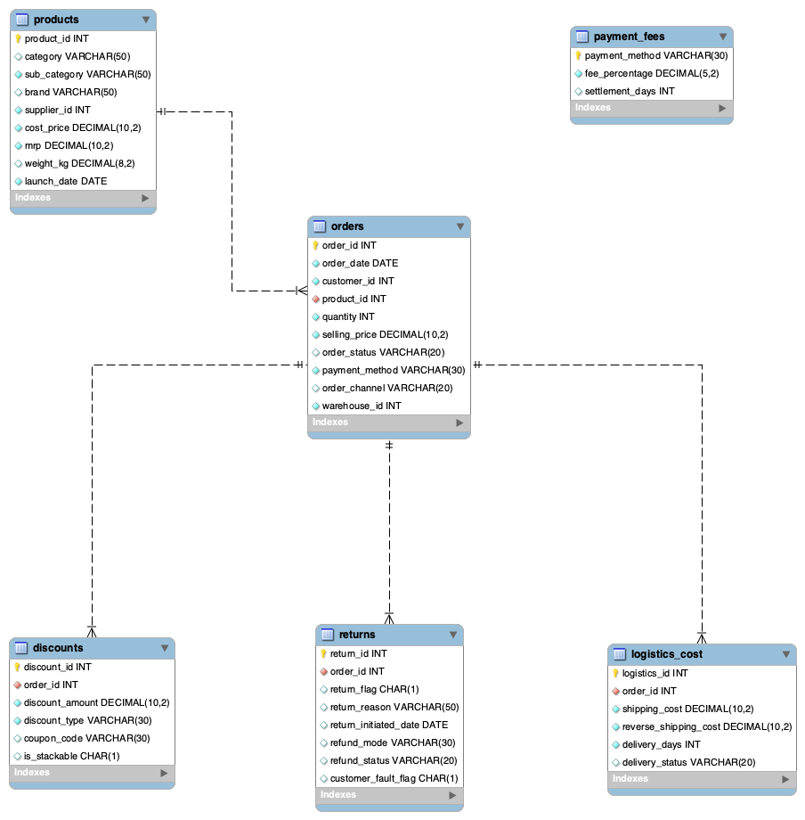
Data Model & Relational Structure
Data Model
Core Tables
Orders — transaction-level order and sales data
Products — product, category, brand and cost information
Discounts — discounts applied to individual orders
Returns — returned orders and return reasons
Logistics Cost — shipping and reverse-shipping costs
Payment Fees — processing fees by payment method
Orders act as the central transactional table connecting the
marketplace's commercial and operational data.
Relational model used to connect sales, product, discount, return, logistics and payment data for profitability analysis.

Slide 4
Executive Profitability Snapshot
TOTAL SALES | PRODUCT COST | GROSS PROFIT
₹62.83M | ₹30.32M | ₹32.51M
51.7% of sales
Business Insight
The marketplace demonstrates strong gross product profitability, but gross profit does not reflect the full economics of the business.
Key Question
₹32.51M Gross Profit
↓
How much value is being eroded by commercial and operational leakage?
Profit is subsequently exposed to:
Discounts • Returns • Logistics Costs • Payment Fees

Slide 5
Category Performance
ELECTRONICS
₹12.00M Sales | ₹6.27M Gross Profit
Highest sales & gross profit
Business Insights
Electronics leads in sales (₹12.00M) and gross profit (₹6.27M), contributing 19.1% of total revenue.
Grocery achieves the highest gross profit margin (52.82%), despite generating lower sales than Electronics, Fashion and Home.
Fashion records the lowest margin among the five identified categories (50.28%).
Uncategorised products account for ₹8.73M in sales (13.9%), highlighting a significant product classification gap.
GROCERY
52.82% Gross Margin
Highest identified margin
FASHION
50.28% Gross Margin
Lowest identified-category margin
Business Implications
Prioritise Electronics for further profitability and leakage analysis because of its high revenue contribution.
Investigate Fashion's comparatively lower margin to identify potential pricing or product-cost inefficiencies.
Resolve missing product categories to improve reporting accuracy and category-level decision-making.
UNCATEGORISED
₹8.73M Sales | 13.9% of revenue
Classification gap

Slide 6
Discount Usage & Effectiveness
Total Discount Value
₹5.73M
Discount-to-Sales Ratio
9.12%
Of gross order value
Orders with Discounts
7,417
33.71% of all orders
COUPON
₹1.54M
Largest identified promotional spend
UNSPECIFIED
₹1.52M
26.55% of total discount value
FESTIVAL
₹1.36M
23.67% of total discount value
BANK OFFER
₹1.31M
22.91% of total discount value
Key Business Findings
Total recorded discounts amount to ₹5.73M, equivalent to 9.12% of gross order value.
Coupon discounts contribute the highest identified promotional expenditure at ₹1.54M.
26.55% of discount value (₹1.52M) lacks discount-type classification, reducing promotional transparency.
Multiple discount records exist for some orders, indicating potential discount stacking that requires validation.
Business Implications
Investigate unclassified discounts to improve promotional accountability.
Review orders with multiple discounts for potential policy violations.
Evaluate discount effectiveness against post-discount profitability before adjusting promotional strategies.

Slide 7
Product Profitability & Loss Risk
PRODUCTS ANALYSED | LOSS-MAKING PRODUCTS | LOSS-MAKING SHARE
1,000 | 71 | 7.1%
Key Business Findings
71 of 1,000 products (7.1%) generated negative gross profit.
Loss-making products can remain hidden when performance is viewed only at category or marketplace level.
Product-level losses may reflect combinations of selling price, procurement cost and discounting.
Product profitability varies materially even within otherwise profitable categories.
Business Implication
Introduce product-level profitability monitoring to identify persistent loss-makers before they materially erode category margins.

Slide 8
Returns & Financial Impact
RETURNED ORDERS | REVENUE LOST | GROSS PROFIT LOST
1,290 | ₹3.69M | ₹1.93M
Rank | Return Reason | Revenue Lost
01 | Unknown | ₹714.7K
02 | Damaged | ₹636.4K
03 | Quality Issue | ₹628.7K
04 | Customer Changed Mind | ₹609.6K
05 | Wrong Item | ₹592.0K
06 | Late Delivery | ₹581.8K
Key Business Findings
1,290 returned orders were associated with approximately ₹3.69M in lost revenue and ₹1.93M in lost gross profit.
Returns represent a material source of profitability erosion.
Unknown is the largest recorded return-reason group, accounting for 242 returns and approximately ₹714.7K in lost revenue.
The high volume of unclassified returns limits management's ability to identify the underlying operational causes.
242 returns
Unknown reason
₹714.7K
Associated revenue loss
Key issue: The largest return-reason category is not actually classified.
Business Implication
Returns are both a profitability issue and a data-quality issue. Improving return-reason capture is necessary before management can effectively target root causes.

Slide 9
Logistics & Payment Cost Burden
Logistics Cost Exposure
₹1.19M
Total Logistics Cost
Payment Processing Costs
₹1.10M
Total Payment Fees
Method | Fee Rate | Total Fees
COD | 3.5% | ₹437.3K
Card | 2.1% | ₹257.3K
Wallet | 2.0% | ₹251.7K
UPI | 1.2% | ₹152.1K
Key Finding
Orders where logistics cost exceeds 20% of order value indicate potential fulfilment inefficiencies or uneconomical transactions.
Anomaly identified: One analysed order recorded ₹0 order value with ₹241 logistics cost.
Highest fee burden → COD
Lowest fee rate → UPI
Business Implication: Fulfilment and payment costs create additional margin pressure beyond product economics. COD generates the highest payment-fee burden, while high logistics-to-order-value ratios highlight transactions requiring operational review.

Slide 10
Revenue Leakage Breakdown
Commercial and operational costs affect profitability through four major leakage channels.
DISCOUNTS
₹4.57M
Largest measured leakage component
RETURNS
₹2.95M
Second-largest measured leakage component
PAYMENT FEES
₹1.10M
COD carries the highest fee burden
LOGISTICS
₹0.95M
High-cost orders require investigation
Leakage Diagnosis
Discounts and returns dominate the measured leakage profile, making commercial effectiveness and return management key areas for further investigation.
Payment and logistics costs are individually smaller but remain recurring operational pressures on retained profitability.
Leakage should not be treated as a single additive KPI without qualification, because the underlying SQL measures use different business definitions.
Executive Takeaway: Strong gross product profitability does not automatically translate into equally strong retained profitability. Management attention should shift from topline performance alone toward the mechanisms through which value is being eroded.

Slide 11
Customer & Data Quality Risks
High-Risk Customers
5.86%
Marketplace Average Return Rate
Payment Data Quality
4,471 orders
INVALID Payment Method
Return Data Quality
242 returns
Unknown Return Reason
Customers with return rates above the marketplace average were classified as high-risk.
Several customers recorded 100% return rates, indicating accounts that warrant further investigation.
INVALID is the largest recorded payment-method category by order count, indicating a significant payment-data classification issue.
Poor payment classification can distort channel-level analysis and reduce confidence in payment-cost decisions.
Unknown is the largest return-reason group and is associated with approximately ₹714.7K in lost revenue.
Missing return-reason information limits root-cause analysis and makes targeted corrective action more difficult.
Why This Matters
Reliable business decisions require reliable data. Customer-risk indicators may identify behavioural or operational issues, but incomplete payment and return classifications reduce the precision of profitability and root-cause analysis.

Slide 12
Management Recommendations
Priority | Recommendation | Action
01 | Optimise Discount Strategy | Evaluate promotions using post-discount profitability, not sales uplift alone. Investigate the ₹1.52M of discounts with unspecified promotion types.
02 | Reduce Return-Related Losses | Improve return-reason capture and investigate the major drivers of returned orders before implementing targeted interventions.
03 | Control Fulfilment & Payment Costs | Review orders with unusually high logistics-to-order-value ratios and assess the commercial impact of high-cost payment methods, particularly COD.
04 | Strengthen Profitability Monitoring | Track product-level profitability, persistent loss-makers, customer return behaviour and data-quality exceptions through recurring management reporting.
Management Focus: Protecting profitability requires coordinated action across pricing, promotions, returns, fulfilment, payment costs and data quality—not simply increasing sales.

Slide 13
Conclusion & Business Impact
The analysis shows that strong marketplace sales and gross product profitability can coexist with meaningful commercial and operational pressures on retained profitability.
PROFITABILITY
₹62.83M Sales | ₹32.51M Gross Profit
The marketplace is profitable at the product level, but aggregate performance masks 71 loss-making products.
PROFIT EROSION
Discounts and returns represent the largest measured leakage components, while logistics and payment fees create additional recurring cost pressure.
CONTROL & DATA QUALITY
Unclassified discounts, INVALID payment methods and Unknown return reasons reduce analytical visibility and limit effective root-cause investigation.
Final Takeaway: Sustainable profitability requires management to look beyond revenue growth and systematically monitor product economics, promotional effectiveness, returns, fulfilment costs, payment costs and data quality.
SQL transformed transactional marketplace data into actionable profitability insights and management priorities.

