Slide 1

Case Study 1 – Winchester House
Create By : Anuj Shahi
anuj@ea-training.com
Date : 08/10/2019
Enterprise Architecture Training – An implementation approach http://www.ea-training.com

Slide 2
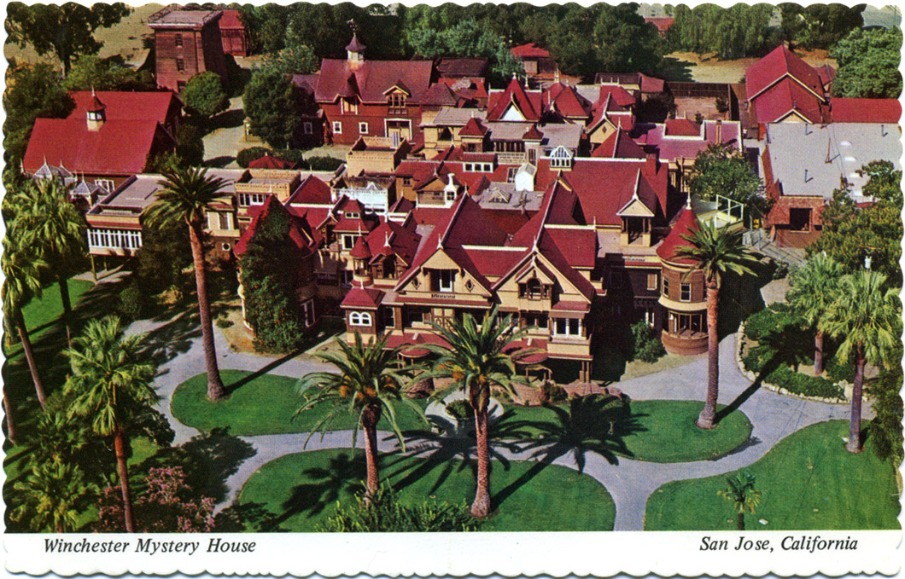
Case Study Workshop - Winchester House
Enterprise Architecture Training – An implementation approach http://www.ea-training.com

Slide 3
Introduction
This learning by example scenario was first introduced in the first book on enterprise architecture which was titled Enterprise Architecture Planning by Spewak and Hill. It was first published in 1997 and for 10 years was the only useful book on the subject.
Spewak and Hill drew some parallels with Winchester House and IT. This course goes further than this.
Learning Objective
To understand the problem that we as Enterprise architects must fix
Enterprise Architecture Training – An implementation approach http://www.ea-training.com

Slide 4
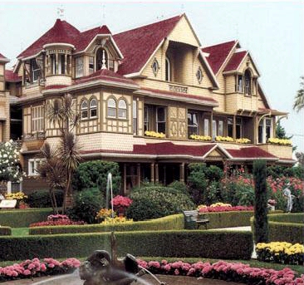
The Winchester House
In the lower Bay Area of sunny California, on the border between San Jose and Cupertino off Interstate Highway 280, there stands an enormous mansion known as Winchester House. It was built around the turn of the century by Sarah Winchester, who inherited a large fortune from her husband’s rifle company.
As she got on in age, Mrs. Winchester became increasingly eccentric. It seems that she was haunted by the ghosts of unfortunate people killed by rifles made by her husband. Two full-time spiritual advisors were employed on her staff who told her that she would continue to live as long as she continued to build.
Thus construction on this mansion continued 24 hours a day, seven days a week, month after month, year after year – for 38 years. The grounds are beautiful and custom-made stained glass, porcelain fixtures, and woodwork remarkable. But over the years Mrs Winchester added new wing here, a tower there. She designed each room individually with no thought to what existed or how the rooms would connect. Some rooms were remodelled more than a dozen times. There are more passageways than rooms. Vast sums of money were spent on the house.
However, the house has such odd features as stairways that rise into ceilings doors and windows blocked by walls, a three-story chimney that falls short of the roof, and many rooms serving the same purpose.
Enterprise Architecture Training – An implementation approach http://www.ea-training.com

Slide 5
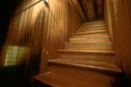
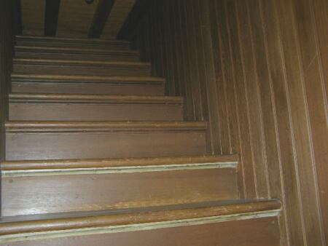
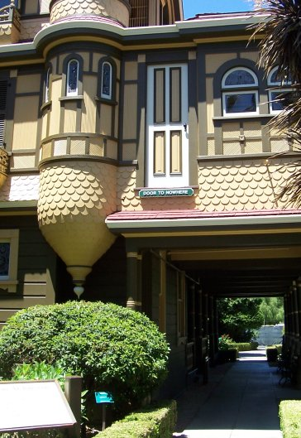
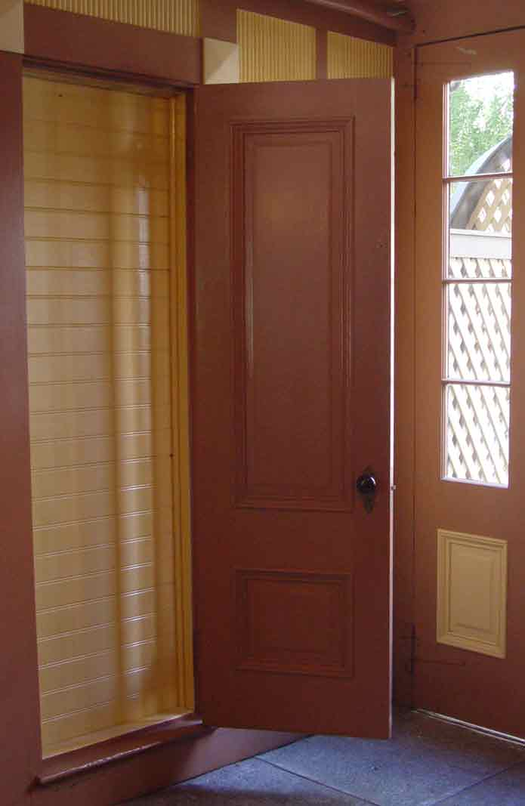
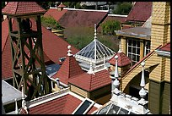
The Winchester House
Enterprise Architecture Training – An implementation approach http://www.ea-training.com

Slide 6
TASKS
A template is provided to assist the team in structuring its presentation. The team should prepare answers to the following questions.
Question 1: | Are there any parallels you can see between The Winchester House and IT in many companies?
Question 2: | Are there any similarities between The Winchester House and the structure and organisation of most businesses?
Question 3: | What could Mrs Winchester have done to avoid building such a chaotic house?
Enterprise Architecture Training – An implementation approach http://www.ea-training.com

Slide 7
Thank You
Enterprise Architecture Training – An implementation approach http://www.ea-training.com

