Slide 1

Case Study 2 – Paris Guide
Create By : Anuj Shahi
anuj@ea-training.com
Date : 08/10/2019
Enterprise Architecture Training – An implementation approach http://www.ea-training.com

Slide 2
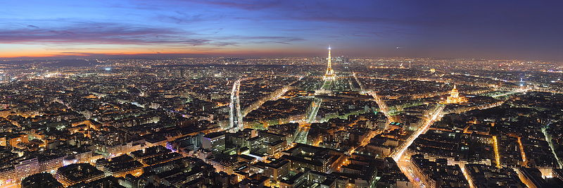
Case Study Workshop – Paris Guide
Enterprise Architecture Training – An implementation approach http://www.ea-training.com

Slide 3

Introduction
This learning by example scenario was first published in the McKinsey Quarterly magazine 2000 Issue number 3. It was written by three architects, Jurgen Laartz, Ernst Sonderegger and Johan Vinckier.
A full version of the article can be sourced on the internet. This Case Study was developed around the McKinsey article. However it has been shortened and simplified for use in the Architecture Training package.
Learning Objective
To appreciate key aspects of doing EA within a legacy environment
Enterprise Architecture Training – An implementation approach http://www.ea-training.com

Slide 4
Paris Guide
City planners try to preserve viable old assets, replace outdated assets and add new assets – all within an infrastructure of transport, power, water and human habitation demands. Companies know today how much they depend on reliable enterprise architectures to achieve their aims. Usually, though, the technology architecture is a costly and aging maze of applications, hardware systems and networks. This can make a mockery of the company’s strategic plans. There are many stories about companies stumbling because their IT architectures could not accommodate drastic change – and they how they failed to meet the changing needs of new customers.
But we can look at the evolution of a complicated set of systems – those that make up a modern city – and discover that a controlled and rationalised development of enterprise architecture is possible. Paris is such a city. When you walk around Paris you see a wonderful variety of buildings that have been build and integrated into the city over many centuries. The infrastructure of Paris, its networks of roads, bridges, rail and underground utilities unite all these buildings and defines the cityscape.
It was not always so! In the 1850’s Napoleon III appointed Baron Georges-Eugene Haussmann to create a new long term plan for Paris. Baron Haussman’s engineers built a stable infrastructure which included cutting boulevards through the city to facilitate commerce and the movement of troops. He zoned areas so that each neighbourhood retained its distinctive social and economic role. Lastly he made the best use of what already existed incorporating everything worthwhile regardless of age into the cityscape.
Today large office towers are outside the historic city borders in areas like Beaubourg and La Defense but the new areas are planned and developed with regard to the overall existing infrastructure. Today if you walk around Paris you will still see roads, building, bridges and new artefacts under development. But Paris remains a modern and highly efficient city despite the fact it is a patchwork of many eras.
Paris has taught us four lessons that can help us manage the evolution of our architectures and help THE ORGANISATION achieve its strategic initiative
Enterprise Architecture Training – An implementation approach http://www.ea-training.com

Slide 5
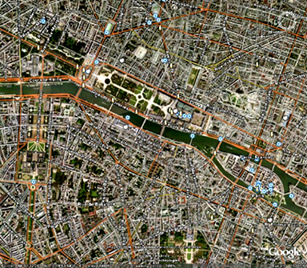
Paris Guide
Enterprise Architecture Training – An implementation approach http://www.ea-training.com

Slide 6
TASKS
A template is provided to assist the team in structuring its presentation. The team should prepare answers to the following questions.
Question 1: | What lessons can we draw from the redevelopment of Paris?
Question 2: | Develop two principles that could have been implied by Baron Haussman?
Question 3: | Reflect on the development of your town and it’s similarity to Paris
Enterprise Architecture Training – An implementation approach http://www.ea-training.com

Slide 7
Thank You
Enterprise Architecture Training – An implementation approach http://www.ea-training.com

