Slide 1
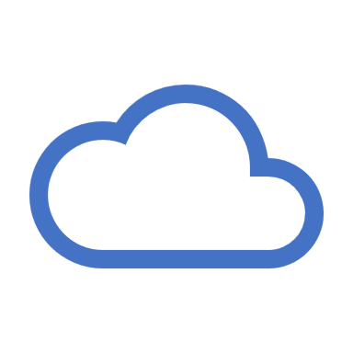
CLOUD DESKTOP

Slide 2
Cloud desktops are an approach to end-user computing where virtual desktops and applications are hosted on cloud-based resources rather than resources in an onpremises corporate data cent
With Desktop as a Service (DaaS), the cloud services provider hosts the infrastructure, network resources, and storage within the cloud, from which the user can access the desktop's data and applications via an internet browser or other software

Slide 3
itopia is a cloud-native automation and orchestration solution enabling desktop as a service (DaaS) on Google Cloud
itopia empowers enterprises to migrate VDI workloads to Google Cloud and rapidly deploy Windows virtual desktops and apps to workers on any device.

Slide 4
Key Features and Benefits
Accessibility: Users can access their desktop environment from anywhere with an internet connection, allowing for remote work and increased flexibility.
device Independence: Cloud desktops can be accessed from various devices, including Windows PCs, Macs, Linux machines, and mobile devices, making it easy to work on different platforms
Security: Data and applications are hosted in secure data centers with robust security measures, reducing the risk of data loss or breaches compared to storing data locally.
Scalability: Cloud desktop solutions can easily scale up or down to accommodate the changing needs of businesses, making it cost-effective.

