Slide 1

PERSONAL BARRIERS
OF COMMUNICATION

Slide 2
PERSONAL BARRIERS
Personal Barriers To Communication Are Factors Which Are Personal That Negatively Impact Effective Communication
The Personal Barriers relate to the factors that are personal to the sender and receiver and act as a hindrance in the communication process.
These factors include the life experiences, emotions, attitudes, behavior that hinders the ability of a person to communicate.

Slide 3
Common personal barriers
Lack of Listening Skills: The efficiency of communication process gets disturbed when the receiver listens only with ears but do not apply his mind. Often, the receiver listens what he wants to listen and give no attention to other aspects of the information, thereby acting as a hindrance to the effective communication.
Selective Attention: This problem arises when the person is impatient and put his objective above all. He gives ears to only that part of the information which is helpful for him and fulfills his objective and ignores all the other aspects.

Slide 4
Lack of knowledge: Also, the communication process suffers if the sender and receiver have less knowledge about the subject matter.
Lack of vocabulary: Often, the communication problem arises when the sender uses some words which are difficult for the receiver to comprehend correctly.

Slide 5
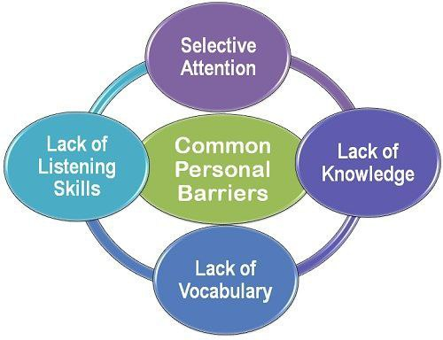

Slide 6
Personal Barriers can be listed as
Barriers in superiors
Attitude of superiors
Fear of challenge to authority
Lack of confidence in subordinates
Lack of time
Lack of awareness
Ignoring communication

Slide 7
Barriers in subordinates
Unwillingness to communicate
Lack of proper incentive
Vocabulary
Partial communication

