Slide 1

Uber Supply – Demand Gap
BY : - VISHNU PAVAN SHARMA ( MACHINE LEARNING )

Slide 2
BUSSINESS OBJECTIVE :-
The objective is to determine the underlying reasons behind the issues of request cancellations and unavailability of cabs and propose suggestions to effectively tackle the problem.

Slide 3

Data used for analysis:
There is a noticeable gap between the supply and demand of uber services. This discrepancy is resulting in longer wait times for passengers and a limited availability of cabs during peak hours.
It is important to analyze the factors contributing to this supply-demand gap, such as fluctuations in customer demand, driver availability, and geographical distribution of rides.
By understanding these factors, we can develop strategies to bridge the gap and improve the overall efficiency and reliability of uber services.
The data utilized exclusively pertains to transportation to and from the airport. The data covers a period of five days.

Slide 4

Data Collection and cleaning:-
The main objectives are to identify any data quality issues and perform data cleansing procedures.
Additionally, it involves formatting date and time variables to ensure consistency and accuracy.
Furthermore, there is a need to extract new variables that are essential for the analysis process.
By addressing these tasks, we aim to improve the overall quality and integrity of the data, enhance analytical capabilities, and derive valuable insights for decision-making purposes.

Slide 5
6 ATTRIBUTES PROVIDED FOR IN THE CSV FILE:-
Request ID: An exclusive identifier assigned to each individual request made.
Pickup Point: The particular location from where the cab request originates.
Driver ID: A distinct identification number given to each driver in the system.
Status: The current state of the request, indicating if it has been completed, cancelled, or if a cab is unavailable.
Request Timestamp: The date and time when the cab request was made.
Drop Timestamp: The date and time when the requested ride was finalized or concluded.

Slide 6
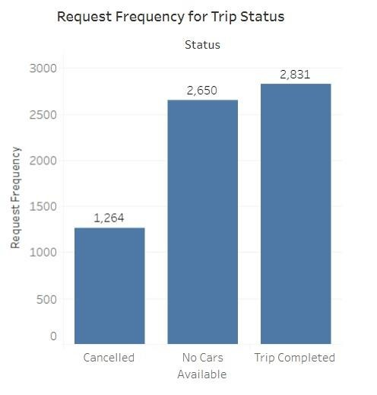
Analysing Trends For Completion of Trips
We can clearly see from this plot that Uber is losing quite a lot of business due to shortage of available Cabs.
Viewing the frequency of request with their status shows us the above the figure.
It is clear that most of the failed request are due to no cars being available at that moment. Still further analysis is need to give a concrete conclusion and the cause for this

Slide 7
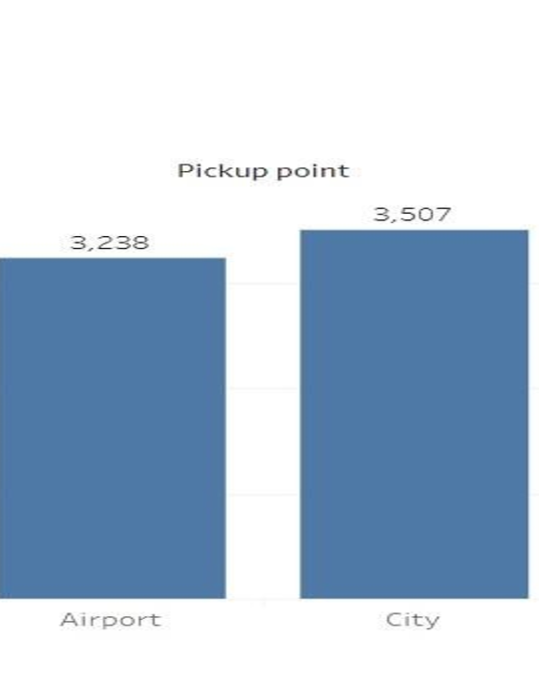
Request at Each Pickup Point.
From above plot it can be seen that there are two pickup points Airport and City.
They have almost equal request however city have slightly more requests than airport.

Slide 8
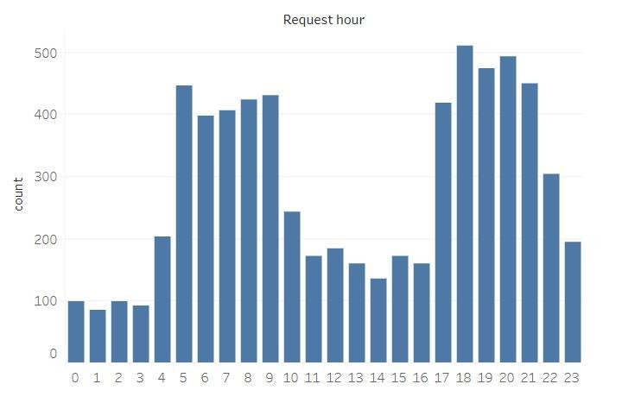
Combining Data For Hour Demand Analysis
THE PLOTS BETWEEN FREQUENCY OF REQUESTS AND HOUR TELLS US THAT MAXIMUM REQUEST ARE BEEN MADE IN MORNING AND EVENING FROM 5 AM-10 AM AND FROM 5 PM -10 PM

Slide 9
Number of Request with Timeslot
As seen in graph that the no of request is high at early morning And Evening.

Slide 10



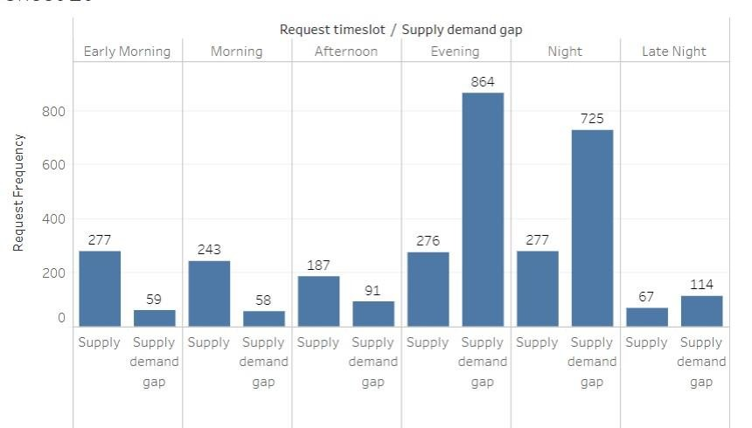


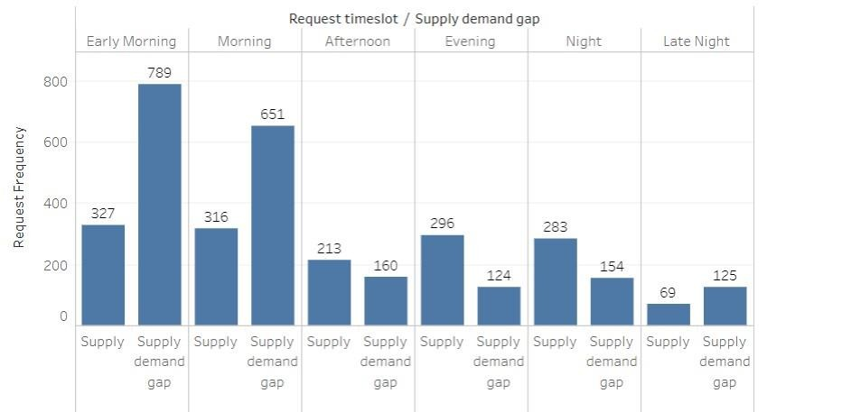

Let Us see Supply And Supply Demand gap at both pickup point

Slide 11
THERE IS A HUGE GAP IN SUPPLY AND DEMAND. IN GENERAL, THE SUPPLY AND DEMAND HAVE
Conclusion:-
A GAP. THERE ARE A LOT OF RIDES WHICH GO
INCOMPLETE (UNAVAILABLE OR CANCELLED) IN
COMPARISON TO BEING COMPLETED.
IRRESPECTIVE OF HOW WE CONSIDER THE DATA, THE LAG IS GREATER THAN THE SUPPLY. IN
FACT, THE LAG GOES FURTHER DOWN DURING PEAK
HOURS BUT IS STILL LESS THAN THE
COMPLETED/SUPPLIED TRIPS.
IN OTHER WORDS, THE SUPPLY-DEMAND GAP IS CLEAR. IT CAN BE FIXED PERHAPS, BY
FOCUSING MORE ON THE PEAK HOURS FIRST AS THEY CONTRIBUTE IN EXTRA TO THE ALREADY
EXISTING GAP. THAT SHOULD BE THE PLACE TO START.

Slide 12
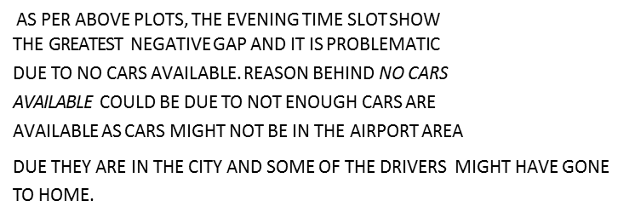
Analysis Conclusion:
PICKUP POINT: CITY
AS PER ABOVE PLOTS, THE MORNING TIME SLOT SHOW THE GREATEST NEGATIVE GAP AND IT IS PROBLEMATIC DUE TO REQUESTS ARE BEING CANCELLED. REASON BEHIND REQUEST CANCELLATION COULD BE MORNING RUSH. IT CAN BE CONSIDERED THAT MOST PROBABLY DRIVES CANCELLED THE REQUEST FOR AIRPORT AS THEY CAN GET MANY RIDES WITHIN THE CITY INSTEAD OF SINGLE AIRPORT RIDE.
PICKUP POINT: AIRPORT

Slide 13
Recommendations:
BASED ON THE PERFORMED ANALYSIS OF DATA, THERE ARE SOME RECOMMENDATIONS WHICH CAN BE USED BY UBER TO BRIDGE THE GAP BETWEEN SUPPLY AND DEMAND:
FOR AIRPORT TO CITY, AN UBER STAND CAN BE CREATED AT AIRPORT WHERE CABS WILL AVAILABLE ALL THE TIME, THIS WILL ITSELF LOWER DOWN THE NO CARS AVAILABLE STATUS.
FOR CITY TO AIRPORT, UBER CAN GIVE SOME SMALL REWARD
OR SOMETHING TO THE DRIVES IN THE MORNING. THIS MIGHT
ATTRACT DRIVERS TO GO FOR AIRPORT, THIS STEP CAN BE
HELPFUL IN REDUCING THE NUMBER OF CANCELLATION
DURING MORNING TIME FOR AIRPORT.
THERE SHOULD BE A THRESHOLD FOR CANCELLING A RIDE IN
A DAY AD SOME SORT OF PENALTY SHOULD BE IMPOSED.
THERE IS DEFINITELY NEED OF MORE CARS FOR FILLING THE
GAP.

Slide 14

THANK YOU

