Slide 1


MINIMISATION OF TUNNEL OVERBREAK IN DRILL AND ROCK BLAST TUNNELLING
Guided by Presented by
Dr R. Senthil Kumar, P. Vishnu Vardhan
Assistant professor M Tech, Construction Technology & Management
Dept of Civil Engineering 203519019
Sanjay Pajni,
Chief Engineering Manager , EDRC Faridabad, Larsen & Toubro

Slide 2
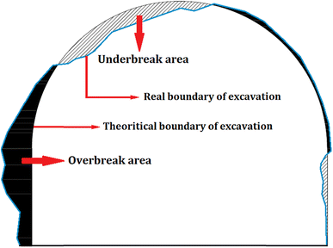
INTRODUCTION
Drilling and blasting type of tunnelling is an age old technique in excavating tunnels.
As the name suggests it involves drilling horizontal holes into the available free face of the rock and then filling these holes with explosives for blasting to generate an opening.
The blasting further continues with rock fragments falling into the available openings created in preceding blasts.
The inability to control the periphery of a profile causes excess removal of rock by blasting which is termed as overbreak.
The excess rock blasted will involve more mucking there by increasing cycle time of a blast round and increasing the amount of shotcrete required for lining .
The increased cost and cycle time will sure lead to a claim from client side.
Underbreak and overbreak in a tunnel cross section; Mottahedi et al (2017)

Slide 3
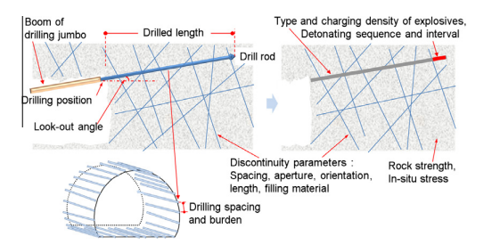
INFERENCE FROM LITERATURE
On studying literature it became evident that overbreak to an extent is inevitable.
The excess overbreak is mainly attributed to three factors namely uncontrollable (geological), semi controllable ( tunnel shape and size) and controllable (blasting parameters).
Blasting parameters include delay timing, spacing to burden ratio, powder factor, lookout angle, round length, type of explosive, while the geological parameters are discontinuity orientation, rock quality index, compressive strength of rock.
Literature existing more or less can be divided into two wings, one tried to generalise overbreak trend in a site after studying initial blast results, while the other worked at developing a blast design to suit the in situ conditions.
Among the blasting parameters powder factor at the perimeter holes and among geological parameters the rock quality index was cited as the most influential parameter influencing overbreak.
Recent literature tried to incorporate machine learning to predict overbreak blocks.
summary of causes of overbreak; Kim and Moon (2012)

Slide 4
OBJECTIVE & SCOPE
OVERBREAK CAUSING FACTORS
GEOLOGICAL
BLASTING
TUNNEL CHARACTERISTICS
AREA OF STUDY
Overbreak volume can be divided into geological overbreak ( excess rock break due to release of in situ stress or due to orientation of discontinuities), blast induced overbreak ( excess rock break due to inaccuracy in drilling and charging of contour blast holes, which control the damage induced in the surrounding rock mass due to blasting.
Inclining with the objective of minimizing overbreak, the study will focus on minimizing blast induced damage as it is something which can be regulated.
Blasting techniques like smooth blasting and pre-splitting design will be done and parameters (blast hole diameter, powder factor, delay time) for the blast will be altered with a view to keep the damage to rock as minimum as possible.

Slide 5
METHODOLOGY (continued)
REVIEWING THE PARAMATERS USED IN BLASTING LIKE POWDER FACTOR, CHARGE LENGTH, DECOUPLING RATIO, EXPLOSIVE KIND, DELAY TIME PER ROUND, LOCATION OF HOLES FROM A LIVE SITE
ANALYSE INSITU GEOLOGY USING BARTON Q SYSTEM AS A GUIDE AND KEEPING THE SIZE OF OPENING ( AREA OF TUNNEL) CONSTANT.
DEVELOP BENCHMARK FROM LITERATURE STUDY REGARDING THE OVERBREAK AFFECTING PARAMETERS
PREPATING A SUITABLE MODEL WHICH CAN BE USED TO PREDICT OVERBREAK AT THE SITE USING ROCK ENGINEERING SYSTEM
IDENTIFYING THE PROBLEMATIC CASES AND ALTERING THE PARAMETERS OF BLAST USING CONTROL BLAST TECHNIQUES.
REPORTING THE BEST PARAMETERS FOR BLAST WHICH CAN MINIMISE THE OVERBREAK AT SITE

Slide 6
IDENTIFICATION
Even though it appears that taking care of contour holes minimises overbreak, there are several other factors all along the tunnelling stages (marking, drilling, loading, blasting) which will affect overbreak before we take care about contours.
All those factors would be studied and the ideal practises will be the benchmark to which practises of a site will be compared to.
CHARGING
DRILLING
BLASTING
SURVEYING
ROCK
SUPPORT
VENTILATION
SCALING
MUCKING
STAGES IN TUNNELLING
SURVEYING
DRILLING
CHARGING
BLASTING
VENTILATION
MUCKING
SCALING
& SUPPORT

Slide 7
CONTROL BLASTING TECHNIQUES
TECHNIQUE | DESCRIPTION
Pre-splitting | Blasting of contour holes with less dense charges before production blast; more of a preventive measure where in the idea is to create a artificial plane of breakage to arrest the movement of blast vibrations damaging rock beyond periphery.
Smooth blasting | A reactive measure similar to pre-splitting but done after or along with production blast using decoupled charges to trim of excess surface
Line drilling | Drilling of holes along contour line but not loading them with explosives, only to allow these empty holes to act as stress concentrators causing the fracture to form between the line drill holes during the production blasting. Used along with pre-splitting or smooth blasting
Cushion blasting | a single row of holes is drilled at the perimeter of the excavation and loaded lightly with explosive with decking of inert material right throughout the blast hole initiated with detonating cord to minimize delay between holes.

Slide 8
RATING OF PARAMETERS
Expert Semi-Quantitative (ESQ) coding method is used to assign codes to the effective parameters based on the views of four experts educated in rock mechanic engineering. [ AZAD (2019) ].
Totally five classification groups, ranging from 0 to 4, were considered, where 0 denotes the best case (most favorable condition (the value assigned to the parameter make no contribution to overbreak)) and 4 the worst (most unfavorable condition (the value assigned to the parameter make significant contribution to overbreak)).
These factors vaguely helps in forming an initial opinion on overbreak causes.
TUNNEL ROCK QUALITY INDEX | RATING
DESCRIPTION | RATING
>61 | 0
6.6-61 | 1
0.72-6.6 | 2
0.1-0.7 | 3
<0.1 | 4
PERIMETER CHARGE(t/m³)
DESCRIPTION | RATING
<0.3 | 0
0.3-0.6 | 1
0.6-0.9 | 2
0.9-1.1 | 3
>1.1 | 4
DELAY TIME(ms)
DESCRIPTION | RATING
0 | 4
25 | 3
50 | 2
75-100 | 1
>100 | 0

Slide 9
RATING OF PARAMETERS (continued)
PERIMETER HOLE DIAMTER(m)
DESCRIPTION | RATING
38-42 | 0
42-51 | 1
51-60 | 2
60-65 | 3
>65 | 4
Burden to spacing ratio
description | rating
<0.85 | 4
0.85-1 | 3
1-1.3 | 2
1.3-1.5 | 1
1.5-2 | 0
Cross section area(m²)
description | rating
<20 | 0
20-40 | 1
40-60 | 2
60-80 | 3
>80 | 4
ROUND LENGTH(m)
DESCRIPTION | RATING
<1.5 | 0
1.5-2 | 1
2-2.5 | 2
2.5-3 | 3
3-3.5 | 4
POWDER FACTOR(t/m³)
DESCRIPTION | RATING
<0.5 | 0
0.5-1 | 1
1-1.3 | 2
1.3-1.5 | 3
>1.5 | 4
TYPE OF EXPLOSIVE
DESCRIPTION | RATING
Tracer Blating | 0
Low Strength Emulsion | 1
High strength emulsion | 2
dynamite | 3
ANFO | 4

Slide 10
SITE INFO
The site chosen for analysing overbreak issues is the “ RVNL – PACKAGE 2 “ ; part of 125 km long new broad gauge line between Rishikesh and karanprayag.
Rvnl package 2 contains construction of 2 tunnels and railway formation works.
Tunnel 2 runs from Shivpuri to Guller and length of the tunnel is 6.09km. (chainage from 18+685 km to 24+775.5 km)
Tunnel 3 runs from Guller to Byasi and length of tunnel is 6.64 km. (chainage from 25+487.5 km to 32+133.50 km).
Each tunnel work includes construction of main tunnel and an escape tunnel.
The overbreak analysis was therefore carried in 4 tunnels.
Final area of tunnel to be formed:
main tunnel 2 & 3 = 60m²
escape tunnel 2 & 3 = 30m²
The two tunnels form the 84% of alignment length (15.14 Km) which is 12.73 Km.

Slide 11
SITE GEOLOGY
Rock mass classification was done based on Rock mass quality index (Q) and ONORM (2203) (Austrian code)
Q provides a quantitative assessment of rock geology where as ON2203 is a qualitative assessment.
A corelation is established for all NATM classes based on Q values.
Borehole assesments were made all along the tunnel length to determine lithology and rock nature.
ROCK CLASSIFICATION FOR TUNNEL 2
KM | LITHOLOGY | Q VALUE RANGE | ONORM CLASS NO
18+685 to 18+760 | Gravel, sand, silt, clay | 1.50 | c4
18+760 to 24+435 | Sandstone, quartz | 0.8 to 4.6 | B1,B2,B3,C2
24+435 to 24+710 | Shale, quartz, limestone | 0.66 | B3

Slide 12
SITE GEOLOGY (CONTINUED)
ROCK CLASSIFICATION FOR TUNNEL 3
KM | LITHOLOGY | Q VALUE RANGE | ONORM CLASS NO
25+487 to 26+150 | Shale, quartz, limestone | 0.028 to 0.293 | C2,C3,B2
26+150 to 26+720 | Quartz, arenite | 1.3 to 1.78 | B3,B2,C3
26+720 to 27+670 | Limestone, marl | 2.8 to 5.2 | B1,B2
27+670 to 29+480 | Shale, dolomite | 0.99 to 2.64 | B2,B3
29+480 to 31+250 | Quartz, arenite | 3.5 to 8.5 | B3,B2,B1
31+250 to 32+110 | Sandstone, arenite | 0.300 to 2.36 | B3
B1,B2 class indicates friable rock mass where blasting operations lead to structural loosening and separation of rock at crown and walls .
B3 indicates rolling rock mass where lack of cohesion and interlocking are predominant.
C1 indicates rock bursting where sudden release of energy leads to explosive rock failure.
C2, C3 represent squeezing conditions where large deformations occur which take longer time to decline.

Slide 13
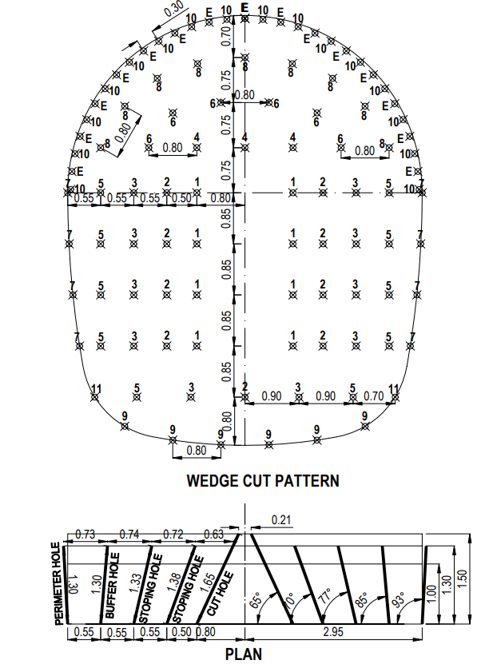
EXSISTING PATTERNS AT SITE
The figure shows blast pattern for a c3 class rock.
Symmetric wedge cut is the used for cut blasting.
Because of the inferior rock condition perimeter spacing was reduced to 0.3 as compared to 0.4 for B class.
Burden for perimeter holes was 0.70 with arch holes.
The numbers for the holes indicate the timing pattern planned for the blast.
DRILL HOLE PATTERN SUMMARY
CUT HOLES | STOPPING HOLES | BUFFER HOLES | PERIMETER HOLES | LIFTER HOLES
8 | 20 | 16 | 34 | 6
Diameter of perimeter hole= 45 mm
Length of hole for charging =1.20m

Slide 14
OVERBREAK VARIATON FOR TUNNELS
TUNNEL | AVERAGE OVERBREAK(m²)
MAIN TUNNEL 2 | 5.23
ESCAPE TUNNEL 2 | 4.89
MAIN TUNNEL 3 | 7.23
ESCAPE TUNNEL 3 | 6.95

Slide 15
OVERBREAK MODEL DEVELOPMENT
A total of 43 blasts were studied across 3 months from September to November 2020 for all 4 tunnels.
As covered earlier, nine major factors affecting overbreak are collected for every blast along with actual overbreak occurred to analyse the impact of those on the breakage levels.
The recorded events in a blast are
RES (Rock engineering system) was used to analyse overbreak trends in the project site.
RES is a comprehensive methodology that is capable of considering unlimited number of parameters for modelling.
The rock engineering systems, as a multi-objective and powerful system, is fast becoming a key instrument in solving complex rock engineering problems especially in the field of rock mechanics.
The major advantage of using RES is that it considers the inter-relation between parameters affecting overbreak.
Q –value of rock
Spacing to burden ratio
Perimeter charge
Powder factor
Hole diameter
Round length
Delay time
Explosive used
Round length

Slide 16
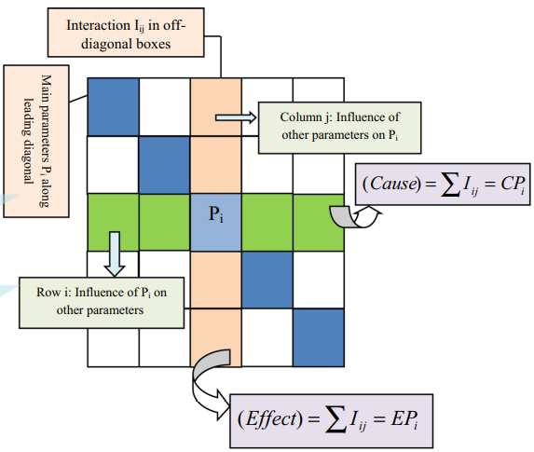
OVERBREAK MODEL DEVELOPMENT (CONTINUED)
All the influencing parameters of a system are placed on the diagonal of the matrix.
The row which the parameter occupies shows the influence of that parameter on the rest of parameters.
The column which the parameters occupy show the influence of other parameters on that particular parameter.
As far as minimisation is concerned the shows us the most influencing parameters on which emphasis can be laid for further control of a system.
On the other hand , it shows us up to what extent the sensitive variable is being affected by other parameters, thereby showing us the factors to be optimised for better controlling the system.

Slide 17
RES MATRIX FOR OVERBREAK
EFFECT
Q- ROCK QUALITY INDEX
B/S- BURDEN TO SPACING RATIO
A- AREA OF TUNNEL
D- HOLE DIAMETER
PF- POWDER FACTOR
PC- PERIMETER CHARGE
L- ROUND LENGTH.
CAUSE
Q | 3 | 4 | 3 | 1 | 2 | 4 | 3 | 0
0 | T | 0 | 0 | 0 | 1 | 0 | 0 | 0
0 | 0 | B/S | 0 | 1 | 1 | 1 | 0 | 3
0 | 1 | 2 | A | 2 | 3 | 3 | 2 | 0
0 | 1 | 1 | 0 | D | 1 | 1 | 0 | 0
0 | 1 | 2 | 0 | 1 | PF | 2 | 0 | 1
0 | 1 | 2 | 0 | 1 | 2 | PC | 1 | 1
0 | 0 | 0 | 0 | 0 | 2 | 3 | L | 0
0 | 0 | 3 | 0 | 1 | 1 | 1 | 1 | K
RATING | DESCRIPTION
4 | CRITICAL INTERACTION
3 | STRONG INTERACTION
2 | MEDIUM INTERACTION
1 | WEAK INTERACTION
0 | NO INTERACTION

Slide 18

CAUSE – EFFECT TABLE
S.NO | PARAMETERS | CAUSE (C) | EFFECT (E) | C+E | C-E | a_{i}(%)
1 | Q | 17 | 0 | 17 | 17 | 16.66
2 | DELAY TIME | 1 | 7 | 8 | -6 | 6.55
3 | B/S | 3 | 11 | 14 | -8 | 13.72
4 | AREA | 12 | 3 | 15 | 9 | 14.7
5 | HOLE DIAMETER | 3 | 6 | 9 | -3 | 8.82
6 | POWDER FACTOR | 5 | 11 | 16 | -6 | 15.68
7 | PERIMETER CHARGE | 6 | 14 | 20 | -8 | 19.6
8 | ROUND LENGTH | 5 | 6 | 11 | -1 | 10.78
9 | EXPLOSIVE | 5 | 7 | 12 | -2 | 9.83
 |  | 57 | 65
Using the cause and effect for each parameter , the weight factor of each parameter are found out.
C+E is called dominance factor.
The more the dominance factor, the more importance the parameter becomes.
In this system perimeter charge is the most dominant factor among blast parameters along with Q.

Slide 19
CAUSE – EFFECT GRAPH
Figure shows the C - E plot for each parameter.
In this figure, the points under the line C = E line are called dominant parameters and the points over the C = E line are subordinate parameters.
Dominant parameters are dominant in the system and subordinate parameters and highly dominated by the system, respectively.
Area and Q values represent the uncontrollable and semi controllable parameters which dictate the blast design and rightly so are below the slope line indicating dominance in the system.

Slide 20
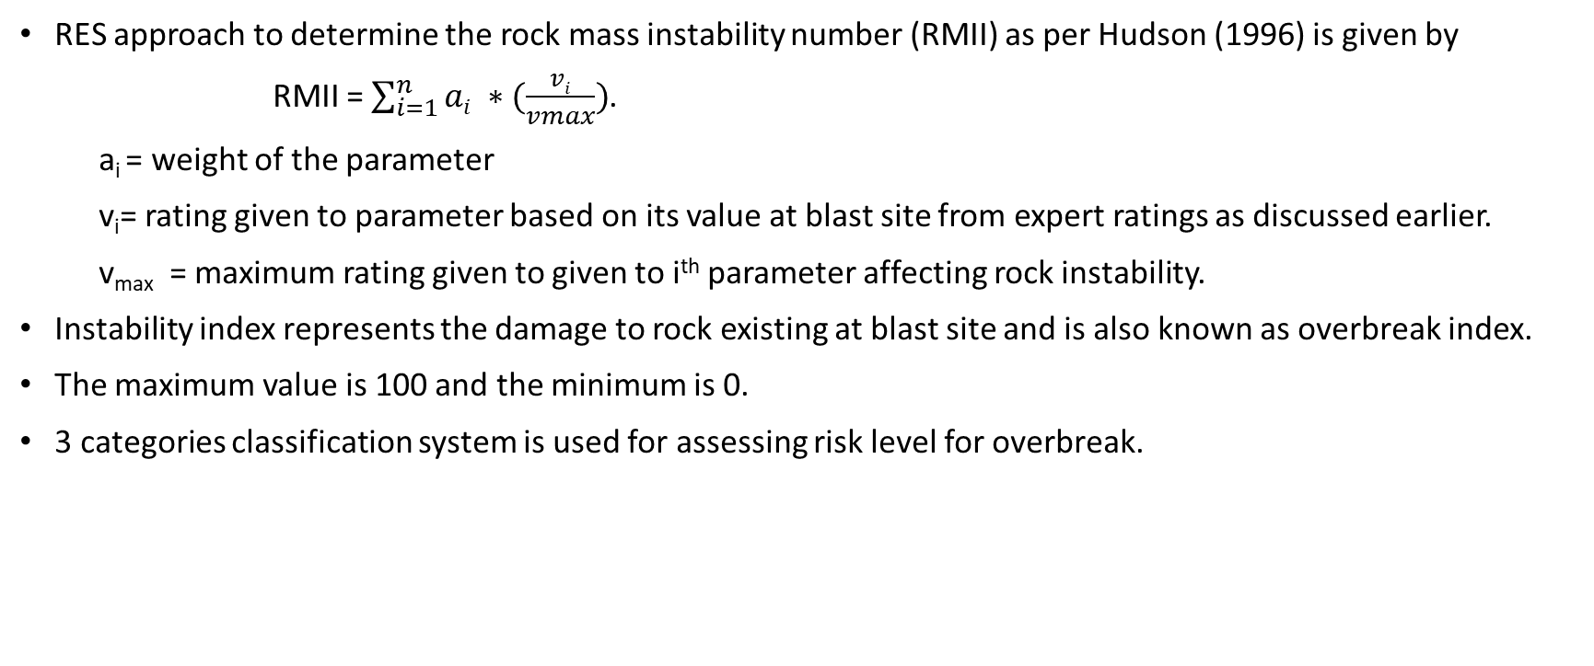
OVERBREAK INDICES
RES approach to determine the rock mass instability number (RMII) as per Hudson (1996) is given by
RMII = $\sum_{i=1}^{n}{ai ∗(\frac{vi}{vmax})}$.
a_{i} = weight of the parameter
v_{i}= rating given to parameter based on its value at blast site from expert ratings as discussed earlier.
v_{max} = maximum rating given to given to i^{th} parameter affecting rock instability.
Instability index represents the damage to rock existing at blast site and is also known as overbreak index.
The maximum value is 100 and the minimum is 0.
3 categories classification system is used for assessing risk level for overbreak.
RISK LEVEL | LOW MEDIUM | MEDIUM HIGH | HIGH- VERY HIGH
CATEGORY | I | II | III
OVERBREAK INDEX | 0-33 | 33-60 | 60-100
CONSEQUENCES | Slight overbreak and no instability of tunnel | Overbreak which will cause extra cost | Extra cost and safety hazards.

Slide 21
OVERBREAK INDICES (CONTINUATION)
Overbreak indices were calculated for 34 blasts across 4 tunnels.
Sample calculation for each of the tunnel is :
 |  | Q | T | B/S | AREA | DIAMETER | POWDER FACTOR | PERIMETER CHARGE | EXPLOSIVE | ROUND LENGTH | overbreak index
 | WEIGHT | 16.6 | 6.55 | 13.72 | 14.7 | 8.82 | 15.68 | 19.6 | 9.83 | 10.78
 | value at blast | 0.08 | 50 | 1.2 | 30 | 45 | 1 | 0.7 | EMULSION | 1.66
escape tunnel 2 | rating assigned | 4 | 2 | 2 | 1 | 2 | 1 | 2 | 1 | 1 | 53.69
 | maximum rating | 4 | 4 | 4 | 4 | 4 | 4 | 4 | 4 | 4
 | value at blast | 3.54 | 75 | 1.2 | 60 | 45 | 1.4 | 0.9 | EMULSION | 2.4
main tunnel 2 | rating assigned | 2 | 1 | 2 | 2 | 2 | 3 | 3 | 1 | 2 | 62.86
 | maximum rating | 4 | 4 | 4 | 4 | 4 | 4 | 4 | 4 | 4
 | value at blast | 0.5 | 50 | 1.4 | 60 | 45 | 0.9 | 0.6 | EMULSION | 1.89
main tunnel 3 | rating assigned | 4 | 2 | 1 | 2 | 2 | 1 | 1 | 1 | 1 | 49.03
 | maximum rating | 4 | 4 | 4 | 4 | 4 | 4 | 4 | 4 | 4
 | value at blast | 5 | 50 | 1.3 | 30 | 45 | 1.3 | 0.6 | EMULSION | 0.4
escape tunnel 3 | rating assigned | 2 | 2 | 1 | 1 | 2 | 2 | 1 | 1 | 0 | 38.28
 | maximum rating | 4 | 4 | 4 | 4 | 4 | 4 | 4 | 4 | 4

Slide 22
OVERBREAK INDEX RESULTING DUE TO BLASTING

Slide 23
OVERBREAK (ACTUAL)
Overbreak was recorded for all the 34 blasts and co related with overbreak index calculated for the blast.
Overbreak= 3.8507+0.1187(OI)
Overbreak calculated using OI was validated for 9 blasts across 4 tunnels.

Slide 24
ALTERING PARAMETERS OF BLAST
Out of 4 blasts considered, 2 were from main tunnel 2 with rock class B2, C2 and another two from escape tunnel 3 with rock class C3.
On applying control blast techniques the optimisable parameters are perimeter charge and spacing to burden ratio.
 | Blast no 4 | Blast 10 | Blast 31 | Blast 32
Overbreak index | 57.36 | 50.26 | 54.18 | 62.86
Q value | 0.08 | 0.021 | 0.015 | 3.54
Area(m²) | 60 | 30 | 30 | 60
B/S | 2.33 | 2.66 | 2.66 | 1.2
Perimeter charge | 0.7 | 0.7 | 0.7 | 0.7
Delay time(ms) | 50 | 50 | 50 | 75

Slide 25
PRESPILLTING & SMOOTH BLASTING
From literature, like Singh et al(2018) , Sushil Bhandari(1997), Zong-Xian Zhang(2016)
Pre-Splitting:
Spacing of perimeter holes for pre-splitting is 8 to 12 times of hole diameter.
Pre-splitting is carried out before production blast and burden to the next buffer roles is half of normal burden used in production blast.
Perimeter charge = the advance achieved through charge length
= (L*S)/0.5. L= half of the hole depth.
S= spacing between contour holes.
for contour holes, charge depth and uncharged depth are to be equal.
Smooth blasting :
Smooth blasting is done post the production blast or sometimes as a part of it in the final round.
Spacing to burden ratio cannot exceed 0.8.
Perimeter charge is calculated similar to the pre-splitting.
Delay time per round for both the control blasting methods must be optimum to ensure enough breakage but should never exceed 100ms.

Slide 26
PRESPILLTING & SMOOTH BLASTING CALCULATIONS
Diameter of drilled hole due to site constraints cannot be less than 45mm and increasing it to further extent does not satisfy conditions of control blasting.
So as per Sushil Bhandari(1997) spacing for 45mm hole diameter for pre-splitting blast is 0.4m.
Burden for next easer hole for pre-splitting is 0.7m.
Burden to spacing ratio= 0.7/0.4= 1.75.
Perimeter charge= (charged length* spacing)/0.5.
hole depth drilled=1.5m; charged length = 0.75m, spacing = 0.4m.
Perimeter charge= 0.75*0.4/0.5= 0.6.
As per Olofsson (1988), for smooth blasting spacing for 45 mm diameter holes is 0.6m and burden is 0.8m.
Burden to spacing ratio = 0.8/0.6=1.33.
Perimeter charge= 0.75*0.6/0.5=0.9.

Slide 27
PRESPILLTING & SMOOTH BLASTING CALCULATIONS
 | Actual blast parameters |  |  | Pre-splitting parameters |  |  | Smooth blasting parameters
 | spacing | B/S | PC | spacing | B/S | PC | spacing | B/S | PC
Blast no 4 | 0.4 | 2.33 | 0.7 | 0.4 | 1.75 | 0.6 | 0.8 | 1.33 | 0.9
Blast no 10 | 0.4 | 2.66 | 0.7 | 0.4 | 1.75 | 0.6 | 0.8 | 1.33 | 0.9
Blast no 31 | 0.3 | 2.66 | 0.7 | 0.4 | 1.75 | 0.6 | 0.8 | 1.33 | 0.9
Blast no 32 | 0.7 | 1.2 | 0.7 | 0.4 | 1.75 | 0.6 | 0.8 | 1.33 | 0.9
On observing blast no 10,31,32 the actual blast parameters are superior to pre-splitting and smooth blasting which indicates parameters other than these are influencing the overbreak.
The other parameters like area of opening and Q value can not be altered, hole diameter is fixed due to site logistics and round length cannot be compromised since reducing advance will not have the nod of client.
The other optimisable parameter for these 3 blasts are delay time.
Delay time is increased by 25 ms from 50 to 75 ms.

Slide 28
CHANGE IN OVERBREAK
 | Changed parameters | Actual index | Changed index | Actual overbreak(m2) | Reduced overbreak(m²) | % in reduction
Blast no 4 | Delay time | 57.36 | 55.73 | 10.76739 | 10.52512 | 2.250053
Blast no 10 | Delay time | 50.26 | 48.625 | 9.882022 | 9.6441 | 2.407625
Blast no 31 | Delay time | 54.18 | 52.54 | 10.37085 | 10.12956 | 2.32658
Blast no 32 (pre-splitting) | Perimeter charge, B/S | 62.86 | 51.10 | 11.45324 | 9.951 | 13.1163
Blast no 32 (smooth blast) | Perimeter charge, B/S | 62.86 | 59.43 | 11.45324 | 10.98392 | 4.097722
Overbreak= 3.6146+0.1247(OI)

Slide 29
ADVANCEMNT FACTOR (A_{f})INFLUENCE ON OVERBREAK
Apart from the factors considered in the model, overbreak variation with respect to commercial aspects like pull achieved will be of great interest to the client. Hence variation of overbreak with respect to Advancement factor will be interesting.
advancement factor is the ratio of pull obtained to hole depth.
It is clear from graph that higher perimeter charge factor gives rise to greater overbreak.
Overbreak caused by perimeter charge(q_{p}) factor can be reduced by optimum advancement in a blasting round.
This is due to the availability of better of free face and lesser burden on the contour holes.
Greater advancement may reduce negative impacts of perimeter charge factor on overbreak.
Better advancement in a blast round will optimally utilize the explosive energy and hence damage to the rock mass will be reduced.
Higher advancement enhances the utilization of explosive energy in productive work, i.e. breaking and displacement of rock pieces.

Slide 30
Normalised confinement factor(c_{f}) influence on overbreak
Effect of confinement of tunnel opening and the charge depth used in creating the opening in the rock influences the overbreak to an extent.
Confinement factor is the ratio of depth of hole to area of opening.
Confinement factor is normalised with Q value and the overbreak variation was observed with respect to it.
It is clear from the graph that average overbreak increases with increase in confinement factor.
Greater hole depth means more room for explosive.
Greater depth of hole beyond optimum value will increase overbreak substantially due to increase in confinement factor.

Slide 31
RESULTS
An index representing the overbreak for a blast was formulated using RES (rock engineering system).
The average overbreak index was 42.70 for all blasts across 4 tunnels.
A relation for actual overbreak in site was found with respect to overbreak index with co-efficient of determination of 0.85.
Overbreak= 3.8507+0.1187(OI)
The model was validated using the remaining blast details.
4 highest cases with overbreak index were identified and their parameters for further optimisation were considered.
Using smooth blasting and pre-splitting blast design wherever there is scope for application (blast no 32) yielded a decrease in overbreak of 4% and 13% respectively.
Delay time was altered for 3 blasts and the reduced overbreak was around 2.25%, 2.32%, 2.40%.
For factors other than what are considered in the RES model like advancement factor and confinement factor an overbreak relation was obtained.
OB=0.54(C_{f}/Q)+5.80; R²=0.81
OB=5.22ln(q_{p}/A_{f})+ 7.57; R²= 0.73

Slide 32
23 days
5 days
2 days
4 days
4 days
TIME LINE
LITERATURE REVIEW
100%
Sep 1 - Dec 1
66 days
DEFINING SCOPE AND OBJECTIVE FOR THE SEMESTER
100%
Oct 24 - Oct 27
DATA COLLECTION THROUGH WORKING SITES FOR PROBLEM SATEMENT
100%
Oct 30 - Dec 1
ANALYSIS OF DATA
100%
Dec 1 - Dec 5
DRAWING CONCLUSIONS
100%
Dec 1 - Dec 5
thesis
100%
Dec 5 - Dec 13
2020
Sep
Oct
Nov
Dec
2020
Today

Slide 33
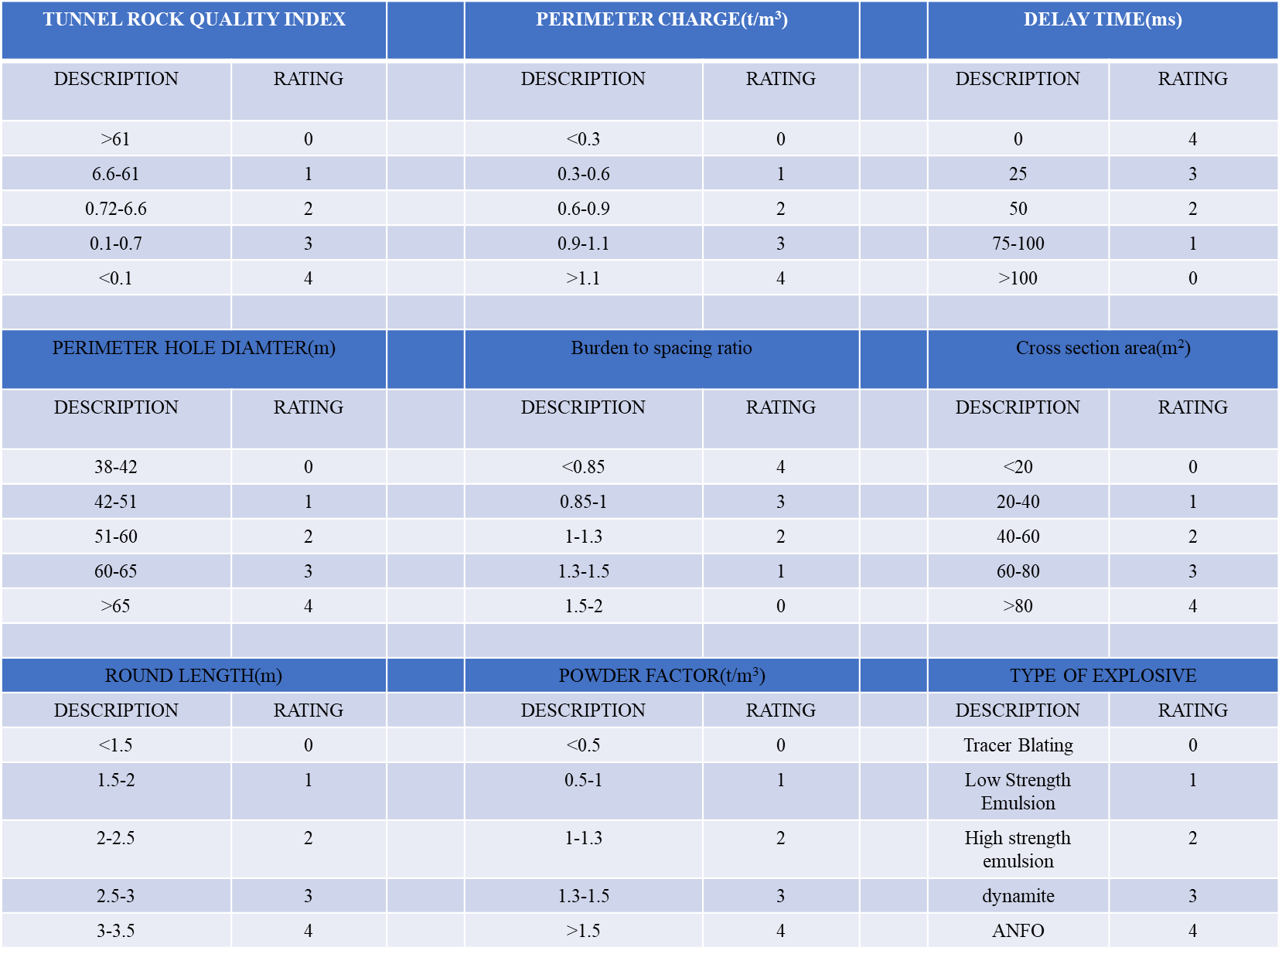
Tunnel Rock Quality index (Q) |  |  | Perimeter Charge (tn/m3) |  |  | Delay Time (ms)
Description | Rating |  | Description | Rating |  | Description | Rating
>61 | 0 |  | <0.3 | 0 |  | 0 | 0
6.6-61 | 1 |  | 0.3-0.6 | 1 |  | 25 | 1
0.72-6.6 | 2 |  | 0.6-0.9 | 2 |  | 50 | 2
0.1-0.7 | 3 |  | 0.9-1.1 | 3 |  | 75-100 | 3
<0.1 | 4 |  | >1.1 | 4 |  | >100 | 4
Perimeter Hole Diameter (mm) |  |  | Burden to Spacing Ratio |  |  | Cross-section area (m²)
Description | Rating |  | Description | Rating |  | Description | Rating
38-42 | 0 |  | <0.85 | 4 |  | <20 | 0
42-51 | 1 |  | 0.85-1 | 3 |  | 20-40 | 1
51-60 | 2 |  | 1-1.3 | 2 |  | 40-60 | 2
60-65 | 3 |  | 1.3-1.5 | 1 |  | 60-80 | 3
>65 | 4 |  | 1.5-2 | 0 |  | >80 | 4
Round length (m) |  |  | Powder Factor (tn/m³) |  |  | Type of Explosive
Description | Rating |  | Description | Rating |  | Description | Rating
<1.5 | 0 |  | <0.5 | 0 |  | Tracer Blasting | 0
1.5-2 | 1 |  | 0.5-1 | 1 |  | Low Strength Emulsion | 1
2-2.5 | 2 |  | 1-1.3 | 2 |  | High Strength Emulsion | 2
2.5-3 | 3 |  | 1.3-1.5 | 3 |  | Dynamite | 3
3-3.5 | 4 |  | >1.5 | 4 |  | ANFO | 4

Slide 34
 |  | Q | T(ms) | B/S | AREA(m2) | DIAMETER(mm) | POWDER FACTOR (tn/m3) | PERIMETER CHARGE(tn/m3) | EXPLOSIVE | ROUND LENGTH (m) | OVERBREAK INDEX
 | WEIGHT | 16.6 | 6.55 | 13.72 | 14.7 | 8.82 | 15.68 | 19.6 | 9.83 | 10.78
 | value at blast | 0.08 | 50 | 1.2 | 30 | 45 | 1 | 0.7 | EMULSION | 1.66
escape tunnel 2 | rating assigned | 4 | 2 | 2 | 1 | 2 | 1 | 2 | 1 | 1 | 53.69
 | maximum rating | 4 | 4 | 4 | 4 | 4 | 4 | 4 | 4 | 4
 | value at blast | 3.54 | 75 | 1.2 | 60 | 45 | 1.4 | 0.9 | EMULSION | 2.4
main tunnel 2 | rating assigned | 2 | 1 | 2 | 2 | 2 | 3 | 3 | 1 | 2 | 62.86
 | maximum rating | 4 | 4 | 4 | 4 | 4 | 4 | 4 | 4 | 4
 | value at blast | 0.5 | 50 | 1.4 | 60 | 45 | 0.9 | 0.6 | EMULSION | 1.89
main tunnel 3 | rating assigned | 4 | 2 | 1 | 2 | 2 | 1 | 1 | 1 | 1 | 49.03
 | maximum rating | 4 | 4 | 4 | 4 | 4 | 4 | 4 | 4 | 4
 | value at blast | 5 | 50 | 1.3 | 30 | 45 | 1.3 | 0.6 | EMULSION | 0.4
escape tunnel 3 | rating assigned | 2 | 2 | 1 | 1 | 2 | 2 | 1 | 1 | 0 | 38.28
 | maximum rating | 4 | 4 | 4 | 4 | 4 | 4 | 4 | 4 | 4

Slide 35
CAUSE – EFFECT TABLE
S.NO | PARAMETERS | CAUSE (C) | EFFECT (E) | C+E | C-E | a_{i}(%)
1 | Q | 17 | 0 | 17 | 17 | 16.66
2 | DELAY TIME | 1 | 7 | 8 | -6 | 6.55
3 | B/S | 3 | 11 | 14 | -8 | 13.72
4 | AREA | 12 | 3 | 15 | 9 | 14.7
5 | HOLE DIAMETER | 3 | 6 | 9 | -3 | 8.82
6 | POWDER FACTOR | 5 | 11 | 16 | -6 | 15.68
7 | PERIMETER CHARGE | 6 | 14 | 20 | -8 | 19.6
8 | ROUND LENGTH | 5 | 6 | 11 | -1 | 10.78
9 | EXPLOSIVE | 5 | 7 | 12 | -2 | 9.83
 |  | 57 | 65

Slide 37
PARAMETER | DESCRIPTION
Perimeter Charge | It is the charge load used in the contour/perimeter holes. Lighter the charge, better the contour profile is the usual belief in the industry. Separate explosives devoted to contour charging itself(less Velocity of Detonation) are the best way to load contour holes. Ideal practise : more number of holes with less dense charges instead of less number of holes with high dense charges.
Hole diameter | It is the diameter drilled by the blasting crew to load explosive charges. Optimum range of hole diameter is the way too important regarding overbreak as it controls the energy spread of the explosive. Hole diameter depends upon the available drilling jumbo at site. The diameter used at contour holes must generally be small compared to production blast diameter. Control of hole diameter range if decided upon geology rather than logistic can better prevent overbreak.

Slide 38
PARAMETER | DESCRIPTION
Spacing to Burden ratio | Spacing is the horizontal distance between drill holes in the same row. Burden is vertical distance between two holes of consecutive rows. In a site which has jointed rock (with very less Q value) there are many ways for a gas wave from explosive to travel. The objective of an ideal spacing and burden is to allow the gas wave to take the path of drill holes. This invariably indicates less spacing is required in contour holes for a clear profile. Ideal practise : B/S for contour holes around 0.8, B/S for other holes in the range of 2.
Delay time | Delay time is the gap between firing successive holes in a blast. The timing of hole blasting should not be too small to not allow proper rock breakage and at the same time not too high to interact with another blast. Delaying too much time in a foliated rock can cause the movement of gas wave to travel into directions of existing discontinuities which only aggravates the problem of rock damage.

Slide 39
PARAMETER | DESCRIPTION
Decoupled charge | This is the ratio of explosive diameter in hole to the hole diameter. The air gap between the borehole wall and the explosive provides additional volume for the expansion of high-pressure detonation products. Using a decoupled charge in contour holes produces less detonation energy since some of it must be consumed to compress air gap between charge and bore hole. This also leads to lower pressure acting on walls of borehole and less cracks around borehole. Ideal practise : charge length of 2/3rd of blast hole length is ideal; but at the end of the day it is again a Q dependent factor.
Explosives | The basic thumb rule in the industry is that detonation velocity (VOD) of explosive must match with sonic velocity (VSO) of rock to obtain fine fragments. There is no value in using an explosive that has a VOD greatly in excess of the VSO of the rock, since there is little or no improvement in fragmentation above the VSO. Two main explosive being used in industry are ANFO ( ammonium nitrate fuel oil) and emulsion explosives. The choice of explosive depends on the fragmentation of rock required and the geology of rock to be blasted. Ideal practice : for good quality rock( Q> 10) emulsion explosive with energy factor around 90% is preferred. For a weak rock with more foliations a less dense explosive like a mixture of ANFO- emulsion might be sufficient.

Slide 40
Rock Class | ET2 cycle time (mins) |  | Reduced time(hr) | ET3 cycle time (mins) |  | Reduced time (hr)
 | Before | After |  | Before | After
B2 | 931.28 | 845.45 | 1.43 | 885.70 | 809.38 | 1.27
B3 | 911.04 | 796.93 | 1.90 | 1098.16 | 988.36 | 1.83

