Slide 1







AFTER MARKET ANALYSIS
TEAM-2
LEADER : RAMESH MENTOR : ASHISH SPONSOR : VENUGOPAL

Slide 2








INTRODUCTION
Aftermarket analysis refers to the process of analyzing the performance of products or services after they have been sold to customers. In the context of spare parts, aftermarket analysis involves analyzing the performance of spare parts in the aftermarket, which is the market for spare parts that occurs after the initial sale of a product.
MISSION:
The goal of aftermarket analysis is to identify areas for improvement and develop recommendations for optimizing aftermarket sales of spare parts.

Slide 3





BUSINESS PROBLEM
The problem statement of aftermarket sales analysis is to predict the sales for the next 3 months with the history of sales data provided.
PROBLEM
With this forecast, capacity allocation for aftermarket and use of available resources become more efficient. This also helps to order imports with a clear window.

Slide 4
PROJECT PLAN
1.Cleaning and Analysis of data - data understanding and pattern identification is made.
2.Modeling Building - using the ARIMA(AutoRegressive Integrated Moving Average) model our prediction model is built
3.Testing - model performance is analysed and improved
4.Deployment - model is presented in API

Slide 5






DATA ANALYSIS
DATA: last 2 years data for top 550 parts.
DATA CLEANING: Google Colab & MS Excel is used for data cleaning.
DATA EXPLORATAION : For exploration we use Google Colabaratory.
DATA VISUALIZATION : We are using tableau for our visualization process

Slide 6


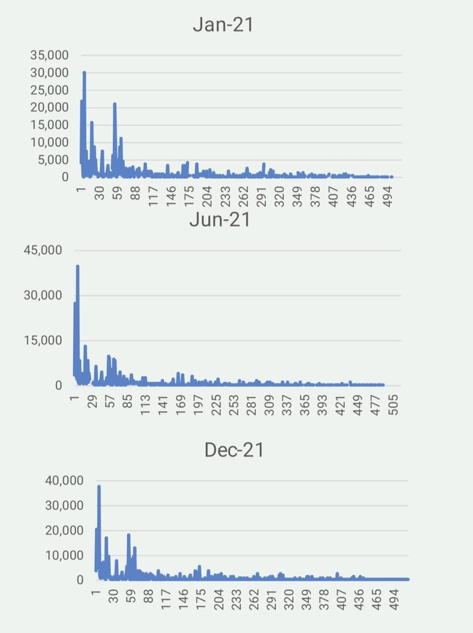
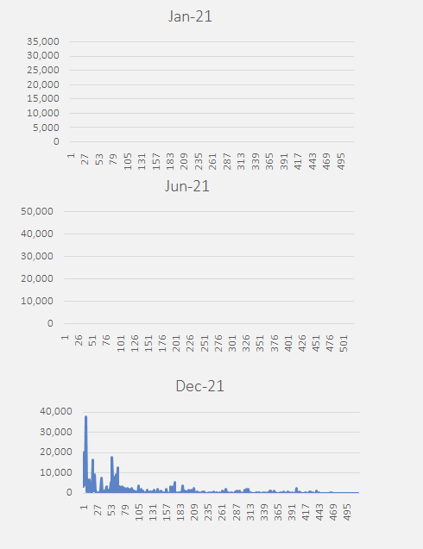
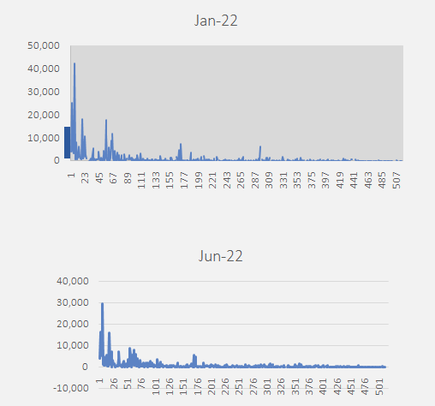

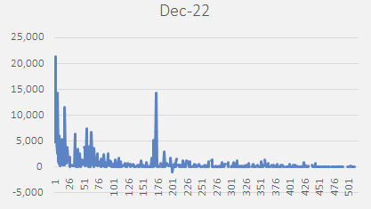


REVIEW ON DATA
From the linear chart we make a conclusion of the annual insight of materials required on the basis of 6 months intervals .
Further we also made the for the year 2022.
From this we come to know that there Is a decreasing amount of orders in the Data of six months intervals of the year 2022.

Slide 7



SOLUTION CONCEPT
AUTOREGRESSIVE INTEGRATED MOVING AVERAGE
An autoregressive integrated moving average, or ARIMA, is a statistical analysis model that uses time series data to either better understand the data set or to predict future trends. A statistical model is autoregressive if it predicts future values . It is used in demand prediction based on past available data.

Slide 8




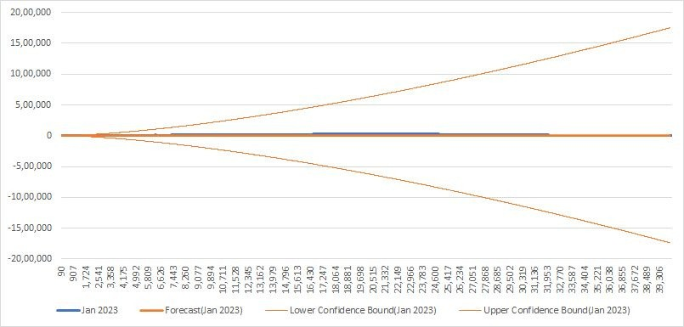
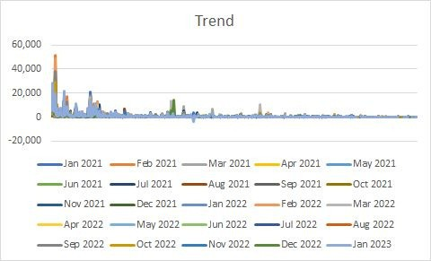

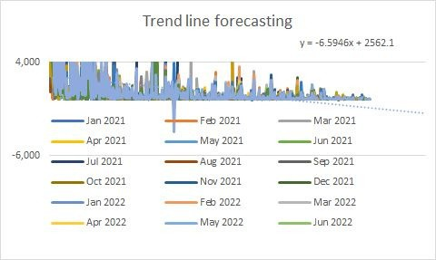


MODELLING
The trend line above in the graph represent the upper bound trend line which shows the maximum values
The lower trend line represents the lower bound trend line which shows the minimum values

Slide 9
MODELLING

Slide 10



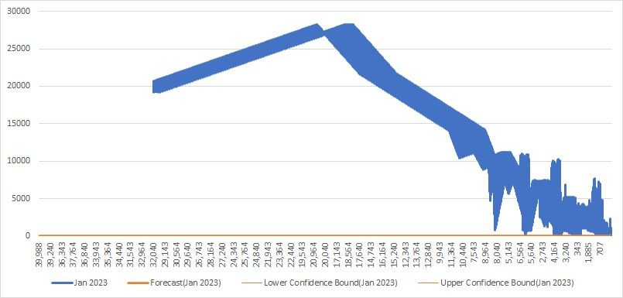
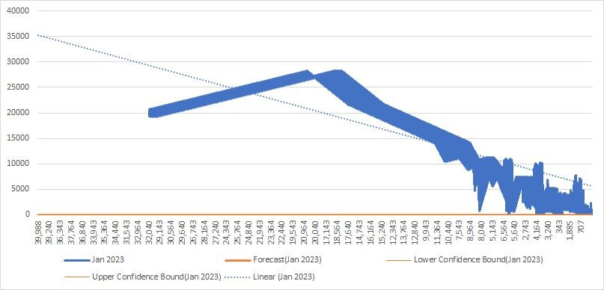
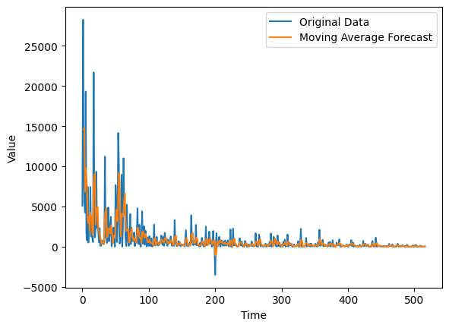


OUTPUT
It shows the forecast of the given sales data

Slide 11
RECOMMENDATION
1.Replacing missing values with zeros may initially improve the accuracy of predicted results, but as we progress through the dataset, the accuracy percentage declines significantly. This is because using zeros as a replacement for missing values can create biases in the data, which can lead to incorrect predictions. As the volume of missing data increases, the impact of these biases becomes more significant and can distort the overall accuracy of the predictions. Therefore, it is important to use appropriate methods for handling missing data, such as imputation techniques, to ensure the accuracy and reliability of the results.
2. Constant updating of sales data can lead to more precise predictions and enhanced demand forecasting. Regular updates to sales data also enable businesses to quickly identify and rectify any issues or faults in their operations. continuous updates to sales data can improve the accuracy and effectiveness of predictive models. constant updating of sales data can lead to more precise demand predictions, faster fault identification, and ultimately help businesses to operate more efficiently and effectively.

Slide 12
LITERATURE REVIEW
S.NO | TITLE | AUTHOR | Reference link
1 | Aftermarket demands forecasting with a Regression-Bayesian-BPNN model | Yun Chen;Ping Liu,Li Yu. | https://ieeexplore.ieee.org/document/5680793
2 | Identifying the critical factors driving the quality of After-sales services in the Nigerian automotive industry | John Aiyesehinde,Clinton Aigbavboa. | https://ieeexplore.ieee.org/document/9134022
3 | After-sales services and aftermarket support: a systematic review, theory and future research directions. | C.M Durugbo Arabian Gulf University | https://www.researchgate.net/publication/337468047_After-sales_services_and_aftermarket_support_a_systematic_review_theory_and_future_research_directions

Slide 13
CONCLUSION
From the provided data we made a prediction sales trend of sales for next three months is predicted using upper bound and lower bound of data as per the dataset.

Slide 14
THANK YOU !

