Slide 1
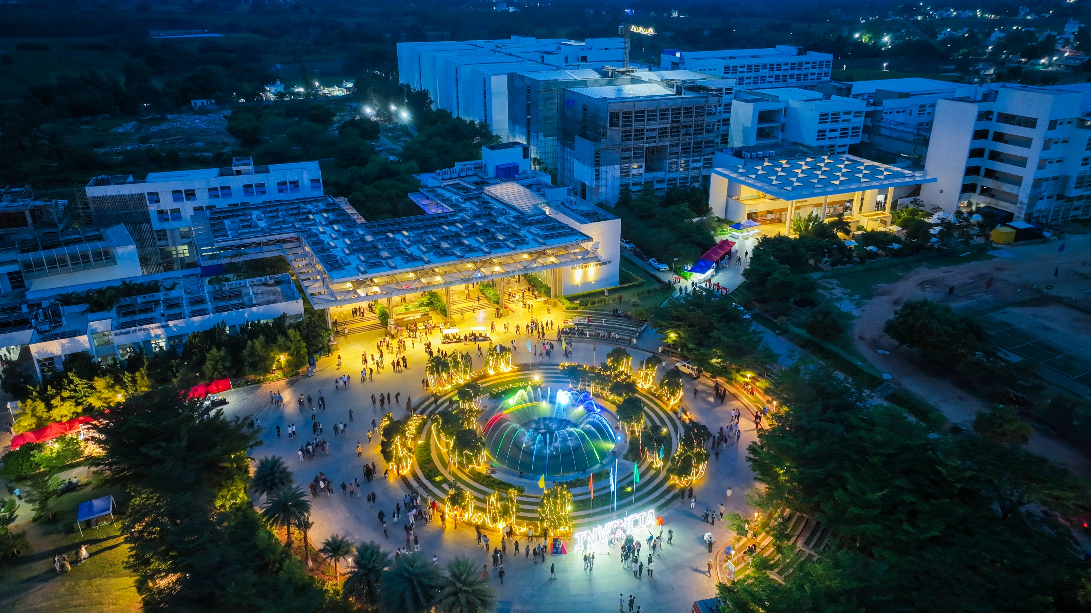

Presidency
Presidency
School of Artificial Intelligence and Advanced Computing

Slide 2
AUTONOMOUS AI AGENT FOR IT HELPDESK
PSAIAC_60
CSS7102 — Mini Project | Review 1 (CA-01)
CSS7102- Mini Project Review-1
Batch Number:CAI_28
Under the Supervision of,
Mr. Parth Naik
Project Guide
Roll Number | Student Name
20221CAI0154 | VISHNU PRASAD GOTUR
20231CAi0139 | SHIVARAJ
Name of the Program: B.Tech Computer Science and Engineering (Artificial Intelligence & Machine Learning)
Name of the HoD: Dr. Zafar Ali Khan
Name of the Program Project Coordinator: Ms. Suma N G
Name of the School Project Coordinators: Dr. Sampath A K

Slide 3
Content
Problem Statement
Github Link
Analysis of Problem Statement
Timeline of the Project
References

Slide 4
Problem Statement Number: PSAIAC_60
Organization: Presidency School of Artificial Intelligence and Advanced Computing (PSAIAC)
Category (Hardware / Software / Both) : Software
Problem Description : IT teams spend 40% of time on repetitive L1 tickets. Industry needs an autonomous AI agent that resolves password resets, software installs, and access requests without human involvement.
Difficulty Level: Not specified

Slide 5
Github Link
The Github link provided should have public access permission.
Github Link: https://github.com/vishnuprasadg2777-source/autonomous-ai-it-helpdesk

Slide 6
Analysis of Problem Statement
Technology Stack Components:
* Frontend: React / Next.js
* Backend: Python, FastAPI
* AI: Large Language Model (LLM)
* Agent: AI Agent / Agent Orchestration
* Knowledge: RAG (Retrieval-Augmented Generation)
* Vector Database: FAISS / Chroma
* Database: PostgreSQL
* Authentication: RBAC
* Version Control: Git, GitHub

Slide 7
Analysis of Problem Statement (contd...)
Software and Hardware Requirements:
Software Requirements
* Operating System: macOS / Windows / Linux
* Programming Language: Python
* Backend Framework: FastAPI
* Frontend: React / Next.js
* AI/LLM: LLM API
* Knowledge Retrieval: RAG
* Vector Database: FAISS / Chroma
* Database: PostgreSQL
* Development Tools: VS Code, Git
* Version Control: GitHub
Hardware Requirements
* Processor: Modern multi-core CPU
* RAM: Minimum 8 GB
* Storage: Minimum 10 GB available
* Internet: Stable internet connection
* GPU: Not mandatory for initial development; cloud/API-based LLM can be used

Slide 8
Analysis of Problem Statement (contd...)
Current Challenges
* High volume of repetitive Level-1 (L1) IT support tickets
* Manual handling of routine requests consumes IT support time
* Repetitive workflows require consistent policy-based handling
* Cases outside the supported scope still require human intervention
Target IT Helpdesk Workflows
1. Password Reset
2. Software Installation
3. Access Request
Proposed AI-Agent Approach
* Understand the user’s request
* Identify the required IT service
* Retrieve relevant IT knowledge/policies
* Determine the appropriate authorized workflow

Slide 9
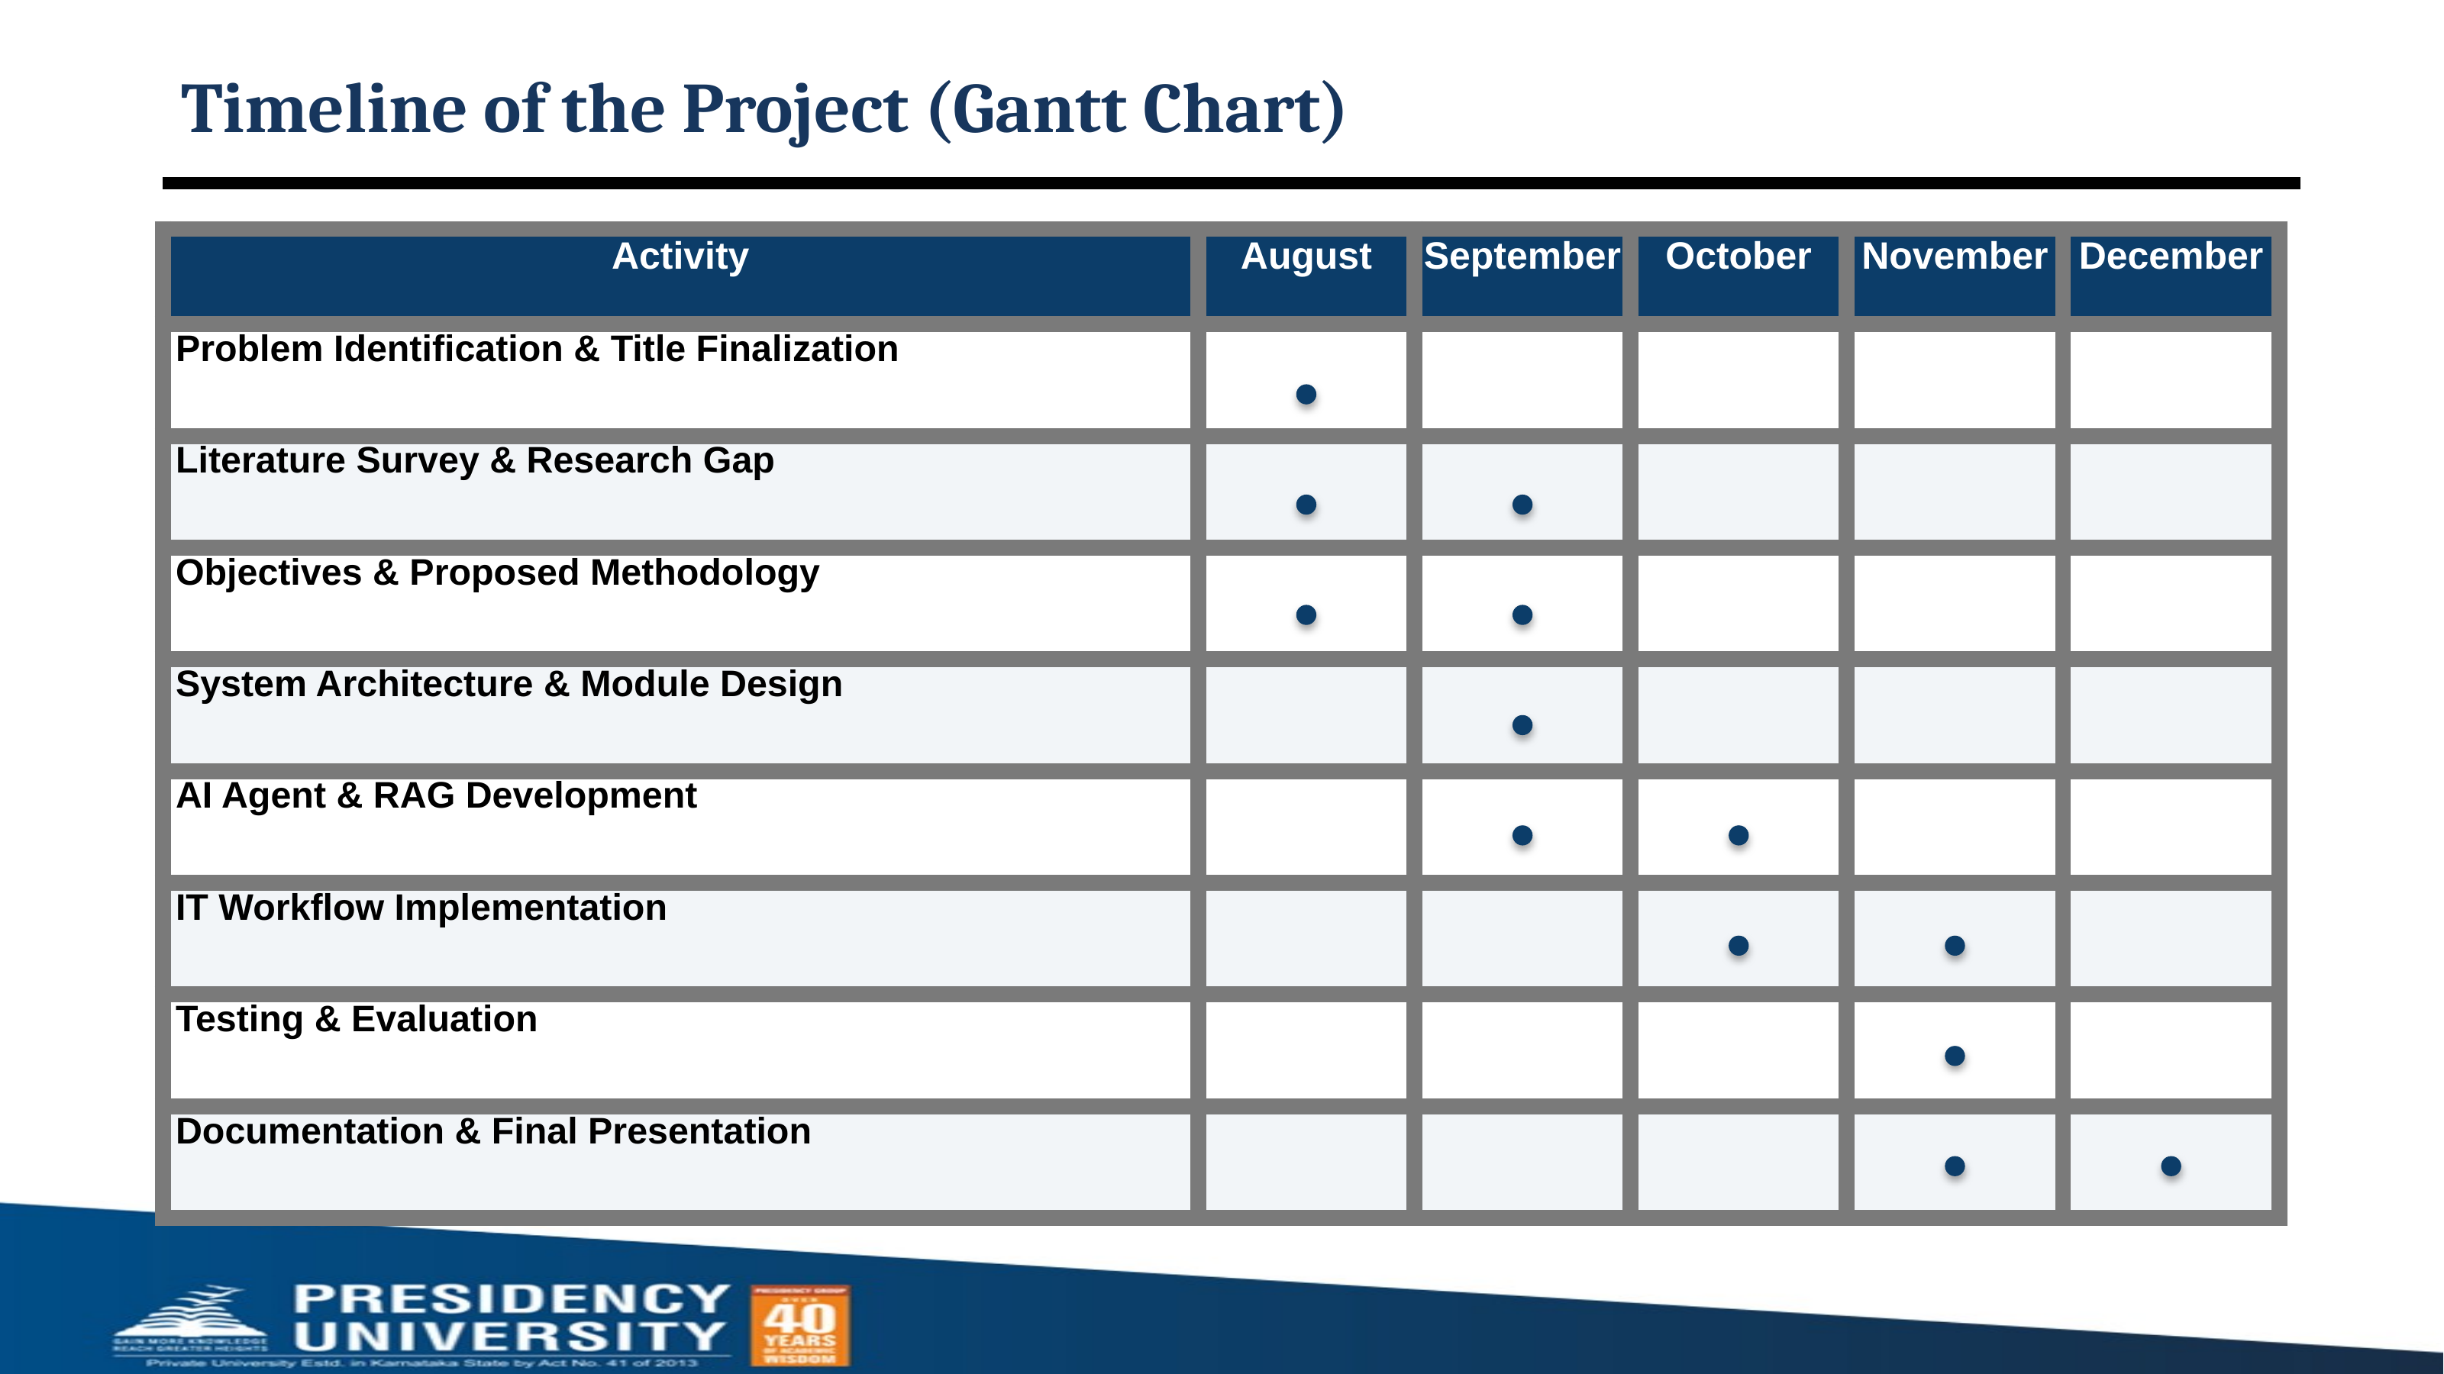
Timeline of the Project (Gantt Chart)

Slide 10
References (IEEE Paper format)
[1] F. Al-Hawari and H. Barham, “A machine learning based help desk system for IT service management,” Journal of King Saud University – Computer and Information Sciences, vol. 33, no. 6, pp. 702–718, 2021, doi: 10.1016/j.jksuci.2019.04.001.
[2] D. Zuev, A. Kalistratov, and A. Zuev, “Machine Learning in IT Service Management,” Procedia Computer Science, vol. 145, pp. 675–679, 2018, doi: 10.1016/j.procs.2018.11.063.
[3] I. Tello, C. Ruiz, and S. G. Yoo, “Analysis of COBIT 5 Process ‘DSS02 - Manage Service Requests and Incidents’ for the Service Desk Using Process Mining,” in 2018 Fifth International Conference on eDemocracy & eGovernment (ICEDEG), 2018, pp. 304–310, doi: 10.1109/ICEDEG.2018.8372335.
[4] L. Wang, C. Ma, X. Feng, Z. Zhang, H. Yang, J. Zhang, Z. Chen, J. Tang, X. Chen, Y. Lin, W. X. Zhao, Z. Wei, and J. Wen, “A survey on large language model based autonomous agents,” Frontiers of Computer Science, vol. 18, no. 6, Art. no. 186345, 2024, doi: 10.1007/s11704-024-40231-1.
[5] X. Zhang, H. Xu, Z. Ba, Z. Wang, Y. Hong, J. Liu, Z. Qin, and K. Ren, “PrivacyAsst: Safeguarding User Privacy in Tool-Using Large Language Model Agents,” IEEE Transactions on Dependable and Secure Computing, vol. 21, no. 6, pp. 5242–5258, 2024, doi: 10.1109/TDSC.2024.3372777.

Slide 11


