Slide 1
Weight Tracking App
Using Tkinter and sqlite3
By- Vishnu Prasad
LinkedIn: https://www.linkedin.com/in/vishnuprasadkk/
Github: https://github.com/vishnuprasadkk
Email: kkvishnuprasad@gmail.com

Slide 2
NOTE
This is a preliminary version of the app. The final version will be uploaded to my github when the project is finished.

Slide 3
Introduction
This is a very simple weight tracking app that can be used to log your weight loss progress daily.
The main purpose of doing this project, for me personally, is to practise using the Tkinter and sqlite3 libraries.
I have been tracking my weight loss progress using an excel sheet and thought why not make a simple app that can be used to store the data in a database.
This app has two “Ends”. A frontend that creates the GUI using the Tkinter library and a backend that creates the database using sqlite3 library.

Slide 4
The Frontend code
The frontend python script contains all the code that creates the graphical user interface using the Tkinter library.
The app has basic buttons like Add Entry, View all, Delete Last Entry and Close.
The functionality of the buttons are self explanatory.

Slide 5
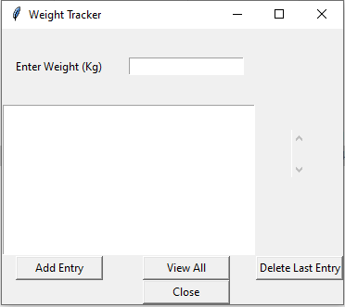

Slide 6
The Backend code
The backend python script contains all the code that is used to store the data in a database using the sqlite3 library.
The backend script creates a database called “counter.db”.
The backend script then creates a table called “tracker” and stores the data in it.
The user only inputs the weight. A unique id is created automatically and the datetime function is used to get the current date.

Slide 7
The Executable File
The pyinstaller library is used to create the final executable file.

Slide 8
THANK YOU !!!

