Slide 1
HIIDeS - Hybrid Intelligent Intrusion Detection System
An Intrusion Detection System developed incoporating Genetic Algorithm
Better throughput, better Speed!
Richard K Jose
Vipin Sreekumar
Vishnu K P
Vishnu Prathish
IDS + GA = HIIDeS

Slide 2
What is an IDS?
Tools, methods and resources to detect deliberate events that try to cause harm to a network
Identify, asses and/or report the activity, ie, alerts about potential of intrusion
No prevention
An additional layer of passive protection

Slide 3
Genetic Algorithm
An optimization algorithm resembling Darwins theory of evolution to obtain best individuals.
Evolves away from bad conditions to reach the best solution
Does not garuntee best results, but generally evolve towards better results
Evolution is based on a fitness value for each chromosome assigned through a fitness function

Slide 4
GA Step by Step
Generate random population of chromosomes encoded as suitable solutions for the problem
Evaluate the fitness of each chromosome in the population
Create a new population by repeating following steps until the new population is complete
  [Selection] of parent chromosomes for reproduction
  [Crossover] cross over the parents to form a new offspring (children).
  [Mutation] Introducing new traits by changing gene structure
  [Accepting] Place new offspring in a new population
Use new generated population for a further run of algorithm
If the end condition is satisfied, stop, and return the best solution in current population
Go to step 2

Slide 5
...Procedure...

Slide 6
Problem Statement
GA is an efficient AI algorithm for optimization problems.
IDSs seemed to be potential field of application of GA.
Eventhough research is being done, none proved to be successfull in achieving the speed required by an IDS(after incorporatng GA)
Our aim was to achieve this somehow.

Slide 7
Challenges
Incoporate GA in an IDS.
Handle huge amount of data in a relatively short period of time.
Find a suitable rule representation as required for GA

Slide 8
Method Proposed
Rule based IDS(Signature based filtering)
Seperate GA from core IDS part into a seperate unit
Use GA to generate required rulebase
Use this rulebase to filter intrusions
Since GA is a seperate module used only to generate rules, it does not intervene in processing real time network data, thus speed is achieved.

Slide 9
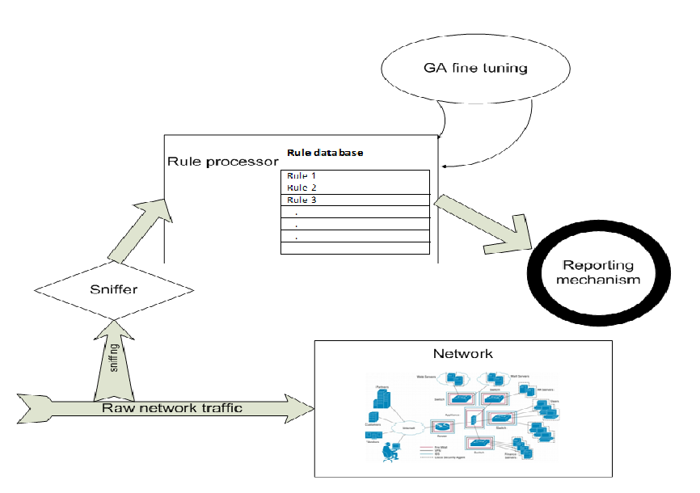
Basic HIIDeS Architecture

Slide 10
How the problem was approached, step by step - I
In the paper titled, ”An Approach to Implement a Network Intrusion Detection System using Genetic Algorithms” by
M. M. PILLAI, J. H.P. ELOFF AND H. S. VENTER
  They suggested the possibilty of rule filtering using GA
Defects -
  No implementation details was availble.
  Rules was rather primitive
  Detailed study was not done.
We decided to expand on the topic by selecting a rule based IDS for the purpose

Slide 11
II - KDD CUP '99 dataset
A comprehesive dataset on network collections
Over 40,000 connection records manually classified as intrusion or not with 41 parametrs per connection
Network security researchers favorite dataset
These data would provide a valuble rule structure
We decided to make the rule structure based on this dataset parameters
The dataset was used as the training sample.
But since dataset is old, it no longer resembles real network data

Slide 12
III – Incorporation of GA
GA reuired an encoded format of string representation
  41 parametrs of KDD CUP '99 dataset was encoded as Binary String
  Consisting of 730 bits per chromosome
  The entire ”training1.data” was encoded as binary string
The binary string was passed through GA to obtain the GA optimized ruleset in binary form
The encoded ruleset was decoded back to obtain rules which is used to filter incoming connections

Slide 13
Fitness function assigns a fitness value to each of the chrmomsomes through fitness function
A fitness table is created using these fitness values, and in each generation a selction function selects suitable indivduals for reproduction
Reproduction is performed using genetic operators Mutation and Crossover
It is not necessory that fittest individual is passed onto next generation, but it is very likely.

Slide 14
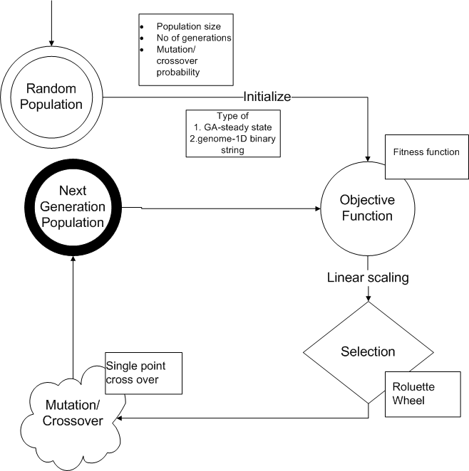
GA Architecture

Slide 15
IV – Applied GA parameters
Type of GA – Steady State
Population size – 400
Number of generations – 4000
Crossover Probability – 0.9
Mutation Probability – 0.001
Type of Chromosome – Binary String.
Selection – Roulette Wheel

Slide 16
V – Fitness function
Total number of intrusions detected by rule – r
Number of intrusions detected that were actually intrusions – a
Actual number of intrusions in the dataset – A
Percentage of false positives - f = (r-a)/r x 100
Percentage accuracy of rule without regard to false positives – b= a/A x 100
Fitness score return value = b/f

Slide 17
To finalize...
Higer the number of intrusions detected( that is lower the value A-a) by the rule, and the ones wth low false positives(r-a) should be given higher score.
A uniform measure for the fitness value independent of the number of connections
After acquiring necessory convergance, the GA is stopped
The final population at the moment of stopping is selected as rule set.
After decoding, this rule set can be used to filter incoming connections from the sniffer(Not implemented)

Slide 18
Coding - What was planned and what was completed...
Introducing a method to implement IDS using GA - Done
Implementing a basic IDS framework - Done
Implementing a Basic Port Scan detection System – Done
Incorporating the GA rule base to IDS framework - X
  Extracting 41 parameters from TCP connections are seemingly difficult
  Dataset to test the settings are not available according to present network conditions
  KDD CUP data is 10 years old.

Slide 19
Advantages and Diadvantages of proposed method
Does not intervene realtime, so speed is unaffected.
Can detect new intrsions depending upon the classifier efficiency.
Frequent update of rulebase with real network data is required to enhance efficiency
Speed is GA is very low(In our case, the program is required to run overnight to get some output) due to high string comparisons.

Slide 20
Future Work
Incorporate the GA rulebase into IDS framework
Improve the Fitness function to bias GA more towards intrusive connections(over 4 methods was tested before selecting the current fitness function)
Reduce the rule length(730 bits) to below 100 by using better encoding methods and dropping unnecessory parameters(Using a decision tree)
Improve IDS rule struct to include wildcards, multiline programmable rules.

