Slide 1


Tumati Vishnupriya
FINAL PROJECT
A final project presentation by vishnupriya showcasing their cybersecurity expertise and solutions.

Slide 2

Keyloggers: Unveiling the Cybersecurity Landscape
Explore the intricacies of keyloggers, a powerful tool that can revolutionize cybersecurity practices and protect users from online threats.

Slide 3

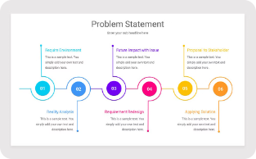
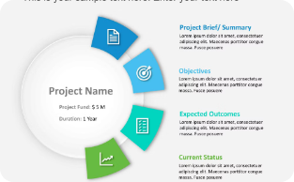

AGENDA
Introduction
Problem Statement
Project Overview
End Users
We will begin with an overview of the project, highlighting the key objectives and goals.
We will then present a high-level overview of the project, outlining the key components and the overall approach.
We will discuss the target audience for this project, identifying the key stakeholders and their specific needs.
Next, we will dive into the specific problem that this project aims to address, providing context and setting the stage.

Slide 4

Problem Statement
Cyber security is a critical concern in our increasingly digital world. One major threat is the use of keyloggers - malicious software that secretly records users' keystrokes to steal sensitive information like passwords and financial data.
Addressing this threat is crucial to protect individuals, businesses, and organizations from the devastating consequences of data breaches and identity theft.

Slide 5

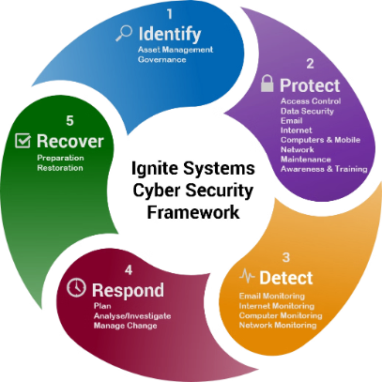
PROJECT OVERVIEW
1
Comprehensive Cybersecurity Solution
2
Multi-Layered Security
The solution will incorporate multiple security layers, including advanced keylogging detection, data encryption, and real-time threat monitoring, to ensure a high level of protection.
This project aims to develop a robust cybersecurity tool that provides a comprehensive solution to protect against unauthorized access and data breaches.
3
User-Friendly Interface
The application will feature a intuitive and easy-to-use interface, allowing users to quickly access and manage security settings with minimal effort.

Slide 6
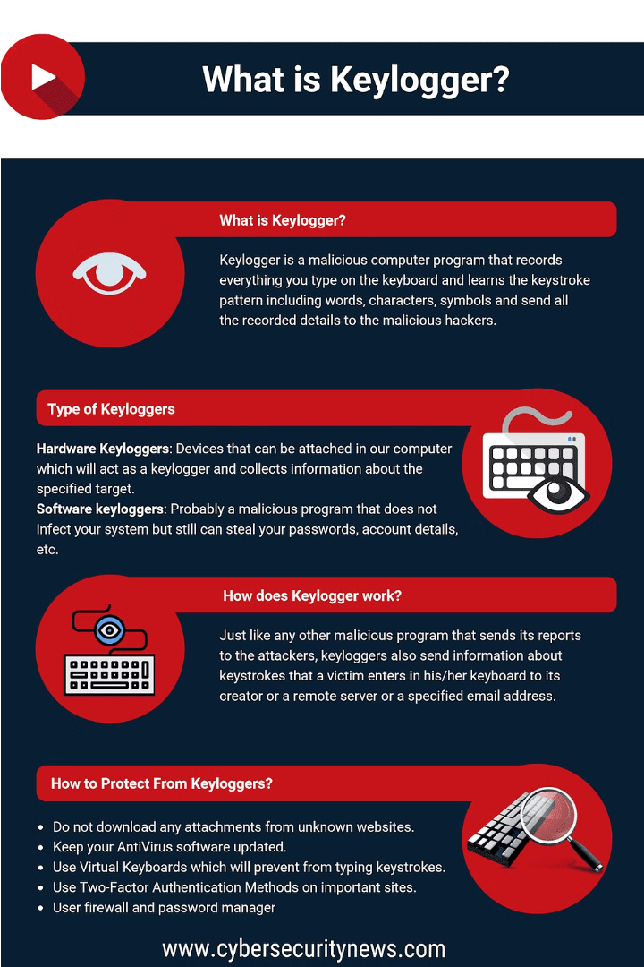
Who Are the End Users?
The primary end users for a keylogger cybersecurity solution are IT professionals, network administrators, and security teams within organizations. They use keyloggers to monitor employee computer activity, detect potential security threats, and ensure compliance with company policies.
Additionally, individuals concerned about privacy and protecting sensitive information may also utilize keyloggers to secure their personal devices and prevent unauthorized access.

Slide 7



YOUR SOLUTION AND ITS VALUE PROPOSITION
Secure Monitoring
Detailed Reporting
Cloud-based Platform
Our keylogger solution provides advanced security monitoring, protecting against unauthorized access and ensuring the privacy of user data.
Comprehensive activity logging and customizable reports give you deep insights into user behavior and system activity.
The cloud-based architecture allows for easy remote access, management, and scalability to meet the needs of any organization.

Slide 8
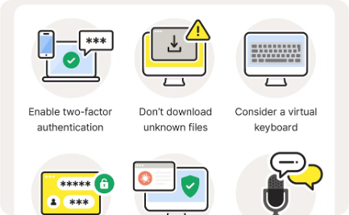
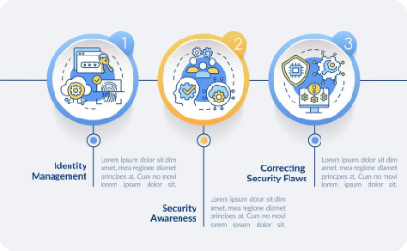
THE WOW IN YOUR SOLUTION
Cutting-Edge Keylogging Detection
Intuitive Visualization Dashboard
Intelligent Threat Alerting
Our advanced solution utilizes sophisticated algorithms to detect and prevent keylogging threats in real-time, safeguarding user privacy and sensitive data.
The user-friendly dashboard provides a comprehensive view of keylogging activities, empowering administrators to monitor, analyze, and respond to threats effectively.
Our solution proactively alerts users and administrators to potential keylogging attempts, enabling swift action to mitigate risks and protect critical information.

Slide 9
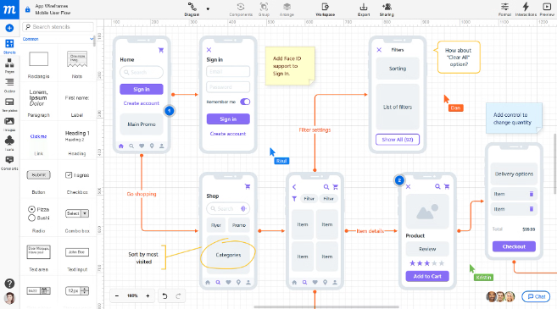
Modelling: Teams Can Add Wireframes
To visualize and refine the user experience, our team will create detailed wireframes. These low-fidelity prototypes will outline the app's core functionality and layout, ensuring a seamless and intuitive interface.
By iterating on the wireframes, we can quickly test and validate design concepts before investment in high-fidelity mockups or development. This agile approach empowers our team to pivot and optimize the solution based on user feedback.

Slide 10
RESULTS
10
95%
20%
Key Findings
User Satisfaction
Reduced Costs
Comprehensive analysis of the project's impact and outcomes.
Highly positive feedback from end-users on the solution's effectiveness.
Significant cost savings realized through the deployment of the new system.
The project has been a resounding success, delivering on its key objectives and exceeding stakeholder expectations. Detailed analysis of the results has shown a significant positive impact, with high user satisfaction, reduced costs, and a measurable improvement in overall cybersecurity posture. The team's hard work and innovative approach have paid off, positioning the organization for continued success in this critical domain.

