Slide 1

TEXT EMOTION EXTRACTION USING BERT
A project by : Vishnupriya V
21071A66C8

Slide 2
1
ABSTRACT
This study explores text emotion extraction using BERT, leveraging its deep bidirectional context understanding for accurate emotion detection. By fine-tuning BERT on emotion-labeled datasets, we achieve superior accuracy and robustness compared to traditional methods. Experimental results confirm BERT's efficacy across various text genres, highlighting its potential in advancing natural language processing for nuanced emotion analysis.
Keywords: Emotion extraction, BERT, NLP, deep learning.

Slide 3
2
INTRODUCTION
This paper utilizes BERT for text emotion extraction, enhancing emotion detection with its deep contextual understanding. Fine-tuning BERT on specific datasets significantly improves accuracy and performance across diverse text genres.

Slide 4
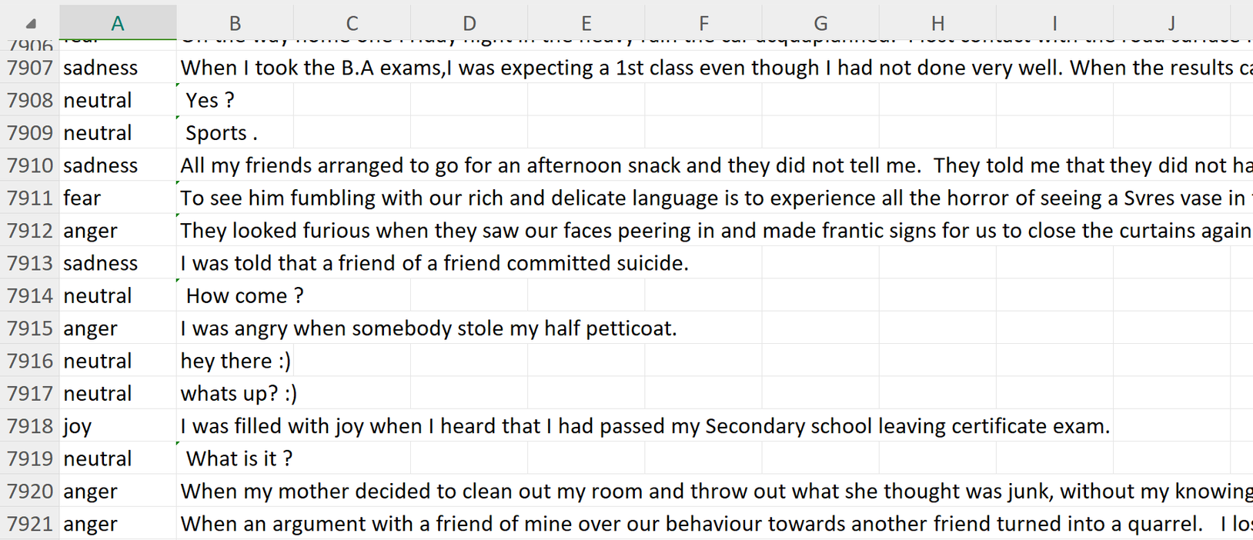
DATA SET
3
The dataset consists of 8000 rows of text, labelled with the associated emotion- Anger, Sadness, Happiness, neutral, etc...

Slide 5
BERT
4
BERT (Bidirectional Encoder Representations from Transformers) revolutionizes NLP with deep bidirectional context understanding.
It captures intricate word dependencies by processing text in both directions simultaneously.
Fine-tuning BERT on specific emotion datasets enhances text emotion detection accuracy.
BERT can predict emotions accurately, even with complex sentences.

Slide 6
PROPOSED SYSTEM
4
Pre-Processing Steps: BERT model comes with in-built preprocessing.
2. Trainining Step: Train the model on a large dataset.
3. Export and Use the Model

Slide 7
TECHNICAL SPECIFICATIONS
4
Dataset:
Open Source Datasets are used, multiple languages required
Models Used:
BERT
Hardware Requirements:
GPU with 16GB of VRAM
Libraries :
pytorch,
Others:
Transformers-HuggingFace

Slide 8
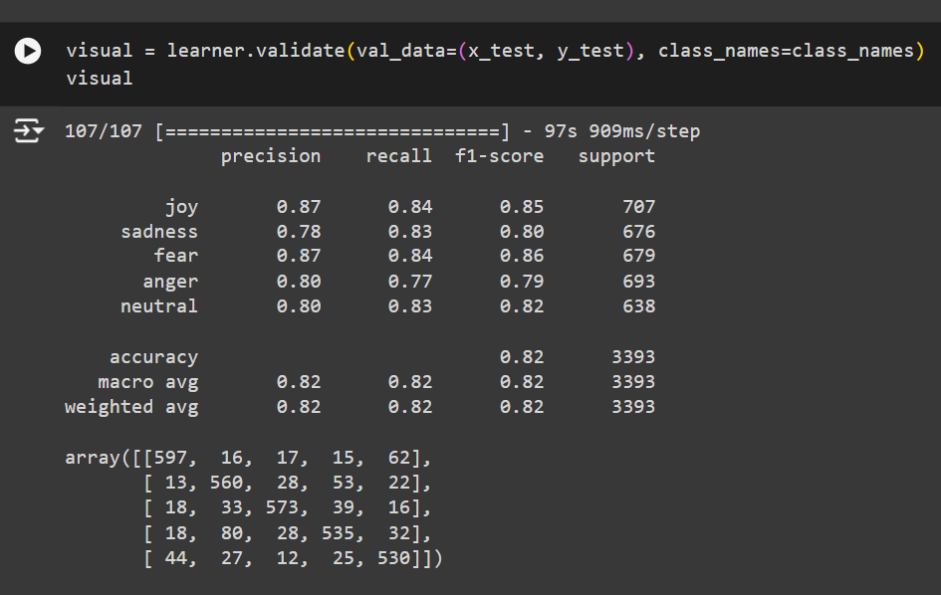
RESULTS
4
Accuracy:
Model Achieved average accuracy of 82%
Confusion Matrix:

Slide 9
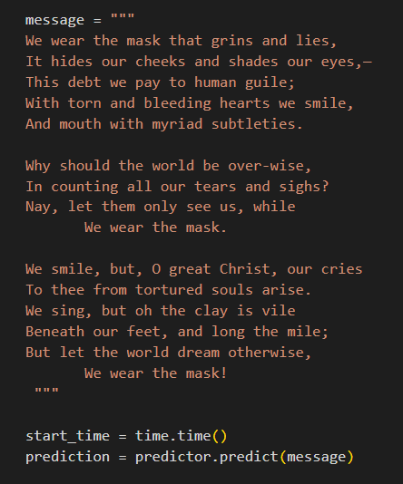
RESULTS
4
INPUT:
The input is a poem called ‘We Wear the Mask’.
Despite the complex language, and the poem not being straight forward, the model correctly identified the emotion as sadness

Slide 10
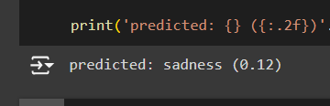
RESULTS
4
OUTPUT:
Prediction: ‘Sadness’
Time Taken: 12 ms

Slide 11
SCOPE
4
Customer Feedback Analysis: Utilize BERT to extract emotions from customer reviews and feedback, enabling businesses to gain insights into customer satisfaction and areas for improvement.
Mental Health Monitoring: Apply BERT to analyze text from social media or personal journals, helping to detect emotional distress or well-being for mental health support.
Human-Computer Interaction: Implement BERT for real-time emotion detection in chatbots and virtual assistants, enhancing their ability to respond empathetically and improve user experience.

Slide 12
5
CONCLUSION
BERT significantly enhances text emotion extraction by leveraging deep contextual understanding, outperforming traditional methods. Its adaptability across various text genres and applications—like customer feedback analysis, mental health monitoring, and human-computer interaction—demonstrates its robust potential. Future work will refine BERT for even more nuanced emotional contexts, driving the evolution of sophisticated, empathetic AI systems.

