Slide 1
HIGH-CONCURRENCY FILE DISTRIBUTION SERVER
Operating Systems and Systems Programming (25CS2104E)
Section 3 • Team 8
Suggula Sri Vishnupriya • Moukthika Vungarala

Slide 2
PROBLEM STATEMENT
Without a proper file server, managing and accessing files for multiple clients is difficult and time-consuming. Clients may have to wait for files to be accessed or updated, especially when many need files at the same time. A file server provides a central place to store files and lets multiple clients read or update them efficiently.
01

Slide 3
OBJECTIVES
  Design and implement a Linux-based high-concurrency file server
  Handle multiple read and write requests using separate child processes
  Use fork() and anonymous pipes for process creation and inter-process communication
  Demonstrate file descriptors and file I/O using open(), read(), write() and close()
  Manage child processes properly using waitpid() and wait()
02

Slide 4
HOW IT WORKS
PARENT
PIPE
CHILD
Shows the menu, takes a READ or WRITE request, creates a pipe, forks a child and sends the request. It is then free to accept the next request.
An anonymous pipe carries only the request: the file name for READ, or the file name and data for WRITE. Each request gets its own pipe.
Closes the unused pipe end, reads the request, performs open(), read() or write(), close() on a file in server_files/, then terminates.
03

Slide 5
CONCEPTS USED
  Processes and fork(): one child process is created for every request
  pipe(): an anonymous pipe carries each request from parent to child
  open(), read(), write(), close(): file I/O on files in server_files/
  File descriptors: pipefd[] and file manage the pipe and file resources
  waitpid() and wait(): finished children are cleaned up, leaving no zombies
04

Slide 6
IMPLEMENTATION
Request received → pipe created → child created with fork() → parent sends the request through the pipe → child reads it → file opened → read or write performed → descriptors closed → child terminates → next request handled.
READ opens the file with O_RDONLY. WRITE opens it with O_WRONLY | O_CREAT | O_APPEND. The parent reaps finished children with waitpid(-1, NULL, WNOHANG) and waits for the rest on exit.
05

Slide 7
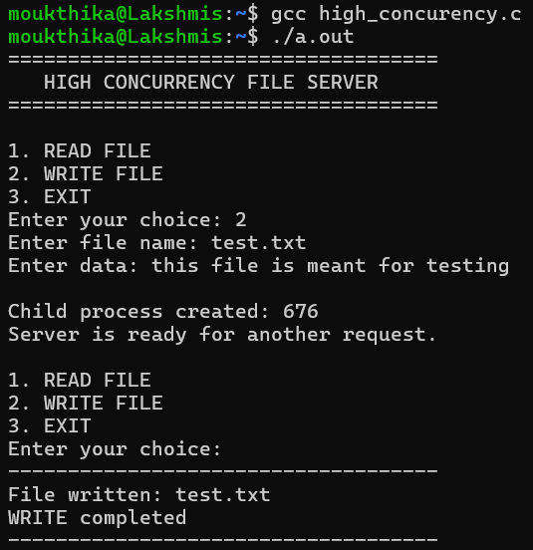
OUTPUT: WRITE
WRITE request for test.txt: the file name and data travel through the pipe to child process 676. The parent prints "Server is ready for another request" at once, while the child appends the data and reports WRITE completed.
06

Slide 8
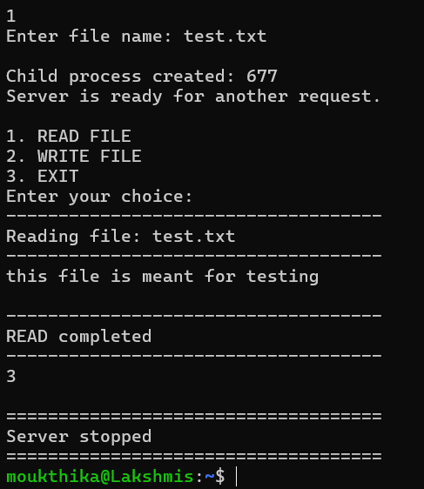
OUTPUT: READ
READ request for test.txt: child process 677 opens the file, reads it and prints its contents. Choosing EXIT waits for any remaining children and then stops the server.
07

Slide 9
WEBSITE LINK
https://vishnupriya-255.github.io/High-Concurrency--File-Distribution-Server/
08

Slide 10
THANK YOU

