Slide 1
School Event Management System
TEAM :- 4
FIRST MEMBER NAME:- SUGGULA SRI VISHNUPRIYA
ROLL NO :- 2520030348
SECOND MEMBER NAME:- SURABHI ANUSHKA
ROLL NO:-2520090168

Slide 2
Introduction
The School Event Management System is a web-based application designed to simplify and automate the management of school events. Traditional event management methods often involve manual paperwork, making it difficult to organize, schedule, and communicate event details effectively. This system provides a centralized platform where organizers can create events, manage schedules, and share information with students in an efficient manner.
The system consists of two main modules: the Student Dashboard and the Organizer Dashboard. Students can view upcoming events, check schedules, register or volunteer for events, and provide feedback after participation. Organizers can create and manage events, schedule activities, monitor registrations, and analyze feedback. By digitizing the entire process, the system improves communication, increases student participation, reduces administrative effort, and ensures the smooth execution of school events.

Slide 3
Abstract
The School Event Management System is a web-based application developed to streamline the planning, scheduling, and management of school events. The system provides a centralized platform that enables organizers to create and manage events while allowing students to access event information easily. It reduces the challenges associated with manual event management, such as inefficient communication, scheduling conflicts, and difficulties in collecting participant feedback.
The project consists of two main modules: the Student Dashboard and the Organizer Dashboard. Through the Student Dashboard, students can view events, check schedules, register or volunteer for activities, and submit feedback after participation. The Organizer Dashboard enables organizers to create events, manage schedules, monitor registrations, and review feedback. By automating these processes, the system improves event coordination, enhances student engagement, reduces administrative workload, and ensures the successful execution of school events.

Slide 4
Problem Statement
Managing school events manually can be inefficient and time-consuming, leading to difficulties in event planning, scheduling, participant registration, communication, and feedback collection. Organizers often face challenges in coordinating activities and maintaining accurate records, while students may not receive timely information about upcoming events. Therefore, there is a need for a centralized School Event Management System that enables organizers to efficiently manage events and allows students to view event details, register or volunteer, access schedules, and provide feedback, ensuring smooth and effective event management.

Slide 5
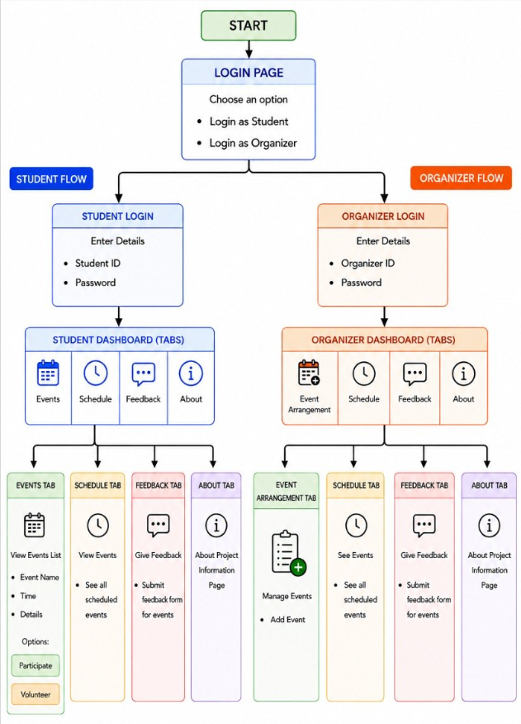
Project Workflow

Slide 6
Project modules
Home Page
The Home Page is the main entry point of the School Event Management System. It provides an overview of the application and allows users to navigate to the Student and Organizer dashboards through a simple and user-friendly interface.
Events
The Events module displays information about upcoming events, including event name, description, and date. Students can view events and register or volunteer for participation.
Schedule
The Schedule module shows event dates, timings, and activity details. It helps students and organizers stay updated and manage event schedules effectively.
Feedback
The Feedback module allows students to submit ratings, comments, and suggestions about events. Organizers can review the feedback to improve future events.
About
The About Page provides information about the project, its objectives, features, technologies used, and the purpose of the School Event Management System.

Slide 7
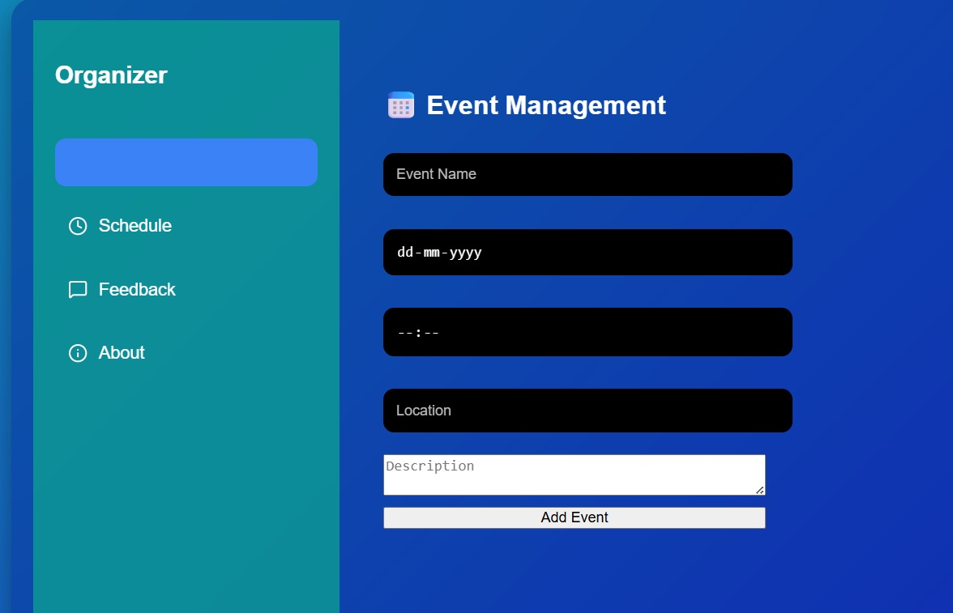
Organizer Dashboard
The Organizer Dashboard allows organizers to create and manage events, schedule activities, and monitor student registrations or volunteers. It also provides access to student feedback, helping organizers improve future events and ensure smooth event management.

Slide 8
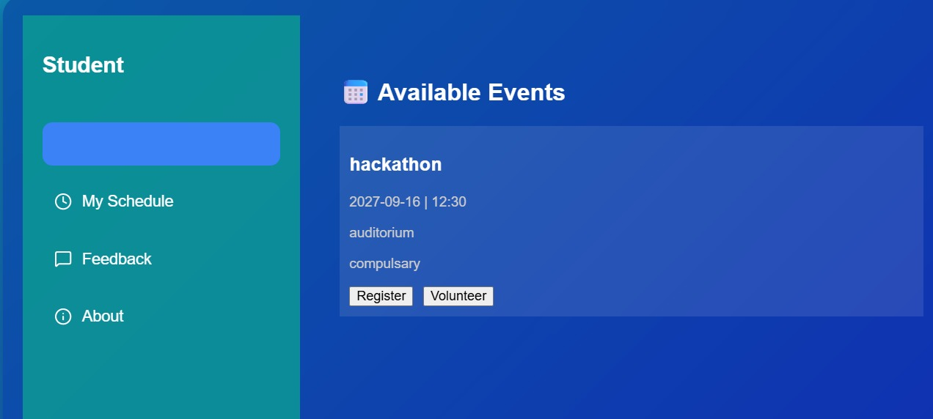
Student Dashboard
The Student Dashboard allows students to view upcoming events, check event schedules, register or volunteer for activities, and submit feedback. It provides a simple and convenient way for students to stay informed and participate in school events.

Slide 9
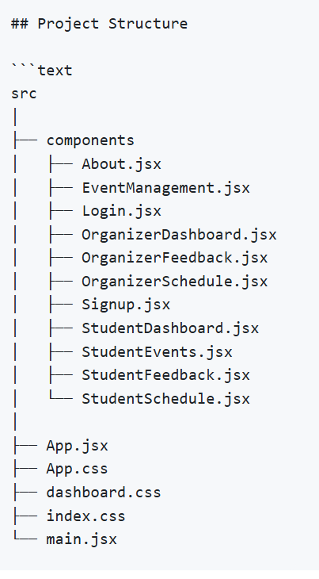
Project structure

Slide 10
Technologies Used
React.js – Used to build the user interface and dashboard components.
JavaScript – Used for application logic and functionality.
HTML – Used to create the structure of web pages.
CSS – Used for styling and designing the application.
Node.js – Used for backend development and server-side operations.
MongoDB/MySQL – Used to store event, schedule, registration, and feedback data.
Git & GitHub – Used for version control and project management.

Slide 11
Future Enhancements
Online event registration and approval system. Attendance tracking for participants and volunteers. Email and SMS notifications for event updates. Event analytics and performance reports. Mobile application support for easy access. Certificate generation for participants and volunteers. Integration with school portals and databases. Real-time announcements and communication features

Slide 12
Conclusion
The School Event Management System provides an efficient and user-friendly platform for managing school events. It enables organizers to create and schedule events while allowing students to view event details, register or volunteer, and submit feedback. By automating event management processes, the system improves communication, reduces manual effort, increases student participation, and ensures the successful organization of school events.

Slide 13
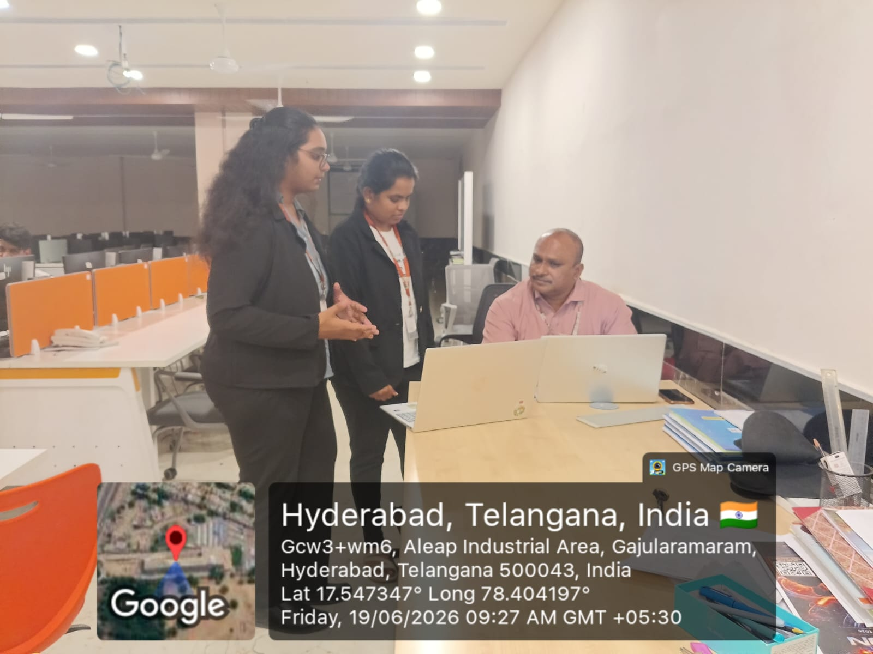
Geotag photo

Slide 14
Thank You

