Slide 1


SMART INDIA HACKATHON 2026
TITLE PAGE
Problem Statement ID – SIH26220
Problem Statement Title – Smart Road Energy Harvesting System
Theme – Renewable / Sustainable Energy
PS Category – Hardware
Team ID – TO BE UPDATED
Team Name – Innovexa

Slide 2
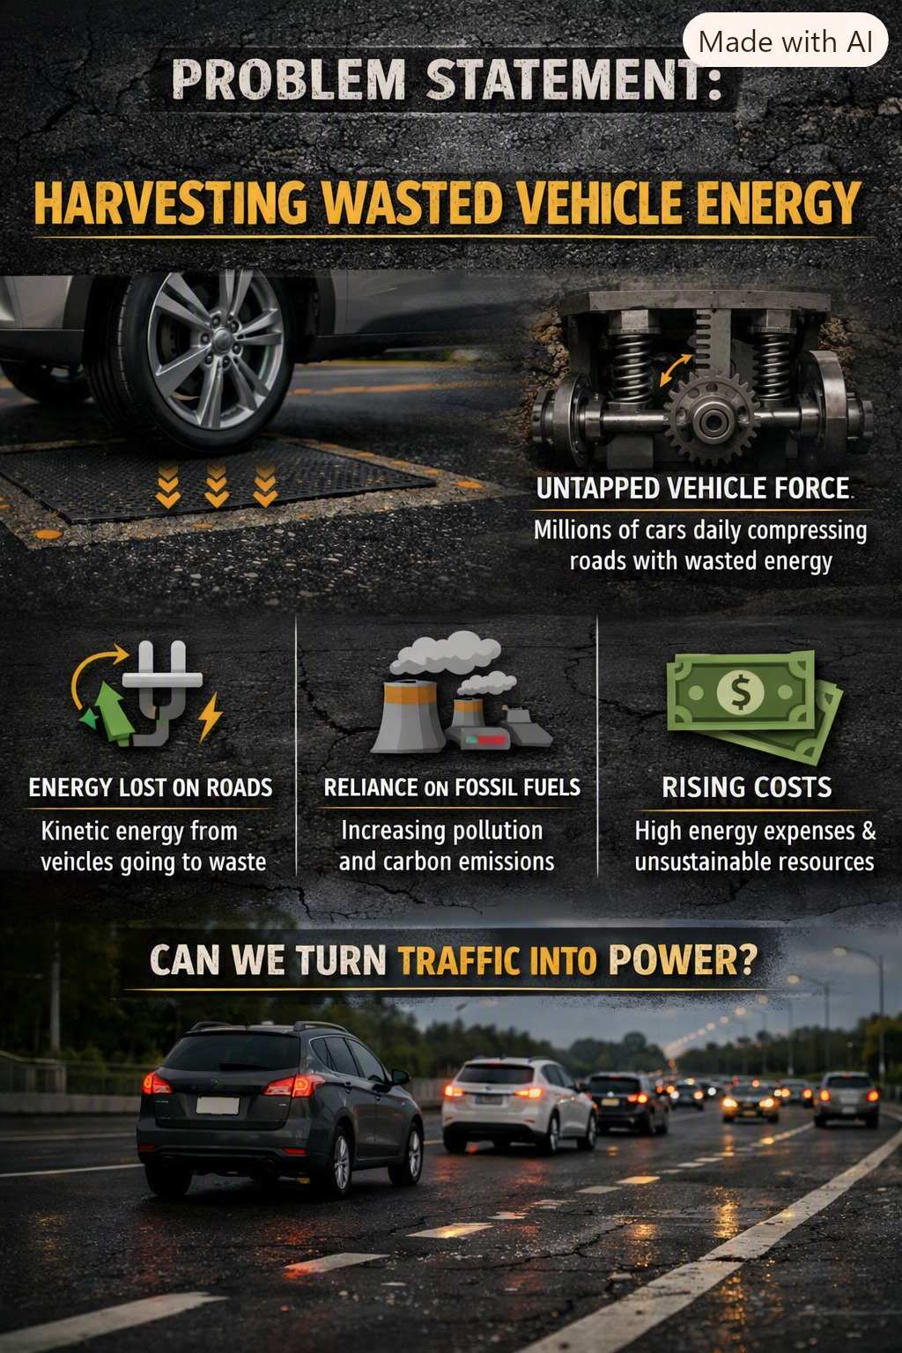
IDEA TITLE
Innovexa
ROAD ENERGY HARVESTING FOR SMART & SUSTAINABLE ROADS
THE IDEAI
Install compact harvesting modules beneath selected road sections. As vehicles pass over them, the pressure from their wheels creates mechanical movement that is converted into usable electrical energy.
WHY IT MATTERSCapture energy that would otherwise be lost as vehicles put pressure on and slightly deform the road surface.
WHERE TO START
High-traffic zones, speed-calming sections and other locations with repeated vehicle loading.

Slide 3
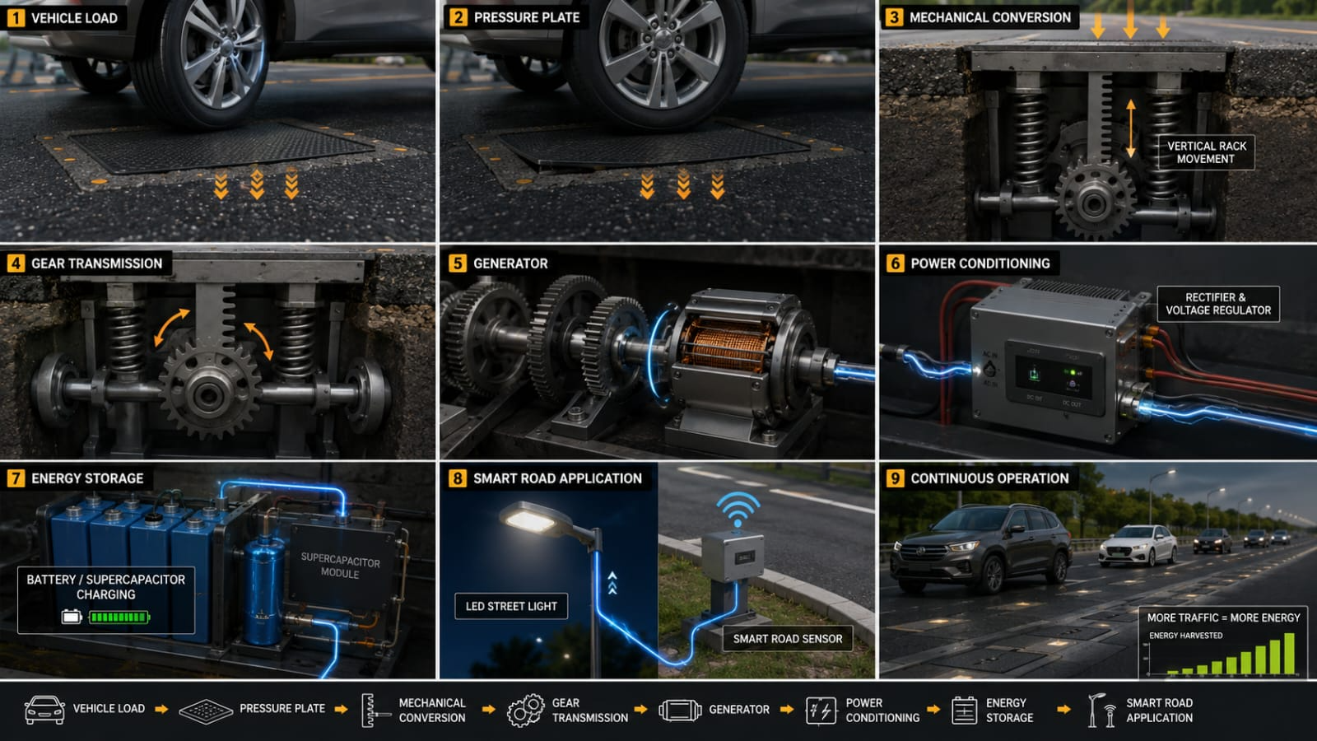
TECHNICAL APPROACH
Innovexa
HOW THE ENERGY IS HARVESTED
Vehicle Load → Pressure Plate → Rack & Pinion → Gear Transmission → Generator → Power Conditioning → Energy Storage
TECHNOLOGIES / HARDWARE
Pressure plate + mechanical frame — captures vehicle load and provides controlled movement
Springs / return mechanism — returns the plate to its original position after each vehicle pass
Rack-and-pinion + gear transmission — converts downward movement into generator rotation
Generator — converts mechanical rotation into electrical energy
Rectifier + voltage regulator — converts and stabilizes the generated electrical output
Battery / supercapacitor — stores the harvested energy
Microcontroller + sensors — monitor vehicle load, energy generation and road conditions
Protective enclosure + wiring — protects the system from dust, water and repeated road loading

Slide 4
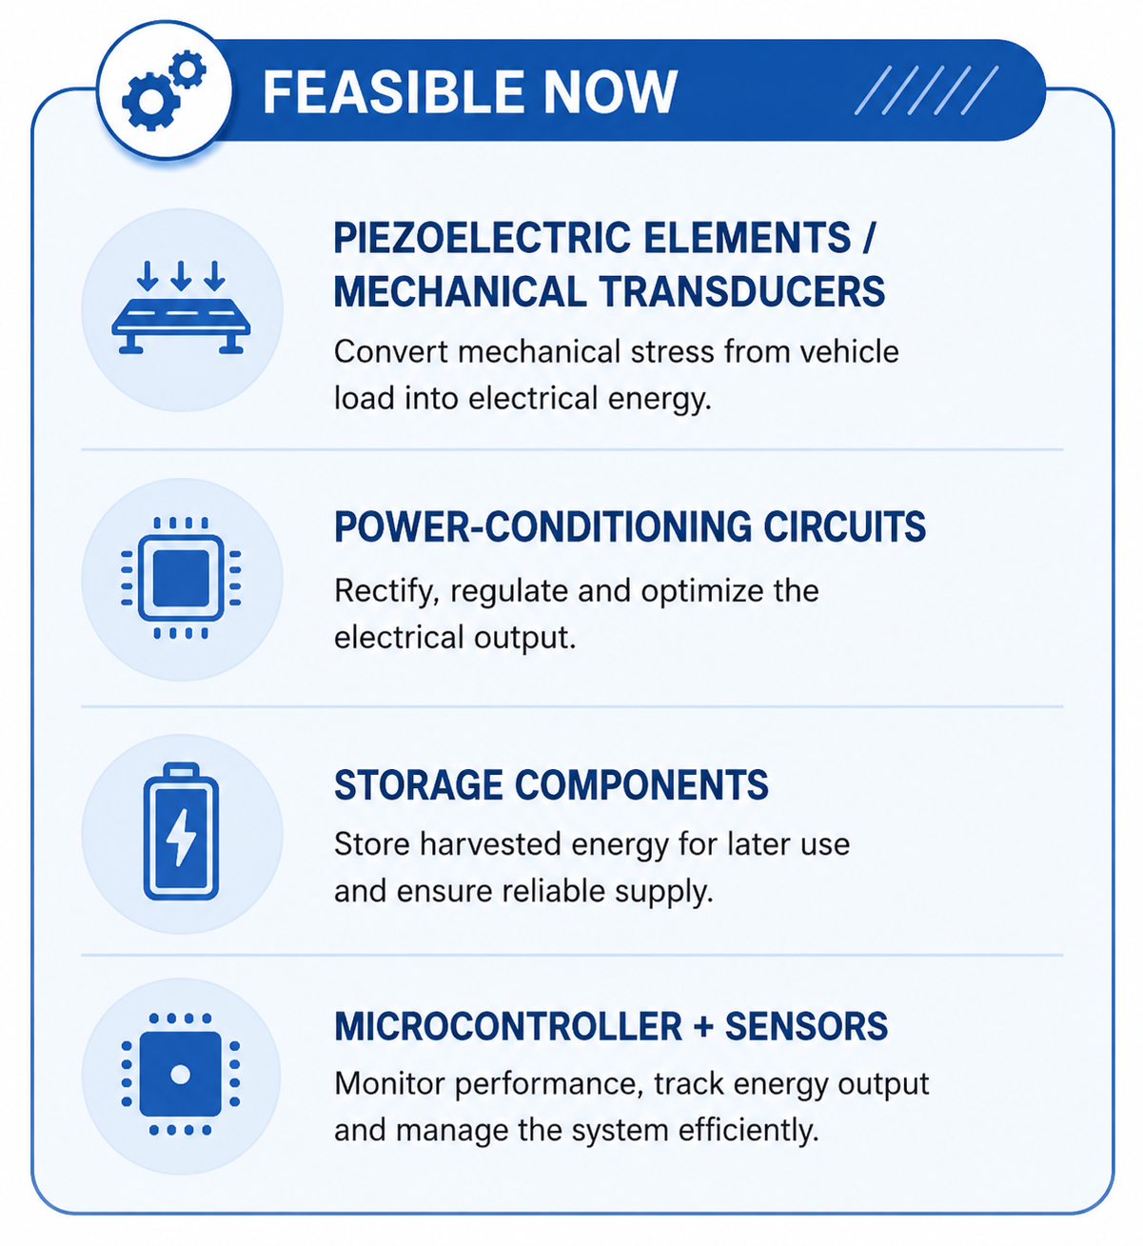
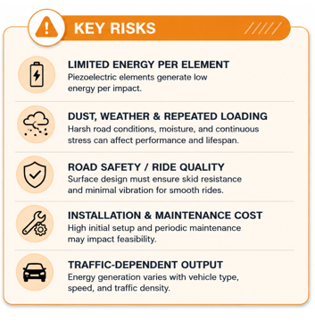
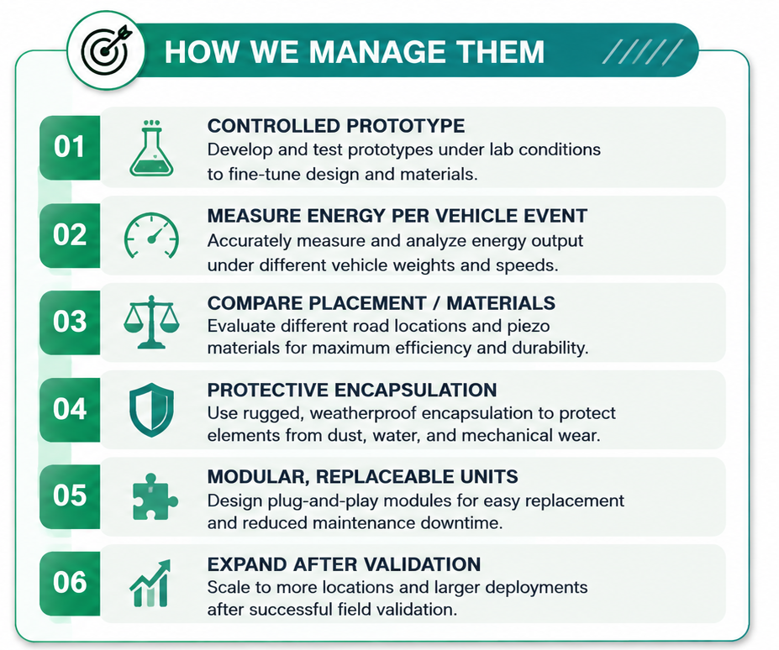
FEASIBILITY AND VIABILITY
Innovexa
VEHICLE LOAD
PRESSURE / VIBRATION
ENERGY HARVESTER
POWER + STORAGE
SMART ROAD LOAD

Slide 5
IMPACT AND BENEFITS
Innovexa
POWERING THE SMART ROAD OF TOMORROW
ENVIRONMENTAL
Recover the discarded mechanical energy into useful energy
SOCIAL
Enable safer, smarter roads. Provide power for road-safety indicators, traffic sensors and real-time monitoring.
ECONOMIC
Potentially reduce wiring / power needs for selected low-power loads.
SMART INFRASTRUCTURE
Combine energy generation with road-condition / traffic monitoring. Start at high-traffic locations, validate performance, then expand.
Vehicle pressure
Generate energy
LOW-POWER LOADS
SMART ROAD

Slide 6
RESEARCH AND REFERENCES
Innovexa
EVIDENCE TO VALIDATE THE PROTOTYPE AND DEPLOYMENT CASE
01 — JAPAN FOOTSTEP HARVESTING
Piezoelectric floor systems convert pressure from footsteps into electrical energy for low-power applications.
02 — VEHICLE / SPEED-BUMP ENERGYHARVESTING
Studies on piezoelectric transducers in pavements and speed-calming structures.
Research paper link:
https://doi.org/10.1016/j.apenergy.2016.04.031?utm_source=chatgpt.com
Research paper link:
https://doi.org/10.1016/j.jtte.2024.11.002?utm_source=chatgpt.com
05 SIH alignment
SIH themes and guidelines for Clean & Green Technologies and Renewable / Sustainable Energy.
06 Prototype evidence
Measured voltage, current, energy/event, durability and module performance from our own testing.

