Slide 1
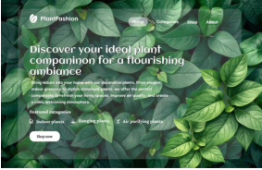
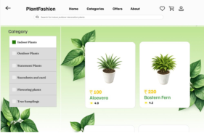
INTERNSHIP PROJECT • UI/UX DESIGN
PlantFashion
A plant e-commerce experience
for greener everyday living
Vishnupriya K
B.E. Computer Science and Engineering
Astonish Infotech | June 2026
University College of Engineering · BIT Campus
PLANTFASHION / UI·UX CASE STUDY
01

Slide 2
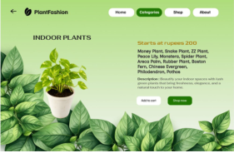
Project at a glance
A calm, category-led shopping journey that helps people discover plants and move from interest to order with less friction.
01
02
03
Project focus
Core users
Main outcome
DESIGNED IN FIGMA
UI/UX design for an online plant store
Plant buyers and gift buyers
Connected high-fidelity website prototype
Research → Wireframes → UI → Prototype → Testing
Internship: 01–30 June 2026 • Domain: UI/UX Design
PLANTFASHION / UI·UX CASE STUDY
02

Slide 3
The design challenge
Buying a plant online should feel simple—not like navigating a crowded catalogue.
Crowded listings
Missing details
01
02
Hard to compare plants at a glance.
Plant names and useful descriptions may be unclear.
Long checkout
Unclear next steps
03
04
Too many steps can interrupt purchase intent.
Customers need confidence after payment.
Design response: clearer categories, visible prices, useful product information and a guided purchase flow.
PLANTFASHION / UI·UX CASE STUDY
03

Slide 4
Project objectives
01
02
03
Discover
Inform
Guide
Organise plants by meaningful categories.
Show price, plant name, scientific name and description.
Keep navigation and calls to action predictable.
04
05
06
Simplify
Unify
Evaluate
Connect cart, address, payment and confirmation.
Reuse visual components across every page.
Test navigation, UI consistency and usability.
PLANTFASHION / UI·UX CASE STUDY
04

Slide 5
Design process
A user-centred workflow—from understanding needs to refining the prototype.
01
02
03
04
05
06
07
→
→
→
→
→
→
Empathize
Define
Ideate
Wireframe
Visual design
Prototype
Test
Research users & pain points
Frame the design problem
Explore structures & ideas
Plan layout and hierarchy
Apply the design system
Connect key interactions
Check and refine usability
Primary tool: Figma • Supporting assets: Google Fonts, icon libraries and plant imagery
PLANTFASHION / UI·UX CASE STUDY
05

Slide 6
Research → user needs
RESEARCH METHODS
M
A
User interviews and online surveys
Meera Nair
Arun Kumar
Competitor analysis of plant stores
PLANT BUYER
GIFT BUYER
Observation of existing shopping experiences
GOAL
GOAL
Decorate an apartment with easy-care plants.
Find attractive plants for gifts, garden or office.
KEY FINDINGS
Users want categories, visible prices, clear plant information, a short checkout and a clear delivery confirmation.
PAIN POINT
PAIN POINT
Cluttered stores and long forms.
Unclear delivery dates and payment choices.
PLANTFASHION / UI·UX CASE STUDY
06

Slide 7
The end-to-end user journey
01
02
03
04
Home
→
Categories
→
Shop
→
Product details
05
06
07
08
Cart
→
Checkout
→
Payment
→
Confirmation
BROWSE
CHOOSE
REVIEW
COMPLETE
Persistent navigation + visible order summary = fewer surprises throughout the journey
PLANTFASHION / UI·UX CASE STUDY
07

Slide 8
Visual identity & design system
A fresh, natural visual language built around clarity and consistency.
Deep green
Action green
Leaf lime
Soft surface
White
Price accent
TYPE & HIERARCHY
REUSABLE COMPONENTS
Bold headings
Pill navigation
Product cards
Primary buttons
Clean sans-serif body copy for readability
Form fields
Order summary
PLANTFASHION / UI·UX CASE STUDY
08

Slide 9
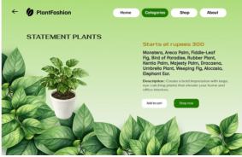
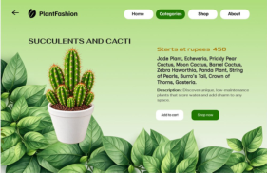
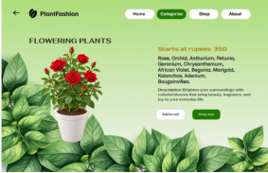
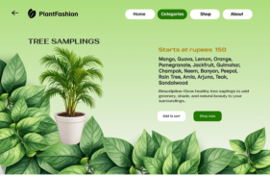
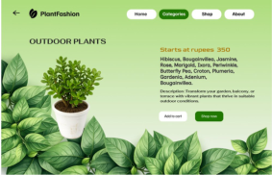
Plant discovery, organised
Six dedicated category pages make browsing feel more intentional.
Indoor plants
Statement plants
Succulents & cacti
Flowering plants
Tree saplings
Outdoor plants
Each category pairs a strong plant visual with a starting price, short description and clear actions.
PLANTFASHION / UI·UX CASE STUDY
09

Slide 10
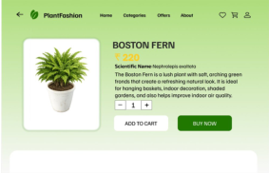
From browsing to confident choice
PRODUCT DETAILS
Boston Fern · ₹220 · Nephrolepis exaltata
SHOP PAGE • CATEGORY SIDEBAR + SEARCH + PRODUCT CARDS
Description + quantity selector + Add to cart / Buy now
PLANTFASHION / UI·UX CASE STUDY
10

Slide 11
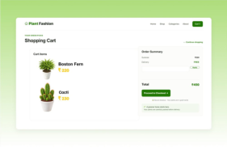
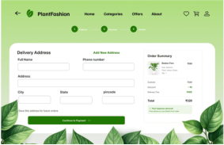
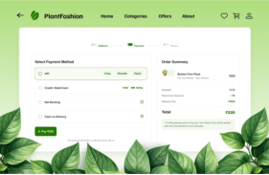
A guided purchase flow
01 Cart
02 Checkout
03 Payment
Review selected plants and order total.
Enter delivery details with a step indicator.
Choose UPI, card, net banking or COD.
Design principle: keep the next action obvious and the order summary visible.
PLANTFASHION / UI·UX CASE STUDY
11

Slide 12
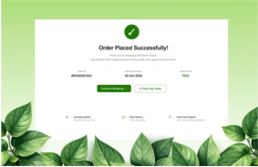
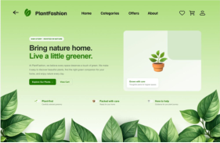
Reassurance after the action
ORDER CONFIRMATION
ABOUT THE BRAND
Order ID, estimated delivery, total and next-step options.
“Bring nature home. Live a little greener.”
PLANTFASHION / UI·UX CASE STUDY
12

Slide 13
Testing & validation
The Figma prototype was reviewed across navigation, UI consistency and usability.
Functional
Header, category buttons, product selection, cart-to-checkout, payment flow
10 / 10
UI consistency
Colours, font readability, button alignment, image and icon placement
listed page areas
marked Passed
Usability
Navigation clarity, interaction effort, form and order-summary visibility
Includes Home, 6 category pages, Shop, Product Details, Cart, Checkout, Payment, Confirmation, About and responsive design.
PLANTFASHION / UI·UX CASE STUDY
13

Slide 14
Outcomes & what comes next
PROJECT OUTCOMES
FUTURE ENHANCEMENTS
Complete high-fidelity page set
Login, profiles and saved addresses
Reusable design system and UI components
Advanced search, filters and sorting
Plant-care guides and watering reminders
Interactive end-to-end Figma prototype
Functional, UI and usability checks documented
Reviews, ratings and live order tracking
Project documentation for developer handoff
Tamil language support and mobile app
Frontend, backend and payment integration
PLANTFASHION / UI·UX CASE STUDY
14

Slide 15
THANK YOU
PlantFashion
A thoughtful digital experience
for every plant lover.
Vishnupriya K | B.E. CSE
Astonish Infotech · UI/UX Internship · June 2026
Questions?
PLANTFASHION / UI·UX CASE STUDY
15

