Slide 1


Case Study Title:
Sustainable Agriculture with Ai for Crop Yield Prediction
College Name:Acharya Institute Of Graduate Studies
Student Name: Vishnu Priya B
Sushmashe p
Sinchana H K

Slide 2
Problem Statement
Brief Overview: Agricultural productivity is crucial for food security and economic stability. However, farmers often face challenges in predicting crop yields due to varying climatic conditions, soil health, and farming techniques. This case study addresses the need for an accurate and data-driven approach to forecast crop yield, enabling better decision-making for sustainable agriculture.
Key Objectives:
Develop a predictive model to estimate crop yield based on historical data.
Identify key factors influencing agricultural productivity.
Provide actionable insights for farmers and policymakers to optimize yield.
Enhance sustainability by promoting efficient resource utilization.
Source :
www.freepik.com/

Slide 3
Dataset Overview
This dataset provides valuable insights into factors influencing crop yield, including environmental conditions, soil properties, and farming practices.
It consists of multiple records covering different regions and crop types, with key attributes such as temperature, rainfall, soil nutrients, and fertilizer application.
The dataset serves as a crucial resource for training machine learning models to predict crop yield accurately.
By leveraging this data, we aim to enhance agricultural productivity and promote sustainable farming practices.
The dataset comprises 500 entries, capturing various factors affecting crop yield. It includes attributes such as Year, Region, Crop type, Soil pH, Organic Matter, Rainfall (mm), Temperature (°C), and Yield (tons per hectare).
Source :
www.freepik.com/

Slide 4
Methodology
Approach:
To predict crop yield, we followed a structured machine learning pipeline. First, we preprocessed the dataset by encoding categorical variables (Region, Crop) and scaling numerical features.
The data was then split into training and testing sets to ensure robust model evaluation. A Random Forest Regressor was trained on the data, leveraging its ability to handle non-linearity and feature importance.
Finally, we evaluated model performance using metrics such as Mean Absolute Error (MAE), Mean Squared Error (MSE), and R² Score to assess prediction accuracy.
Algorithms Used:
We implemented a Random Forest Regressor, a powerful ensemble learning technique that aggregates multiple decision trees to enhance prediction accuracy and reduce overfitting.
This algorithm was chosen due to its robustness in handling diverse agricultural data, its ability to capture complex relationships between features, and its feature importance insights, which help identify the most influential factors affecting crop yield.
Source :
www.freepik.com/

Slide 5

Conclusion
Summary:
This study successfully developed a machine learning model to predict crop yield based on various environmental and agricultural factors. By leveraging a Random Forest Regressor, we achieved accurate predictions while identifying key factors influencing yield, such as rainfall, temperature, and soil quality. The model’s evaluation metrics indicate strong predictive performance, making it a valuable tool for farmers and policymakers to optimize agricultural practices and enhance productivity.
Future Work:
Future improvements can include incorporating additional features such as pest impact, advanced soil composition data, and real-time weather updates to enhance accuracy.
Exploring deep learning models like neural networks and integrating geospatial analysis could further refine predictions. Additionally, deploying this model as a user-friendly web or mobile application could make it accessible for farmers to receive real-time yield forecasts and recommendations.
Source :
www.freepik.com/

Slide 6
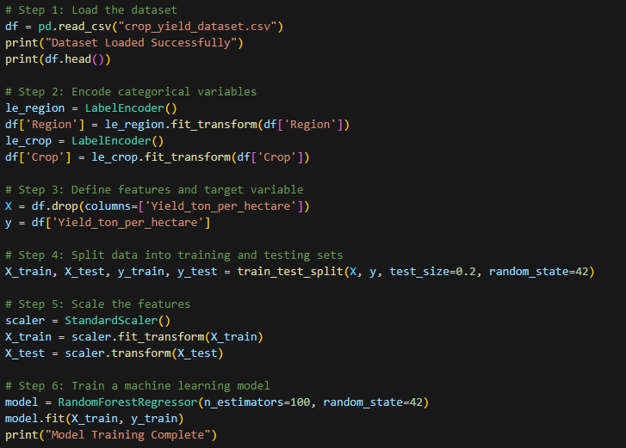
SOURCE CODE

Slide 7
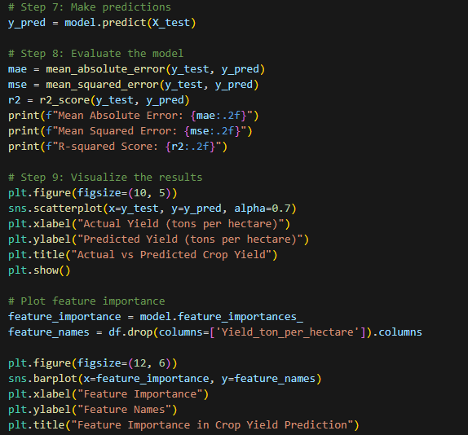
SOURCE CODE

Slide 8
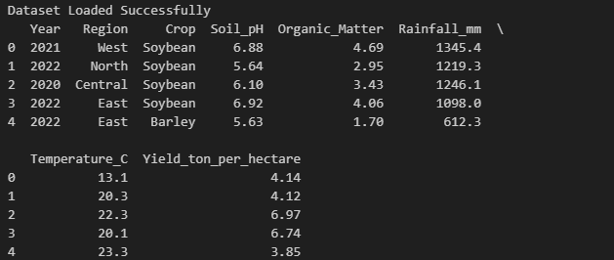
SOURCE CODE

Slide 9
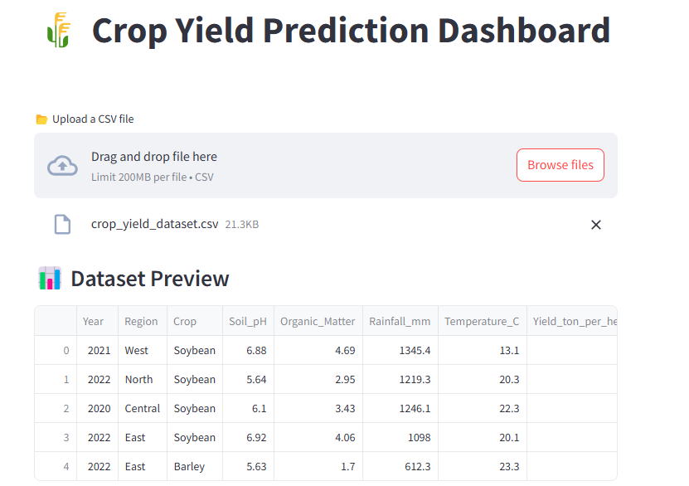
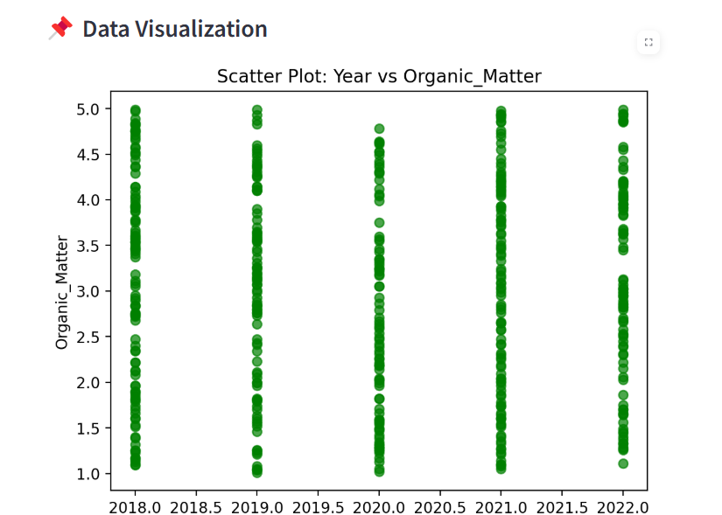

Slide 10
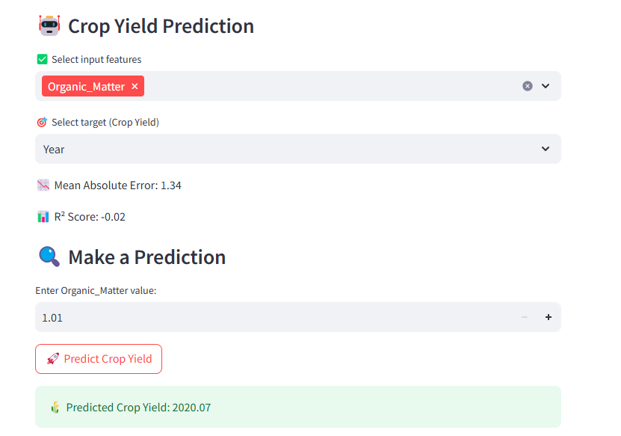

Slide 11
References
Dataset : Kaggle Crop Yield Dataset
Scikit-Learn Documentation: https://scikit-learn.org/stable/
Random Forest Algorithm: https://towardsdatascience.com/random-forest-explained-9babbe9b5de2
Data Preprocessing Techniques: https://machinelearningmastery.com/data-preprocessing-for-machine-learning/
Source code:

Slide 12
Thank You
Notes:
Thank You !!

