Slide 1
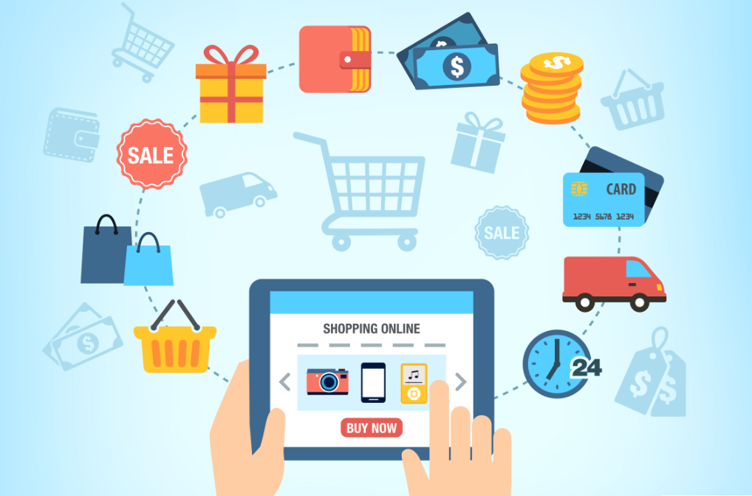
Fashion Cart
By:
D. Satya Lahari 17B01A0521 CSE
A.Vishnu Priya 17B01A0530 CSE
Ch. SriKavya 17B01A0515 CSE
D.L.Sravanthi 17B01A0523 CSE
G.Pallavi Sowmya 17B01A0231 EEE

Slide 2
Introduction
‘FashionCart’ is an online shopping application.
Customers can buy products of various categories and can
also participate in bidding. It provides a real shopping experience with a feature named ‘Custom Design’ where customer can pair up clothes and buy them together. On the other hand ’Bidding’ wakes up the customers enthusiasm to buy a product and indirectly the bidding gives a new
experience to the customer.

Slide 3
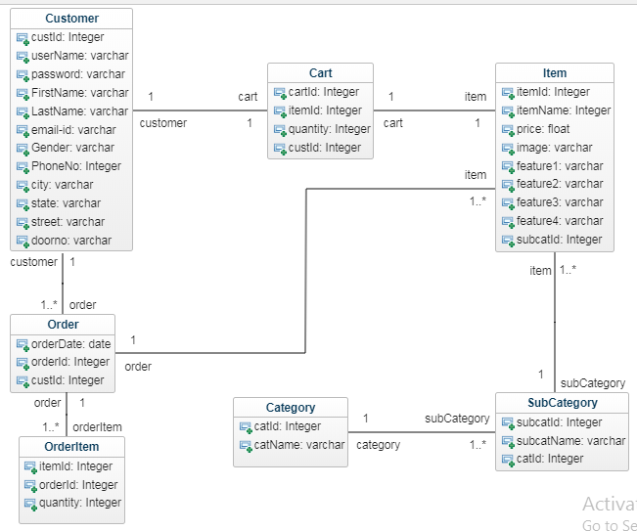
Database Schema

Slide 4
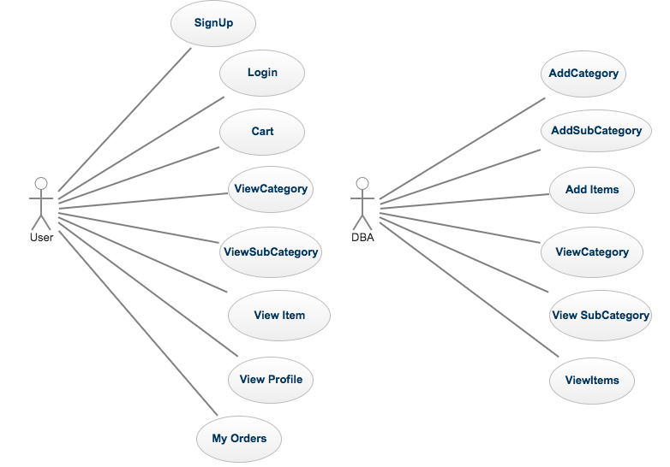
Use Case Diagram

Slide 5
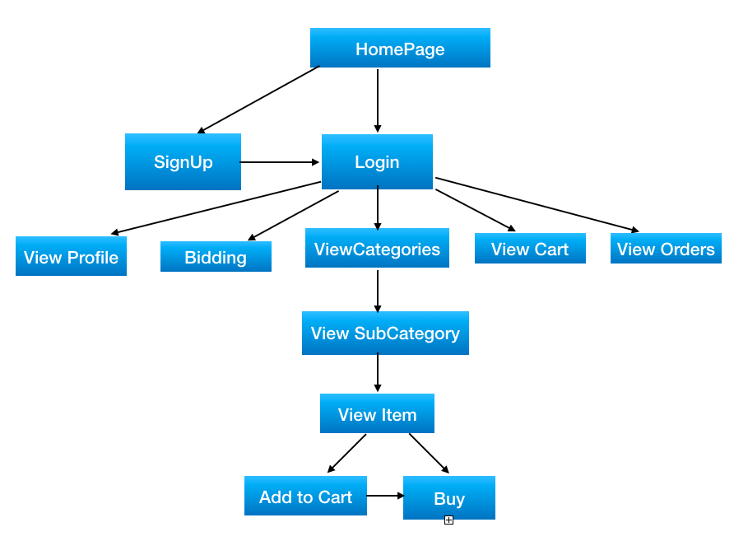
Application Flow Diagram

Slide 6
Technologies Used
Front End
HTML : Used to design a webpage
CSS : It describes how the HTML elements are to displayed on the screen. Bootstrap : By establishing links we can directly use the bootstrap elements.
Back End
JSP : It is preferred since we can write both java and as well as HTML code in it.
Servlet : It is java program that runs on server side. It handles the request obtained,
Hibernate : It is an ORM framework. It is the upper layer of jdbc and it is preferred since it
processes it and produces response.
reduces the size of code and easy to implement using it.
Database
MySQL :
It is preferred since it is an open source that is available to us and even it is convenient to use.

Slide 7


Slide 8
PROJECT DEMO

