Slide 1
Media Asset Management CDEEP

Slide 2
Contents
Project Overview
Recap
Task assigned for this week
Class Diagram
Add Asset Module
File upload and download Module
Check In and Check Out
File logs, properties
Reviewer
Problems Faced
Further Enhancements
Demo

Slide 3
Project Overview
A professional software repository which allows users to store any digital asset.
Software will centrally store and manage all digital assets.
Dynamic organization structure.
Gives the limited access to users with tracking feature.
One place for all your queries.
Videos + Documents + Images + Slides + Audio.

Slide 4
RECAP
Why use a framework.
Various PHP frameworks available,Why use YII,GII AND CRUD.
Organisation Registration.
OU structure represented by JSTREE.
Admin Module
Add asset module
Check in and check out
Maintenance of file access logs
Maintenance of versions of files

Slide 5
TASK ASSIGNED FOR THIS WEEK
File Upload Module.
File Download Module.
Add asset Module.
File properties.
Check in.
Check out.
Reviewer module

Slide 6
CLASS DIAGRAM
Design Phase of the ER Diagram
It converts the Valid ERD entity into a class model with attributes and functions
Also shows the relationship existing between different classes
#one to one relationship
#one to many
#many to one
#many to many

Slide 7
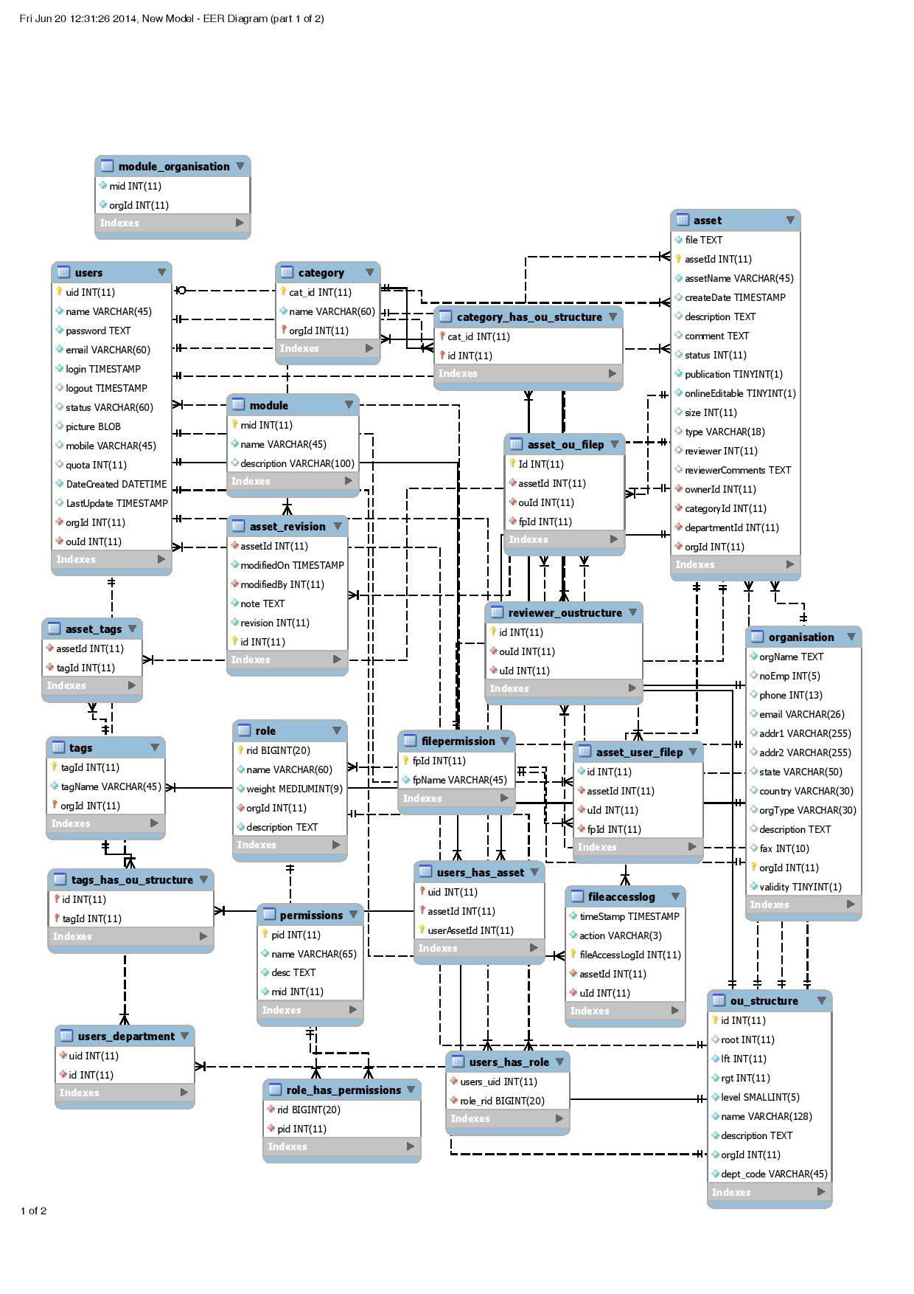

Slide 8
File UPLOAD MODULE
Provides uploading any kind of files to the server for valid users.
valid means having the permission to do so
Uploaded file will be stored in a dynamically created folder having the name same as organization id (ORG_ID)
It will have further nesting as category folder under which the file has been uploaded within organization
Renaming of any file to “assetId.dat” before storing will be done on a fly

Slide 9
FILE DOWNLOAD MODULE
Downloading feature to the valid user for the uploaded files
Conversion of .dat file extension to their original extension before downloading starts.

Slide 10
ADD ASSET Module
It utilises the file upload module for its functionality
Assign file access to users and department.
Define file properties of the uploaded file.
#which category it belongs
#what are all the tags it belongs to

Slide 11
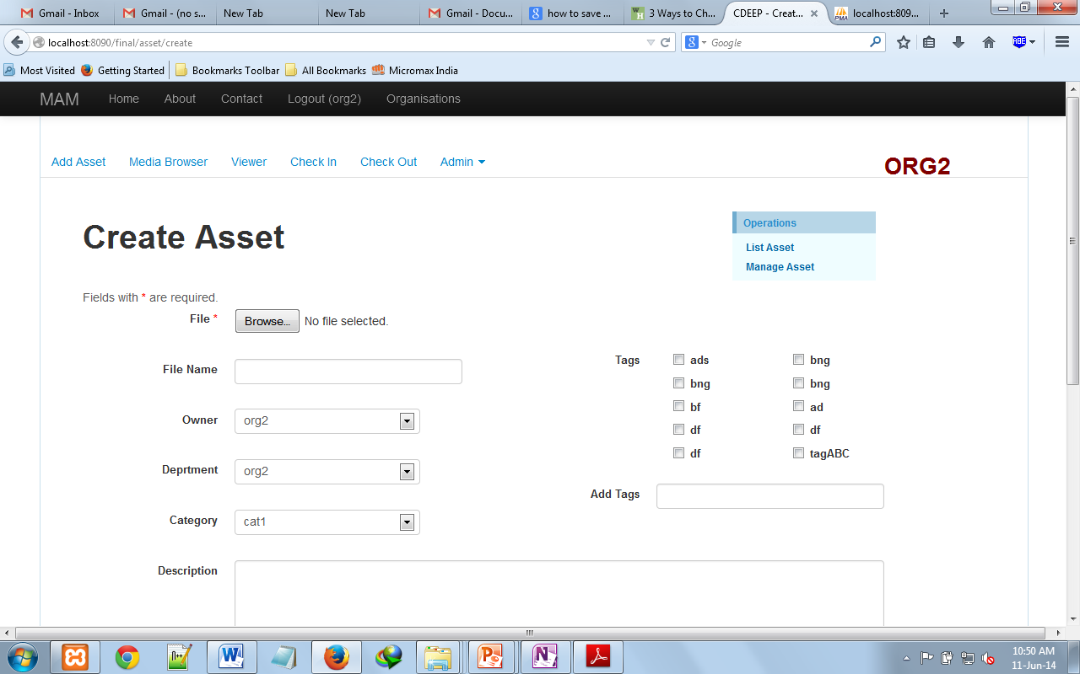

Slide 12
CHECK OUT MODULE
An asset is checked out when the author or any user of that asset wants to modify it.
The status gets changed to checked out
The filename appears in the list of files to be checked in

Slide 13
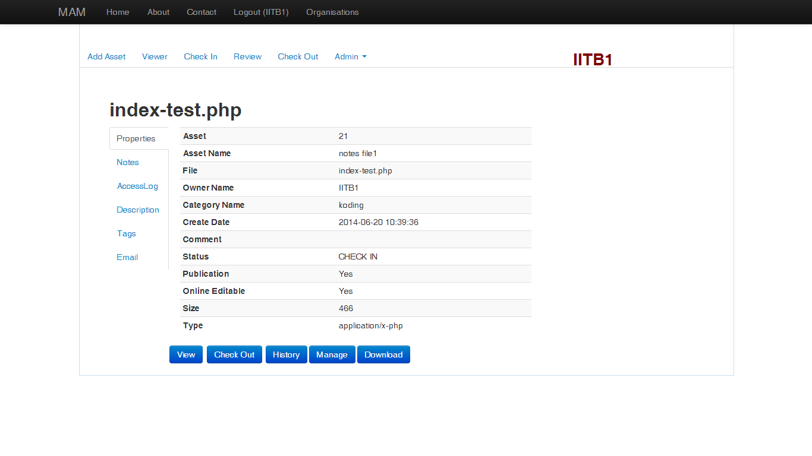

Slide 14
CHECK IN MODULE
Once the asset is checked out for revision, it appears in list of files to be checked in
The authors checks in the new version.
The current version is uploaded
And the versioning is maintained in the versioning folder with asset Id as its name

Slide 15
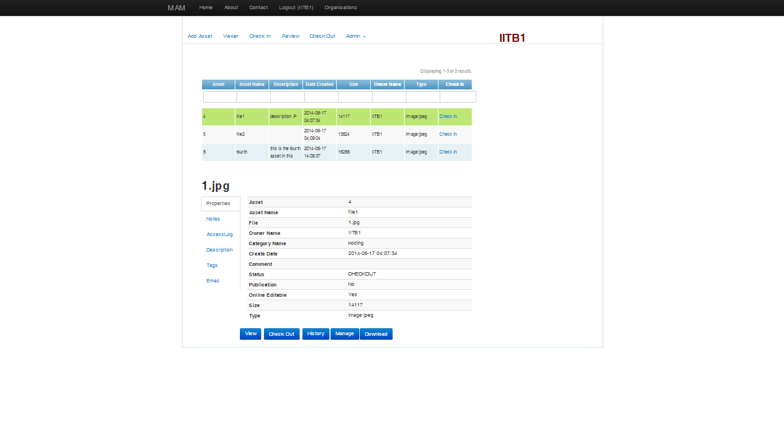

Slide 16
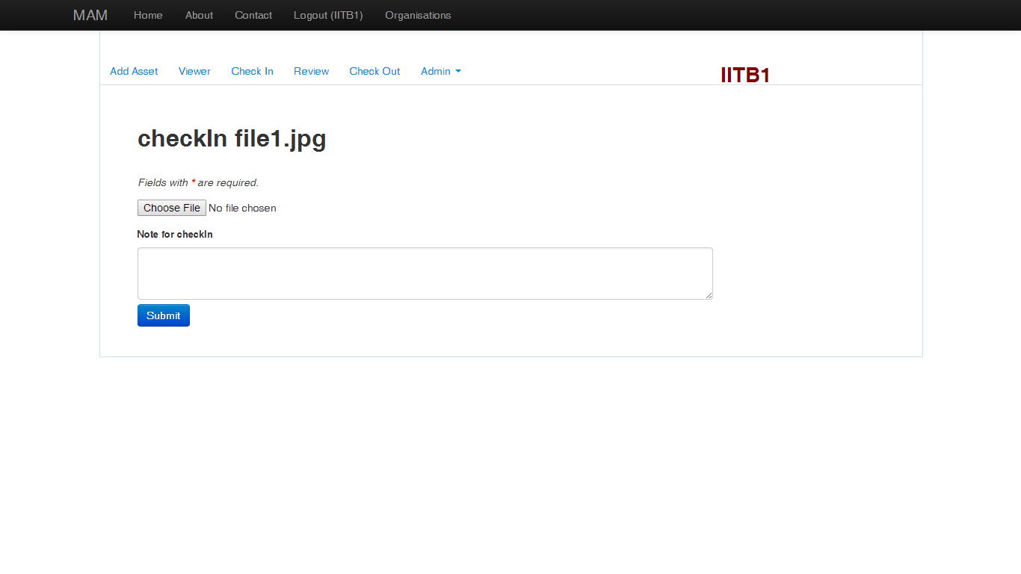

Slide 17
Versioning
Each version of asset is maintained in a separate folder of its own.
When browsing through each version is available for download
And the particular version is downloaded.

Slide 18
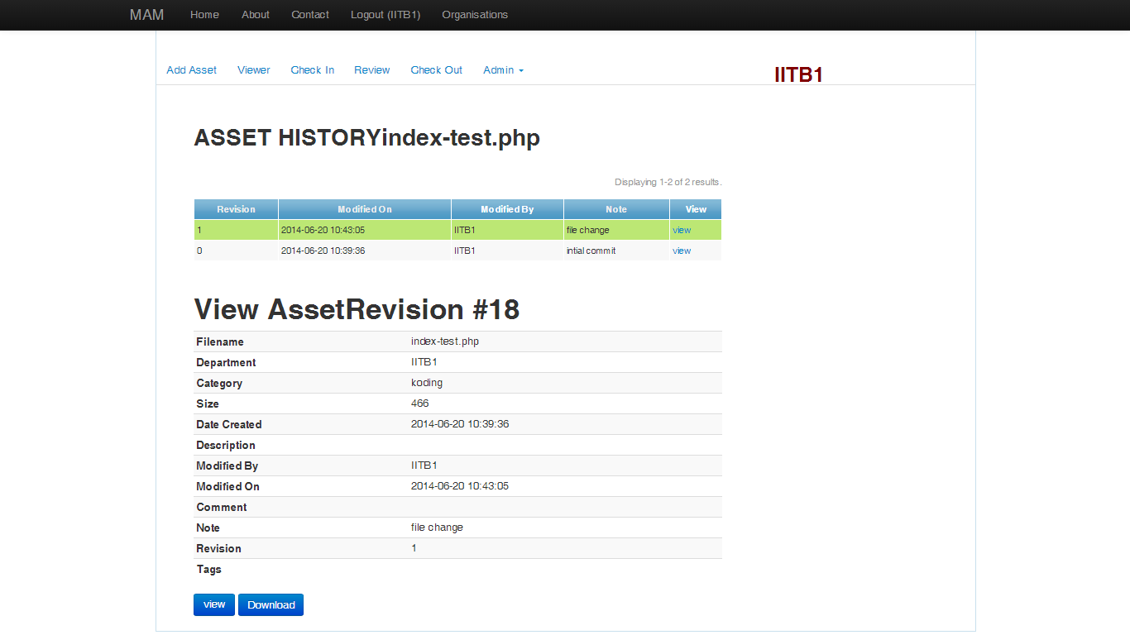

Slide 19
REVIEWER MODULe
Each department is assigned a reviewer.
When reviewer logs in , he is shown the list of files which are to be reviewed by him.
The reviewer can authorize or reject the new version.

Slide 20
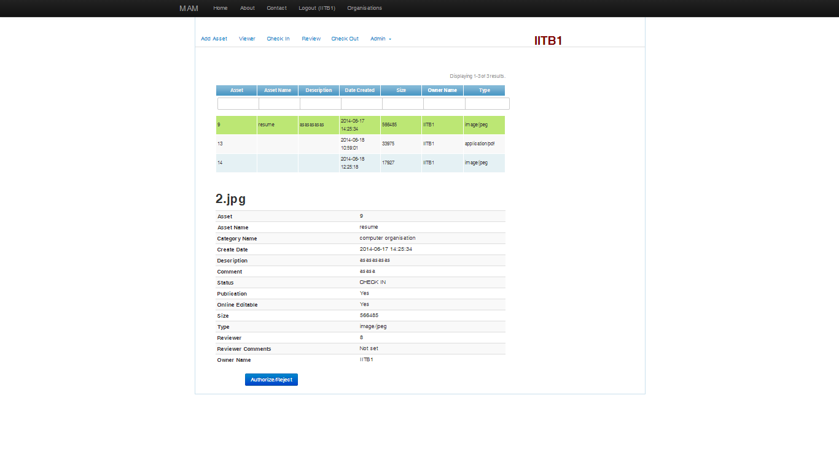

Slide 21
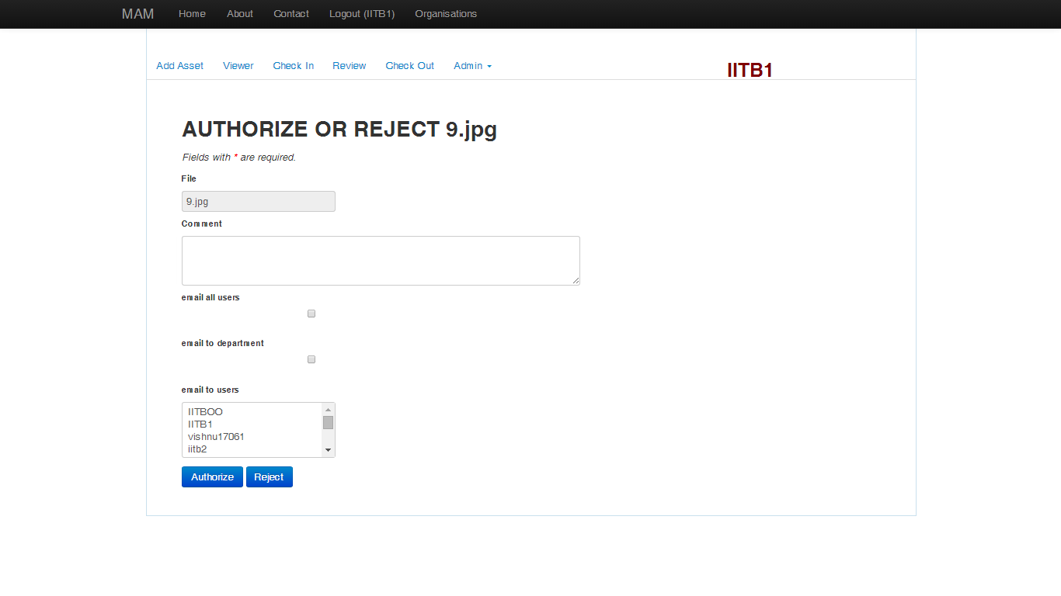

Slide 22
Reason for raw coding
We have the alternative of going for a ready made extensions for upload and download
But we will loss the control over the process
Since we have to add many other features ,we decided to go for hard coding it manually
Encryption and decryption(AES-256) are the main features which we will lose if not hard coded

Slide 23
PROBLEMS FACED
At times it become difficult to write Ajax and jQuery for yii inbuilt functionality
The .dat file save doesn’t allow the file search and view.
Dynamic nature of database, with many foreign relationship and many to many tables
MVC doesn't allow to pass control to more than one controller at once but we need it as per requirements.
Many Small errors which hinders faster devlopment

Slide 24
Further enhancement
Permission based user login and accessing to files( a kind of Role Based Access Control)
Search engine functionality to our project with encryption
Management of assets
Tagging functionality (with URL) for faster access to different documents in same category or having common tags.

Slide 25
MEDIA BROWSER
Folder for every Organisation.
Organisation can add directory structure to their folder.
Upload files to specific folders.
Images, PPT’s, PDF, DOCS, Videos…
Can rename , copy, move and delete directory.
Can view and download files.
Using DDMedia extension and Yii file manager file picker extension.

Slide 26
Thank you
CDEEP: MAM

