Slide 1
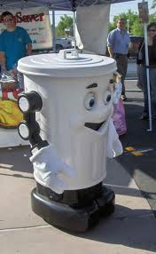

SRM University, Vadapalani
Robotics Club
Presents
XION
Introducing
Scrappy-robot out of waste
In Association with

Slide 2
About Paperman
Paperman is a social venture launched with the objective to raise the spirit of recycling, and to make a measurable environmental impact in the society. We identify the PAPERMAN (old paper dealer) as the pillar of recycling as every paperman's routine plays a major role in saving number of trees and retains the earth's temperature.
Our activities are channeled to make people understand the importance of paper recycling and the role Paperman plays in it. We believe we can improve the rate of recycling in our country by strengthening his network, creating more visibility and connecting him with you.
Our ROOTS….
Though most of them are aware that 'Recycling is good for the environment', they do not understand the significance of recycling yet. In India 8.5 million tonnes of paper is produced every year of which only 20% is recycled that means 6.8 million tonnes of paper go to waste every year. So this movement focuses on notching up the spirit of recycling in every individual.

Slide 3
About PAPERMAN
Paperman connects the recycling sector with the community through innovative platforms to enable better recycling
We show people life in waste by using waste to change lives
The movement is spread across 66 cities in India
Recognized as the fastest growing movement by many reputed media
More info at www.paperman.in

Slide 4
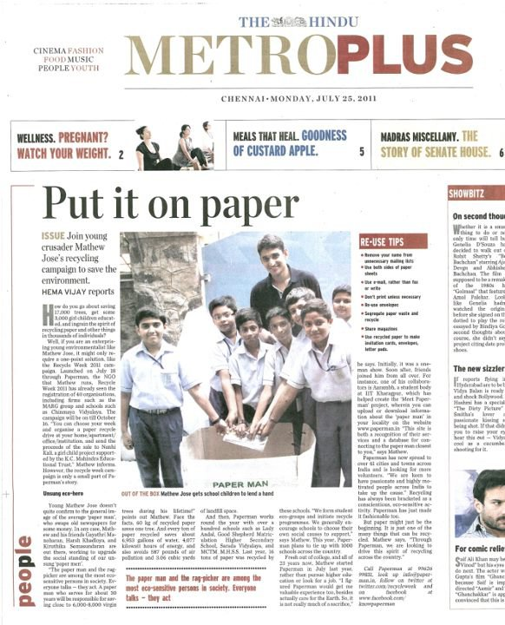
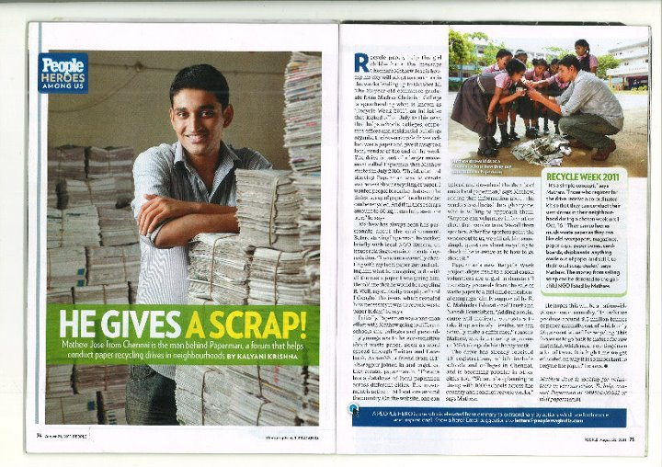
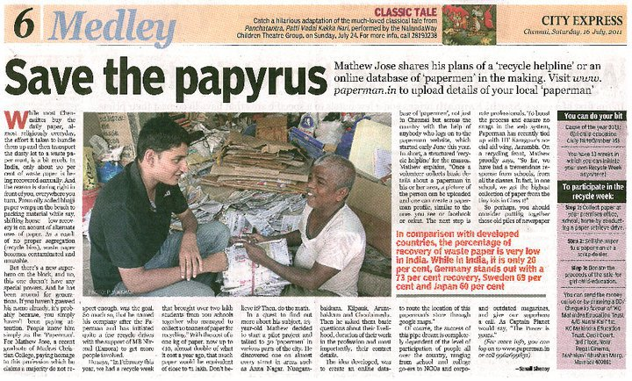
Paperman in media

Slide 5
Paperman Role at XION
We are interested to associate with xion to promote the message of recycling
Paperman will connect with Xion to promote scrappy- a waste robot- as the face of the campaign
Green cause for social cause- Will manage the waste system of the event and use the waste at the event to support girl child education-
Event theme - We will associate with a few technical events and Non Technical events position the activity environment friendly
I see life in waste corner - Organize awareness shows during the event to connect people with the environment
Will connect the xion organizers with potential TITLE sponsors

Slide 6
Introducing Scrappy
Jointly work with students to create a robot that is made of waste as the face of the campaign
Promotes scrappy across the country – creating more visibility for the event

Slide 7
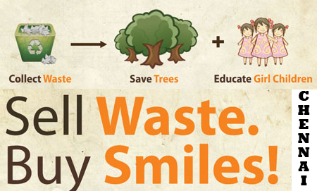
Green Cause for a Social Cause
Using the waste of the event to support of girl child education
Process

Slide 8
Event Theme
Technical
Robofesta – Old waste materials to make the robot fashionable
Non Technical
Waste Zap – Adzap using waste as tools to promote
Treasure hunt- themed with old materials

Slide 9
I see life in waste corner
A spot in the event where people can sign their petition to join the campaign
“We see life in waste , we use waste to change lives “

Slide 10
Assist with sponsors
We will work with the title sponsor to create the whole ‘waste’ experience – certificates , banners , waste corner , waste collection boxes and more
We will create a joint sponsor proposal
We will help the team meet potential sponsors

Slide 11
If agreed – Time line
20/02/2012- Idea approval & working model of robot
21/02/2012- sponsor proposal ready
22/02/2012 onwards- start sponsor visits
24 /02/2012- Press meet introducing scrappy !!
29/02/2012- Finalize title sponsor

