Slide 1
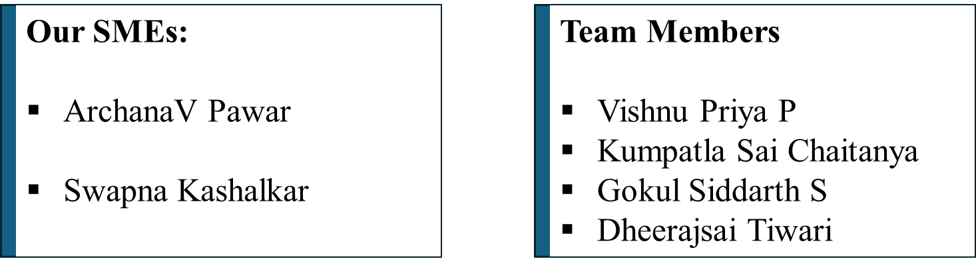
Prompt-Driven Full Stack Application Development with GitHub Copilot, Integrated Standards Checklist, and Code Review

Slide 2
Introduction:
A robust, full-stack Inventory Management System developed using prompt-driven GitHub Copilot workflows, designed for local deployment without cloud dependencies. This project demonstrates how AI-assisted development can accelerate delivery while maintaining code quality through structured standards and best practices/standards.
Tech Stack:
Frontend: Angular (TypeScript, HttpClient, Reactive Forms)
Backend: ASP.NET Core Web API (C#)
Database: SQL Server / LocalDB via Entity Framework Core

Slide 3
Problem Statement:
Manual code reviews are time-consuming and effort-intensive.
Slow down development velocity and delay releases.
Prone to human errors, missing coding or security standards.
Quality depends heavily on reviewer expertise.
Results in inconsistent quality and standards

Slide 4
Purpose & Key Benefits
Automate First-Pass Code Reviews
Accelerated Development Velocity
Enhanced Code Quality & Security
Instant Developer Feedback
Consistent Coding Standards

Slide 5
Existing Manual Process | Proposed System
Developer ➔ WAIT (8-10 Hours) ➔ Manual Review(1-2 Hours) ➔ Slow Feedback Loop | Developer ➔ AI Review (< 2 Minutes) ➔ Developer Fixes ➔ Focused Human Review(~30 Minutes)
Productivity Impact: • High Cost: Developer wait time & context switching. • Bottleneck: Senior developer time is blocked. | Productivity Impact: • High Gain: Instant feedback keeps developers in flow. • Efficiency: Senior time is focused only on critical logic.
Total Review Cycle: 1-2 DAYS | Total Review Cycle: < 1 HOUR

Slide 6
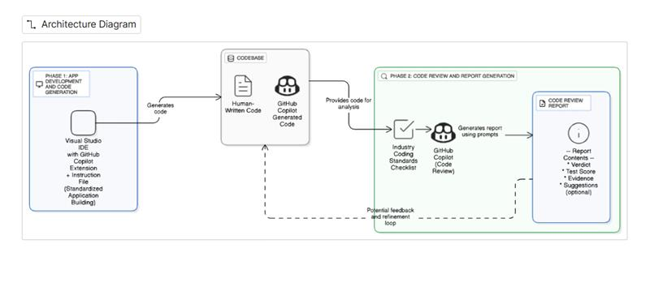
Architecture:
Fig.1 Architecture Diagram for Prompt-Driven App Development and Code Review Workflow Using GitHub Copilot

Slide 7
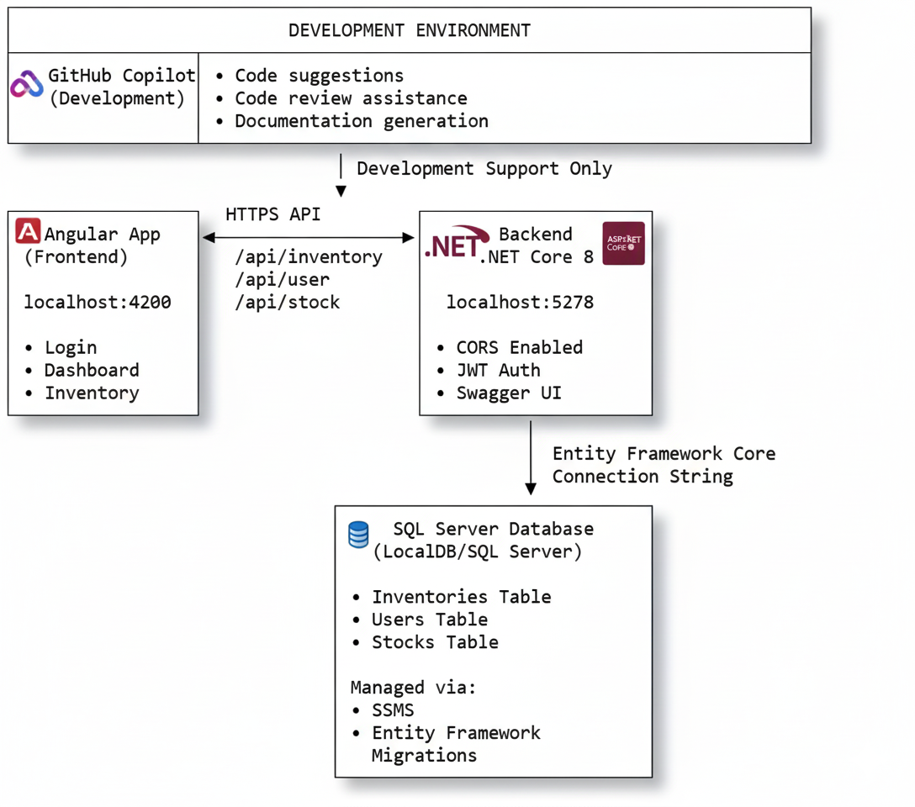
Project Flow:
Fig 2: Overview of the development environment and architecture, showing GitHub Copilot integration with Angular frontend, .NET Core 8 backend, and SQL Server database.

Slide 8
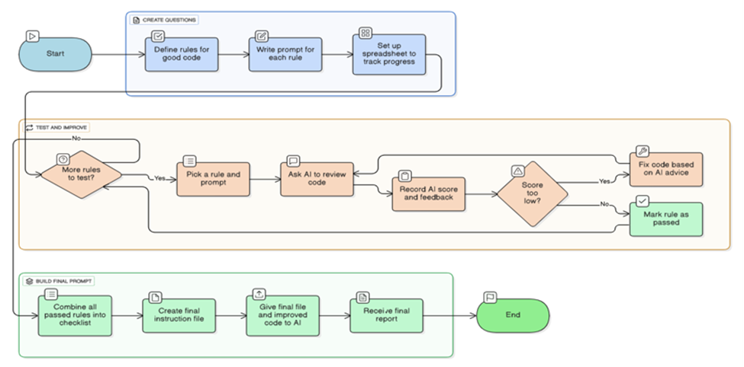
AI-Driven Code Review and Prompt Refinement Workflow
Figure 3: Flowchart depicting the iterative process of code creation, testing, and refinement using AI-driven feedback and rule-based prompts.

Slide 9
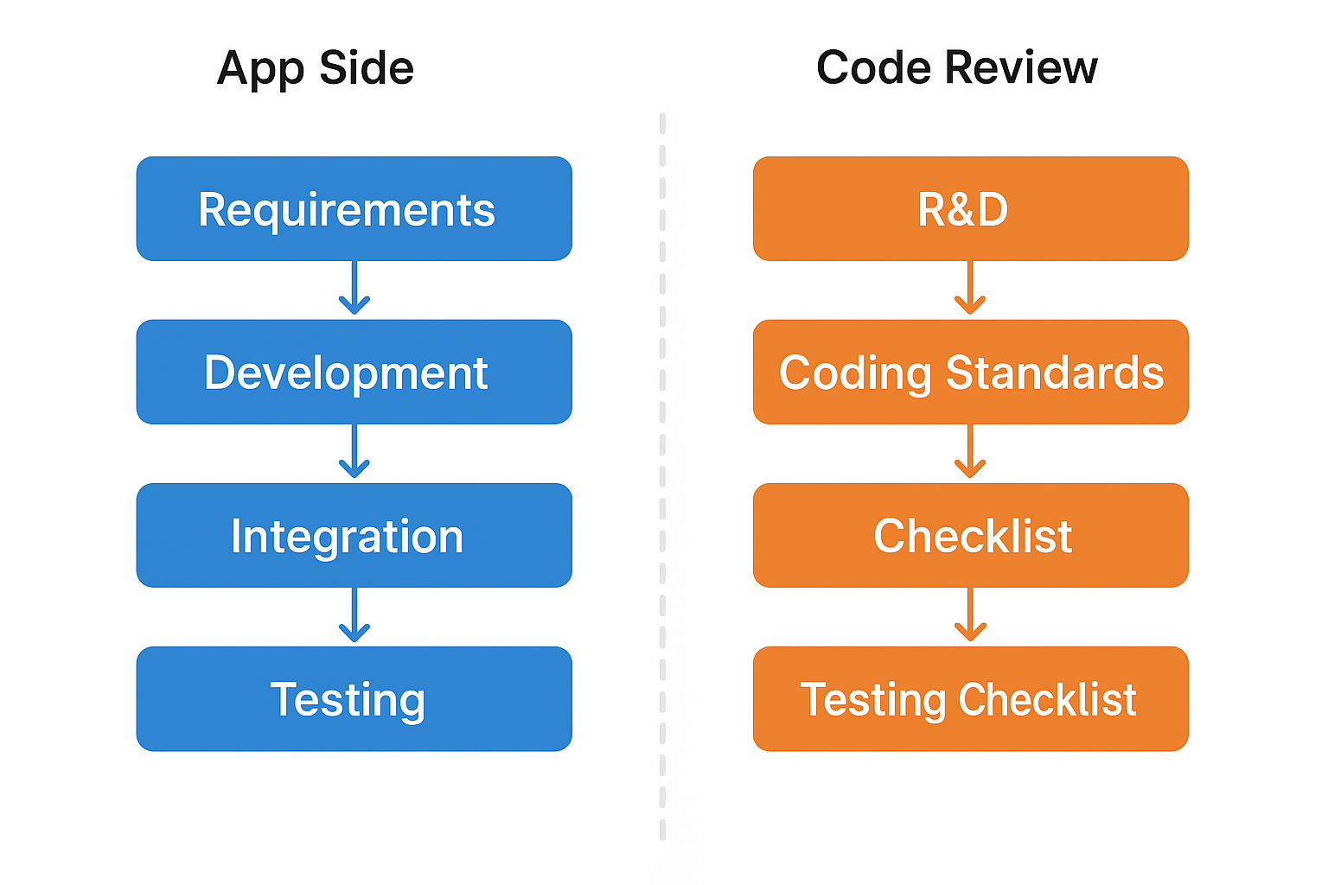
Project Phases:

Slide 10
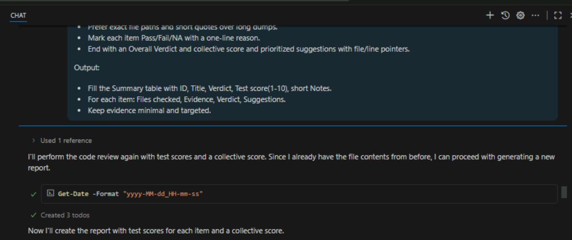
Results : Front-End Part's Code Review Checklist

Slide 12
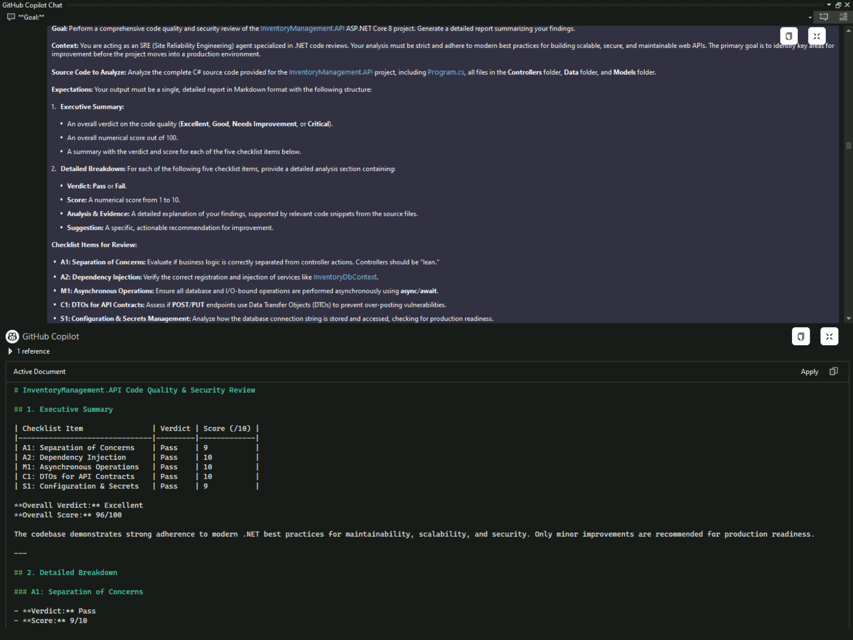
Back-End Part's Code Review Checklist:

Slide 13
Demo

Slide 14
Comparative Study :
Response Time Overview:
GPT-5: 1.5s initial / 11.2s complete
Claude Sonnet 3.5: 2.2s initial / 10.8s complete
Gemini 2.5 Pro: 1.9s initial / 11.5s complete
Performance Leaders:
Fastest Start: GPT-5 (1.5s)
Fastest Complete Analysis: Claude (10.8s)
Most Comprehensive: GPT-5 (9.72/10)
Resource Usage:
Most Efficient: Claude Sonnet 3.5
Highest Overhead: GPT-5 (type checking)
Most Resource-Intensive: Gemini 2.5 Pro (security scanning)
Consistency Metrics:
Variance between runs: <0.2s
Linear scaling with codebase size
Stable performance across code sections

Slide 15
Future Use-Case Enhancements:
Automated Pull Request Review System
Role-Based Review Prompts
Copilot-Driven Code Quality Dashboard
Integration with Project Management Tools
Copilot-Powered Documentation Generator

Slide 16
Constraints
Slow Azure VM performance on office hardware hindered development speed
Company policy restricted use of personal high-performance PCs
Administrative lockdowns delayed installations, requiring IT support
Stop-and-start workflow due to dependency on IT availability
System restrictions blocked essential software updates and config changes.
Limited Resource Allocation: VMs may be provisioned with minimal resources, affecting build and test cycles.

Slide 17
Conclusion:
Delivered a working full-stack inventory system (Angular + ASP.NET Core + SQL Server)
Frontend-backend integration over HTTPS with CORS and Swagger validation
Durable data operations verified in SSMS across Inventories, Users, and Stocks
GitHub Copilot-assisted review rated with strong scores.
Demo-ready for classrooms and internal tooling.
Foundation ready for future enhancements: auth hardening, reporting, predictive inventory

Slide 18
Thankyou

