Slide 1
COVID-19 in India

Slide 2
About
The goal of the project is to find out the covid condition in india statewise.
The main idea is to find a data set you find interesting, and to summarize it and make some inferences
This analysis will help us to find covid related information (active cases,discharge and death cases) of each state.
This will useful for government also,to take necessary action on state which have more death/active cases.

Slide 3
DataSet
Dataset contains latest covid19 in india statewise date as july 25,2021.
Source : https://www.kaggle.com/anandhuh/latest-covid19-india-statewise-data
Data set contains 36 row of data and 8 columns
Dataset have the following columns:
State/UTs
Total Cases
Active
Discharge
Deaths
Active Ratio(%)
Discharge Ratio(%)
Death Ratio(%)

Slide 4
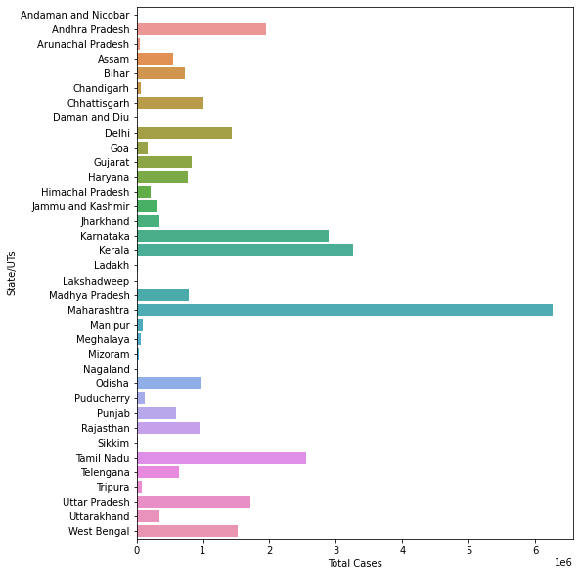
Covid cases in india statewise

Slide 5
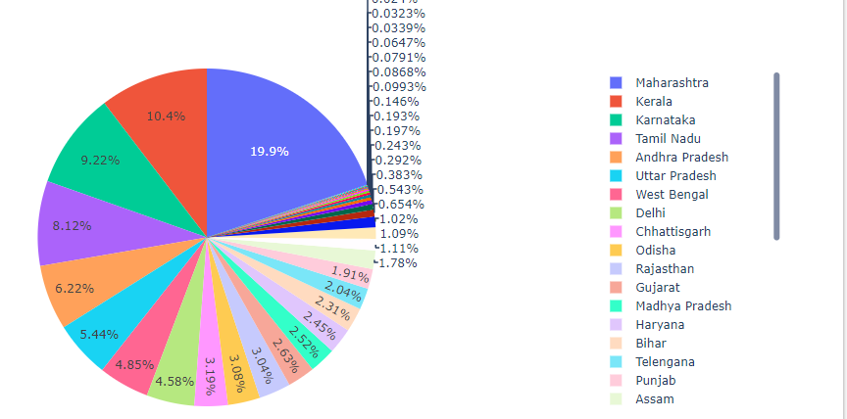
Covid cases (%) in all states of India

Slide 6
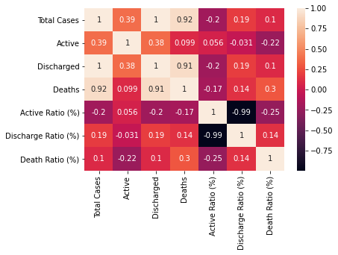
correlations within between data

Slide 7
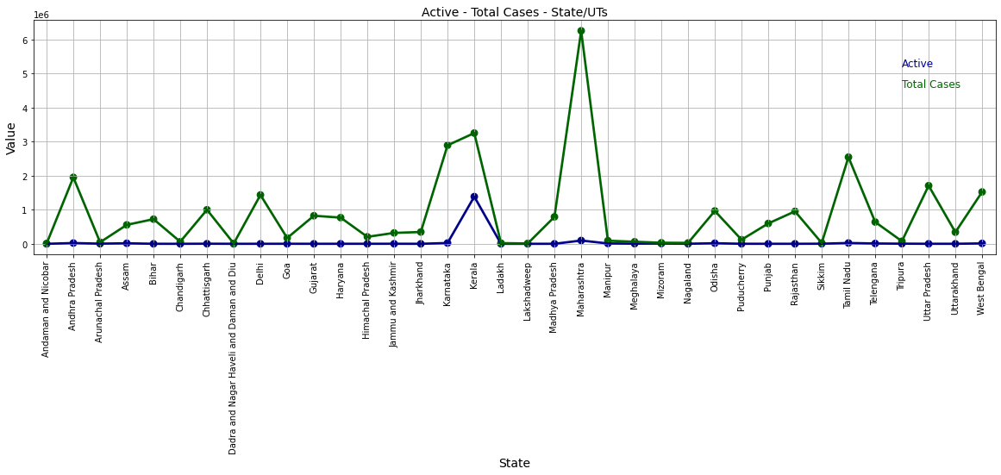
Active - Total Cases - State/UTs

Slide 8
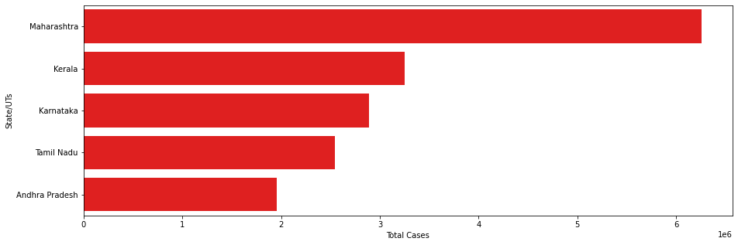
Top 5 total cases in the country

Slide 9
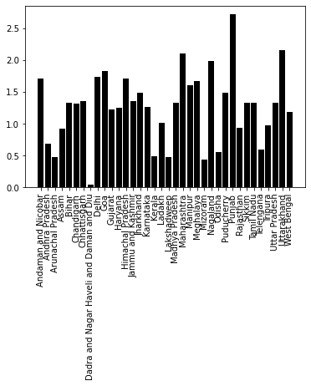
Death Ratio

Slide 10
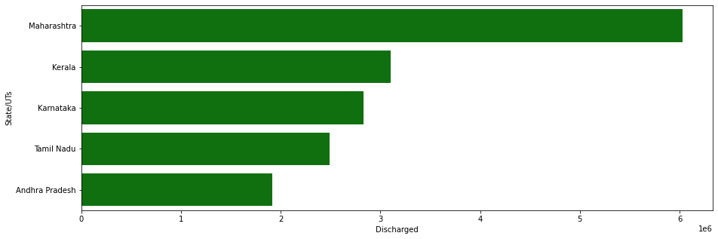
Top 5 discharge reported state india

Slide 11
conclusion
Highest total cases are in Maharashtra and Active cases are high in Kerala.
The total cases and active cases are low in Andaman and Nicobar .
High death ratio is reported in Punjab(2.72) and Uttarakhand is at second position.Daman and Diu has low death ratio(0.04%)
Maharashtra,kerala,Karnataka,tamilnadu and Andhra pradesh are the top 5 state which has high total covid cases reported in india.

Slide 12
THANK YOU
VISHNURAJ

