Slide 1
Multi-Graph Contextual Learning for Multimodal Meme Classification
Vishnu Chityala – E23CSEU0049
Harshil Uttaradhi – E23CSEU0073
Sutejas Hashia – E23CSEU0047

Slide 2
ABSTRACT
This work proposes a multi-graph contextual classification framework for multimodal meme analysis that leverages relationships between samples rather than treating them independently. Experiments are conducted on the What’s Beneath Misogynous Stereotyping (WBMS) Dataset, which contains meme images and captions annotated for misogynistic content. Text and image features are extracted using BERT and CLIP, respectively, and reduced using Principal Component Analysis (PCA). Three similarity graphs are then constructed using cosine similarity–based k-nearest neighbors (KNN): a text semantic graph, a visual semantic graph, and a class-discriminative graph obtained using Linear Discriminant Analysis (LDA). These graphs are processed using Graph Attention Networks (GAT) to learn contextual node representations through attention-based neighbor aggregation. The contextual features from the graphs are fused to perform final classification. This approach aims to incorporate dataset-level contextual information by modeling statistical relationships between samples in the embedding space.
Keywords: Multimodal Meme Classification, Graph Neural Networks, Graph Attention Networks

Slide 3
Literature Review
Paper | Key Idea | Method | Contribution
KNN-GNN: Enhancing GNNs via Common Subspace | Improve GNN performance when graph connections do not reflect feature similarity | Learn a shared latent subspace and retrieve feature-similar neighbors using kNN | Enables aggregation from non-local but similar nodes; improves representation learning
kNNGNN: Learning kNN Hyperparameters via GNNs | Reformulate kNN as a learnable graph-based model | Construct micro-graphs with query node and neighbors and apply Message Passing Neural Network (MPNN) | Learns similarity metrics and neighbor weights automatically instead of manual tuning
kNN-KGE: Retrieval-Augmented Knowledge Graph Embedding | Use nearest neighbor retrieval to improve knowledge graph reasoning | Retrieve k nearest entities from a knowledge store using embedding similarity | Improves prediction for rare entities using external contextual memory

Slide 4
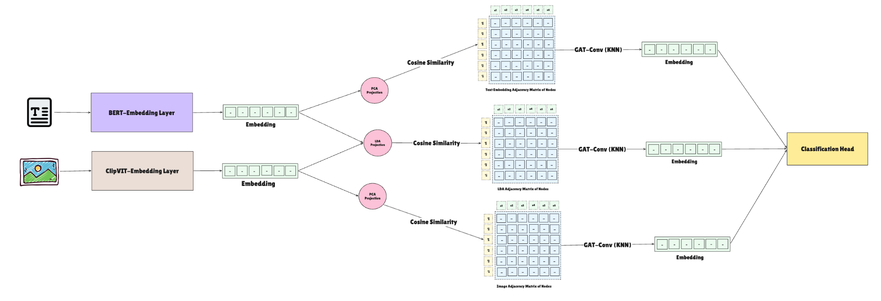
Proposed Solution
Multi-Graph Contextual Learning for Multimodal Meme Classification
Step 1 – Feature Extraction
Text embeddings: BERT
Image embeddings: CLIP
Dimensionality reduction using PCA
Step 2 – Graph Construction
Three similarity graphs using cosine similarity and KNN:
Text Semantic Graph
Visual Semantic Graph
Class-Discriminative Graph (LDA projection)
Step 3 – Contextual Learning
Graph Attention Networks aggregate neighbor information:
hᵢ' = σ( Σⱼ αᵢⱼ W hⱼ )
Step 4 – Feature Fusion
Contextual representations from all graphs are fused for final classification.

Slide 5
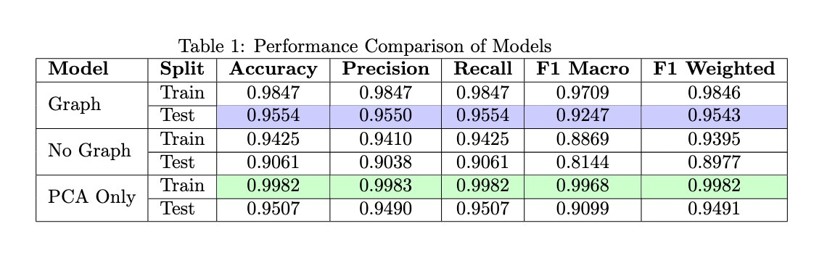
Preliminary Results
Preliminary experiments were conducted to evaluate the effect of incorporating class-semantic relationships before implementing the full multi-graph architecture. At this stage, the modality-specific graphs (text and visual graphs) were not included. Instead, the focus was on analyzing the impact of the class-semantic graph constructed in the LDA space.

Slide 6
Future Scope
Completion of Multi-Graph Framework
Integrate the Text Semantic Graph and Visual Semantic Graph with the current class-semantic graph.
Perform joint contextual learning across all three graphs.
Improved Graph Fusion
Explore advanced feature fusion strategies for combining contextual representations from multiple graphs.
Model Evaluation
Conduct extensive experiments on the WBMS dataset using standard classification metrics.
Perform ablation studies to evaluate the contribution of each graph component.
Generalization to Other Multimodal Tasks
Apply the framework to other multimodal datasets such as meme sentiment analysis or multimodal misinformation detection.

Slide 7
Thank You

