Slide 1
HOSPITAL MANAGEMENT SYSTEM
Team members:
Adithya Oasis
Monish S
Pranav L Nambiar
Vishnu S Reddy

Slide 2
CONTENTS
Objective
Program Implementation
Project Demo

Slide 3
OBJECTIVE
To provide the hospital staff an easy way to :
Manage and store patient data.
Manage and store room data i.e. room number, number of rooms that are empty and so on.
Manage and store doctors data.

Slide 4
PROGRAM IMPLEMENTATION
The three main classes in our program are:
private
public
PATIENT
ROOM
private
public
DOCTOR
private
public

Slide 5
The PATIENT class
The private methods :
MODIFY_RECORD()
RECORDNO()
DISPLAY_RECORD()
DELETE_RECORD()
The public members :
ADMIT()
DISCHARGE()
MODIFY()
LIST()
DISPLAY()

Slide 6
The ROOM class
The Private methods :
RECORDNO()
The Public methods :
ADD_ROOMS()
AVAILABLE()
EMPTY()
CHANGE_STATUS()
LIST()
ROOMNO()
BEDNO()
LAST_ROOMNO()

Slide 7
The DOCTOR class
The Private methods :
This class has no Private methods.
The Public methods :
ADD()
DELETED()
LIST()
RECORDS()

Slide 8
DATA STORAGE
We use .DAT files to store data of patients, rooms and doctors.
A .DAT file is a generic data file that contains information regarding the program that created the file.

Slide 9
A FEW SAMPLE SCREENSHOTS OF OUR OUTPUT

Slide 10
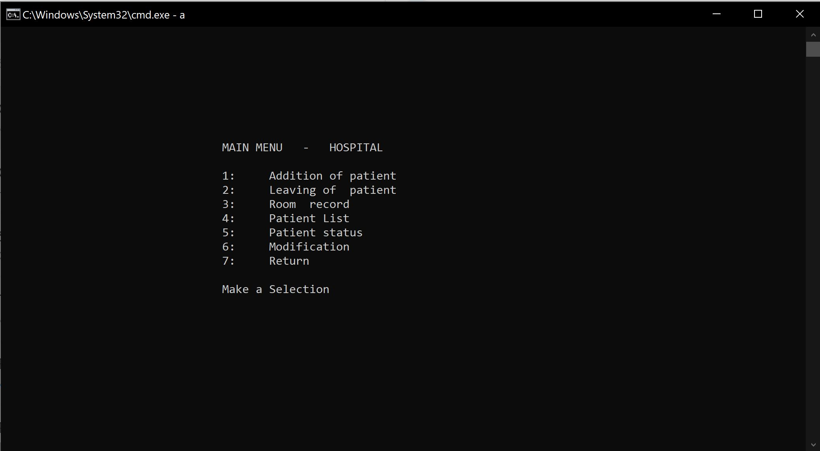
MAIN MENU

Slide 11
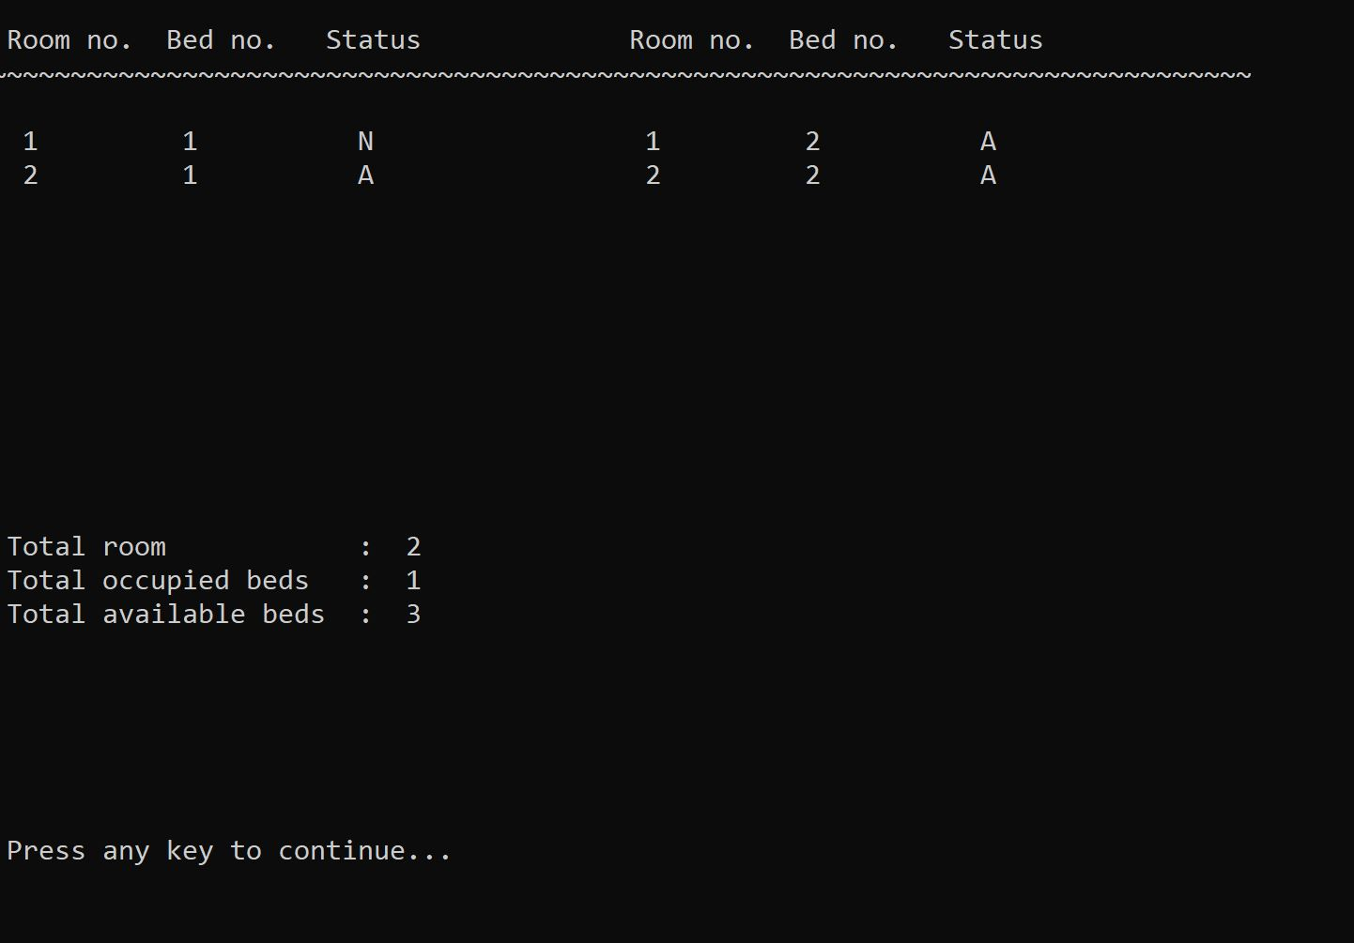
ROOM STATUS

Slide 12
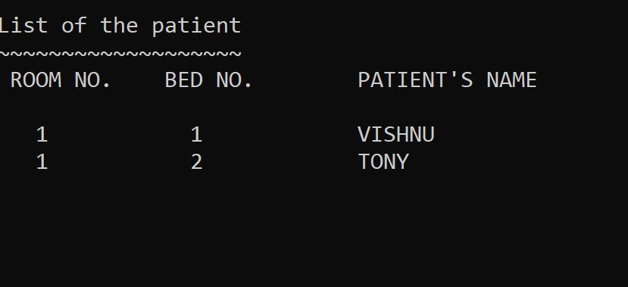
LIST OF ALL PATIENTS

Slide 13
PROJECT DEMO

