Slide 1

Linear Regression Bike Sharing DataSET
Vishnu sagar thupili

Slide 2
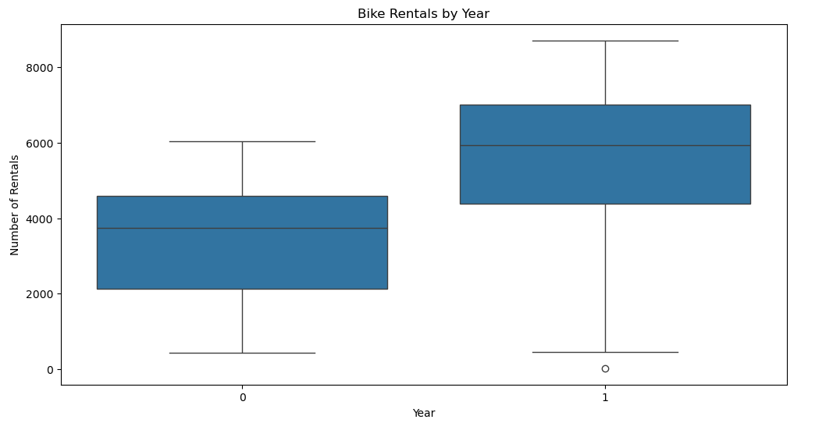
Visualization: Boxplot for bike rentals by year
Based on the graph, the key outcomes are:
Significant increase in bike rentals from year 0 to year 1, rising from around 4,000 to over 7,000.
The graph shows a clear upward trend in bike rentals over the 2-year period depicted.

Slide 3
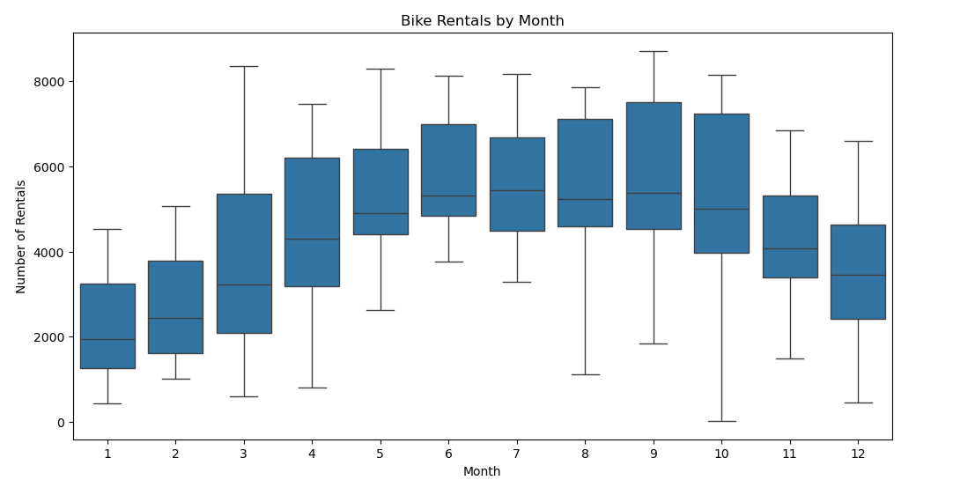
Visualization: Boxplot for bike rentals by month
Based on the graph showing bike rentals by month, the key outcomes are:
Bike rentals peak during the summer months (June-August) with the highest number around 7,500 rentals.
Bike rentals are lowest during the winter months (November-February) with the lowest point around 2,500 rentals.
The graph shows a clear seasonal trend in bike rentals, with highs in the summer and lows in the winter.
There is significant monthly variation in bike rentals, ranging from around 2,500 to 7,500.

Slide 4
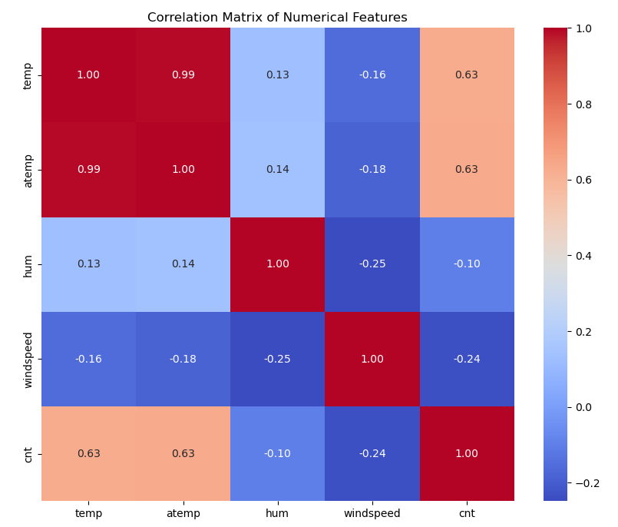
correlation analysis on numerical variables
The feature with the highest positive correlation (1.00) is temp with itself, indicating a perfect linear relationship.
The features with the next highest positive correlations are atemp (0.99) and temp (0.99), suggesting a very strong positive linear relationship between these two.
The features with the lowest correlations are windspped (-0.25 to -0.18) and hum (-0.25 to 0.14), indicating weaker and more variable linear relationships with the other features.
The feature cnt has a strong positive correlation (0.63) with both temp and atemp, implying a potential connection between temperature-related variables and the target variable.
Overall, the matrix highlights both strong and weak linear relationships between the various numerical features, which could be useful for further analysis and modeling.

Slide 5
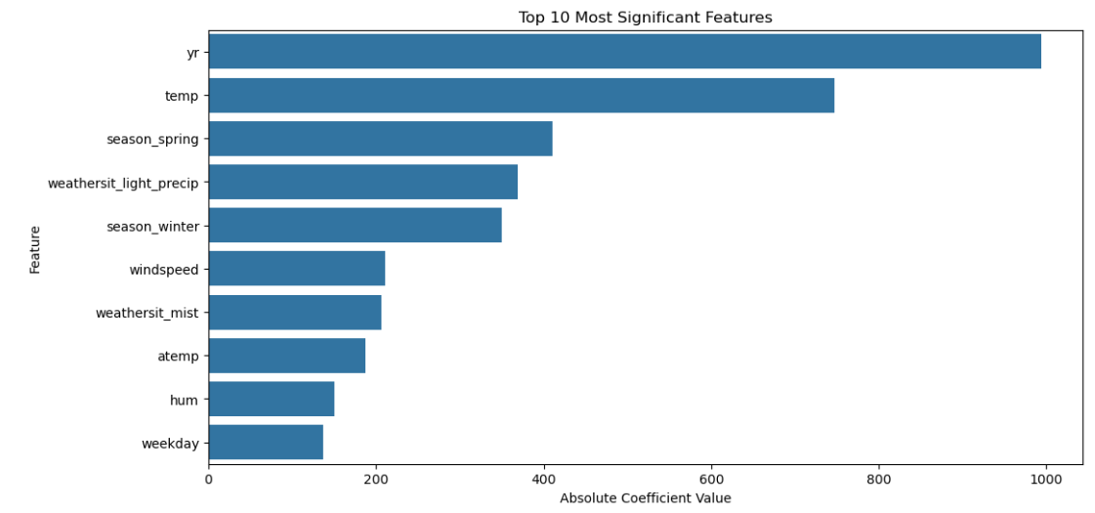
bar plot for the top 10 most significant features
The most significant feature is 'yr', with the highest absolute coefficient value.
'temp' is the second most significant feature, with a relatively high coefficient value.
'season_spring' and 'weathersit_light_precip' are the next two most significant features.
'season_winter' and 'windspeed' have moderately high coefficient values.
'weathersit_mist', 'atemp', and 'hum' have lower but still notable coefficient values.
'weekday' has the lowest coefficient value among the top 10 most significant features.
The graph provides a clear visualization of the relative importance of the top 10 numerical features, which could be useful for guiding feature selection or weighting in a predictive model.

Slide 6
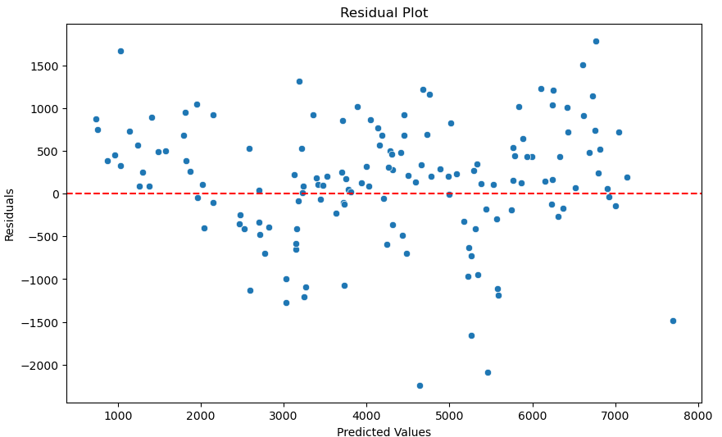
scatter plot to visualize residuals
The residuals appear to be randomly scattered around the x-axis at 0, indicating the model's predictions do not show any clear patterns or trends.
The range of residuals extends from around -1500 to 1500, suggesting the model has moderate prediction accuracy with room for improvement.
There are no obvious outliers or extreme residual values that would significantly skew the model's performance.
The random, unstructured distribution of residuals implies the model's assumptions, such as linearity and homoscedasticity, are reasonably met.
Overall, this residual plot suggests the model has reasonable predictive power, but there may be opportunities to further refine the model and reduce the magnitude of the residuals. The lack of clear patterns in the residuals is a positive sign, but the range of residuals indicates there is still room for improving the model's accuracy.

Slide 7
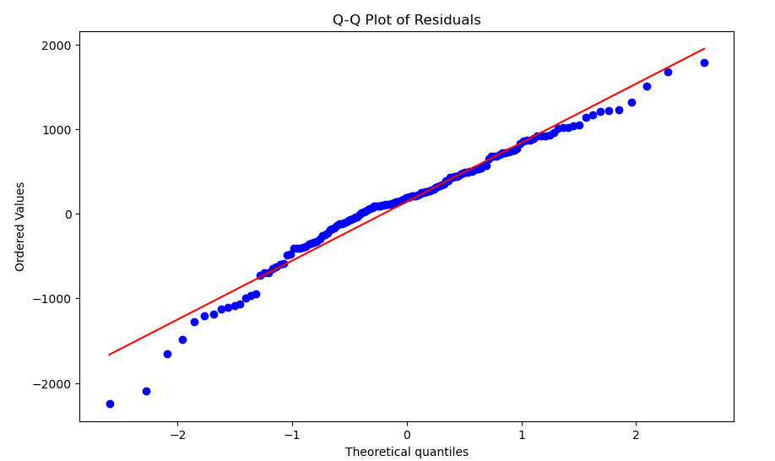
Q-Q Plot to examine the normality of residuals
The residuals follow a generally linear trend, indicating the errors are approximately normally distributed.
There are some deviations from the linear trend, particularly in the tails, suggesting potential issues with the model assumptions or the presence of outliers.
The plot shows the residuals closely tracking the theoretical quantiles up to around the 95th percentile, but then diverging more at the higher quantiles.
This pattern implies the model may be capturing the central tendency of the data well, but struggling to predict the most extreme values accurately.
Overall, the Q-Q plot provides evidence that the residuals are reasonably well-behaved and follow a normal distribution, with some potential issues in modeling the tails of the distribution. This information could be useful for refining the model or investigating the presence of influential outliers.

